Slide 1

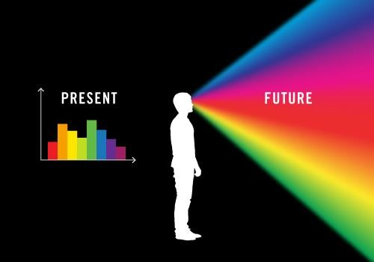
Course Suggestions and Insights on edX
By :
Harika Malapaka &
Apurva Bakshi

Slide 2
Objective(1)
2 course suggestions
(2)
Based on what his peers selected
[ Content based/collaborative filtering]
(1)
Based on his topic of interest
[ user based filtering]

Slide 3
Objective(2)
A student who is new to edX can gain knowledge on :
What type of course is best for him (given his topics of interest)
How many seeked certification in that course
How many dropped out of that course
Grade distribution of that course
What kind of courses did people similar to him choose
Few Insights about courses and their distributions

Slide 4
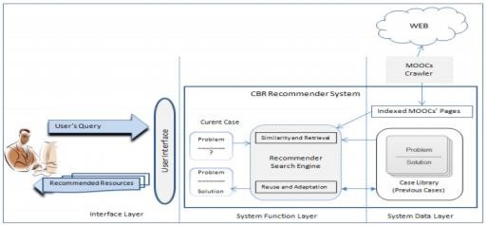
Other’s Work(1)
A Case Based Recommender System for MOOCs by Fahita Bousbahi and Henda Chorfi in July 2015.
They considered user’s input as a query and applied Case Based Reasoning (CBR) which are a form of content based reasoning.
Casebased reasoning systems are distinguished from other forms of content-based recommendation systems by using fairly well- structured descriptions of those items

Slide 5
Other’s Work(2)
Harvard researchers did many works on the following :
MOOC Dropout Prediction: How to Measure Accuracy?
Beyond Prediction: First Steps Toward Automatic Intervention in MOOC
Student Stopout
Getting to know English language learners in MOOCs: Their motivations, behaviors and outcomes.

Slide 6
Dataset
HarvardX and MITx released de-identified dataset of their students activity in 2014 academic year
Data from the first year (Academic Year 2013: Fall 2012, Spring 2013, and
Summer 2013) of MITx and HarvardX courses on the edX platform
Total records: 6,41,139
No of columns : 20
Number of students: 4,76,532
Number of courses: 16
“_DI” at the end of a variable name indicates that this variable was transformed during the de-identification process → Privacy Concern

Slide 7
Features
course_id:identifies institution (HarvardX or MITx), course name, and semester, e.g. “HarvardX/CB22x/2013_Spring”
userid_DI: first portion identifies dataset (MHxPC13 corresponds to MITx HarvardX Person-‐Course AY13), second portion is a random ID number. Example ID: “MHxPC130442623”.
registered: registered for course
viewed: anyone who accessed the ‘Courseware’ tab
explored: anyone who accessed at least half of the chapters in the courseware
certified: anyone who earned a certificate. the
cutoff for a certificate varies from 50% -‐ 80%.
final_cc_cname_DI: Country
LoE: highest level of education completed.
YoB: year of birth.
gender: m (male), f (female) and o (other).
grade: final grade in the course, ranges from 0
to 1. Example: “0.87”.
start_time_DI: date of course registration. Example: “12/19/12”.
last_event_DI: date of last interaction with course Example “11/17/13”.
nevents: number of interactions with the
course, recorded in the tracking logs;
ndays_act: number of unique days student interacted with course.
nplay_video: number of play video events within the course.
nchapters: number of chapters with which
the student interacted.
nforum_posts: number of posts to the Discussion Forum.
roles: identifies staff and instructors, but blank as staff and instructors were removed from this release.
inconsistent_flag: identifies records that are
internally inconsistent

Slide 8
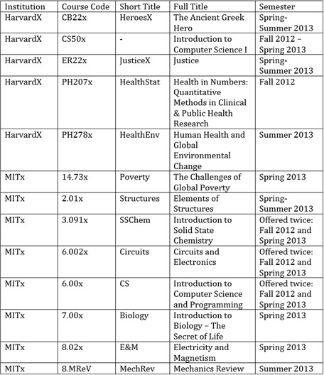
Courses Data

Slide 9
Data Cleaning(1)
Remove rows where incomplete flag is set (1)
Now remove the following columns : incomplete_flag
User id
Roles Start time End time

Slide 10
Data Cleaning(2)
Combine the spring and fall semester students into the same course.
ex : Harvard/CDX2.0/Spring_2015
Harvard/CDX2.0/Fall_2016
Grades :
If the student has performed some activity (i.e did some learning), and still has ‘0’ as grade, then we assumed that he will have gain some knowledge and eventually predicted a new grade based on his count of activities . The new grade was predicted using Machine learning algorithm – Gaussian Naïve Bayes
Justice

Slide 11
Result of Data Cleaning:
Before:
Total records : 6,41,139
Number of columns : 20
Number of courses: 16
After:
Total records: 5,40,977
Number of columns : 15
Number of courses: 13

Slide 12
Implementation
The following functions were implemented after data cleaning :
Function 1 : certified
Function 2 : dropouts
Function 3 : grade distribution
Function 4 : predict best course

Slide 13


Feature Engineering
No of chapters read
Function 1
How many students seeked a certificate
No of videos
played
Certified
Function 3 Grade Prediction
No of forum posts
No of days active
Viewed
Explored
Year of Birth
Grade
Function 2
How many did not continue the course after registering?
Country of residence
No of Forum posts
Function 4 What course did peers do?
No of chapters read
Gender
No of videos played
Highest level of education
No of days active

Slide 14
Machine Learning(1)
1. For Grade Prediction :
 | Training (Length : 60774 - where grades are non ‘0’) | Testing (Length : 104678 - where grades are ‘0’)
Data | No of videos played No of forum posts No of chapters read No of days active | No of videos played No of forum posts No of chapters read No of days active
Labels | Grades | Grades
Apply Gaussian Naïve Bayes Algorithm

Slide 15
Gaussian Naïve Bayes
Classical Naive Bayes supports categorical features and models each as conforming to a Multinomial Distribution.
Gaussian Naive Bayes supports continuous valued features and models each as conforming to a Gaussian (normal) distribution.

Slide 16
Machine Learning (2)
2. Collaborative Filtering to select best course as per peers
 | Training (70 %) | Testing (30 %)
Data | Year of Birth | Year of Birth
 | Country | Country
 | Gender | Gender
 | Highest level of | Highest level of
 | education | education
Labels | Course Name | Course Name
Dynamic value which user gives through UI.
Decision Tree Classifier
Output the best course through the UI

Slide 17
Results (1)
Accuracy of the Classifiers
SVM took too much time and the results of Decision tree were not that diverse, so we have used GNB.
The accuracy of Guassian Naïve bayes classifier to predict appropriate grades is 0.0.
Note : This doesn’t mean that classifier is not performing well. We actually do not want any more zeros in the updated grades.
Decision tree Classifier to predict best course as per peers
Accuracy : 0.66
Precision : 0.43
Recall : 0.66
fβ_score : 0.52

Slide 18
Results(2) Statistics of Courses
Course | Number of students | certified | dropouts
HeroesX | 30,002 | 384 | 10,355
IntrotoCS | 1,69,621 | 1287 | 58,762
JusticeX | 57,406 | 2346 | 19,337
HealthStat | 41,592 | 1842 | 14,504
HealthEnv | 39,602 | 711 | 17,637
Poverty | 27,870 | 2085 | 8,579
Structures | 5,665 | 247 | 1,497
SSChem | 14,215+6139 | 632+138 | 6,274
Circuits | 40,811+22,235 | 1750+593 | 18,566
CS | 66,731+57,715 | 2477+1253 | 23,969
Biology | 21,009 | 823 | 5,717
E&M | 31,048 | 822 | 5,295
MechRev | 9,477 | 297 | 1,884
Note :The other Results can be found through graphs and User Interface

Slide 19
Results(3)
Country | Dropouts | Total Students | Percentage of Dropouts
Australia | 1946 | 5518 | 35.26640087
Bangladesh | 844 | 2633 | 32.05469047
Brazil | 5021 | 16123 | 31.14184705
Canada | 3320 | 10705 | 31.01354507
China | 1251 | 4787 | 26.13327763
Colombia | 1073 | 4301 | 24.94768658
Egypt | 3116 | 8269 | 37.68291208
France | 1050 | 4080 | 25.73529412
Germany | 1648 | 7259 | 22.70285163
Greece | 1181 | 4584 | 25.76352531
India | 22229 | 79483 | 27.96698665
Indonesia | 1006 | 3001 | 33.52215928
Japan | 449 | 2128 | 21.09962406
Mexico | 1195 | 4997 | 23.91434861
Morocco | 968 | 3534 | 27.39105829
Nigeria | 2216 | 6350 | 34.8976378
Other | 73679 | 154343 | 47.73718277
Pakistan | 3518 | 9377 | 37.51732964
Philippines | 1579 | 4479 | 35.25340478
Poland | 690 | 4727 | 14.59699598
Portugal | 509 | 1890 | 26.93121693
Russian Federation | 2782 | 9100 | 30.57142857
Spain | 1946 | 8798 | 22.11866333
Ukraine | 908 | 3504 | 25.91324201
United Kingdom | 5332 | 19333 | 27.57978586
United States | 52920 | 157674 | 33.56292096
Dropout Statistics :
There maybe few countries where English is not native language and perhaps maybe the reason for students to drop the course because they are unable to follow the course.
Other countries include :
Africa
East Asia
Europe
Middle-east
North & Central America
Oceania
South America
South Asia

Slide 20
the user interface where a student can choose to view graphs or enter his basic details and his interests for receiving suggestions about the course and its statistics

Slide 21
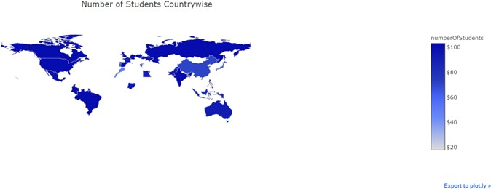
Results(4)
We can understand that only in few countries literacy rates are very high. Density of e-Learners in the countries can also be seen.
Atleast in e-Learning point of view, citizens of USA and India are active in MOOC’s

Slide 22
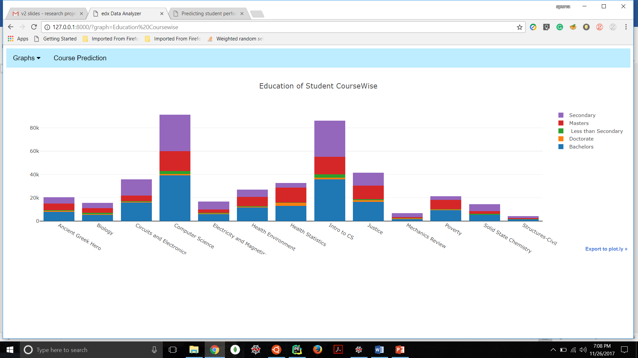
Results(5)
The MOOCs can benefit from this information on deciding the complexity of the course.

Slide 23
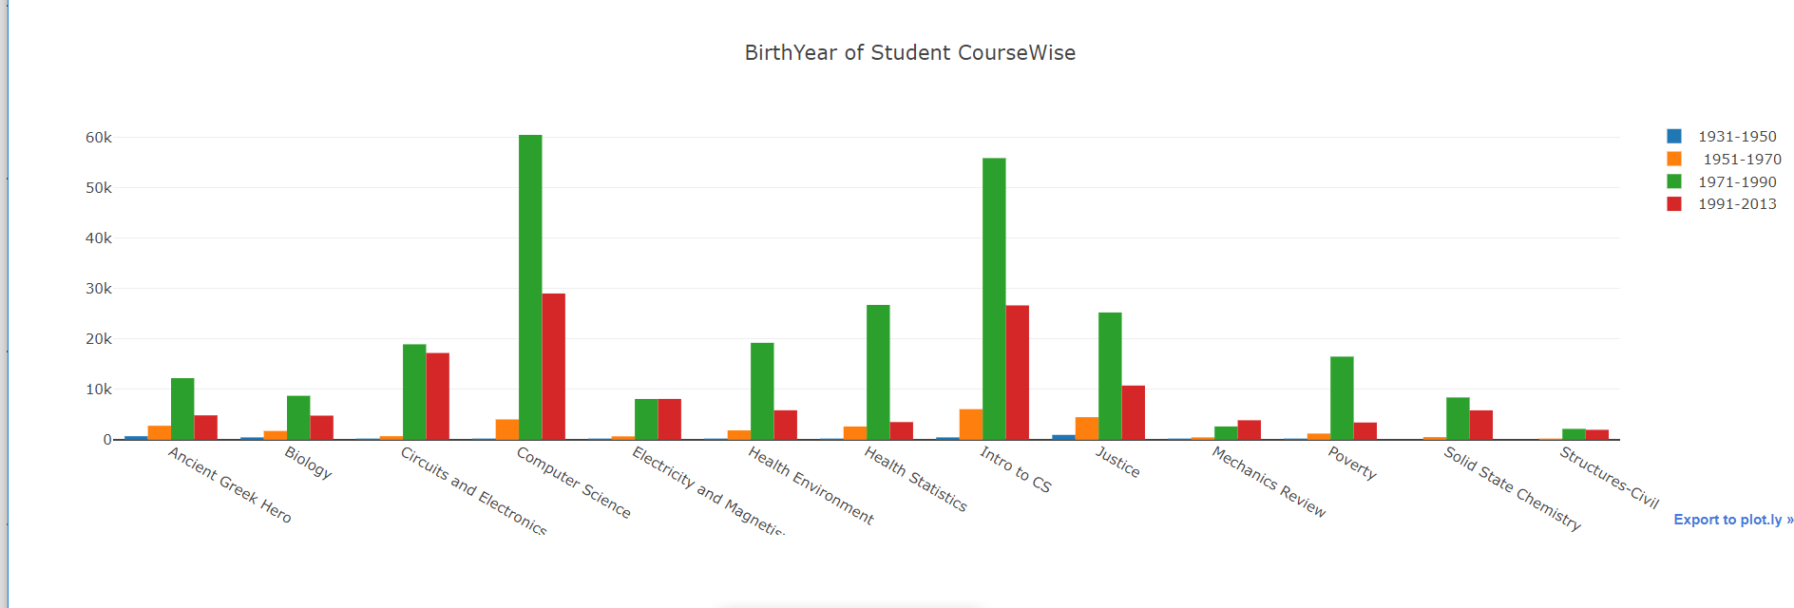
Results(6)
The age range for various courses is shown
From the above graph, we can deduce that Computer Science is a field that is trending in 40-50 age range.
The youth are almost interested in diverse courses

Slide 24
Conclusion
The system was built taking student behavior on MOOC into
account and generalized based on only 1 dataset.
The problem of many students dropping out due to lack of interest can be partially solved.
Visualization of student data (how they interact with courses) will help potential students in many ways.

Slide 25
Caveats
While combining 2 courses with same name (but offered in different semester), we assumed that the course structure/materials/instructor didn’t change.
Student who did some learning may not give a final exam. So if he doesn’t give an exam and get’s a ‘0’ grade, it doesn’t mean he doesn’t know anything. So we predicted a grade for him based on his activities.
We do not have any feed back from the users, we just assume that collaborative filtering helps the users in picking courses
For predicting Drop-outs, we assumed that if the student doesn’t get a grade, doesn’t do any activity, doesn’t view atleast half of study materials he dropped out of the course.
The split of grades on a scale of 0 to 1 is as follows :
0 to 0.2 → D
0.2 to 0.5 → C
0.5 to 0.8 → B
0.8 to 1 → A

Slide 26
Challenges Faced
The dataset required a lot of preprocessing to make the classifiers work on them and this took lot of time.
The length of training data is very less compared to testing data while applying Gaussian Naïve Bayes to predict grades.
The output takes so much time to load as the Django server needs time to startup and also because the dataset is huge.
We can’t run this project on Linux Virtual Machine if memory assigned to the machine is not sufficient.

Slide 27
Future Work
Making the UI more user friendly.
Considering many topics of interests at an instance from user through radio buttons (in the User Interface)
Integrating many other datasets so that we have many courses with a vast student data.
Take other inputs from user like :
In which branch he was graduated from
The University name where is studied/presently studying
List of courses he has done before.
Note : Although these features are not in the dataset at the moment, once people start using we can store them and use it when we have enough data.

Slide 28
Finish
We can run this project on a Linux OS
Detailed steps are there in readMe file attached in the zip folder along with the code and dataset.
The accuracy measure (like precision, recall, f1_measure and accuracy) are not found in the code because the output is through a User Interface (user will not be interested in them).

Slide 29
Any Questions?

