Slide 1



Garbage Classification
Name: Dasari Harika

Slide 2


Learning Objectives
Understand image classification using deep learning
Apply transfer learning with MobileNetV2
Build and train a working garbage classification model
Visualize model performance using training graphs
Predict garbage category for new images
GOAL
Source :
www.freepik.com/

Slide 3




Tools and Technology used
Language: Python
Frameworks: TensorFlow, Keras
Model: MobileNetV2
Notebook Environment: Jupyter Notebook
Libraries: Matplotlib, NumPy
Image Preprocessing: ImageDataGenerator

Slide 4
Problem Statement:
Garbage mismanagement is a major environmental issue. Manual sorting is inefficient, time-consuming, and error-prone. There's a need for smart systems that can automate garbage classification for better waste management.

Slide 5
Solution:
A machine learning model using MobileNetV2 is used to classify images of garbage into six categories. The model is accurate, lightweight, and can be used in smart bins, recycling apps, and real-time waste sorting systems.

Slide 6
Methodology
Load dataset
Preprocess using Keras
Freeze base MobileNetV2 model
Add custom dense layers
Train for 10 epochs
Plot accuracy and loss
Predict test image
Save model for deployment

Slide 7
Dataset Description
Dataset: Trash Type Image Dataset on Kaggle
Classes: cardboard, glass, metal, paper, plastic, trash
Folder structure:
trashtype_image_dataset/
├── cardboard/
├── glass/
├── metal/
├── paper/
├── plastic/
└── trash/
Automatic 80:20 split using validation_split

Slide 8
Model Architecture Diagram
Input Image (224x224x3
↓
MobileNetV2 (pre-trained, frozen)
↓
GlobalAveragePooling2D
↓
Dense(128, ReLU)
↓
Dropout(0.3)
↓
Dense(6, Softmax)

Slide 9
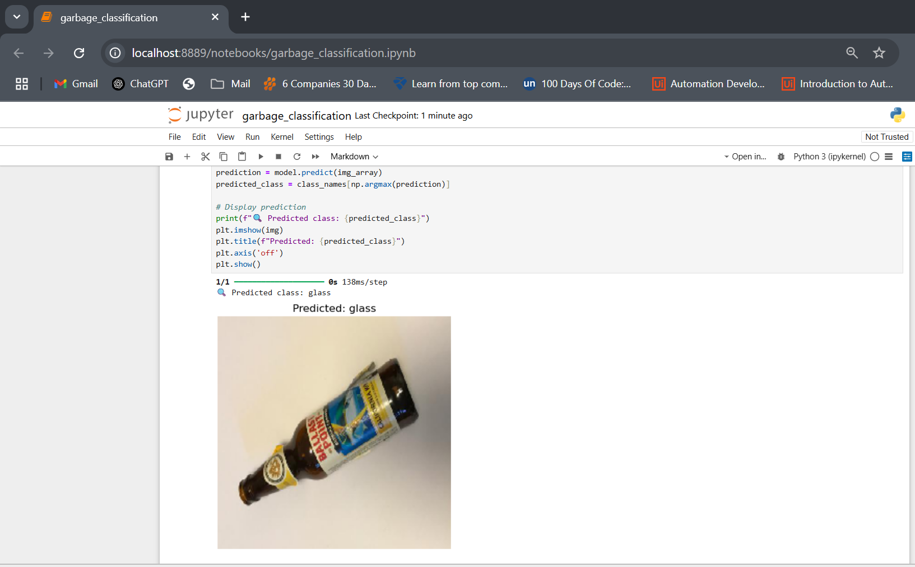
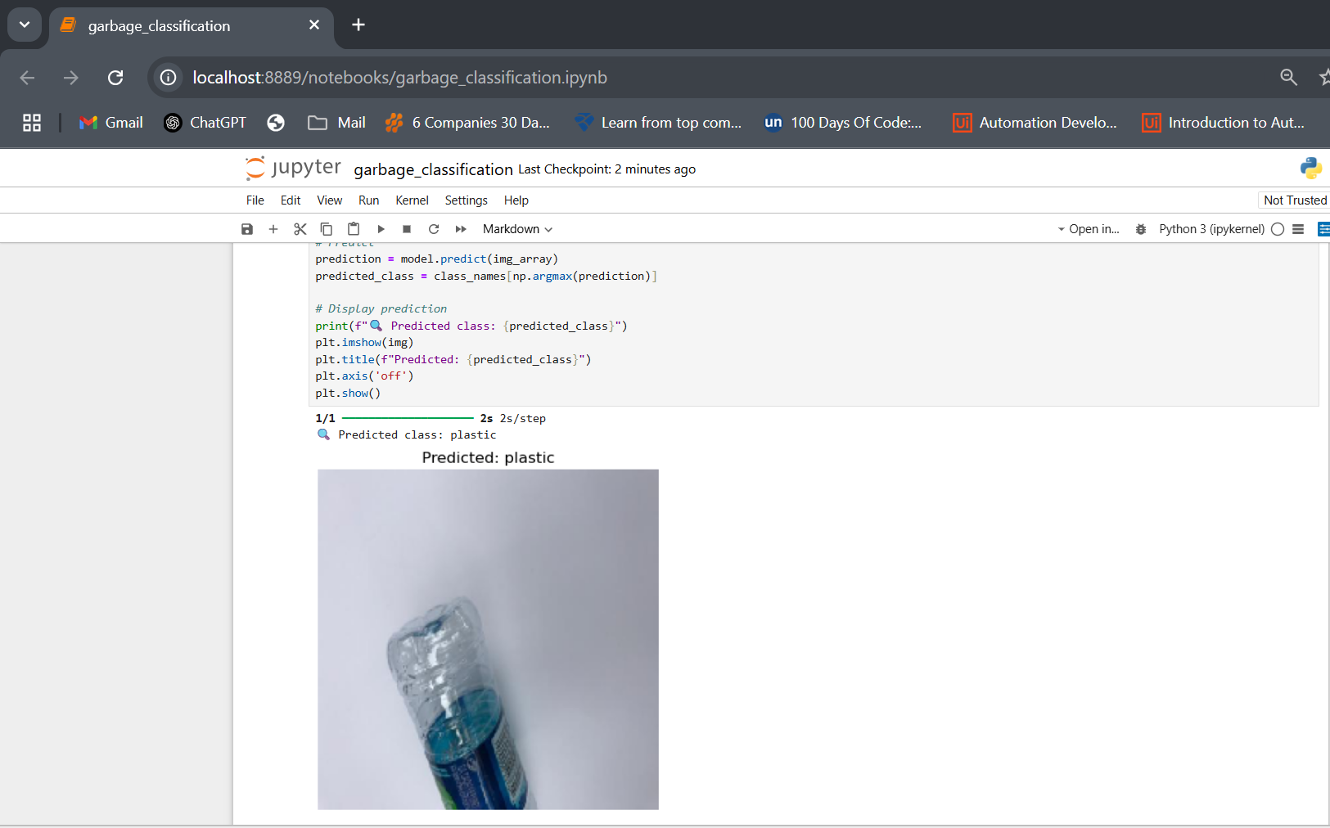
Screenshot of Output:

Slide 10
Conclusion:
Transfer learning helped reduce training time
The model performs well on a small dataset
Lightweight and fast – ideal for:
Smart bins
Recycling plants
Mobile waste management apps

Slide 11
GitHub Link & Notebook
📄 Notebook: https://drive.google.com/file/d/1IcdOcSFsUkmHxOkMUzsNJYuX-7V-_kHS/view?usp=sharing
🔗 GitHub Repo: https://github.com/Harika4235/Garbage-Classification.git

