Slide 1
Tittle : Cross Site Scripting Domain : Vulnweb.com Subdomain : testasp.vulnweb.com Steps to reproduce:
Step 1: Visit http://testasp.vulnweb.com/
Step 2: On the top menu you will find a search option.
Step 3: Click on it and you will be prompted with the Search box.
Step 4: You can intercept the request in Burp Suite
Step 5: Now you can find different payloads for XSS.
Step 6: Send the request to the intruder and paste all the payloads.
Step 7: Try to find a successful payload for XSS.
Step 8: prepare a report for it.
Impact : Cross-site scripting (XSS) vulnerabilities continue to remain a major threat to web applications as attackers exploiting XSS attacks can gain control of the user’s account and steal personal information such as passwords, bank account numbers, credit card info, personally identifiable information (PII), social security numbers, and more.
Mitigation: if you want to prevent your website to be vulnerable of cross site scripting then ,whenever possible, prohibit HTML code in inputs , validate inputs, Secure your cookies, Sanitize data, use a web application firewall(WAF).

Slide 2
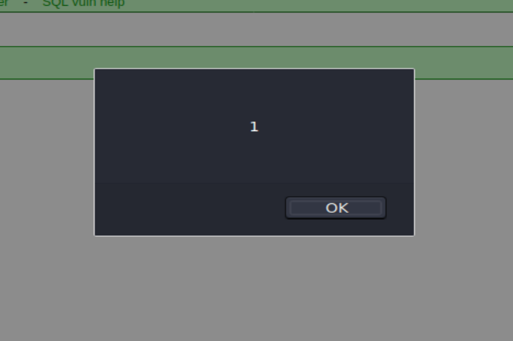
POC including screenshot/screen recording is included in the report
POC (Proof Of Concept)
Image1

Slide 3
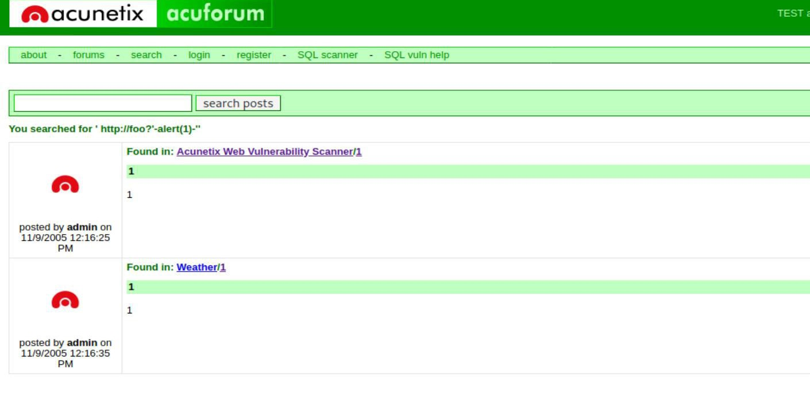
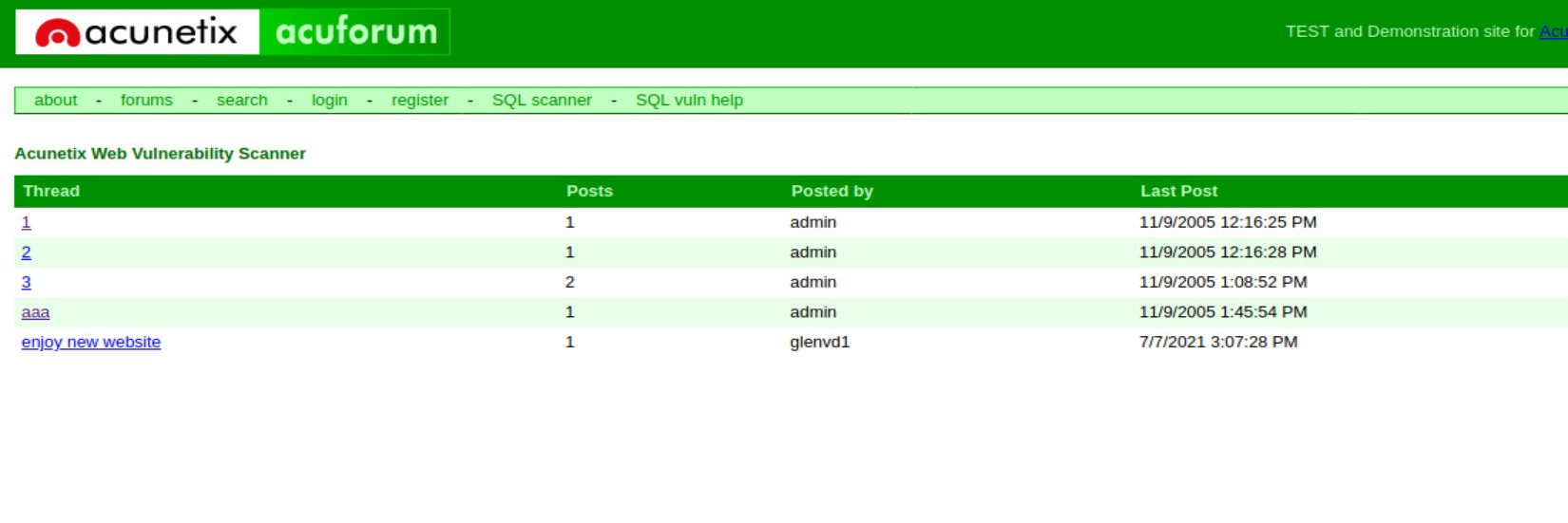
Image2
Image3

