Slide 1
PREDICT THE DISEASE BASED ON SYMPTOMS USING NLP TECHNIQUES

Slide 2
ABSTRACT :
Predicting diseases based on symptoms using Natural Language Processing (NLP) techniques is a burgeoning field with significant potential for improving healthcare diagnostics. NLP enables the analysis and interpretation of unstructured text data, such as patient symptoms recorded in electronic health records or online health forums. This abstract explores the application of NLP techniques in disease prediction based on symptoms, highlighting the benefits, challenges, and future directions of this approach. The abstract begins by introducing the importance of accurate disease prediction and the role of NLP in processing textual symptom data. NLP techniques enable the extraction of relevant information from symptom descriptions, such as the presence, severity, and temporal aspects of symptoms. These techniques also facilitate the identification of symptom co-occurrences and relationships, which can aid in disease prediction.
Keywords: Disease prediction, Symptoms, Natural Language Processing (NLP), Text analysis, Named Entity Recognition (NER), Semantic Role Labeling (SRL), Sentiment analysis, Medical ontologies, Deep learning, Transfer learning, Multimodal data.

Slide 3
EXISTING SYSTEM:
This systematic review surveyed automatic emotion recognition systems applied in real clinical contexts, focusing on populations with pathologies. The review included 52 scientific papers meeting the inclusion criteria. Clinical applications primarily targeted neuro-developmental, neurological, and psychiatric disorders, aiming to diagnose, monitor, or treat emotional symptoms. Observational study designs were common for monitoring and diagnosis, while interventional approaches were used for treatment. Video and audio signals were the most adopted, and supervised shallow learning was the prevalent approach for emotion recognition algorithms. Clinical limitations included small sample sizes, absence of control groups, and lack of real-life conditions testing. Technically, heterogeneity in performance metrics, datasets, and algorithms challenged result comparability, robustness, reliability, and reproducibility. Suggested guidelines were provided to address these challenges and guide future research.

Slide 4
DEMERITS
Focused on only emotion Recognition medical diagnosis.
They did not compared more than an algorithms to getting better accuracy level.
They did not build the deploy model.
Limited scope.
The accuracy level and performance level are low.

Slide 5
PROPOSED SYSTEM:
The proposed system aims to leverage NLP techniques for disease prediction based on symptoms, incorporating advancements in the field to enhance accuracy and usability. The system consists of several components and methodologies to achieve its objective. The key components of the proposed system are as follows. Data Collection: The system will gather a comprehensive dataset comprising symptom descriptions along with their corresponding disease labels. This dataset can be obtained from electronic health records, patient forums, medical literature, or crowd sourced platforms. The dataset will serve as the foundation for training and evaluating the disease prediction model. Pre-processing and Text Analysis: The system will employ NLP techniques for pre-processing and text analysis. This includes tasks such as tokenization, part-of-speech tagging, and syntactic parsing to extract relevant information from symptom descriptions. Named Entity Recognition (NER) will be applied to identify medical entities (symptoms, body parts, medical conditions) mentioned in the text. Semantic Role Labeling (SRL) will help understand the relationships between symptoms and modifiers, aiding in accurate symptom interpretation.

Slide 6
MERITS
We compared more than a two algorithms to getting better accuracy level.
We predict symtoms to disease using nlp techniques.
We improve the accuracy.
We develop a full stack framework based application for deployment purpose.
We improved the accuracy level and performance level.

Slide 7
LITERATURE REVIEW:
Title: NLP based Segmentation Protocol for Predicting Diseases and Finding Doctors
Author:Aswathy K P1, Rathi R2, Shyam Shankar E P3
Year: 2019
-In these decades the Web-browsing have become a habitual or imperative thing for the mankind. The people have been using many browsers, online/offline Apps and Software for their daily needs including their healthcare queries. The proper clarification of such healthcare queries and accurate disease-predictions will be very serviceable for the society. In light of this we developed a medical query system which has the ability not only to predict the disease by analyzing the user’s symptoms but also to suggest doctors in user’s locality if entered the locale while registering. In this paper we proposed a NLP based Unstructured Data Processing Method (NUDPM) which enables the facile segmentation and extraction of medical terms/symptoms from the user queries. The analysis of this NUDPM computed data with a predefined ‘Disease data base’ will predict the disease accurately. As well as the execution of Doctor-Type selection methods will choose appropriate doctors near to user’s locality. Finally the system exhibits the details of the disease and nearby doctors to user.

Slide 8
LITERATURE REVIEW:
Title: Multiple Disease Prognostication Based On Symptoms Using Machine Learning Techniques
Author: Kajal Patil , Sakshee Pawar , Pramita Sandhyan and Jyoti Kundale
Year: 2022
. Disease Prediction system that uses Machine Learning forecasts the ailments on the basis of the data pertaining to the symptoms entered by the user and provides trustworthy findings based on that data. If the patient isn’t in any danger and the user merely wants to know what kind of ailment he or she has had. It is a system that gives the user suggestions and methods on how to keep their health system in good shape, as well as a way to find out if they have a sickness utilizing this forecast. Due to a diversity of diseases and a lower doctor-patient ratio, the use of particular disease prediction technologies as well as concerns about health has risen. We are focusing on offering customers with an instant and accurate disease prognosis based on the symptoms they enter, as well as the severity of the condition projected. It will provide the best algorithm and doctor consultation. Different machine learning algorithms are employed to forecast illnesses, ensuring speedy and reliable predictions

Slide 9
SYSTEM STUDY:
Overview of the system
The system utilizes Natural Language Processing (NLP) techniques to analyze and predict diseases based on symptoms, extracting meaningful patterns from textual symptom descriptions to enable accurate and timely disease identification.
AIM:
Develop a disease prediction system leveraging NLP techniques to analyse and interpret textual symptom descriptions, facilitating accurate and timely diagnosis for improved healthcare outcomes.
OBJECTIVE:
Develop a predictive model using Natural Language Processing (NLP) techniques to analyse and correlate textual symptom descriptions with medical knowledge, enabling accurate disease prediction and diagnosis.
SCOPE:
Developing and refining Natural Language Processing (NLP) models to accurately predict diseases based on textual symptoms, enabling early diagnosis and personalised healthcare interventions.

Slide 10
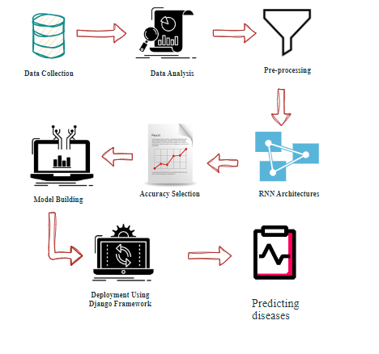
System Architecture:

Slide 11
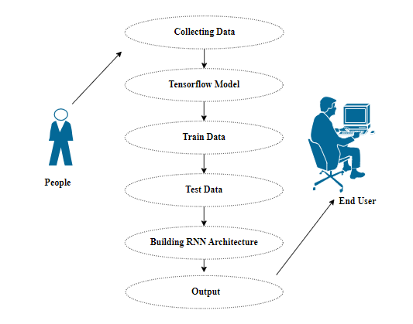
Use Case Diagram:

Slide 12
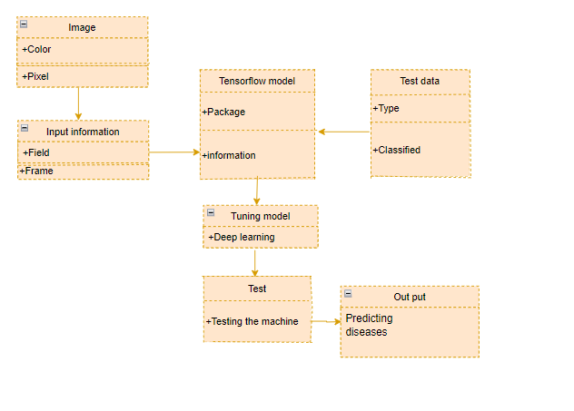
Class Diagram:

Slide 13
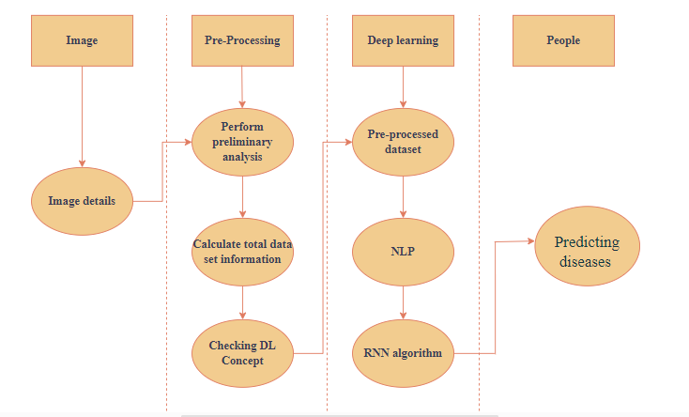
Activity Diagram:

Slide 14
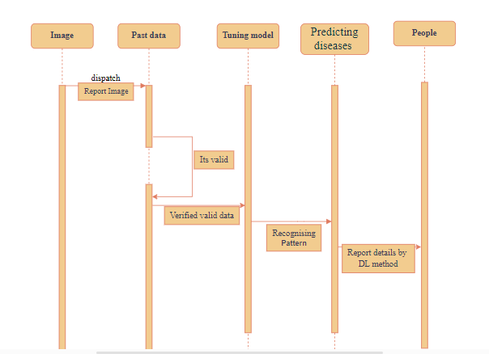
Sequence Diagram:

Slide 15
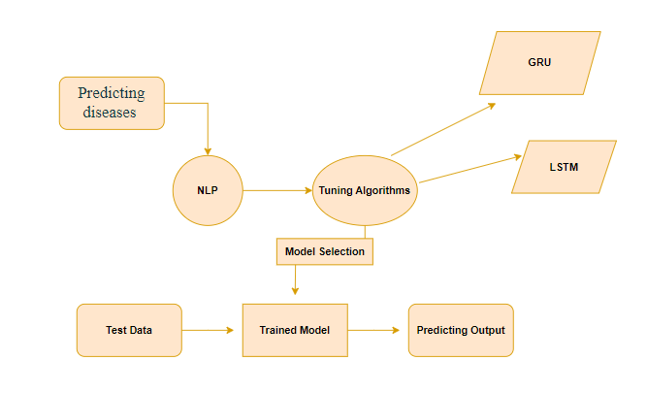
Entity Relationship Diagram (ERD):

Slide 16
ENVIRONMENT REQUIREMENTS:
Software Requirements:
Operating System : Windows
Tool : Anaconda with Jupyter Notebook
Hardware requirements:
Processor : Pentium IV/III
Hard disk : minimum 80 GB
RAM : minimum 4 GB

Slide 17
LIST OF MODULES:
Data Pre-processing
Data Analysis of Visualization
GRU
LSTM
Deployment

Slide 18
GRATED RECURREND UNIT ARCHIETECTURE:
Implementing the Gated Recurrent Unit (GRU) architecture involves utilizing a type of recurrent neural network (RNN) that incorporates gating mechanisms to manage information flow. By combining reset and update gates, GRU efficiently captures long-range dependencies in sequential data, making it suitable for tasks like Predicting diseases where contextual understanding is crucial for accurate classification.

Slide 19
LSTM ARCHITECTURE:
Long Short-Term Memory (LSTM) is a type of recurrent neural network (RNN) architecture designed to address the vanishing gradient problem and capture long-term dependencies in sequential data. It consists of memory cells, input gates, forget gates, and output gates. The memory cells store information over long sequences, while the gates regulate the flow of information, allowing LSTMs to effectively learn and remember patterns in time-series data. In the context of Predicting diseases architecture helps the model understand the context of user comments and detect spam based on intricate patterns and dependencies within the text.

Slide 20
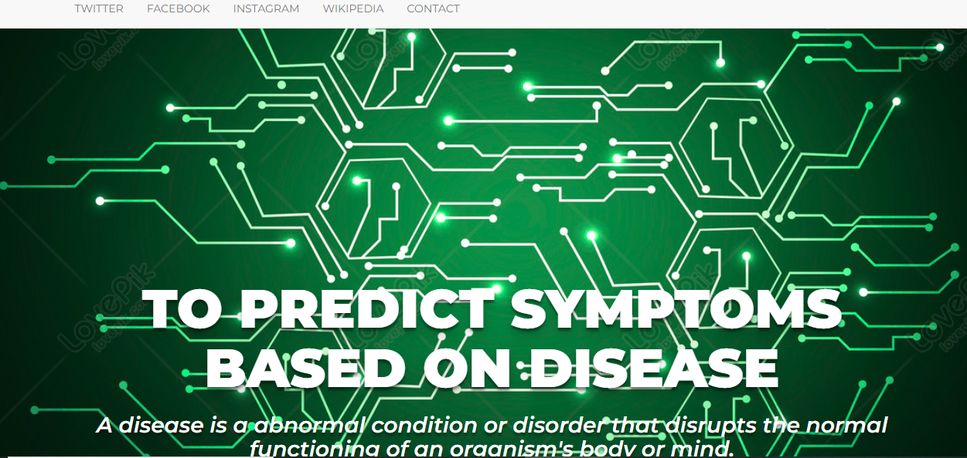
OUTPUT:

Slide 21

OUTPUT:

Slide 22
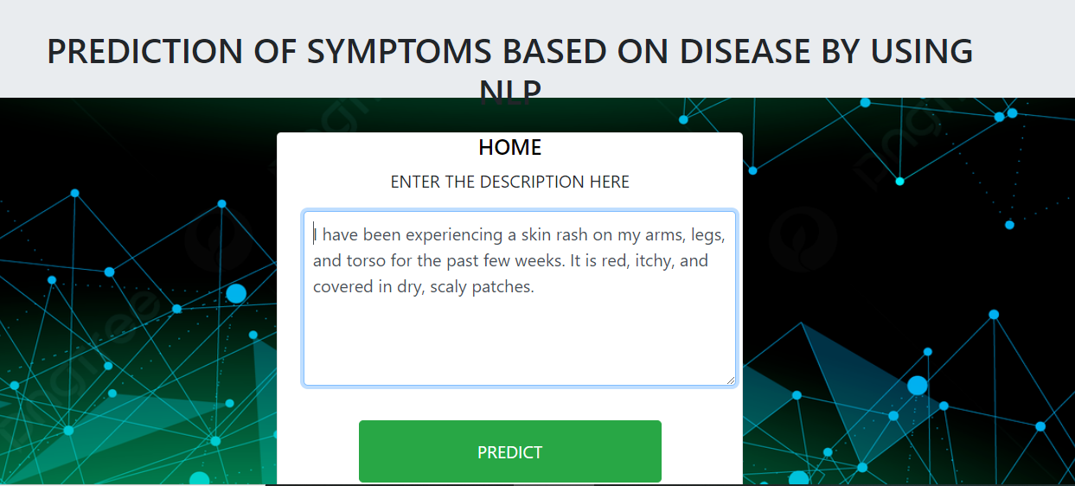
OUTPUT:

Slide 23
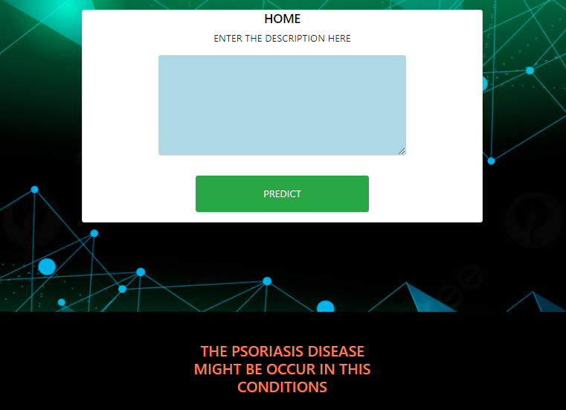
OUTPUT:

Slide 24
CONCLUSION:
employing Natural Language Processing (NLP) techniques for disease prediction based on symptoms holds tremendous potential for revolutionizing healthcare. The integration of advanced machine learning models and semantic analysis allows for more accurate and timely identification of diseases, facilitating early intervention and personalized medical care. Further research and development in this field could significantly enhance the efficiency of diagnostic processes, ultimately leading to improved patient outcomes and healthcare system effectiveness.

Slide 25
FUTURE WORK:
Future work can focus on refining disease prediction through NLP by developing advanced semantic embeddings that capture subtle contextual relationships between symptoms, enhancing the model's ability to discern complex patterns in medical text data.
Explore the integration of continuous learning mechanisms to adapt and update the disease prediction model over time, accommodating new medical knowledge, evolving symptom patterns, and ensuring the system's relevance in dynamic healthcare environments.

