Slide 1
Logistic regression
Harika Pillutla
TuringMinds.ai

Slide 2
Outline:
Introduction to Supervised Learning
Why is logistic regression important?
What is Logistic Regression?
Linear Regression Vs. Logistic Regression
Maximum Likelihood Estimation Vs. Least Square Method
Sigmoid Function
Types of Logistic Regression
Model Evaluation using Confusion Matrix
ROC Curves and AUC
Advantages & Disadvantages
Applications of Logistic Regression
Conclusion

Slide 3
Introduction to Supervised Learning:
Machine learning has revolutionized the world of business and is helping us build sophisticated applications to solve tough business problems. Using supervised and unsupervised machine learning models, you can solve problems using classification, regression, and clustering algorithms. Here, supervised machine learning known as logistic regression in Python. Logistic regression can be used to solve both classification and regression problems.
Supervised machine learning algorithms derive insights, patterns, and relationships from a labelled training dataset. It means the dataset already contains a known value for the target variable for each record. It is called supervised learning because the process of an algorithm learning from the training dataset is like an instructor supervising the learning process.
Supervised learning problems can be further classified into regression and classification problems.
• Classification: In a classification problem, the output variable is a category, such as “red” or “blue,” disease” or “no disease,” “true” or “false,” etc.
• Regression: In a regression problem, the output variable is a real continuous value, such as “dollars” or “weight”.

Slide 4
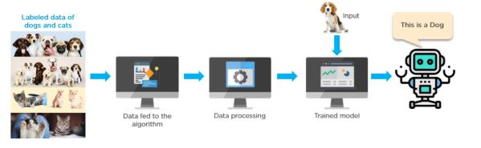
The following is an example of a supervised learning method where we have labeled data to identify dogs and cats. The algorithm learns from this data and trains a model to predict the new input.

Slide 5
Why is logistic regression important?
Some benefits of using logistic regression over other ML techniques:
Simplicity :
Logistic regression models are mathematically less complex than other ML methods. Therefore, you can implement them even if no one on your team has in-depth ML expertise.
Speed:
Logistic regression models can process large volumes of data at high speed because they require less computational capacity, such as memory and processing power. This makes them ideal for organizations that are starting with ML projects to gain some quick wins.
Flexibility:
You can use logistic regression to find answers to questions that have two or more finite outcomes. You can also use it to preprocess data. For example, you can sort data with a large range of values, such as bank transactions, into a smaller, finite range of values by using logistic regression. You can then process this smaller data set by using other ML techniques for more accurate analysis.
Visibility:
Logistic regression analysis gives developers greater visibility into internal software processes than do other data analysis techniques. Troubleshooting and error correction are also easier because the calculations are less complex.

Slide 6
What is Logistic Regression?
Logistic regression is a statistical method that is used for building machine learning models where the dependent variable is dichotomous: i.e. binary. Logistic regression is used to describe data and the relationship between one dependent variable and one or more independent variables. The independent variables can be nominal, ordinal, or of interval type.
Logistic regression is a data analysis technique that uses mathematics to find the relationships between two data factors. It then uses this relationship to predict the value of one of those factors based on the other. The prediction usually has a finite number of outcomes, like yes or no.
It is easy to implement and can be used as the baseline for any binary classification problem. Its basic fundamental concepts are also constructive in deep learning. Logistic regression describes and estimates the relationship between one dependent binary variable and independent variables.

Slide 7


It is a special case of linear regression where the target variable is categorical in nature. It uses a log of odds as the dependent variable. Logistic Regression predicts the probability of occurrence of a binary event utilizing a logit function.
Linear Regression Equation:
Where, y is a dependent variable and x1, x2 ... and Xn are explanatory variables.
Sigmoid Function:
Apply Sigmoid function on linear regression:

Slide 8
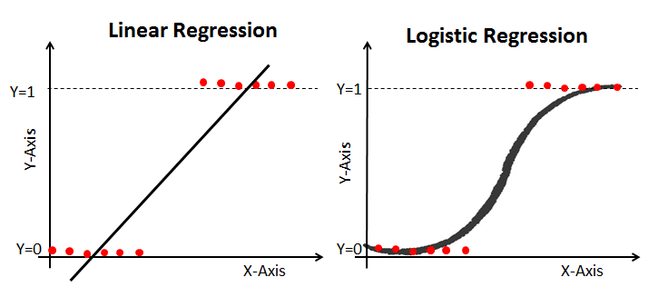
Linear Regression Vs. Logistic Regression
Linear regression gives you a continuous output, but logistic regression provides a constant output. An example of the continuous output is house price and stock price. Example's of the discrete output is predicting whether a patient has cancer or not, predicting whether the customer will churn. Linear regression is estimated using Ordinary Least Squares (OLS) while logistic regression is estimated using Maximum Likelihood Estimation (MLE) approach.

Slide 9
Maximum Likelihood Estimation Vs. Least Square Method
The MLE is a "likelihood" maximization method, while OLS is a distance-minimizing approximation method. Maximizing the likelihood function determines the parameters that are most likely to produce the observed data. From a statistical point of view, MLE sets the mean and variance as parameters in determining the specific parametric values for a given model. This set of parameters can be used for predicting the data needed in a normal distribution.
Ordinary Least squares estimates are computed by fitting a regression line on given data points that has the minimum sum of the squared deviations (least square error). Both are used to estimate the parameters of a linear regression model. MLE assumes a joint probability mass function, while OLS doesn't require any stochastic assumptions for minimizing distance.

Slide 10

Sigmoid Function:
The sigmoid function, also called logistic function gives an ‘S’ shaped curve that can take any real-valued number and map it into a value between 0 and 1.
If the curve goes to positive infinity, y predicted will become 1, and if the curve goes to negative infinity, y predicted will become 0.
If the output of the sigmoid function is more than 0.5, we can classify the outcome as 1 or YES, and if it is less than 0.5, we can classify it as 0 or NO.
For example: If the output is 0.75, we can say in terms of probability as: There is a 75 percent chance that a patient will suffer from cancer.

Slide 11
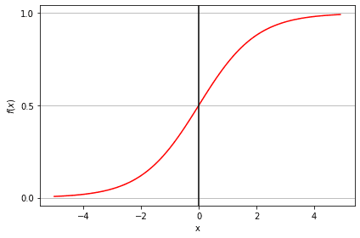

Slide 12
Types of Logistic Regression
Types of Logistic Regression:
Binary Logistic Regression: The target variable has only two possible outcomes such as Spam or Not Spam, Cancer or No Cancer.
Multinomial Logistic Regression: The target variable has three or more nominal categories such as predicting the type of Wine.
Ordinal Logistic Regression: the target variable has three or more ordinal categories such as restaurant or product rating from 1 to 5.

Slide 13
Model Evaluation using Confusion Matrix
A confusion matrix is a table that is used to evaluate the performance of a classification model. You can also visualize the performance of an algorithm. The fundamental of a confusion matrix is the number of correct and incorrect predictions summed up class-wise.
The confusion matrix in the form of the array object. The dimension of this matrix is 2*2 because this model is binary classification. You have two classes 0 and 1. Diagonal values represent accurate predictions, while non-diagonal elements are inaccurate predictions.

Slide 14
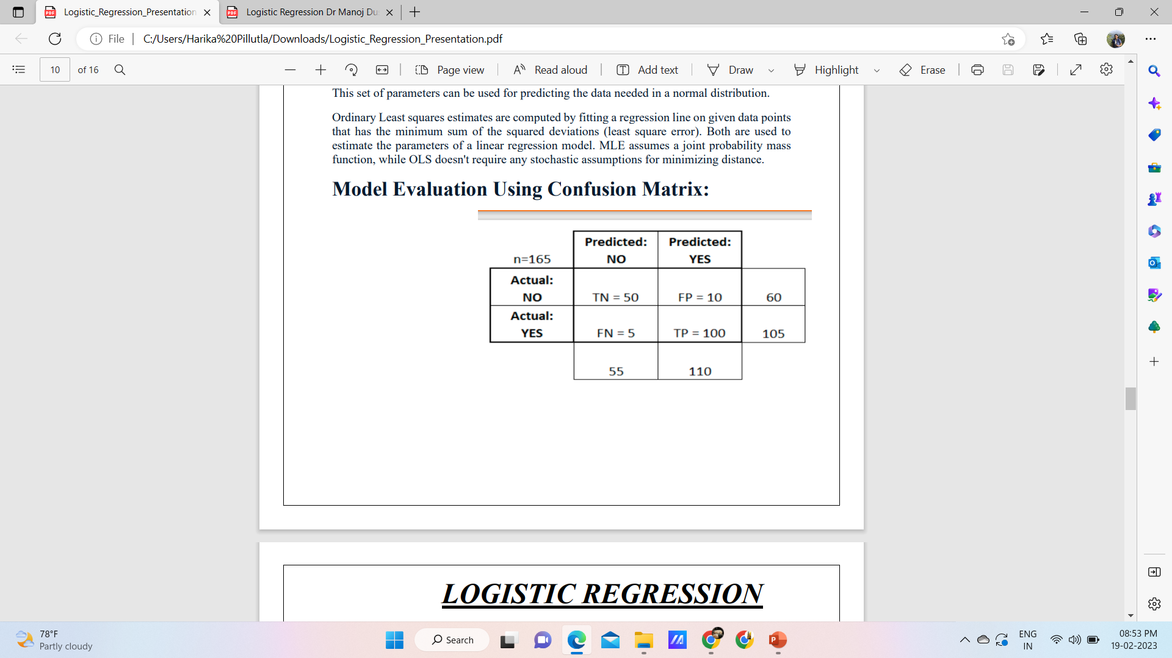
Accuracy:
Overall, how often is the classifier correct?
• (TP+TN)/total = (100+50)/165 = 0.91
Misclassification Rate:
•Overall, how often is it wrong?
• (FP+FN)/total = (10+5)/165 = 0.09
• equivalent to 1 minus Accuracy
• also known as "Error Rate"

Slide 15
True Positive Rate:
•When it's actually yes, how often does it predict yes?
• TP/actual yes = 100/105 = 0.95
• also known as "Sensitivity" or "Recall"
True Negative Rate:
•When it's actually no, how often does it predict no?
• TN/actual no = 50/60 = 0.83
• equivalent to 1 minus False Positive Rate
• also known as "Specificity"
Precision:
•When it predicts yes, how often is it correct?
• TP/predicted yes = 100/110 = 0.91
False Positive Rate:
•When it's actually no, how often does it predict yes?
• FP/actual no = 10/60 = 0.17

Slide 16

Most commonly used metrices in classification_report are accuracy, precision, and recall.
Precision: Precision is about being precise, i.e., how accurate your model is. In other words, we can say, when a model makes a prediction, how often it is correct. For example., prediction case, when our Logistic Regression model predicted patients are going to suffer from diabetes, that patients have 73% of the time.
Recall: If there are patients who have diabetes in the test set and our Logistic Regression model can identify it 57% of the time.
F1 score formula:
The F1 score is defined as the harmonic mean of precision and recall.
F1 score is a machine learning evaluation metric that measures a model's accuracy. It combines the precision and recall scores of a model. The accuracy metric computes how many times a model made a correct prediction across the entire dataset.

Slide 17
ROC Curves and AUC
• ROC – Receiver Operating Characteristics.
• AUC – Area Under the ROC Curve.
At a given threshold, we can evaluate the classification accuracy (accuracy, sensitivity, recall, etc)
• ROC curve tries to evaluate how well the regression has achieved the separation between the classes at all threshold values.
It measures how well predictions are ranked, rather than their absolute values.
AUC is classification-threshold-invariant. It measures the quality of the model's predictions irrespective of what classification threshold is chosen.
The Area Under the ROC curve (AUC) is an metric that evaluates how well a logistic regression model classifies positive and negative outcomes at all possible cutoffs. It can range from 0.5 to 1, and the larger it is the better.

Slide 18
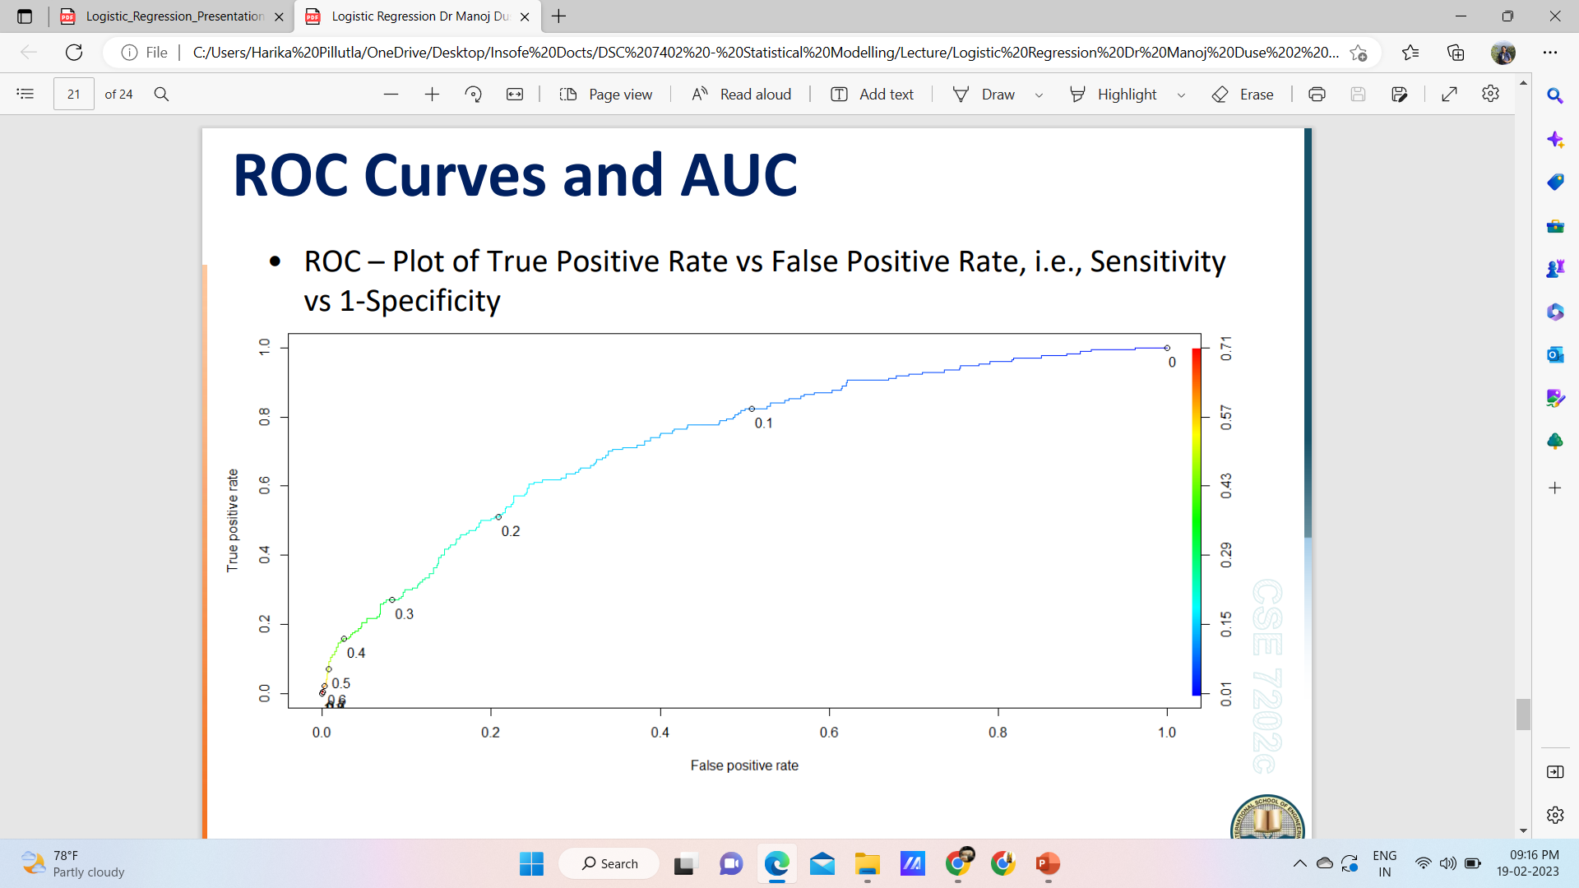

Slide 19
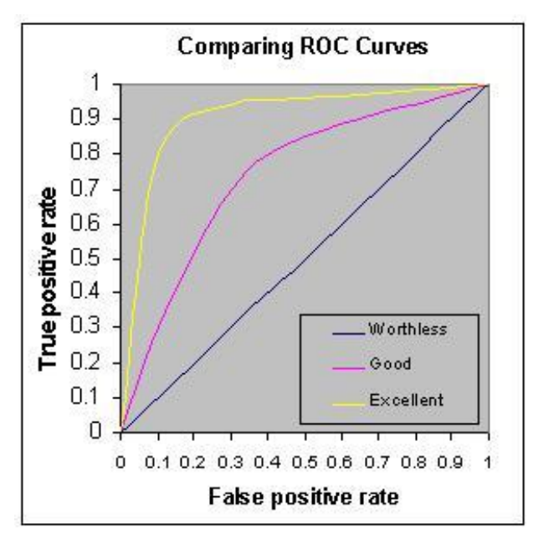
Rough rule of thumb:
• 0.90 -1.0 = Excellent
• 0.80 – 0.90 = Good
• 0.70 – 0.80 = Fair
• 0.60 – 0.70 = Poor
• 0.50 – 0.60 = Fail

Slide 20
Advantages & Disadvantages:
Advantages:
Because of its efficient and straightforward nature, it doesn't require high computation power, is easy to implement, easily interpretable, and used widely by data analysts and scientists. Also, it doesn't require scaling of features. Logistic regression provides a probability score for observations.
Disadvantages:
Logistic regression is not able to handle a large number of categorical features/variables. It is vulnerable to overfitting. Also, can't solve the non-linear problem with the logistic regression that is why it requires a transformation of non-linear features. Logistic regression will not perform well with independent variables that are not correlated to the target variable and are very similar or correlated to each other.
Disadvantages

Slide 21
Applications of Logistic Regression
Logistic regression has several real-world applications in many different industries.
Manufacturing:
Manufacturing companies use logistic regression analysis to estimate the probability of part failure in machinery. They then plan maintenance schedules based on this estimate to minimize future failures.
Healthcare:
Medical researchers plan preventive care and treatment by predicting the likelihood of disease in patients. They use logistic regression models to compare the impact of family history or genes on diseases.
Finance :
Financial companies have to analyze financial transactions for fraud and assess loan applications and insurance applications for risk. These problems are suitable for a logistic regression model because they have discrete outcomes, like high risk or low risk and fraudulent or not fraudulent.
Marketing:
Online advertising tools use the logistic regression model to predict if users will click on an advertisement. As a result, marketers can analyze user responses to different words and images and create high-performing advertisements with which customers will engage.

Slide 22
Conclusion:
In this PPT, we have covered a lot of details about Logistic Regression. We have learned what logistic regression is, how to build respective models, how to visualize results and some of the theoretical background information.
Also, we covered some basic concepts such as the sigmoid function, maximum likelihood, confusion matrix, ROC curve.
Then, we looked at advantages & disadvantages of logistic regression and then, the different applications of logistic regression.
Hopefully, we can now utilize the Logistic Regression technique to analyze the datasets.

Slide 23


