Slide 1
Logistic Regression Prediction on Diabetes Patient's Hospital Readmission
-Harika Pillutla
TuringMinds.ai

Slide 2
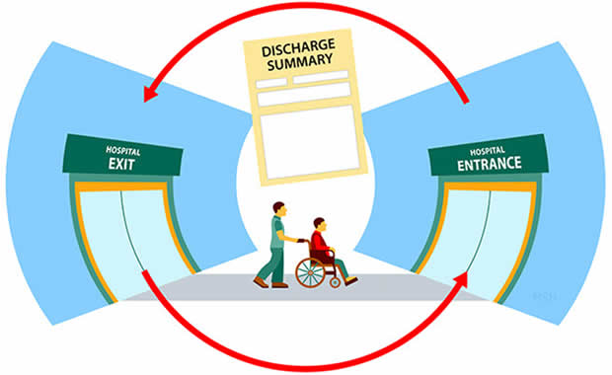

Slide 3
Recap:
Problem Statement and Objective:
A hospital readmission is when a patient who is discharged from the hospital gets re-admitted within a certain period. Hospital readmission rates for certain conditions are now considered an indicator of hospital quality, and also affect the cost of care adversely. For this reason, the Centers for Medicare & Medicaid Services established the Hospital Readmissions Reduction Program which aims to improve the quality of care for patients and reduce healthcare spending by applying payment penalties to hospitals that have more than expected readmission rates for certain conditions. Although diabetes is not yet included in the penalty measures, the program is regularly adding new disease conditions to the list, now totaling 6 for FY2018. In 2011, American hospitals spent over $41 billion on diabetic patients who got readmitted within 30 days of discharge. Being able to determine factors that lead to higher readmission in such patients, and correspondingly being able to predict which patients will get readmitted can help hospitals save millions of dollars while improving the quality of care. So, with that background in mind, we used a medical claims dataset (description below), to answer these questions:
What factors are the strongest predictors of hospital readmission in diabetic patients?
How well can we predict hospital readmission in this dataset with limited features?

Slide 4
Data Set Description
Encounter ID: Unique identifier of an encounter
Patient number: Unique identifier of a patient
Race Values: Caucasian, Asian, African American, Hispanic, and other
Gender Values: male, female, and unknown/invalid Age Grouped in 10-year intervals: 0, 10), 10, 20), …, 90, 100)
Weight: Weight in pounds
Admission type: Integer identifier corresponding to 9 distinct values, for example, emergency, urgent, elective, newborn, and not available
Discharge disposition: Integer identifier corresponding to 29 distinct values, for example, discharged to home, expired, and not available
Admission source: Integer identifier corresponding to 21 distinct values, for example, physician referral, emergency room, and transfer from a hospital
Time in hospital: Integer number of days between admission and discharge
Payer code : Integer identifier corresponding to 23 distinct values, for example, Blue Cross/Blue Shield, Medicare, and self-pay Medical

Slide 5
Medical specialty: Integer identifier of a specialty of the admitting physician, corresponding to 84 distinct values, for example, cardiology, internal medicine, family/general practice, and surgeon
Number of lab procedures: Number of lab tests performed during the encounter
Number of procedures: Numeric Number of procedures (other than lab tests) performed during the encounter
Number of medications: Number of distinct generic names administered during the encounter
Number of outpatient visits: Number of outpatient visits of the patient in the year preceding the encounter
Number of emergency visits: Number of emergency visits of the patient in the year preceding the encounter
Number of inpatient visits: Number of inpatient visits of the patient in the year preceding the encounter
Diagnosis 1: The primary diagnosis (coded as first three digits of ICD9); 848 distinct values
Diagnosis 2: Secondary diagnosis (coded as first three digits of ICD9); 923 distinct values
Diagnosis 3: Additional secondary diagnosis (coded as first three digits of ICD9); 954 distinct values
Number of diagnoses: Number of diagnoses entered into the system 0%

Slide 6
Glucose serum test: result indicates the result’s range or if the test was not taken. Values: “>200,” “>300,” “normal,” and “none” if not measured
A1c test result: Indicates the range of the result or if the test was not taken. Values: “>8” if the result was greater than 8%, “>7” if the result was greater than 7% but less than 8%, “normal” if the result was less than 7%, and “none” if not measured.
Change of medications: Indicates if there was a change in diabetic medications (either dosage or generic name). Values: “change” and “no change”
Diabetes medications: Indicates if there was any diabetic medication prescribed. Values: “yes” and “no” 24 features for medications For the generic names: metformin, repaglinide, nateglinide, chlorpropamide, glimepiride, acetohexamide, glipizide, glyburide, tolbutamide, pioglitazone, rosiglitazone, acarbose, miglitol, troglitazone, tolazamide, examide, sitagliptin, insulin, glyburide-metformin, glipizide-metformin, glimepiride- pioglitazone, metformin-rosiglitazone, and metformin- pioglitazone, the feature indicates whether the drug was prescribed or there was a change in the dosage. Values: “up” if the dosage was increased during the encounter, “down” if the dosage was decreased, “steady” if the dosage did not change, and “no” if the drug was not prescribed
Readmitted (Target Column): Days to inpatient readmission. Values: “<30” if the patient was readmitted in less than 30 days, “>30” if the patient was readmitted in more than 30 days, and “No” for no record of readmission

Slide 7
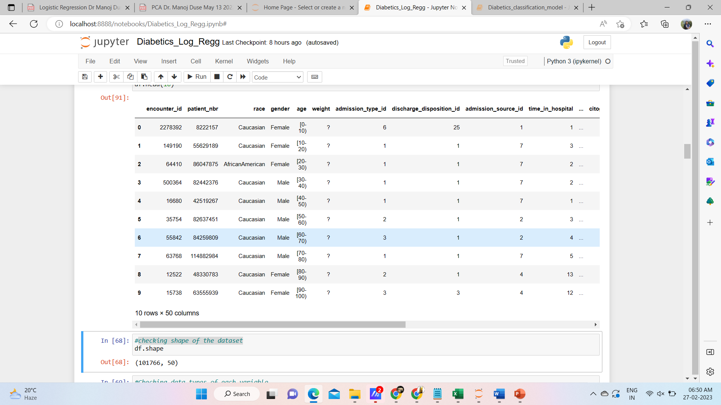

Slide 8
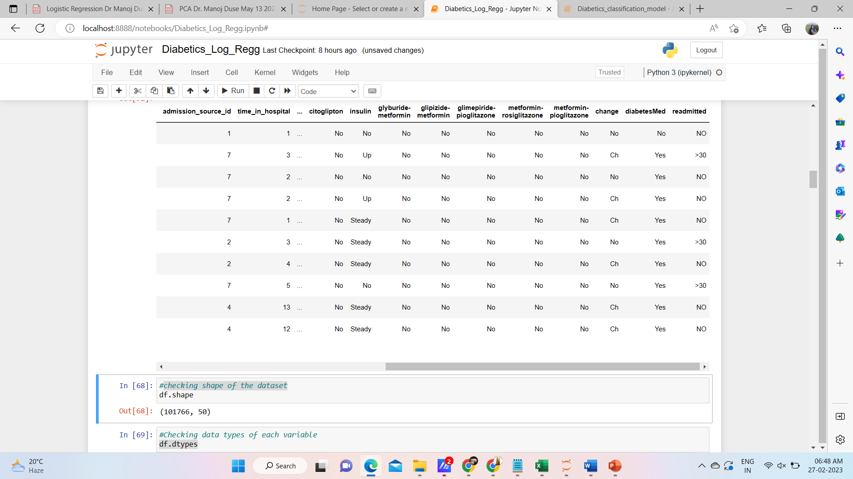

Slide 9
Data Preparation & Exploration
Importing necessary packages
Loading Dataset
Displaying the first 10 rows of data
Checking the shape of the dataset
Checking the info on the dataset
Checking whether our data has missing values
Null Handling
Correlation

Slide 10
The data frame contains 101766 rows and 50 columns.
There are several columns that contain missing data, as indicated by the "Non-Null Count" column. For example, the "race" column has 99493 non-null values, which means that there are 2273 missing values in this column. The "weight" column has only 3197 non-null values, which means that there are 983569 missing values in this column.
The data frame contains a mix of numeric and non-numeric data types. There are 13 columns with integer data types (indicated by the "int64" type), and 37 columns with object data types (indicated by the "object" type). The object data type is typically used for columns that contain text data or other non-numeric data types.
The "readmitted" column is an object data type, which suggests that it may contain categorical or text data. In this case, we know from the dataset description that the "readmitted" column contains one of three values: "NO", ">30", or "<30", which indicate whether the patient was readmitted within 30 days, after 30 days, or not at all. This information could be useful for analyzing readmission rates and identifying factors that may contribute to readmissions.
The DataFrame contains several columns with IDs, such as "encounter_id", "patient_nbr", "admission_type_id", "discharge_disposition_id", and "admission_source_id". These columns may be useful for tracking individual patients and analyzing patterns in hospital admissions and discharges.
The DataFrame contains several columns that represent numeric values, such as "time_in_hospital", "num_lab_procedures", "num_procedures", and "num_medications". These columns may be useful for analyzing patient care and treatment patterns, as well as identifying potential risk factors for adverse outcomes.

Slide 11
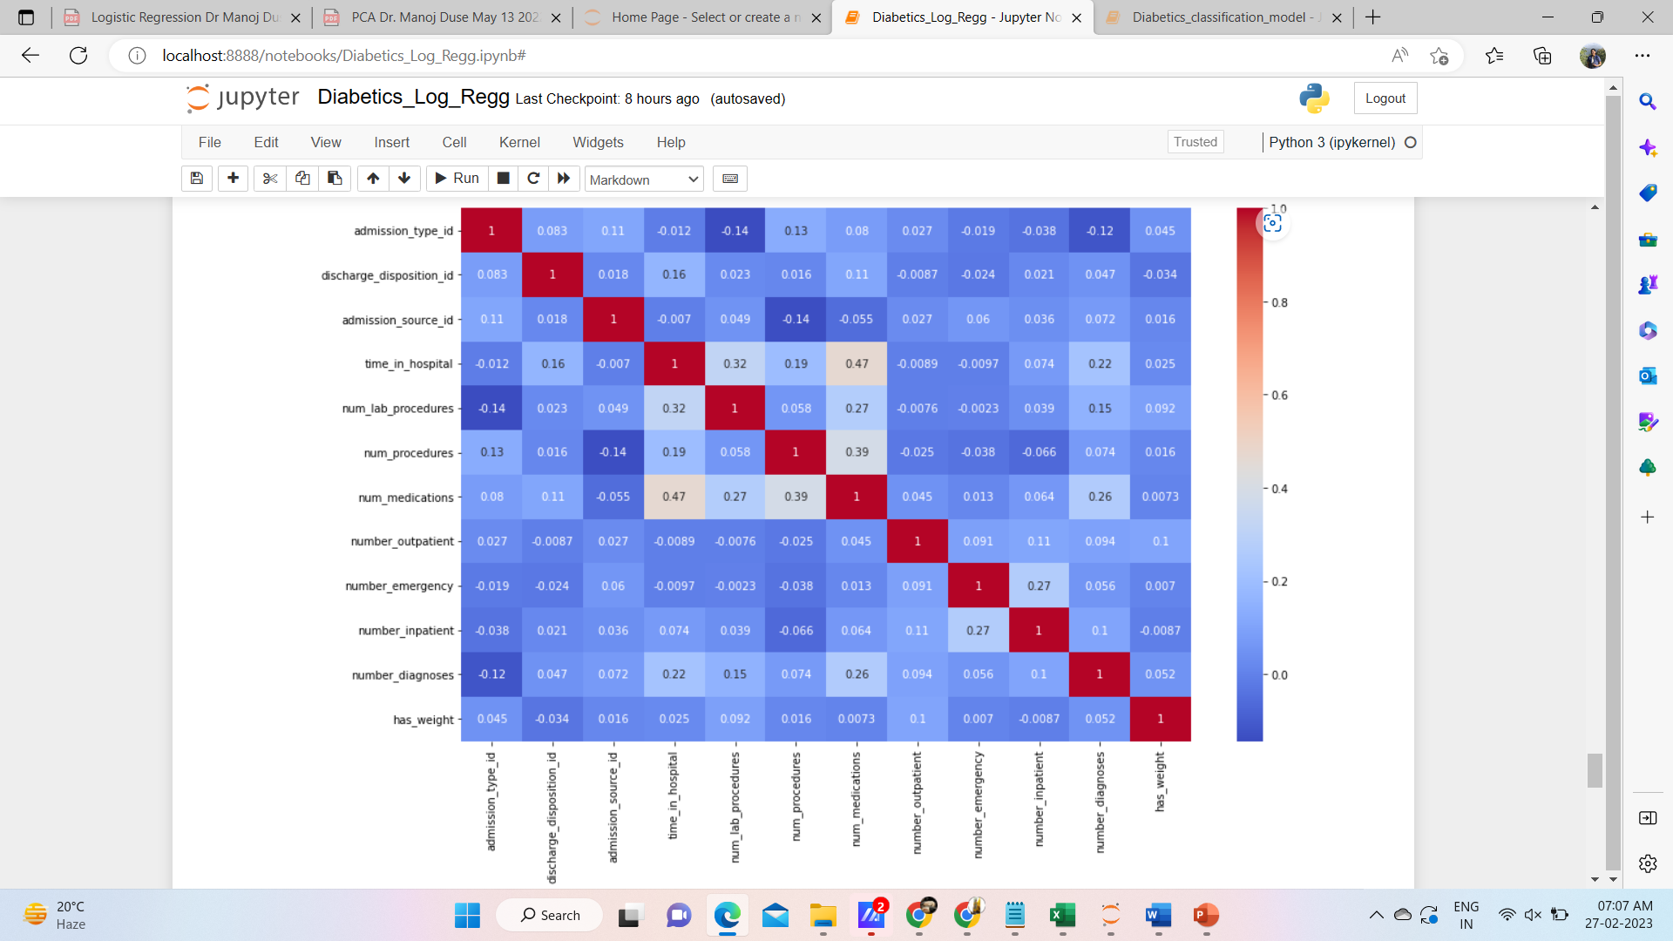
Correlation

Slide 12
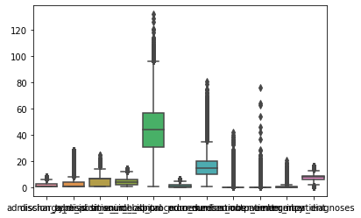
Plot boxplots of all numerical variables to identify outliers
admission_type_id 341
discharge_disposition_id 3588
admission_source_id 175
time_in_hospital 1042
num_lab_procedures 43
num_procedures 0
num_medications 1361
number_outpatient 1457
number_emergency 1664
number_inpatient 2016
number_diagnoses 281

Slide 13
Overview:
Box Plot for after median imputation.
Feature Engineering
Data Visualization
One-Hot Encoding
Based on icd(international classification of disease) codes we group some disease
Train_Test_Split
Model Building
Model Evaluation

Slide 14
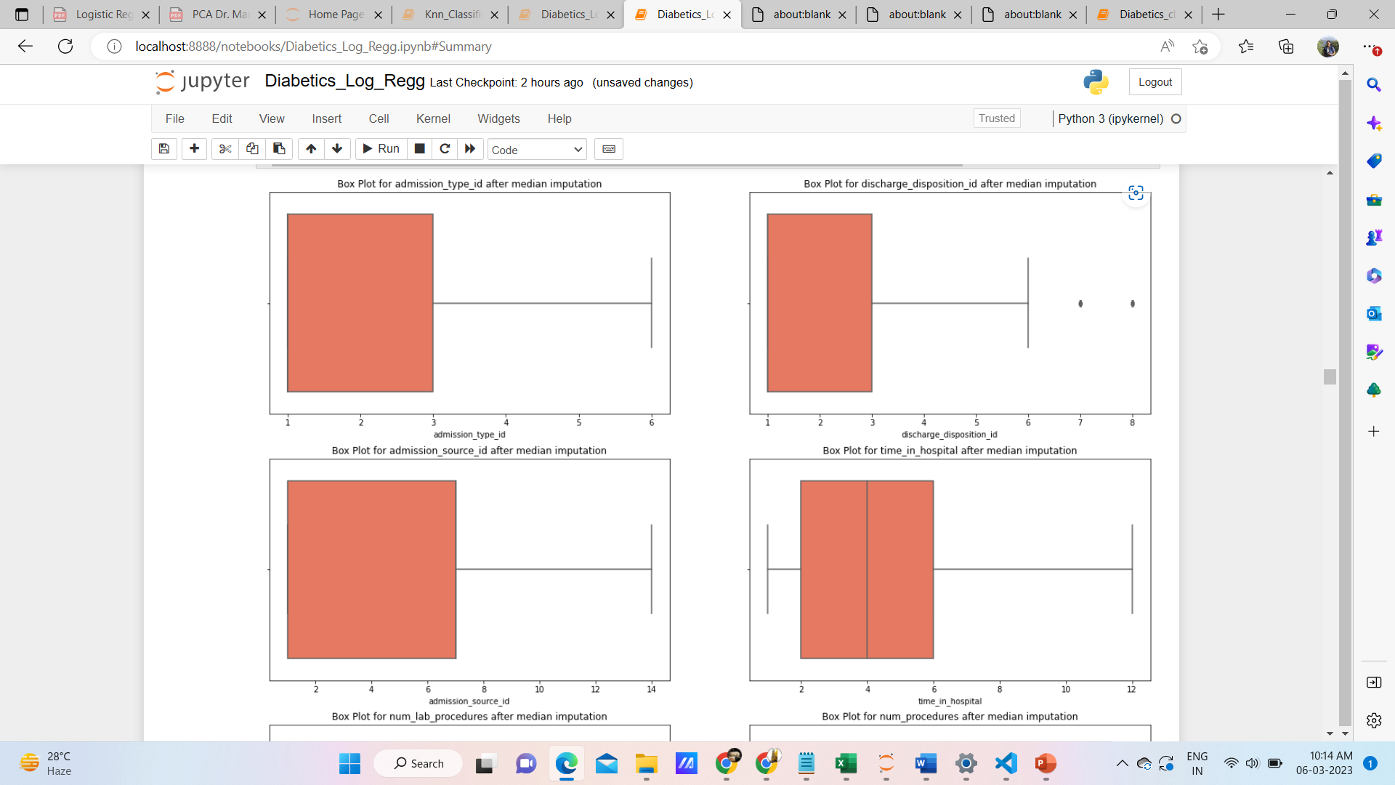

Slide 15
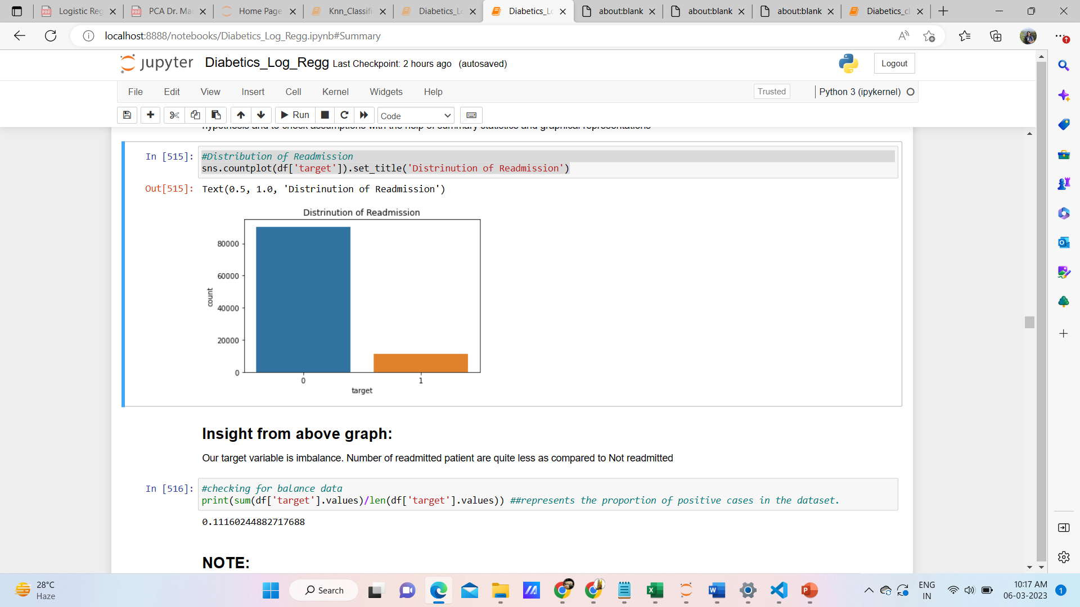

Slide 16
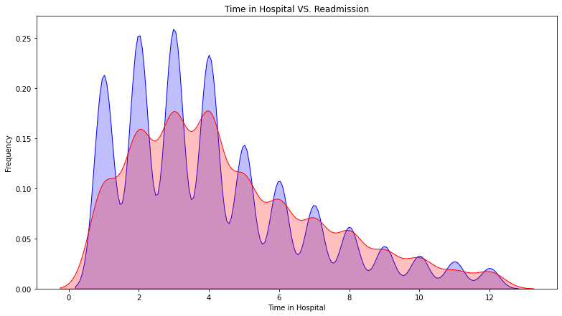
Insight from graph: If no of days in hospital increased readmission rate is getting decreased.Mostly patient between 3 to 4 days are admitted frequently

Slide 17
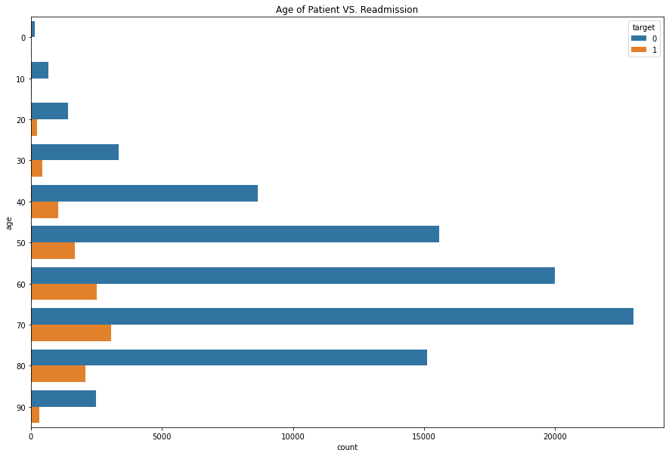
Insight from above graph:¶ Patient with age 60 and 70 have more readmission

Slide 18
Train_Test_Split:
Here's how it works:
The input data X and target variable y are combined using the zip() function to create a list of tuples, where each tuple contains an input and its corresponding target value.
The np.random.shuffle() function is used to shuffle the list of tuples randomly, so that the order of the input-target pairs is randomized.
The split variable is calculated as 80% of the length of the shuffled list of tuples, which represents the number of samples that will be used for training.
The first split samples from the shuffled list of tuples are extracted and assigned to the train_data list, while the remaining samples
are assigned to the test_data list.
The x_train, y_train, x_test, and y_test lists are created by extracting the input and target values from
the train_data and test_data lists, respectively.
The resulting x_train, y_train, x_test, and y_test lists can be used to train and evaluate a machine learning model.
The training set contains 80% of the data, while the testing set contains the remaining 20%. This is a common way to split the data for supervised learning tasks.

Slide 19
Shape of X_train:
(80192, 150)
Shape of y_train:
(80192,)
Shape of X_test:
(20049, 150)
Shape of y_test:
(20049,)

Slide 20
Model Building
This defines a LogisticRegression class that implements a logistic regression algorithm for binary classification. The class has three methods:
init(self, learning_rate = 0.01, no_of_iterations = 1000): This is the constructor method that initializes the hyperparameters of the algorithm. It takes two arguments:
• learning_rate: The learning rate determines the step size at each iteration while moving toward a minimum of the cost function.
• no_of_iterations: The number of iterations to be performed for gradient descent.
fit(self, X, y): This method fits the logistic regression model to the training data X and the corresponding binary labels y. It updates the weights and bias of the model using gradient descent optimization algorithm. The method performs the following steps:
• Initializes the weights and bias to zero.
• Calculates the sigmoid function to predict the binary labels.
• Calculates the cost function to evaluate the quality of the predicted labels.
• Calculates the gradients of the weights and bias using the cost function.
• Updates the weights and bias using the gradients and learning rate.
predict(self, X): This method predicts the binary labels for the input data X. It calculates the sigmoid function using the weights and bias of the trained logistic regression model, and converts the probabilities to binary labels using a threshold value of 0.4.

Slide 21
Model Evaluation
Accuracy: measures the proportion of correct predictions among all predictions made. It is calculated as
(true positives + true negatives) / total number of predictions.
Precision: measures the proportion of true positives among all positive predictions made. It is calculated as
true positives / (true positives + false positives).
Recall: measures the proportion of true positives among all actual positive instances. It is calculated as
true positives / (true positives + false negatives).
• F1 score: is the harmonic mean of precision and recall. It takes into account both precision and recall, providing a balance between the two metrics. It is calculated as
2 * (precision * recall) / (precision + recall).

Slide 22
Hyper Parameter Tuning
Hyperparameter tuning is the process of finding the optimal combination of hyperparameters for a machine learning model to achieve the best performance on a given task. Hyperparameters are parameters that are set before the training process and define how the model will learn from the data, such as learning rate, number of iterations, etc in Logistic Regression.
There are several types of hyperparameter tuning techniques, including:
Grid Search: In this technique, a predefined grid of hyperparameters is defined, and the model is trained and evaluated on each combination of hyperparameters to find the optimal set.
Random Search: This technique randomly samples hyperparameters from a predefined distribution to find the best combination of hyperparameters.

Slide 23
Grid Search
This is how grid search can be used to tune hyperparameters related to the learning rate and number of iterations in a Logistic Regression Model:
Here, we have a binary classification problem where we want to predict whether a patient will readmit in the hospital or not based on their age, time in hospital, medical specialty. We decide to use logistic regression as our model,
and we want to tune two hyperparameters: The learning rate and The number of iterations.
For the learning rate, we define a grid of values to search over:[0.1, 0.01, 0.001].
For the number of iterations, we define another grid of values to search over:[1000, 5000, 10000].
Using grid search, we train and evaluate the logistic regression model on all possible combinations of the learning rate and number of iterations. For each combination, we compute the accuracy or other evaluation metric on a validation set. The combination with the highest accuracy or best performance on the evaluation metric is selected as the optimal set of hyperparameters for our model.
Grid search allows us to systematically explore the hyperparameter space and find the best combination of hyperparameters for our logistic regression model in terms of the learning rate and number of iterations.

Slide 24


