Slide 1

Predicting Online Shopping Revenue Using Classification
Group 9
Selvapriya selva kumar
Subhasree Vemparala Sathyanarayan
Sri Mahalakshmi Harika Punati

Slide 2
Introduction
Predicting online purchasing revenue is vital for e-commerce, offering benefits like process optimization, improved customer satisfaction, and revenue growth. Accurate forecasts enable customization of marketing, product recommendations, and website design based on whether a visitor is likely to generate revenue or not. This strategic adaptation caters to diverse client needs, enhancing overall effectiveness in the e-commerce sector.

Slide 3
Objective
The project's primary goal is to create a classification model predicting whether an online shopper will generate revenue based on user-specific attributes. The analysis aims to uncovercomplex connections between these attributes and online behavior, offering e-commerce businesses actionable insights for strategy optimization and tailored user experiences. Successful implementation of this model could empower companies to efficiently target the right audience, customize designs, and enhance marketing tactics, ultimately boosting revenue. The focus is on leveraging statistical approaches to provide valuable data for strategic fine-tuning and customer-centric optimization in the e-commerce sector.

Slide 4
Data Description
This project utilizes the "Online Shoppers Purchasing Intention Dataset," featuring 17 user behavior and website interaction attributes, including Administrative_Duration, BounceRates, PageValues, SpecialDay, Month, VisitorType, Weekend, and Revenue. With 12330 instances, the dataset ensures diversity by assigning each session to a distinct user across a year, minimizing biases. Our analysis focuses on 13 key features, such as Administrative, BounceRates, and VisitorType, excluding variables like "Browser" and "OperatingSystems" as they proved irrelevant to our predictive model.

Slide 5
Exploratory Data Analysis
The dataset on online shopper revenue reveals a substantial majority of instances (10,422) without revenue and 1,908 instances with revenue. A thorough check indicates a clean dataset with no missing values across various features, ensuring reliability. To enhance model effectiveness, correlated columns such as "ProductRelated" and "ProductRelated_Duration" are addressed by dropping one from each pair. Additionally, columns "Browser" and "OperatingSystems" are removed due to perceived insignificance. Categorical features like "Month," "VisitorType," and "Weekend" are transformed into numerical representations for compatibility with machine learning algorithms. Visual analysis through box plots shows a uniform distribution with no significant outliers.

Slide 6
NULL Value Results : Administrative 0
Administrative_Duration 0
Informational 0
Informational_Duration 0
ProductRelated 0
ProductRelated_Duration 0
BounceRates 0
ExitRates 0
PageValues 0
SpecialDay 0
Month 0
OperatingSystems 0
Browser 0
Region 0
TrafficType 0
VisitorType 0
Weekend 0
Revenue 0

Slide 7
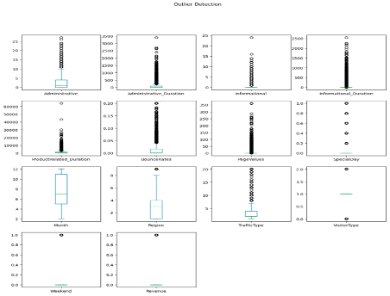
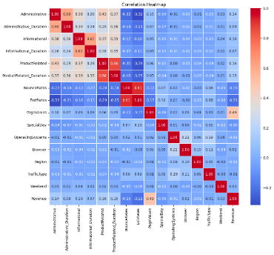

Slide 8
Models Used
Logistic Regression
Naive Bayes
Soft Margin SVM

Slide 9
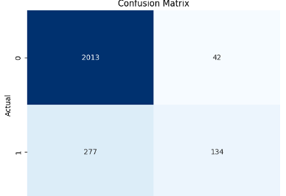
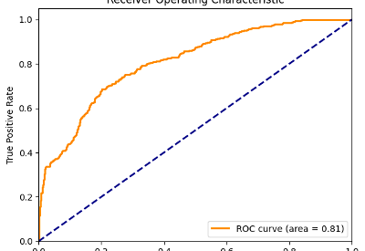
Logistic Regression: The logistic regression model, trained on the provided dataset, achieved an 88.7% accuracy on the test set. It demonstrates a balance between false positives and true cases, with a recall of 39.3%, precision of 77.8%, and an F1 score of 52.2%. The model's effectiveness is reinforced by insightful visualizations like the confusion matrix and ROC curve, the latter showing a reasonably predictive AUC of 0.76.

Slide 10
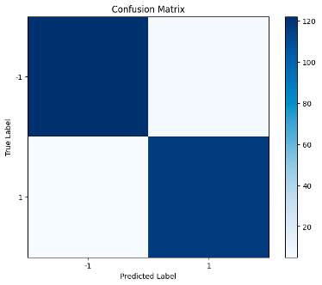
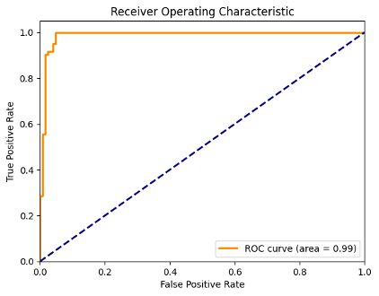
Naïve Bayes:The Naive Bayes classifier achieved an accuracy of approximately 76.86% on the test data, indicating that it correctly predicted the class for a majority of instances. The reported recall of approximately 75.40% signifies the classifier's effectiveness in identifying positive instances. Overall, the Naive Bayes model performs reasonably well on the test dataset, with a notable balance between accuracy and recall.

Slide 11
Soft Margin SVM : The SoftMarginSVM model, instantiated with a regularization parameter (C=0.69), achieved an accuracy of approximately 95.6% on the test set. Selected features, including 'Month' and 'VisitorType,' were extracted, and standard scaling was applied for uniformity. The ROC curve visually illustrates the model's ability to distinguish between positive and negative classes, providing insights into its discriminative performance. Overall, the Soft Margin SVM exhibits promising accuracy on the balanced online shopper dataset, emphasizing its potential effectiveness in identifying revenue-generating instances. .

Slide 12

Results:
Logistic Regression achieved an accuracy of 88.7%, demonstrating a balanced trade-off between precision and recall. Naive Bayes performed reasonably well with 76.86% accuracy and 75.40% recall. SoftMarginSVM, instantiated with C=0.69, excelled with a 95.6% accuracy, showing potential in distinguishing revenue-generating instances. Logistic Regression emerged as the best model, proving efficient and effective, particularly on large datasets, outperforming SoftMarginSVM

Slide 13

THANK YOU

