Slide 1
Enterprise Reviews Sentiment Analysis
By - Ravi Teja Reddy Dodda
Sanjay Bhargav Madamanchi
Harika Satti
Pragna Kancheti Team: Data Divers

Slide 2
CONTENT
Data
Visualization
Modeling
Deployment

Slide 3
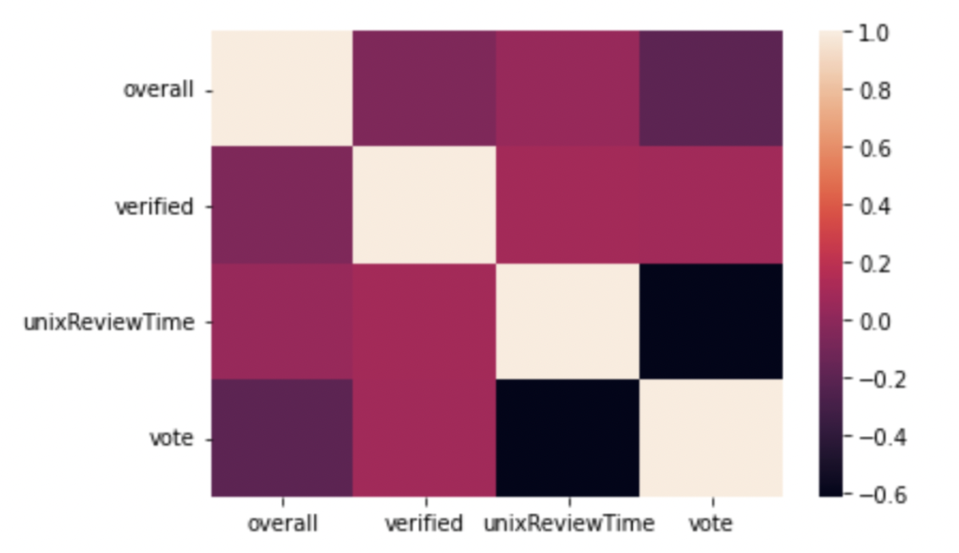
ABOUT DATA
The data used for the sentiment analysis is gathered from UCSD EDU
This contains a subset of the data in which all users and items have at least 5 reviews
A total of 41.13 million reviews

Slide 4
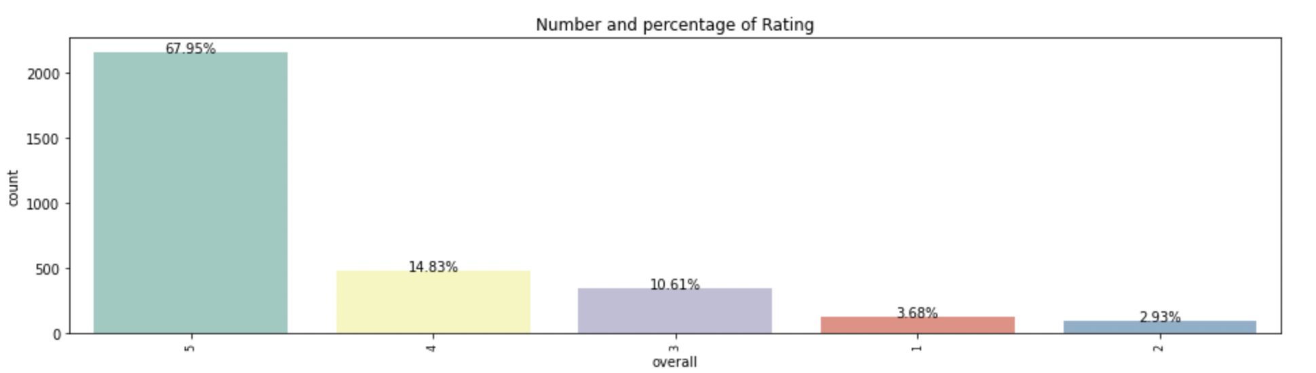
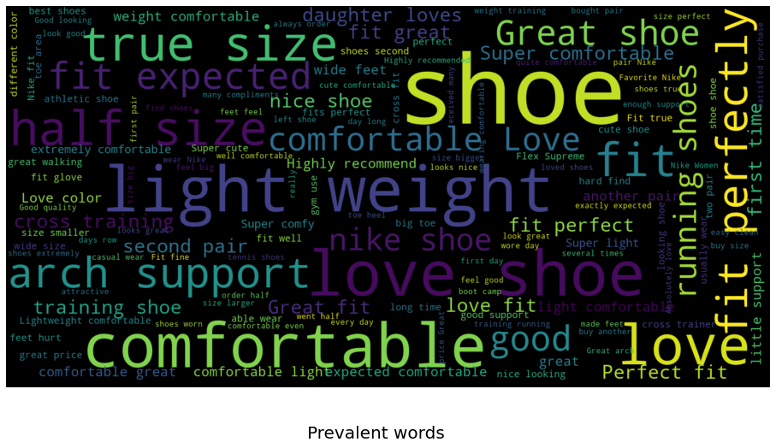
Visualization
Rating to it’s sum:
Prevalent words in fashion dataset:

Slide 5
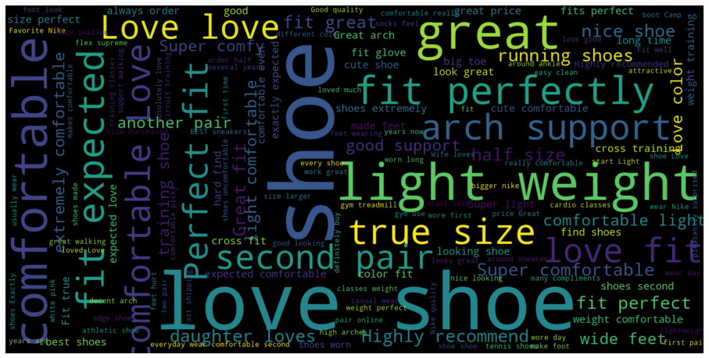
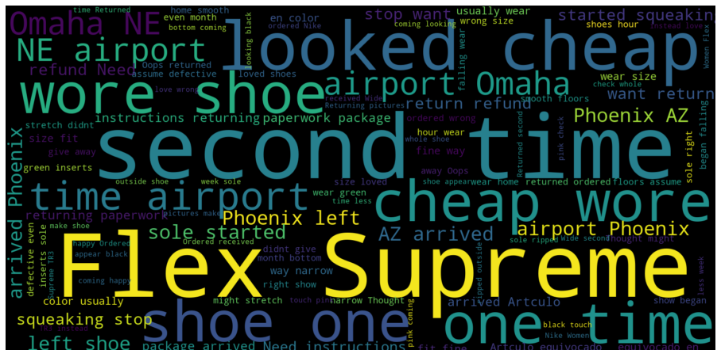
Visualization
Prevalent Words in 5 star review :
Prevalent Words in 1 star review :

Slide 6
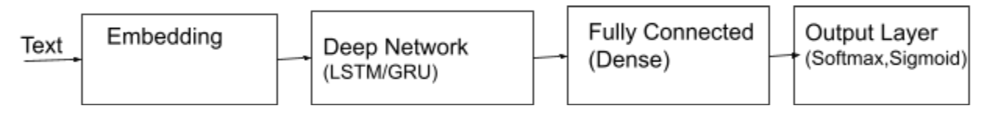
MODEL
Model 1: Sequential LSTM
Model 2 : Pre trained HuggingFace model
Model 3: Sentiment analysis using Bert model

Slide 7
DEPLOYMENT
Dumped model into pickle file.
Loaded the pickle file and ran in local host.

Slide 8
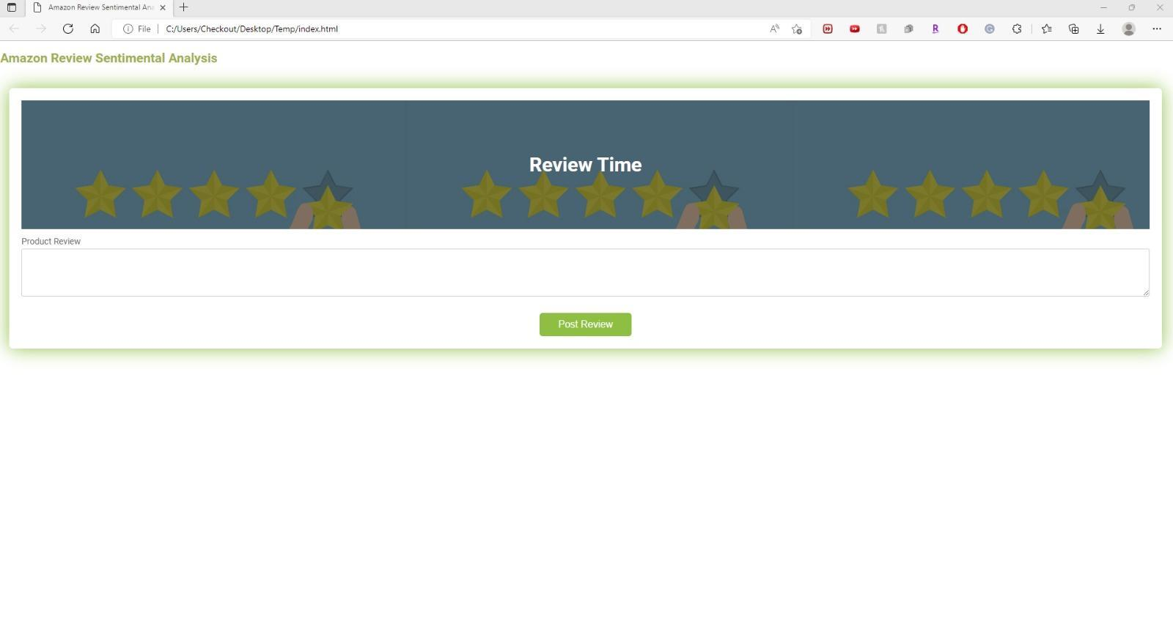
Outputs (Main input terminal)

Slide 9
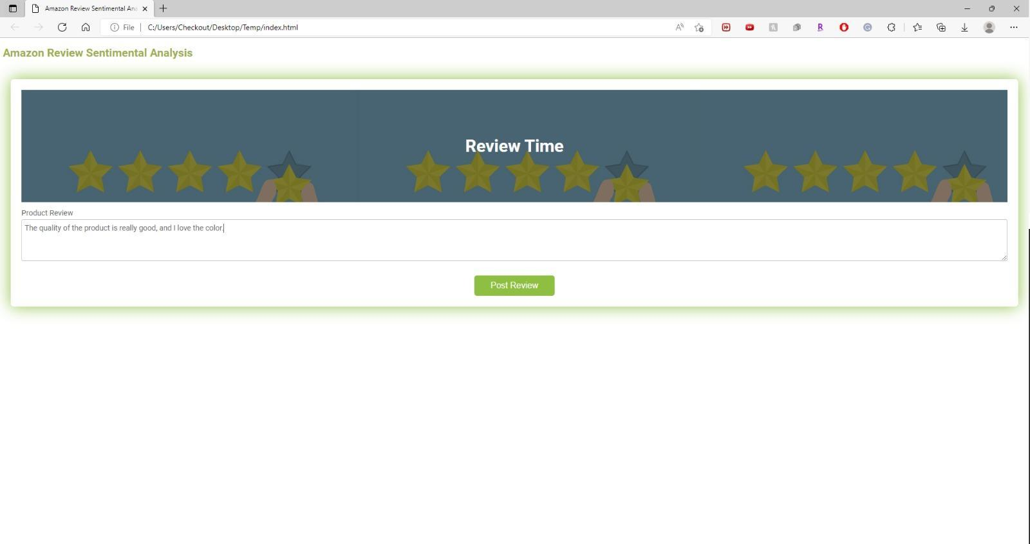
Positive review Test

Slide 10
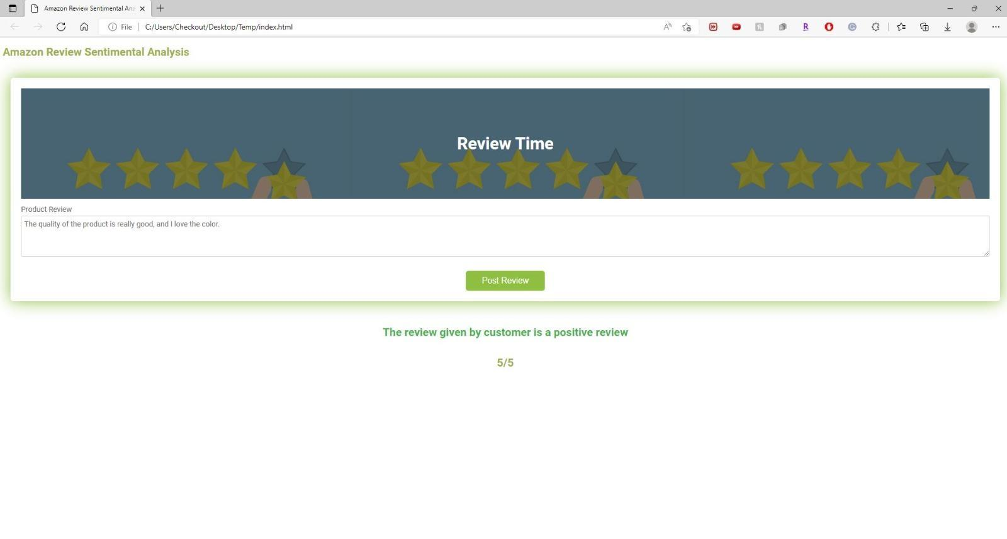

Slide 11
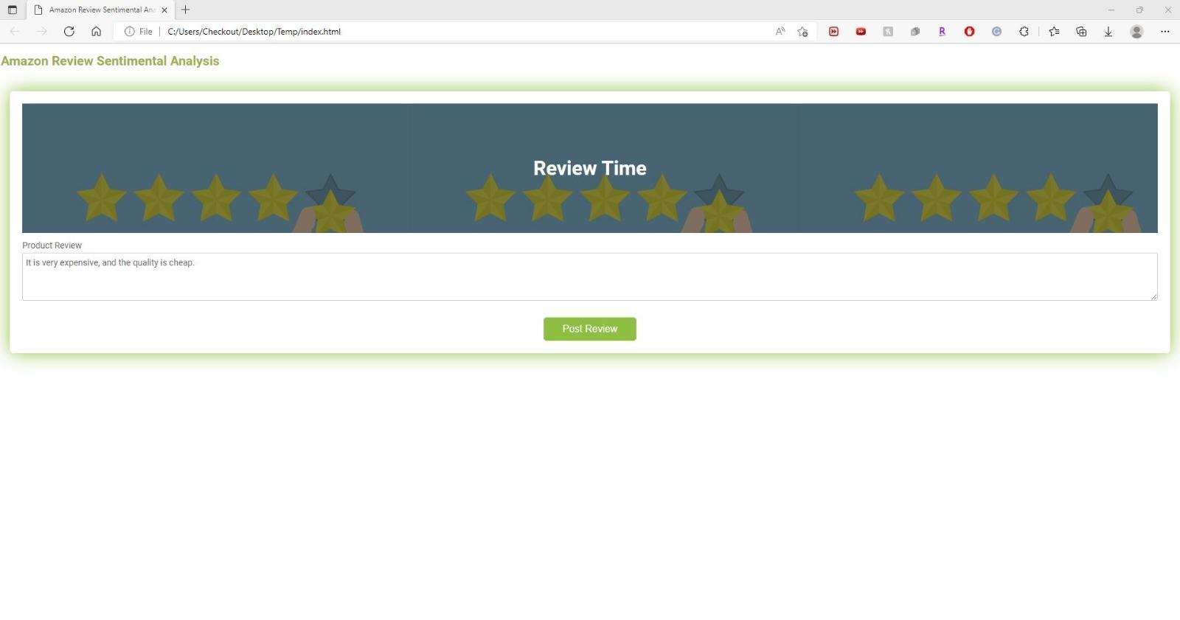
Negative review Test

Slide 12
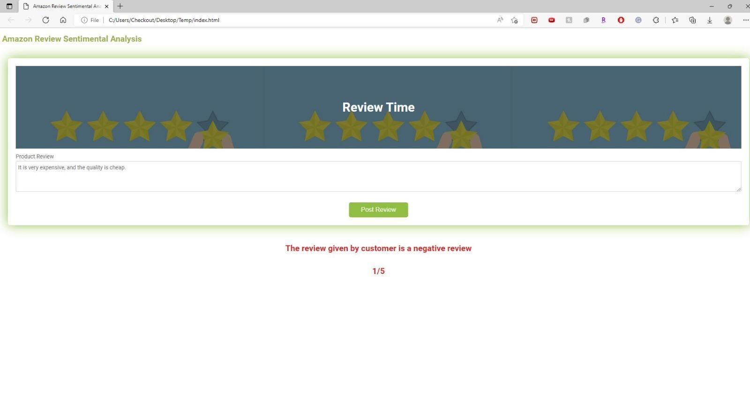

Slide 13
Thank You!

