Slide 1
KEY LOGGER
-Harika Naga Durga

Slide 2
Problem Statement:
Keyloggers are software or hardware tools designed to monitor and log keystrokes made on a keyboard. While keyloggers can be used for malicious purposes, such as stealing passwords and sensitive information, they also have legitimate applications, including monitoring employee productivity, parental control, and cybersecurity analysis.
The goal of this project is to design, implement, and test a software-based keylogger. The keylogger should be capable of running in the background, capturing all keystrokes made on the keyboard, and storing the logged data securely

Slide 3
Introduction:
A keylogger is a type of monitoring software or hardware device designed to record keystrokes made by a user on their keyboard. The primary function of a keylogger is to capture every keystroke entered on the keyboard, including letters, numbers, symbols, and special keys, and store this information for later retrieval and analysis.
Types of Keyloggers
1.Software Keyloggers
2.Hardware Keyloggers

Slide 4
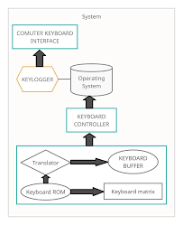
Working:
Keyloggers operate by intercepting and recording every keystroke made by the user on their keyboard. This data can then be used for various purposes, depending on the intent behind the keylogger's deployment. The working mechanism of keyloggers can be broken down into several stages, including capturing keystrokes, storing data, and, optionally, transmitting the data to a remote location.

Slide 5
A Solution:
A keylogger solution involves developing a tool that captures and records keystrokes for legitimate purposes, such as parental control or authorized employee monitoring. It requires implementing platform-specific hooks to capture keystrokes, securely storing the logged data using encryption (e.g., AES-256), and ensuring it operates discreetly as a background service. Additionally, an administrative interface should be provided for configuration and control. This ensures that the keylogger functions efficiently and securely, maintaining ethical standards and legal compliance.

Slide 6
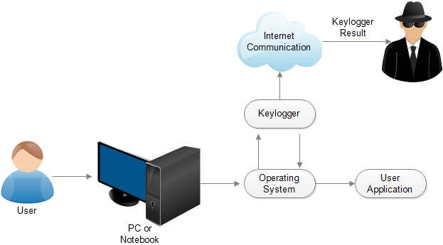
Modeling:
Modeling a keylogger involves designing its architecture to include key components such as keystroke capturing, secure data storage, encryption, and an administrative interface. The keystroke capturing component uses platform-specific hooks (e.g., Windows API, Quartz Event Services for macOS) to intercept keystrokes. The captured data is encrypted using strong encryption (e.g., AES-256) and stored securely. The keylogger runs discreetly in the background to minimize system impact. An administrative interface allows for configuration and monitoring, ensuring the tool operates within ethical and legal boundaries.

Slide 7
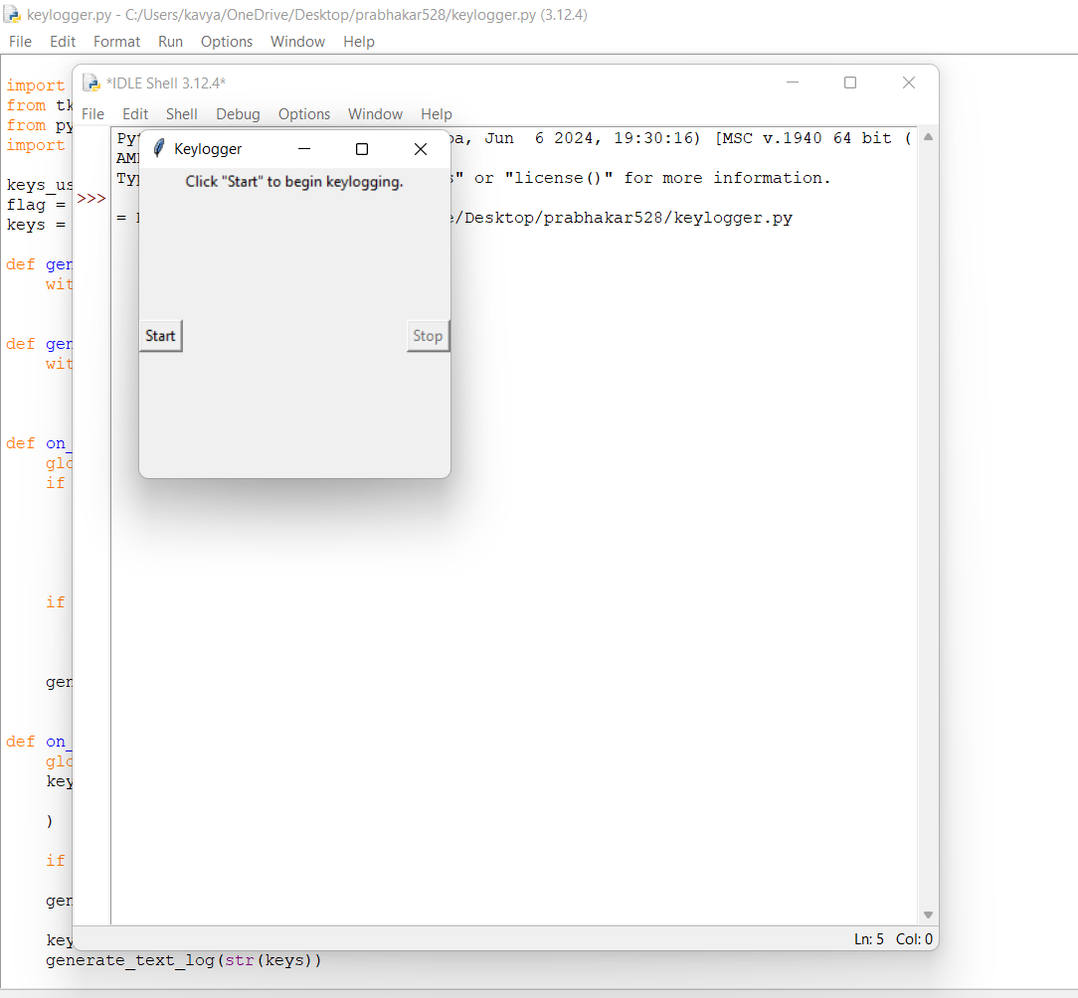
RESULT:

