Slide 1

Welcome to VS Code! 🚀
Learn to Code Like a Pro!
A beginner's guide to setting up VS Code for Python on Windows

Slide 2
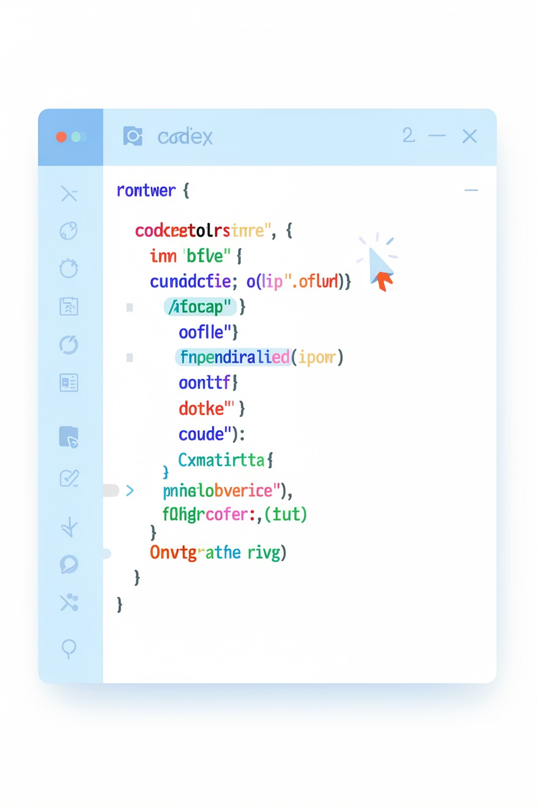
What is VS Code? 💻
VS Code is a code editor
It's like a special notebook for programmers
You write code here, and the computer reads it
It helps you write Python code in a clean, organized way
Many professional programmers use it!

Slide 3

Step 1: Download VS Code 📥
Open Website
Find Download Button
Click to Download
Follow these simple steps to get VS Code on your system:
Go to: https://code.visualstudio.com/
Look for the big blue button that says "Download for Windows"
Click it!
The file will start downloading to your computer

Slide 4
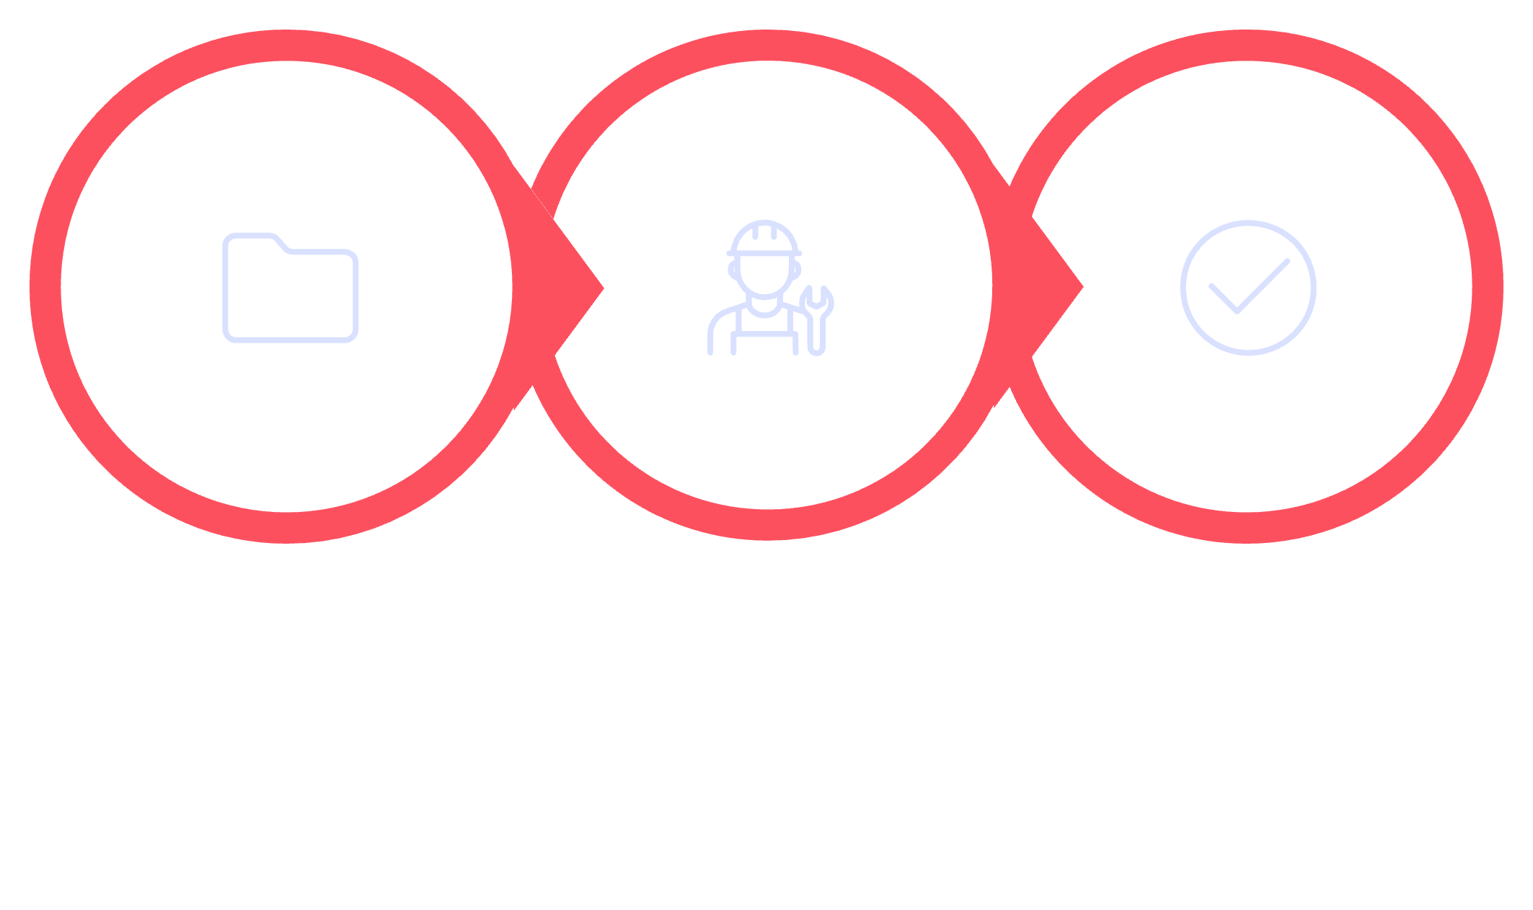
Step 2: Install VS Code 🔧
Find File
Run Installer
Finish Setup
Follow these steps to install VS Code:
Find the downloaded file (usually in your Downloads folder)
Double-click it to open the installer
Click "Next" to continue
Click "Install" when asked
Wait for it to finish!
Important checkboxes to check:
✓ Add to PATH (helps you use VS Code from anywhere)
✓ Add "Open with Code" (lets you right-click files to open them in VS Code)

Slide 5
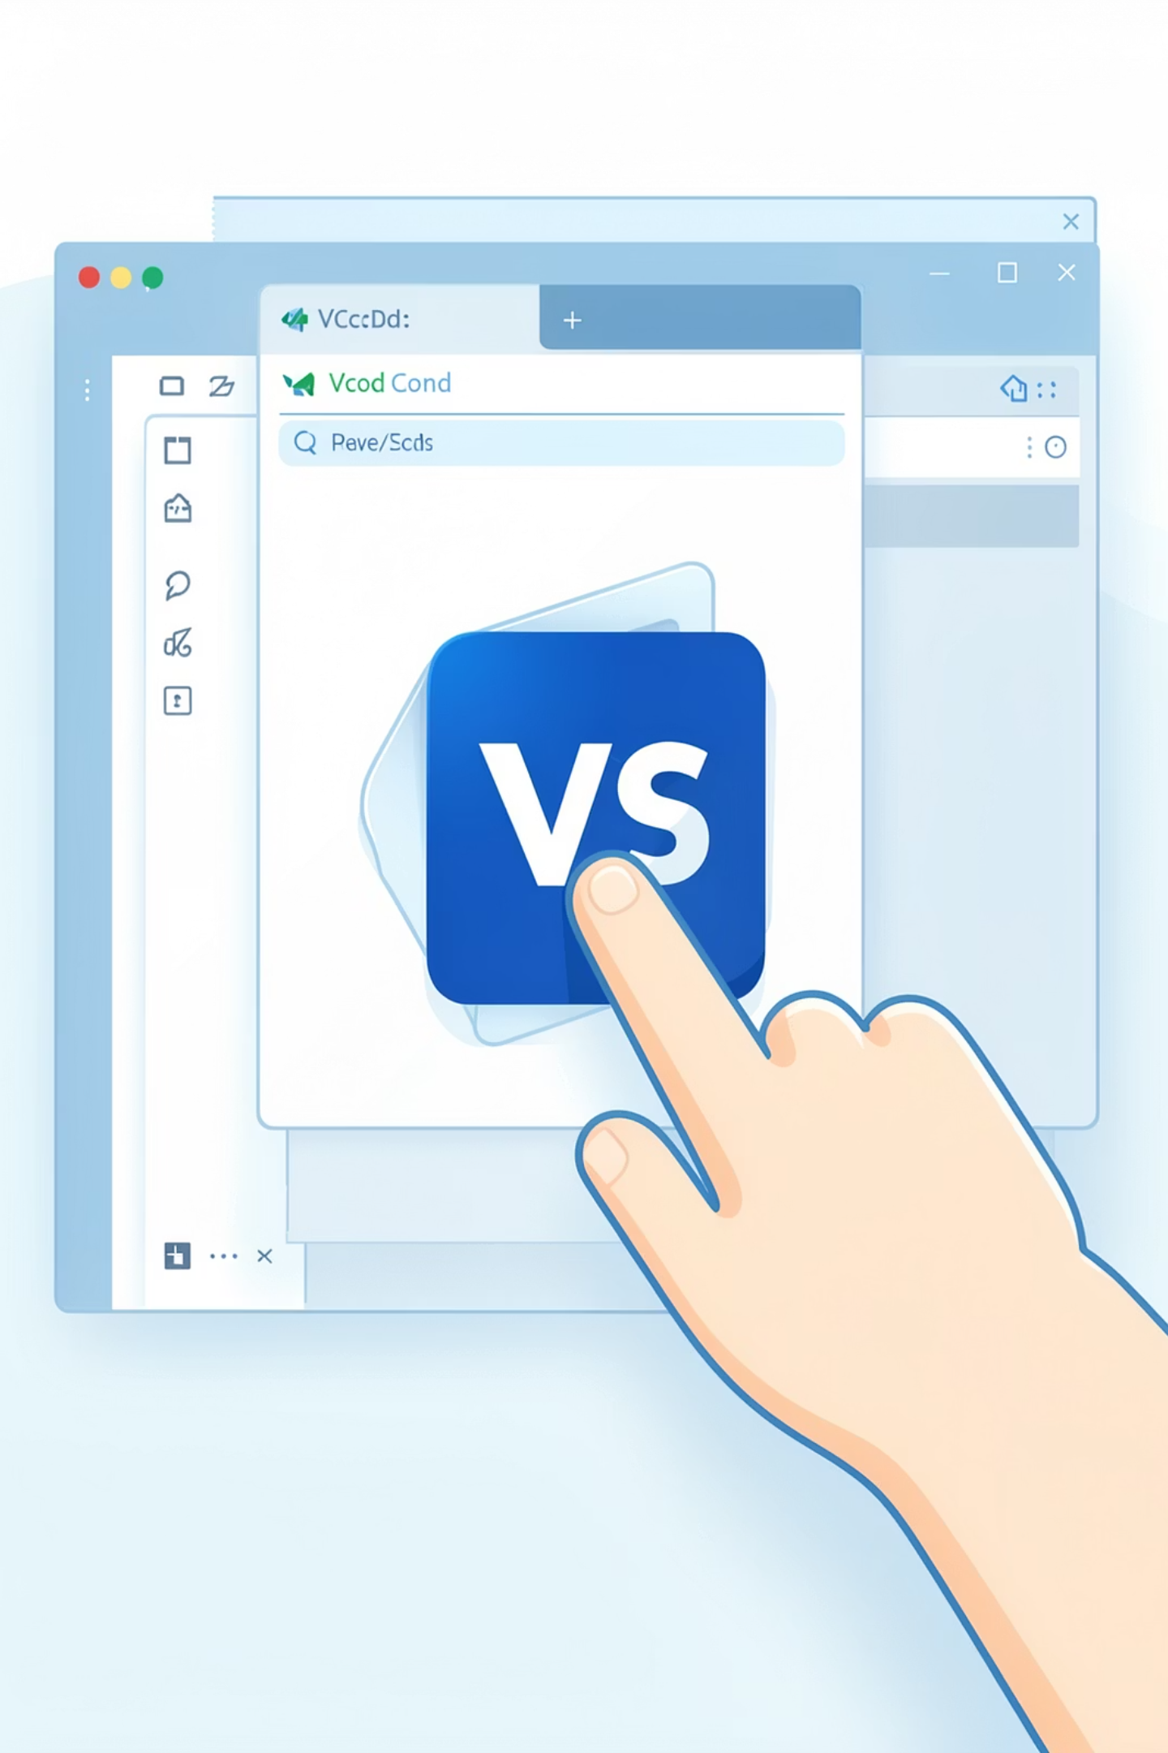
Step 3: Open VS Code 🎉
Installation is complete! Great job!
Look for VS Code on your desktop or in your Start menu
Double-click the VS Code icon to open it
You should see a welcome screen with lots of options
Don't worry if it looks complicated - we'll learn it step by step!

Slide 6
Step 4: Install Python Extension 🐍
Extensions are like add-ons that give VS Code special powers!
We need the Python extension to write Python code.
Look for the Extensions icon on the left side (it looks like 4 squares)
Click it to open the Extensions tab
Type "Python" in the search box
Find the one made by Microsoft (it will have a blue checkmark)
Click "Install"
Wait for it to finish!

Slide 7
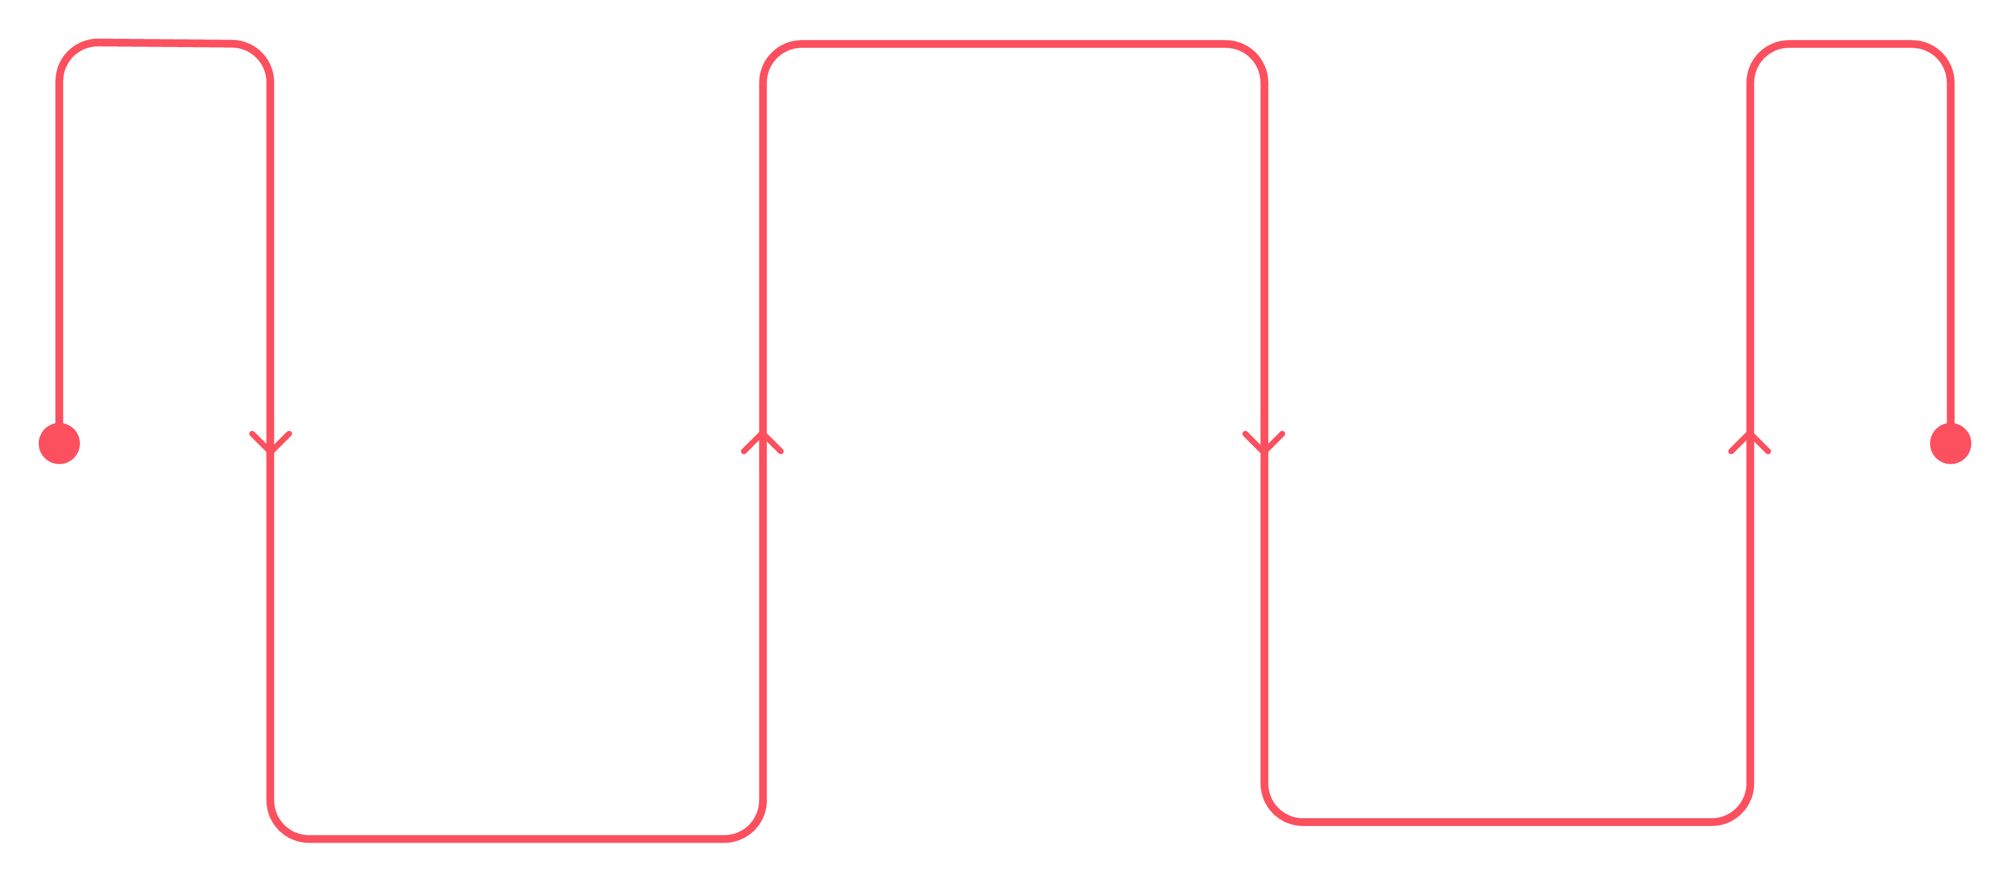
Step 5: Create Your First Python File 📝
Select New File
Create a blank file
Save as hello.py
Click File
Type name and press Enter
Open the top menu
Now we're ready to write code!
Click "File" in the top menu
Click "New File"
A blank file will appear
Save it with a Python name: type "hello.py"
The ".py" tells VS Code it's a Python file
Press Enter to save it

Slide 8
Step 6: Write Your First Program! 💻
Now type this code in your hello.py file:
print("Hello from VS Code!")
This code tells the computer to print (show) a message
"print" is a Python command
The message goes inside the parentheses and quotes
Don't worry about understanding everything yet - you'll learn!

Slide 9
Step 7: Run Your Code! ▶️
You've written your first program! Awesome!
Now let's run it and see what happens
Look for the "Run" button (it looks like a play button ▶️) in the top right
Click it!
You should see the message "Hello from VS Code!" appear at the bottom
Alternative way to run:
Right-click on your code
Click "Run Python File in Terminal"

Slide 10
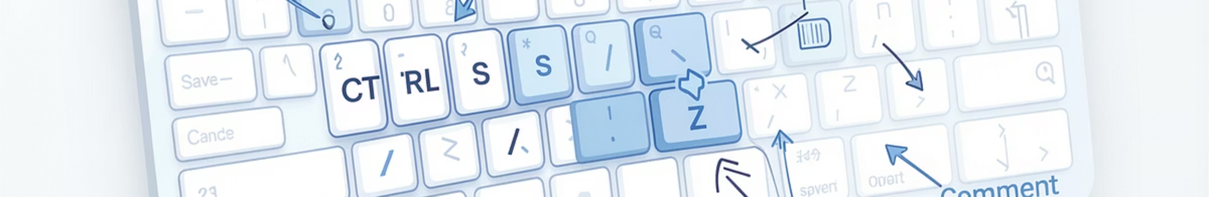
Helpful Keyboard Shortcuts ⌨️
Shortcuts make coding faster and easier!
Here are the most important ones:
Shortcut
Action
Ctrl + S
Save your file
(Always save your work!)
Ctrl + `
Open the Terminal
(The terminal is where your code runs)
Ctrl + /
Comment out code
(Useful when you want to hide code temporarily)
Ctrl + Z
Undo
(Oops! Go back to what you had before)

Slide 11

Your First Challenge! 🎯
Now it's your turn to create something!
Create a new file called "about_me.py"
Write code that prints your name and your favorite hobby
Example:
print("My name is Alex")
print("My favorite hobby is playing video games")
Save the file
Run it!
See your message appear!
You're officially a programmer! 🎉

Slide 12

What's Next? 🚀
Congratulations! You've set up VS Code and written your first Python program!
You're ready to learn more Python!
Next steps:
Learn about variables
Learn about loops
(storing information)
(repeating actions)
Learn about functions
Build fun projects!
(reusing code)
Remember:
Practice makes perfect!
Don't be afraid to make mistakes - that's how we learn!
Have fun coding! 💻

