Slide 1

Diabetic Retinopathy Diagnosis and Classification using Vision Transformer
Department of Information Technology
Team Members:
Harikanth R
Sabarinath A
Naveenkumar S
Under the Guidance of
Mrs.C.Vanaja
Assistant Professor
Information technology

Slide 2


Introduction
Diabetic Retinopathy (DR) is a serious eye disease caused by diabetes and a leading cause of vision loss worldwide. Early detection is crucial, but traditional diagnosis using fundus images is time-consuming, subjective, and dependent on expert analysis. Existing deep learning methods improve detection but still face challenges in efficiency and feature representation.
To overcome these limitations, this project uses Vision Transformer (ViT), which captures both local and global features by analyzing images as patches. The system processes retinal images and performs multi-class classification to identify different DR severity levels. This enables faster, accurate, and more reliable diagnosis, supporting better clinical decision-making.

Slide 3
DOMAIN – ARTIFICIAL INTELLIGENCE
Artificial Intelligence (AI) is a vast field focused on creating machines that can perform tasks that typically require human intelligence.
AI systems learn and improve through exposure to vast amounts of data, identifying patterns and relationships that humans may miss.
This learning process often involves algorithms, which are sets of rules or instructions that guide the AI's analysis and decision-making.

Slide 4
Deep Learning, a further specialization, utilizes artificial neural networks with multiple layers to process information, mimicking the structure and function of the human brain.
CNN (Convolutional Neural Network):A deep learning model designed to automatically extract local features from images using convolutional layers, widely used in image classification and detection tasks.
ViT (Vision Transformer): A deep learning model that uses self-attention mechanisms to capture global image relationships, offering better scalability and interpretability than CNNs, especially with large datasets.

Slide 5
Problem statement
Diabetic Retinopathy (DR) is a leading cause of vision loss, and early detection is crucial for timely treatment and prevention of blindness. Existing machine learning and deep learning approaches have improved diagnosis, but they often lack interpretability and fail to capture complex patterns in retinal images. Additionally, many models are limited in their ability to represent both local and global features effectively.
Most traditional systems focus on binary or single-stage classification, which is insufficient for identifying multiple severity levels of DR. This limitation reduces their clinical usefulness in real-world diagnosis and treatment planning. Therefore, there is a need for an advanced, explainable, and efficient model that supports multi-class classification and provides better insights into the decision-making process.

Slide 6

LITERATURE SURVEY
SI.NO | TITLE | AUTHOR | YEAR | METHODS USED | ADVANTAGE | DISADVANTAGE
1. | Developing a Transparent Diagnosis Model for Diabetic Retinopathy Using Explainable AI | Tariq Shahzad et al. | 2024 | CNN, Explainable AI (XAI) | Improved interpretability and accuracy | Complex symptom handling, model opacity previously
2. | Advancing diabetic retinopathy diagnosis with fundus imaging | S. Prathibha, Siddappaji | 2024 | Deep Learning, Ensemble Learning | Holistic CAD solution, multi-trait analysis | Limited generalizability, multiple CAD stages needed.
3. | Application of AI for Classification, Segmentation, Early Detection, Early Diagnosis, and Grading of DR | G. Rajarajeshwari, G. Chemmalar Selvi | 2024 | ML, DL, XAI, Transfer Learning | Covers full DR pipeline, XAI support | Challenges in input modality and fusion.

Slide 7
Sl.NO | TITLE | AUTHOR | YEAR | METHODS USED | ADVANTAGE | DISADVANTAGE
4. | Deep Learning in Automatic DR Detection and Grading Systems | Israa Y. Abushawish et | 2024 | CNNs, Transfer Learning, Grad-CAM | Strong model benchmarking, interpretability | Black-box issue, real-time limitations
5. | Deep Diabetic: An Identification System of Diabetic Eye Diseases | Arwa Albelaihi, Dina M. Ibrahim | 2024 | EfficientNetB0, VGG16, ResNet152V2 + GRU/Bi-GRU | Multi-class eye disease classification | Limited dataset size, resource-heavy
6. | Diabetic Retinopathy Classification With DL via Fundus Images | Shanshan Zhu et al. | 2024 | CNNs (ResNet, VGG), Transfer Learning | Detailed trends and DL strategies | Still lacks full clinical integration
7. | Diagnosis of DR Using Deep Neural Networks | Zhentao Gao et al. | 2018 | Deep CNN | Cloud deployment, good consistency with experts | Older model, 88.72% accuracy only

Slide 8
Sl.NO | TITLE | AUTHOR | YEAR | METHODS USED | ADVANTAGE | DISADVANTAGE
8. | Enhancing Early Detection of DR Through DL and XAI | Kazi A. Alavee et al. | 2024 | CNN, Xception, ResNet50, VGG19, Grad-CAM | 95.27% accuracy, XAI integration | Manual screening still required for subtle features
9. | Optical imaging for DR diagnosis using ensemble models | S. Pavithra et al. | 2024 | VGG19, ResNet50, InceptionV3, CNN ensemble | Fine and multi-scale feature extraction | Early-stage detection still challenging
10. | Hybrid approach for DR detection | Uzair Ishtiaq et al. | 2023 | GraphNet124, ResNet50, LBP | High accuracy (98.85%) | Complex feature optimization

Slide 9
Existing System
The existing system in the base paper employs:
A Convolutional Neural Network (CNN) to classify diabetic retinopathy stages from retinal fundus images.
Integration of Explainable AI (XAI) tools like Grad-CAM to visualize model decisions and improve trust.
Achieved a diagnostic accuracy of 94%, outperforming some traditional and deep learning approaches.
Aimed to bridge the gap between automation and clinical acceptance through transparency in predictions.

Slide 10
Limitations of existing solution
Local Feature Focus: CNNs mainly capture local patterns, missing long-range relationships crucial in complex retinal images.
Interpretability Constraints: Although Grad-CAM adds interpretability, it is still post hoc and does not explain all internal decision logic.
Generalization Issues: CNN models often struggle to generalize across diverse datasets due to sensitivity to image noise and variations.
Model Complexity: Deep CNNs may require extensive tuning and resources while still acting as black-box systems to some extent.
Training Limitations: CNNs can be prone to overfitting on small datasets and may not scale efficiently with large, high-resolution fundus images.

Slide 11
Proposed System
To overcome the limitations of the existing CNN-based solution, the proposed system introduces the Vision Transformer (ViT) architecture in place of traditional convolutional neural networks for the task of diabetic retinopathy diagnosis.
ViT uses self-attention to capture long-range dependencies in fundus images, unlike CNNs which focus on local features.
ViT provides native attention maps that make the model's decision-making process more transparent and explainable to clinicians.
Improved Diagnostic Accuracy
Scalability and Robustness
Enhanced Clinical Trust

Slide 12
Modules
Module 1: Input and Preprocessing
Module 2: Patch embedding
Module 3: Vision Transformer Processing
Module 4: Classification & Diagnosis
Module 5: Explainability and Output

Slide 13
Modules
Module 1: Input & Preprocessing
Retinal fundus images are collected from medical datasets or hospitals.
Images are resized to maintain uniform shape and clarity.
Noise, blur, and unwanted parts are reduced for better visibility.
Adjustments like brightness, contrast, and sharpness are applied.
The cleaned and standardized images are prepared for the next step.

Slide 14
Modules
Module 2: Patch Embedding
Each image is divided into smaller, equal-sized patches.
Patches are flattened into numerical values for computer understanding.
Extra information is added to remember each patch’s position.
All patches are arranged in a sequence like words in a sentence.
This sequence becomes the input for the Vision Transformer.

Slide 15
Modules
Module 3: Vision Transformer (ViT) Processing
The model analyzes the patch sequence using self-attention.
Relationships between different image regions are identified.
Both overall (global) patterns and local details are learned.
Multiple layers refine and improve the feature extraction.
A complete feature representation of the image is produced.

Slide 16
Modules
Module 4: Classification & Diagnosis
Extracted features are passed into a classifier layer.
The model predicts the severity of DR into five levels: No DR, Mild, Moderate, Severe, and Proliferative.
For quick screening, it can also predict simply as DR or No DR.
Performance is measured using accuracy, sensitivity, and specificity.
Final diagnosis results are generated based on the predictions.

Slide 17
Modules
Module 5: Explainability & Output
The system highlights the specific regions used for diagnosis.
Heatmaps or attention maps are generated for better clarity.
Doctors and users can visually verify the prediction results.
Final diagnosis and visualization are displayed as output.
This increases reliability and trust for clinical usage.

Slide 18
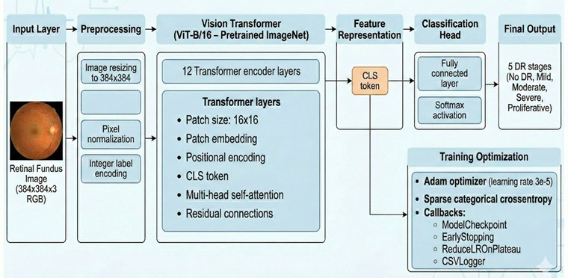
Architecture
Retinal fundus images spanning all diabetic retinopathy stages are collected from benchmark datasets.
These images are cleansed, normalized, and resized to ensure quality and consistency for the model.
The Vision Transformer learns both local and global retinal features via self-attention, improving representation.
The model is trained and fine-tuned using key hyperparameters to maximize classification accuracy.

Slide 19
Parameters
Patch Embeddings
The input retinal image is divided into fixed-size patches (e.g., 16×16), which are converted into vector representations. These embeddings act as the fundamental input features that the model learns from.
Global Context Understanding
ViT captures relationships between distant regions of the image using self-attention. This helps in identifying DR patterns spread across the entire retina.
Local Feature Representation
Each patch helps the model learn fine-grained details such as lesions, exudates, and hemorrhages. These local features are crucial for detecting early-stage abnormalities.
Attention Weights (Feature Importance)
The model assigns importance scores to different image patches during processing. This highlights critical regions and improves interpretability of the diagnosis.

Slide 20
Metrics
Accuracy
Measures the overall percentage of correctly classified retinal images. It provides a general idea of model performance but may be misleading for imbalanced datasets.
F1-Score
The harmonic mean of precision and recall, balancing false positives and false negatives. It is especially important for medical datasets where class imbalance exists.
Sensitivity (Recall)
Measures the model’s ability to correctly identify actual DR cases. High sensitivity is critical to ensure that affected patients are not missed.
Support
Represents the number of actual instances of each class present in the dataset. It helps in understanding class distribution and evaluating model performance across different categories.

Slide 21
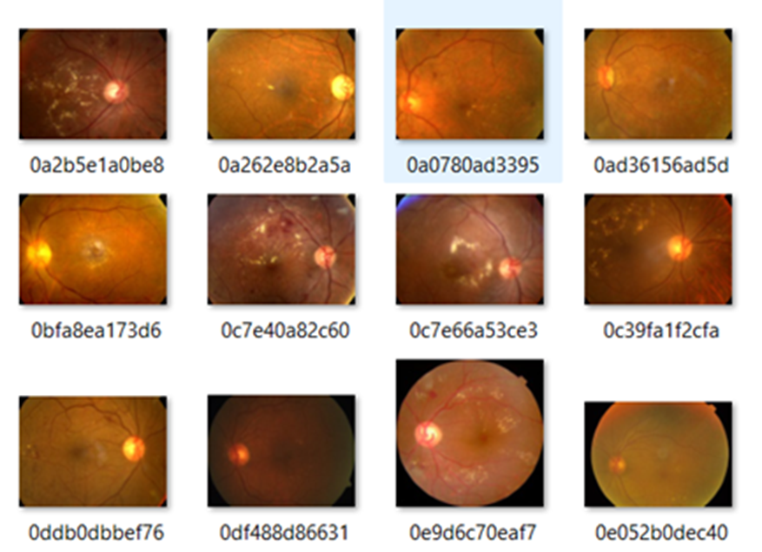
Implementation

Slide 22
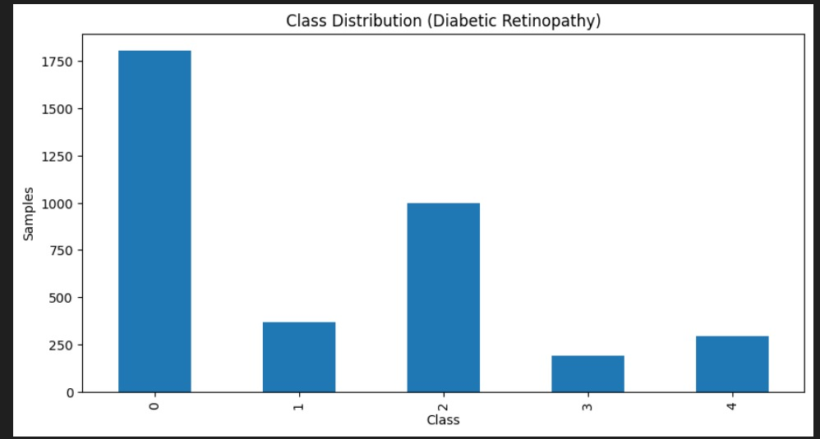
Implementation

Slide 23
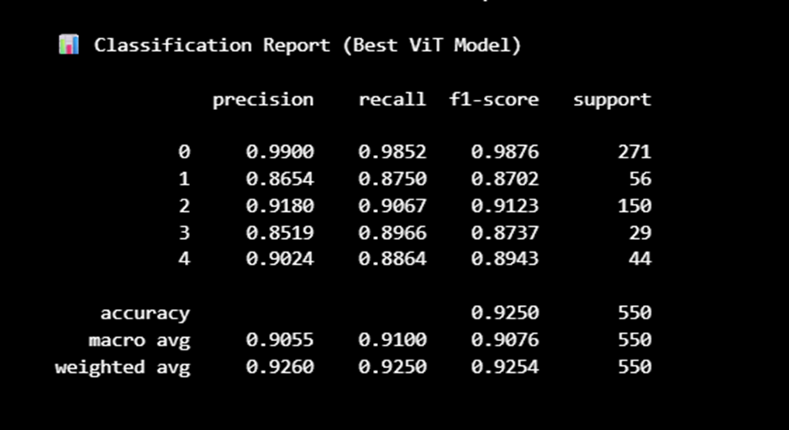
Implementation

Slide 24
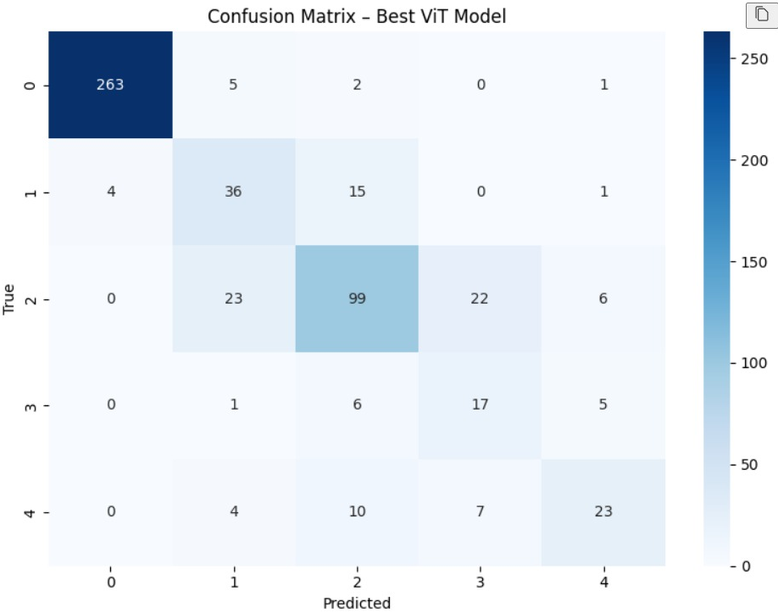
Implementation

Slide 25
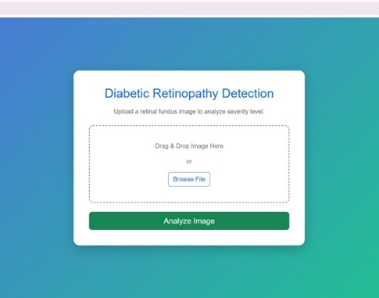
Implementation

Slide 26
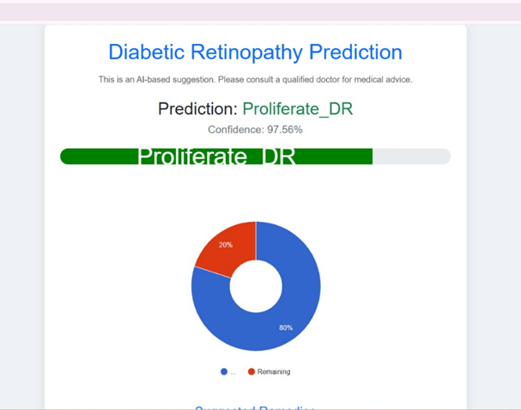
Implementation

Slide 27
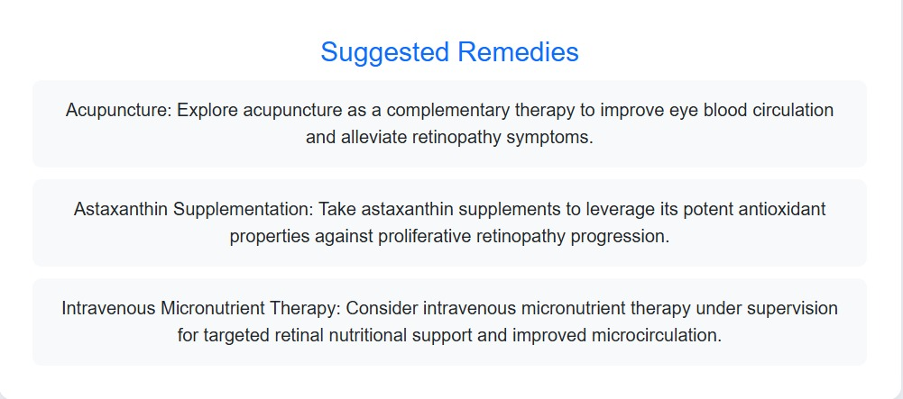
Implementation

Slide 28
System Requirements
Modern Web Browser – Chrome/Edge/Firefox with latest updates.
Stable Internet Connection – Minimum 10 Mbps for smooth cloud integration.
Backend Framework – Python with Flask/Django or Node.js for server-side processing.
Frontend Framework – React.js or Angular for interactive user interface.
Deep Learning Support – PyTorch/TensorFlow with ViT models via Timm library.
Database System – MySQL or MongoDB to manage user data, logs, and results.

Slide 29
Conclusion
This project presents an efficient and explainable approach for Diabetic Retinopathy (DR) detection using Vision Transformer (ViT). By capturing both local and global features, the model overcomes limitations of traditional methods and enables accurate multi-class classification of DR severity levels.
The system improves diagnostic performance while providing better interpretability through attention mechanisms. Overall, it offers a reliable and scalable solution that can support clinicians in early detection and informed decision-making, ultimately helping to prevent vision loss.

Slide 30
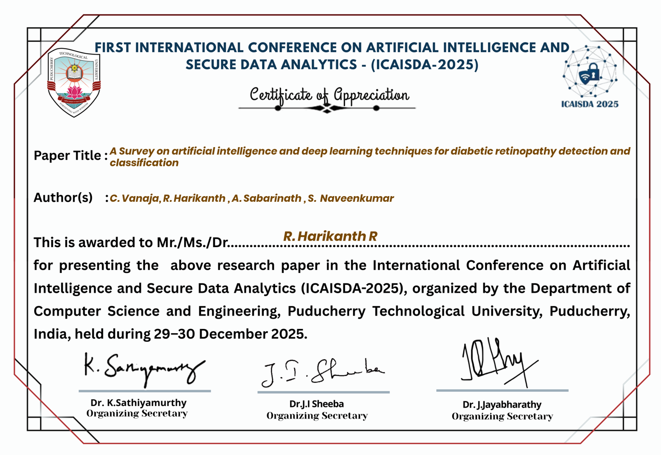
Publication Status
Title: A survey on artificial intelligence and deep learning techniques for diabetic retinopathy detection and classification
Authors Name: Mrs.C.Vanaja, Harikanth R, Sabarinath A, Naveenkumar S Conference
Name: International Conference on Artificial Intelligence and Secure Data Analytics (ICAISDA-2025) Organized by: Pondicherry Techniacal University
Current Status: Paper accepted

Slide 31
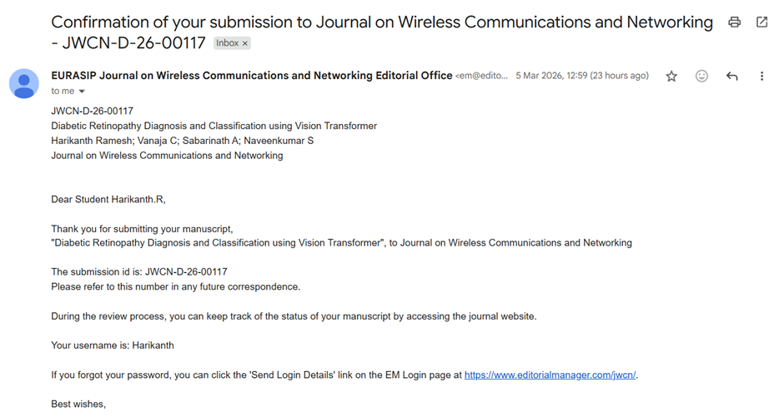
Publication Status
Title: Diabetic Retinopathy Diagnosis and Classification using Vision Transformer
Authors Name: Mrs.C.Vanaja, Harikanth R, Sabarinath A, Naveenkumar S Conference
Name: EURASIP Journal on Wireless Communications and Networking Editorial Office
Current Status: Paper submitted, Not yet accepted

Slide 32
References
[1] Shahzad, Tariq, Muhammad Saleem, Muhammad Sajid Farooq, Sagheer Abbas, Muhammad Adnan Khan, and Khmaies Ouahada. "Developing a transparent diagnosis model for diabetic retinopathy using explainable AI." IEEE Access (2024).
[2] Zhu, Shanshan, Changchun Xiong, Qingshan Zhong, and Yudong Yao. "Diabetic retinopathy classification with deep learning via fundus images: A short survey." IEEE Access 12 (2024): 20540-20558.
[3] Pavithra, S., Deepika Jaladi, and K. Tamilarasi. "Optical imaging for diabetic retinopathy diagnosis and detection using ensemble models." Photodiagnosis and Photodynamic Therapy 48 (2024): 104259.
[4] Alavee, Kazi Ahnaf, Mehedi Hasan, Abu Hasnayen Zillanee, Moin Mostakim, Jia Uddin, Eduardo Silva Alvarado, Isabel de la Torre Diez, Imran Ashraf, and Md Abdus Samad. "Enhancing early detection of diabetic retinopathy through the integration of deep learning models and explainable artificial intelligence." IEEE Access 12 (2024): 73950-73969.
[5] Gao, Zhentao, Jie Li, Jixiang Guo, Yuanyuan Chen, Zhang Yi, and Jie Zhong. "Diagnosis of diabetic retinopathy using deep neural networks." IEEE Access 7 (2018): 3360-3370.

Slide 33
References
[6] Albelaihi, Arwa, and Dina M. Ibrahim. "DeepDiabetic: an identification system of diabetic eye diseases using deep neural networks." IEEE Access 12 (2024): 10769-10789.
[7] Abushawish, Israa Y., Sudipta Modak, Esam Abdel-Raheem, Soliman A. Mahmoud, and Abir Jaafar Hussain. "Deep learning in automatic diabetic retinopathy detection and grading systems: a comprehensive survey and comparison of methods." IEEE Access 12 (2024): 84785-84802.
[8] Nazir, Kinza, Jisoo Kim, and Yung-Cheol Byun. "Enhancing early-stage diabetic retinopathy detection using a weighted ensemble of deep neural networks." IEEE Access (2024).
[9] Wang, Xu, Weijie Wang, Huiling Ren, Xiaoying Li, and Yili Wen. "Prediction and analysis of risk factors for diabetic retinopathy based on machine learning and interpretable models." Heliyon 10, no. 9 (2024).
[10] Pratt, Harry, Frans Coenen, Deborah M. Broadbent, Simon P. Harding, and Yalin Zheng. "Convolutional neural networks for diabetic retinopathy." Procedia computer science 90 (2016): 200-205.

Slide 34
References
[11] Rajarajeshwari, G., and G. Chemmalar Selvi. "Application of artificial intelligence for classification, segmentation, early detection, early diagnosis, and grading of diabetic retinopathy from fundus retinal images: a comprehensive review." IEEE Access (2024).
[12] Asif, Malaika, Fasih Ur Rehman, Zoya Rashid, Altaf Hussain, Alina Mirza, and Waqar Shahid Qureshi. "An Insight on the Timely Diagnosis of Diabetic Retinopathy using Traditional and AI-Driven Approaches." IEEE Access (2025)..
[13] Prathibha, S. "Advancing diabetic retinopathy diagnosis with fundus imaging: A comprehensive survey of computer-aided detection, grading and classification methods." Global Transitions 6 (2024): 93-112.
[14] Ikram, Amna, Azhar Imran, Jianqiang Li, Abdulaziz Alzubaidi, Safa Fahim, Amanullah Yasin, and Hanaa Fathi. "A systematic review on fundus image-based diabetic retinopathy detection and grading: Current status and future directions." IEEE Access (2024).
[15] Ng, Jun Chen, Pauline Shan Qing Yeoh, Li Bing, Xiang Wu, Khairunnisa Hasikin, and Khin Wee Lai. "A privacy-preserving approach using deep learning models for diabetic retinopathy diagnosis." IEEE Access (2024).

Slide 35

THANK YOU

