Slide 1
UST
Case study
GROUP 009 :- Employee HR Data Management
Harika Pudota
Vishnu Sashank
Sanjeev Gowtham
Under the Noble Guidance of
Mr. Upendar Reddy Nallori
11-06-2024

Slide 2
OVERVIEW OF PROJECT
1. Role-based access control for managers and non-managers ensures proper permissions.
2. Mandatory fields and error messages maintain data integrity and guide user actions.
3. Automated email notifications streamline communication for leave and expense requests.
4. Seamless integration with database tables facilitates accurate tracking of request statuses and employee data.
5. User-friendly interface features dropdown menus, ALV displays, and functional buttons for intuitive navigation.

Slide 3
TABLE OF CONTENTS
TABLES USED
REPORTS
FORMS
EMAIL
CDS VIEWS
CDS REPORTS
PERFORMANCE TUNING

Slide 4
TABLES USED :
ZTR_ORG_TREE: Organisation tree
ZTR_E0000 : Employee Availability data
ZTR_HR_DATA: Employee Reporting data
ZTR_EMP_EXPENSE: Employee Expense Table
ZTR_HR_LEAVE_REC: HR Leave Data
ZTR_REQ_STATUS: Resource Leave Request Exchange Table
ZTR_TIMESHEET: For Storing Employee Time Sheet Details

Slide 5
2. REPORTS
ZG09_BUSSINESS_LOGIC
ZG09_EXPENSE_REQUEST
ZG09_LEAVE_REQUEST
ZG09_ADOBE
ZG09_DRIVER_PROGRAM
ZG09_SF_PROGRAM

Slide 6
3. FORMS
SMART FORMS : ZG09_SF
ADOBE FORMS : ZG09_ADOBE_FORM_
4. EMAIL
INCLUDE ZDG09EMAIL

Slide 7
5 & 6 :- CDS VIEWS & REPORTS
ZG09_CDS_VIEW : CDS VIEW
ZG09_CDS_REPORT : CDS REPORT
7. PERFORMANCE TUNING
EPC CHECKS
ATC CHECKS

Slide 8
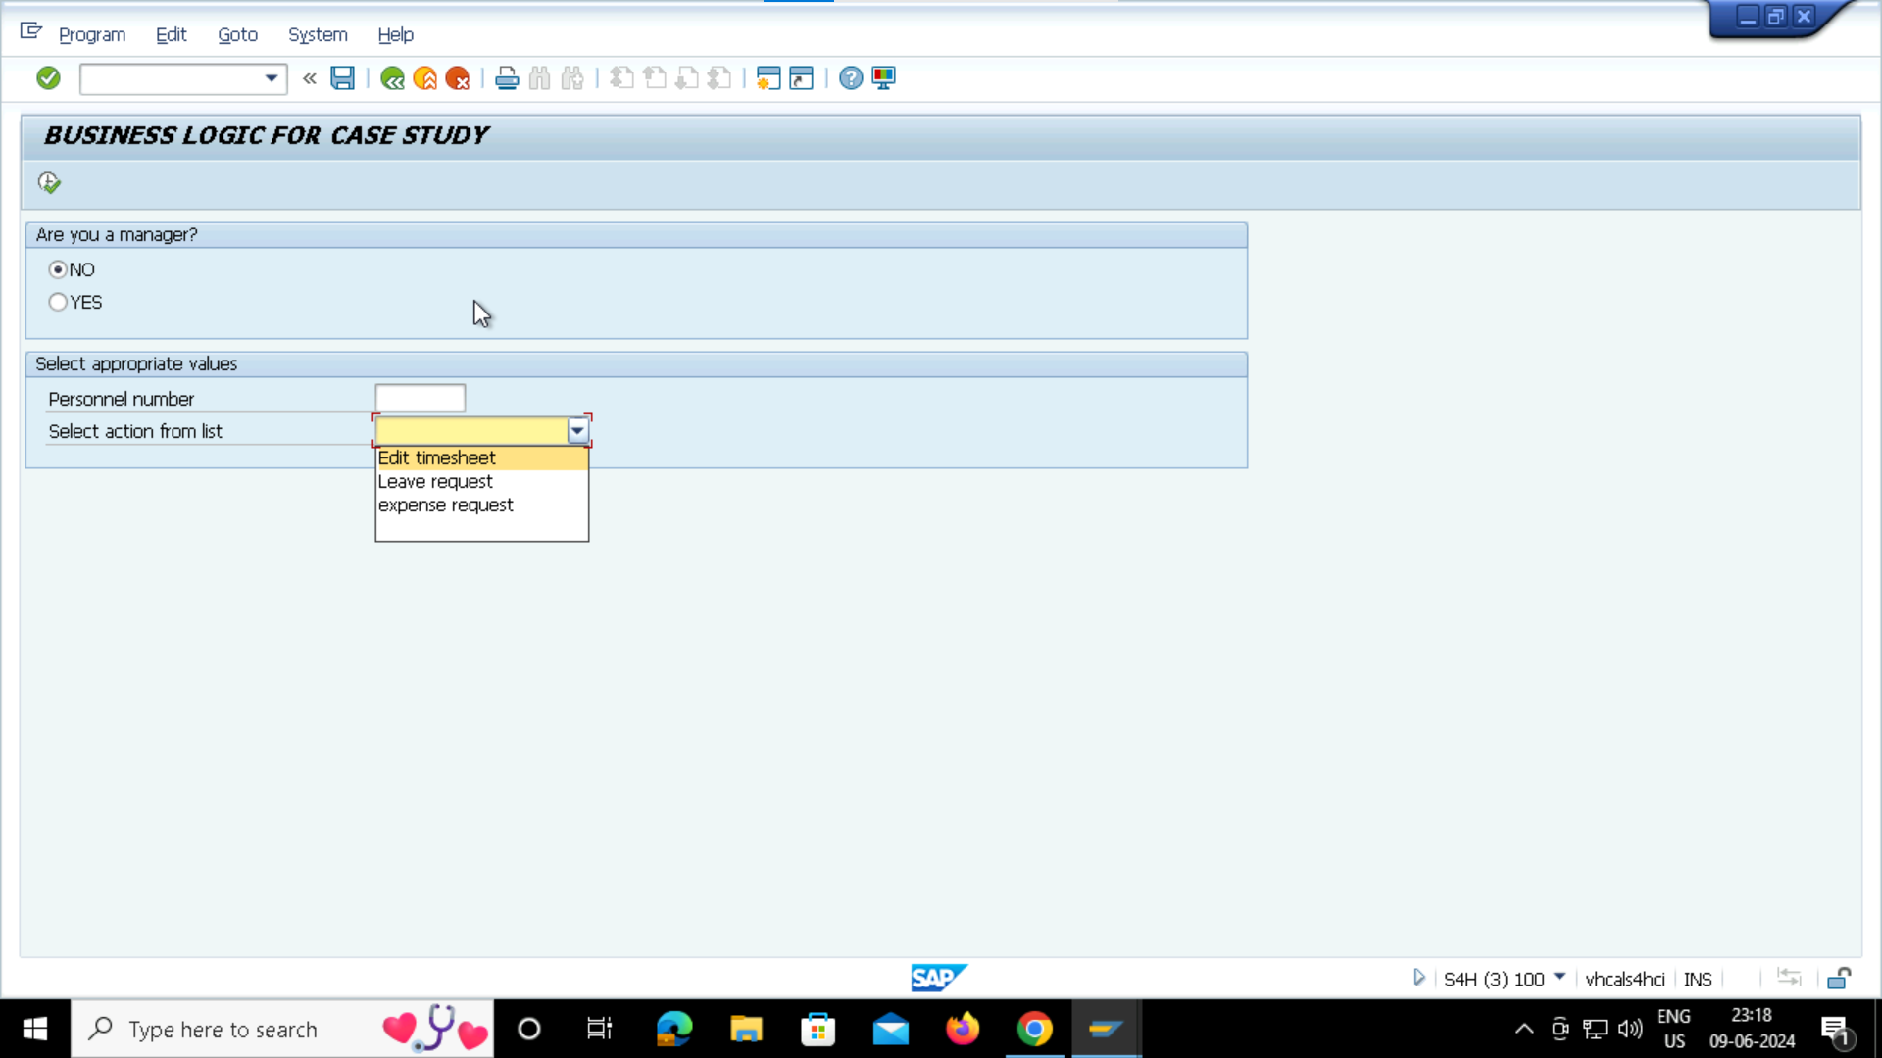
INPUT SELECTION SCREENS:

Slide 9
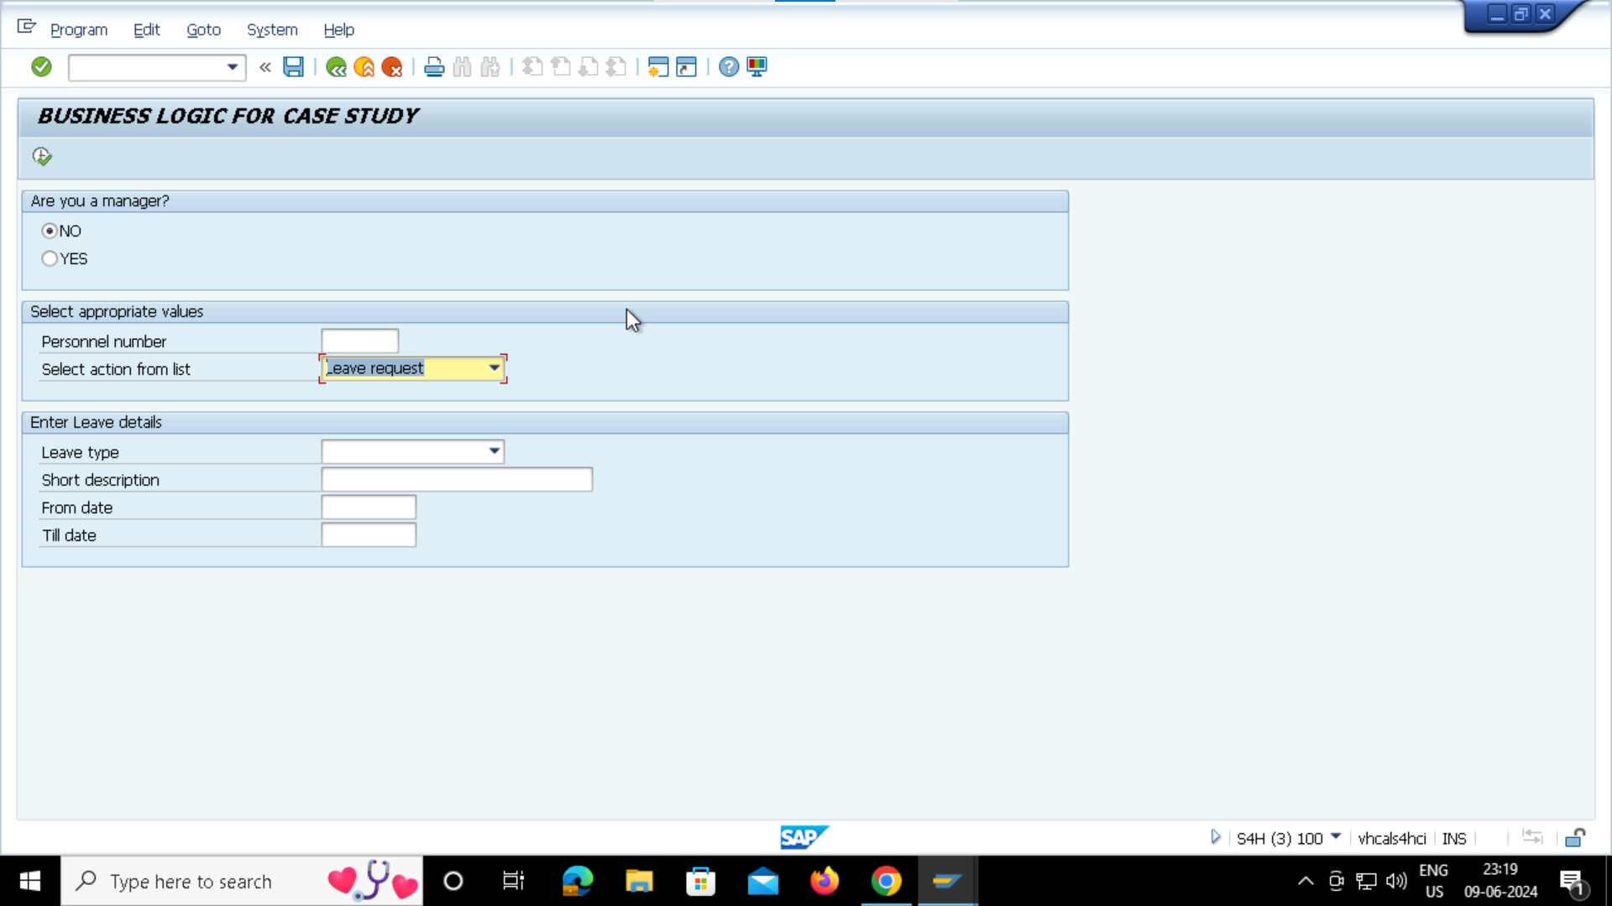
INPUT SELECTION SCREENS:

Slide 10
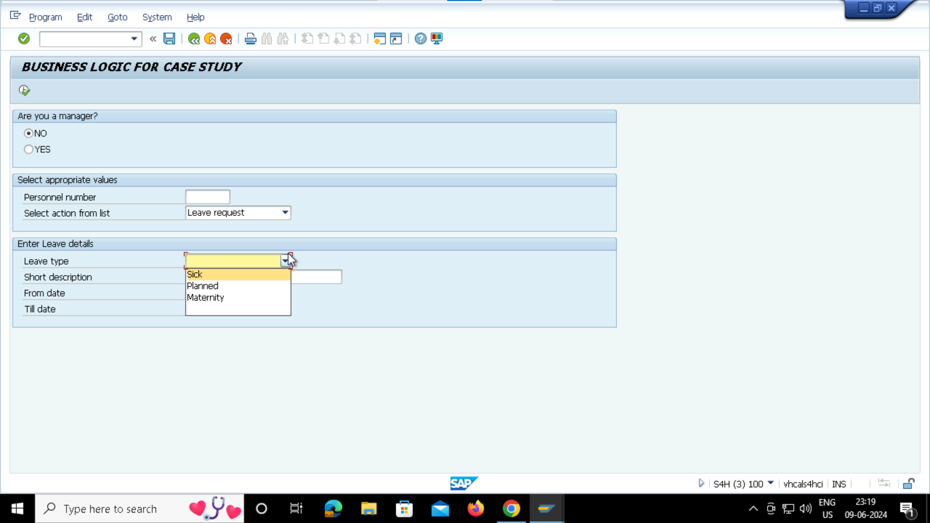
INPUT SELECTION SCREENS:

Slide 11

INPUT SELECTION SCREENS:

Slide 12
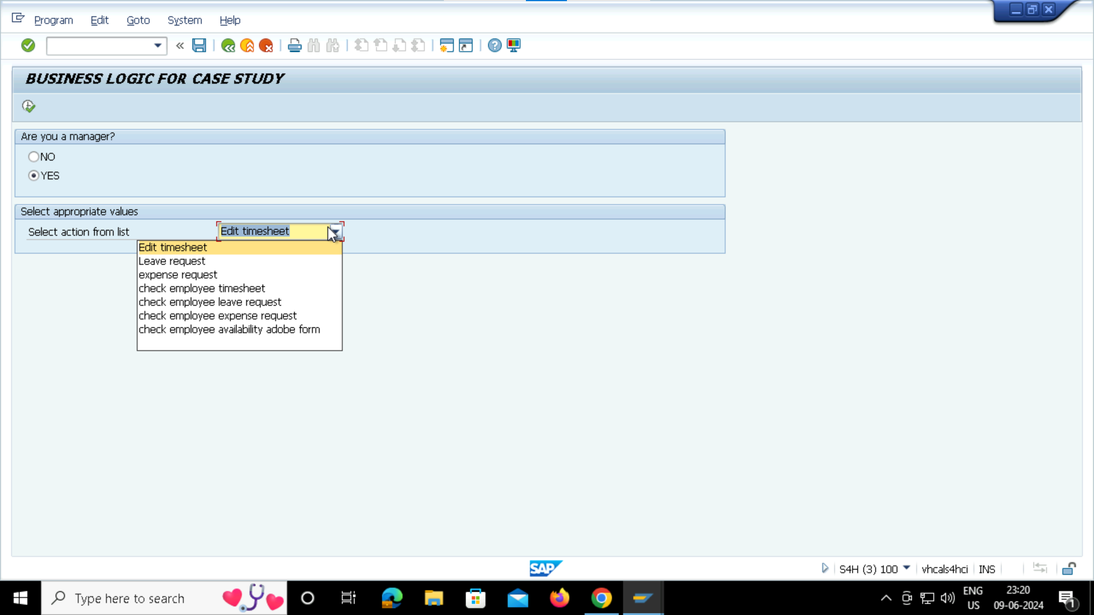
INPUT SELECTION SCREENS:

Slide 13

BUSSINESS LOGIC SELECTION SCREENS:

Slide 14
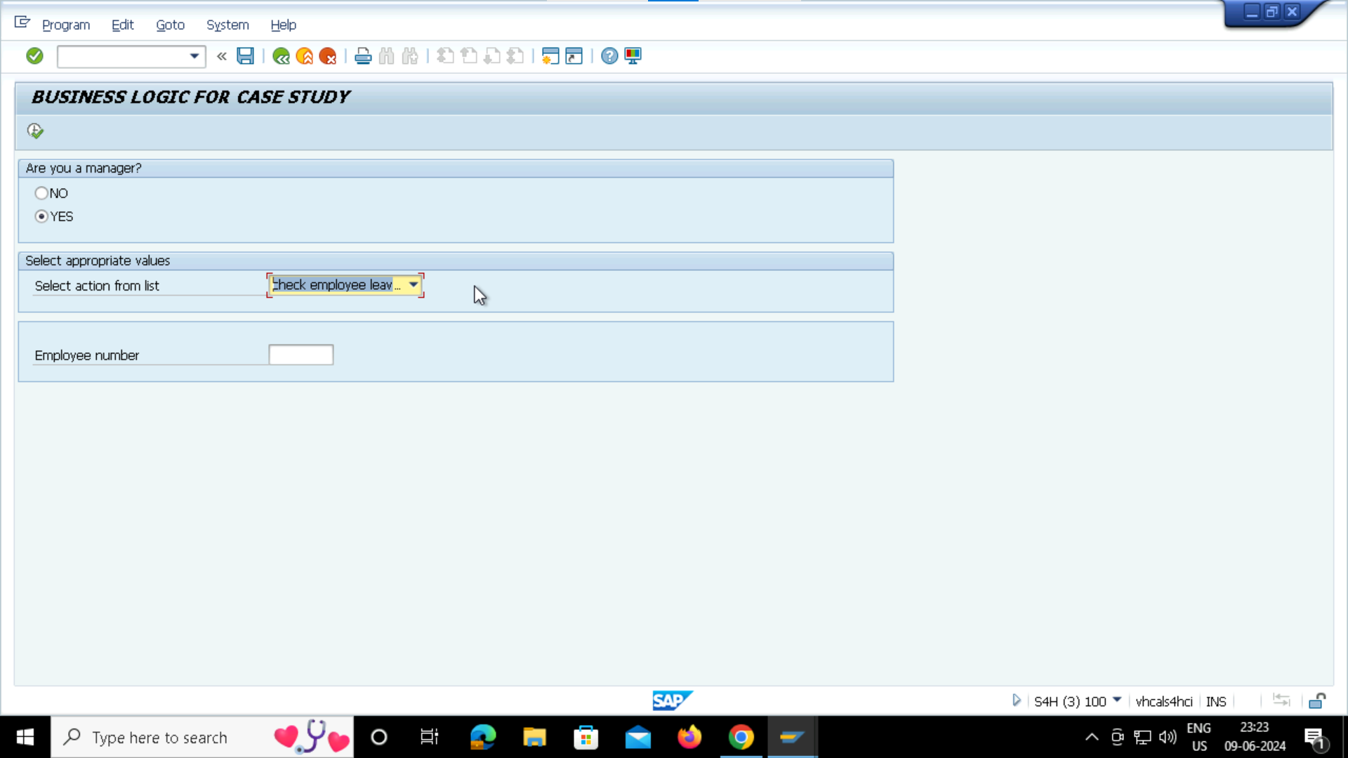
BUSSINESS LOGIC SELECTION SCREENS:

Slide 15

TYPE OF LEAVE SELECTION SCREENS:

Slide 16
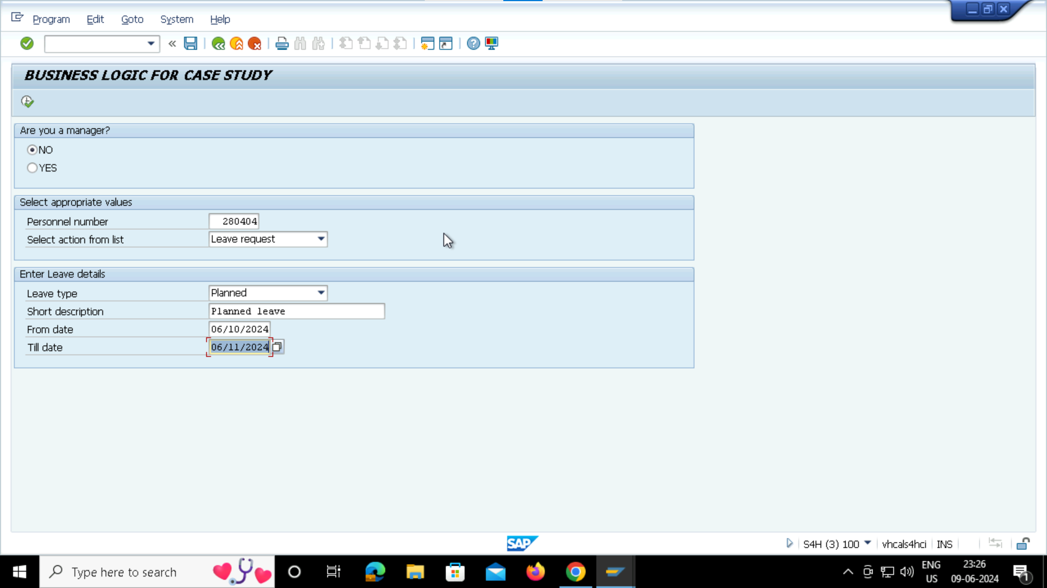
LEAVE DETAILS SCREENS:

Slide 17
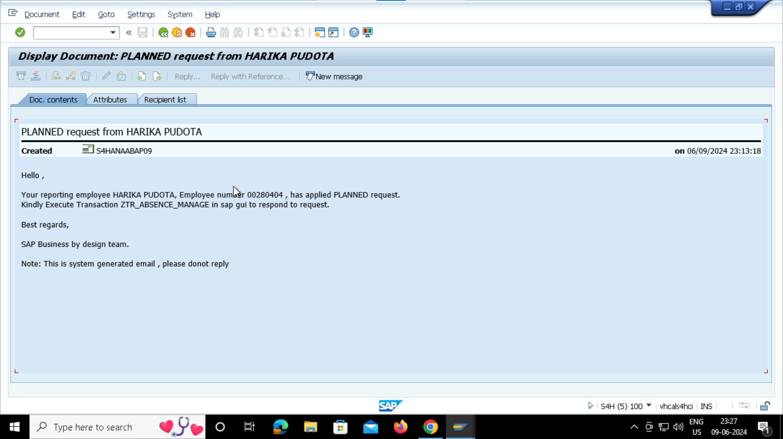
LEAVE DOCUMENT SCREEN:

Slide 18
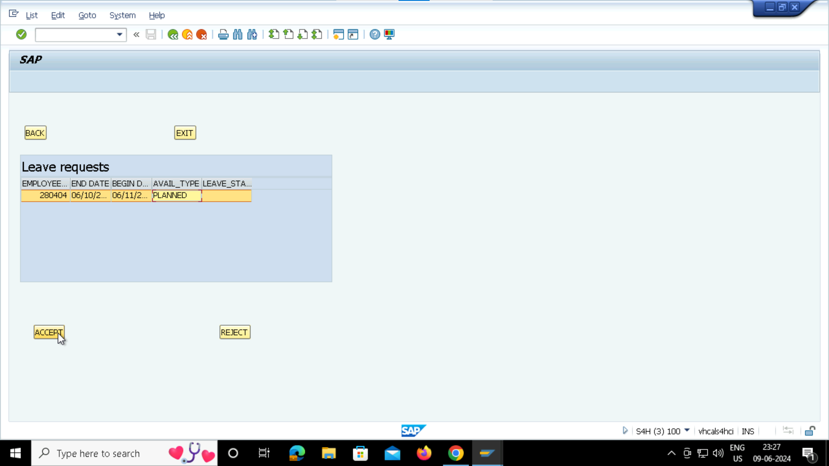
LEAVE ACCEPT/REJECT SCREEN:

Slide 19
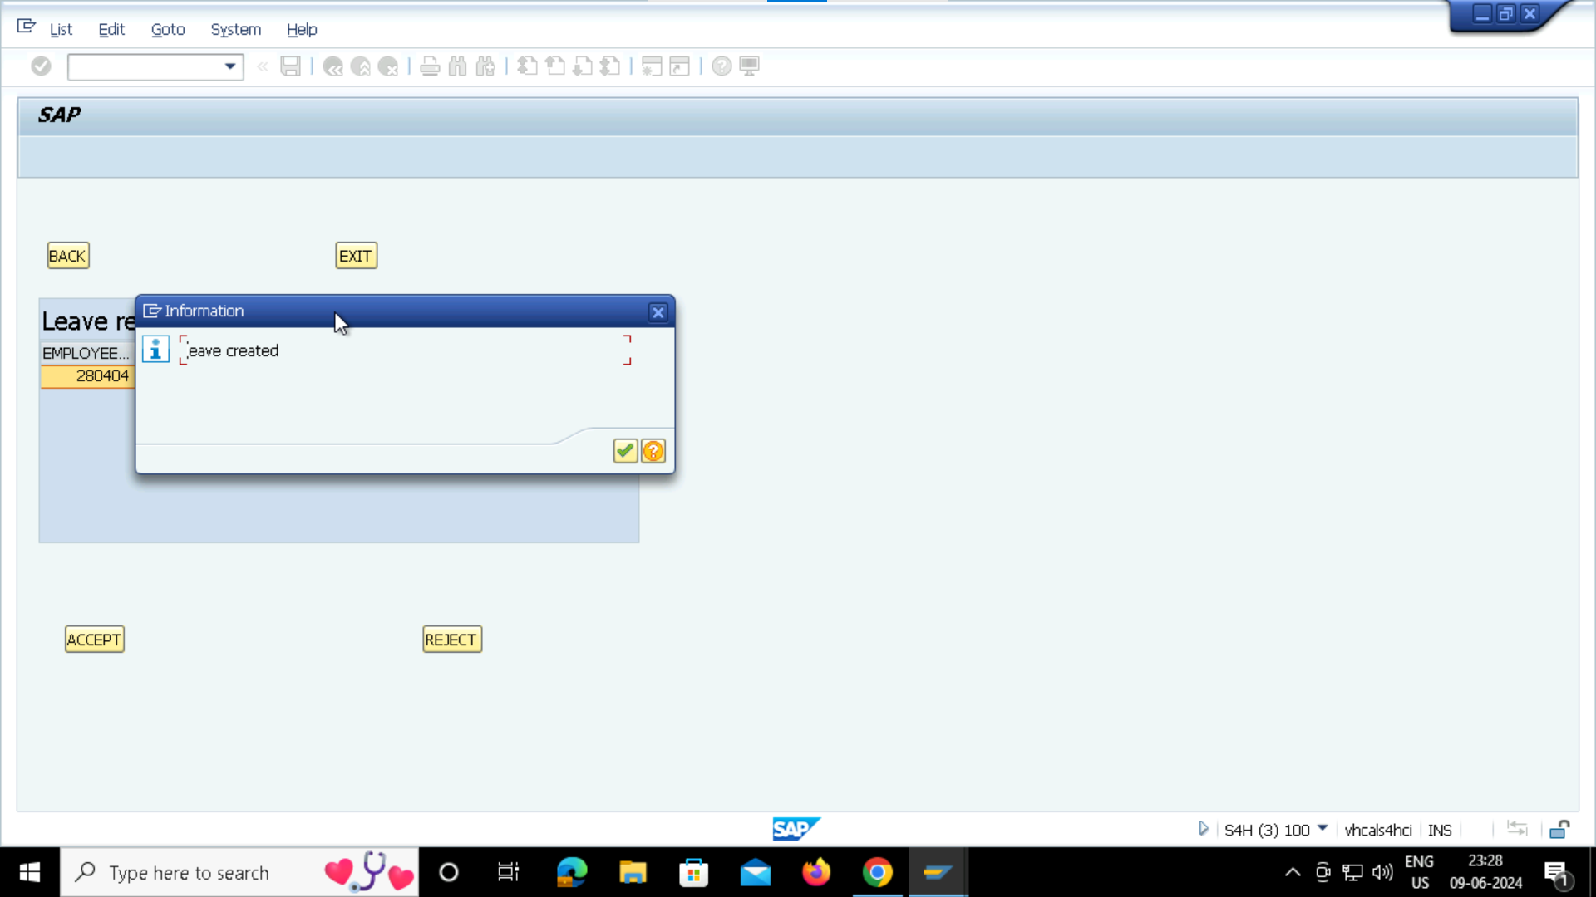
LEAVE CONFIRMATION SCREEN:

Slide 20
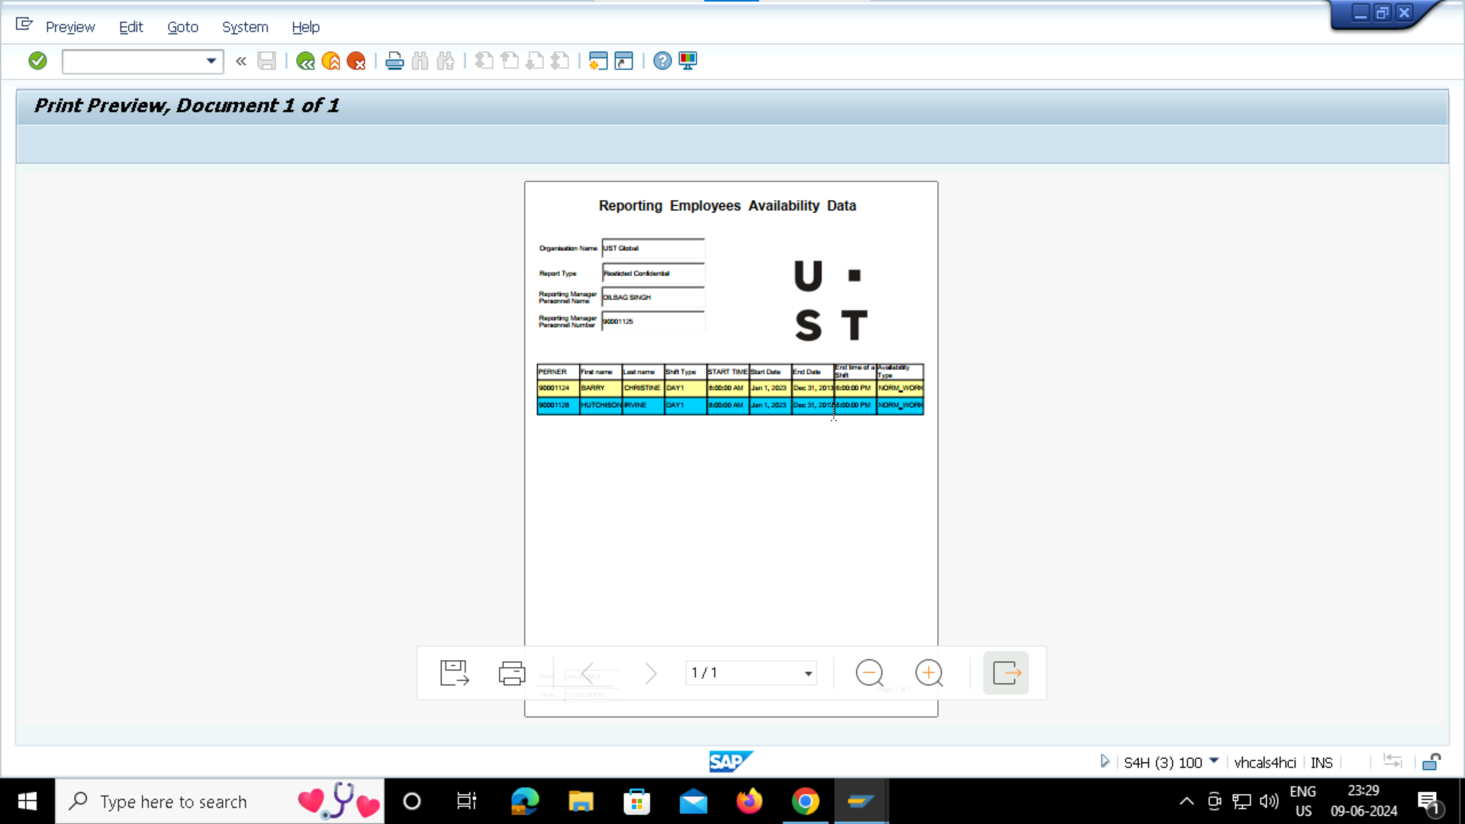
EMPLOYEE DETAILS SCREEN:

Slide 21
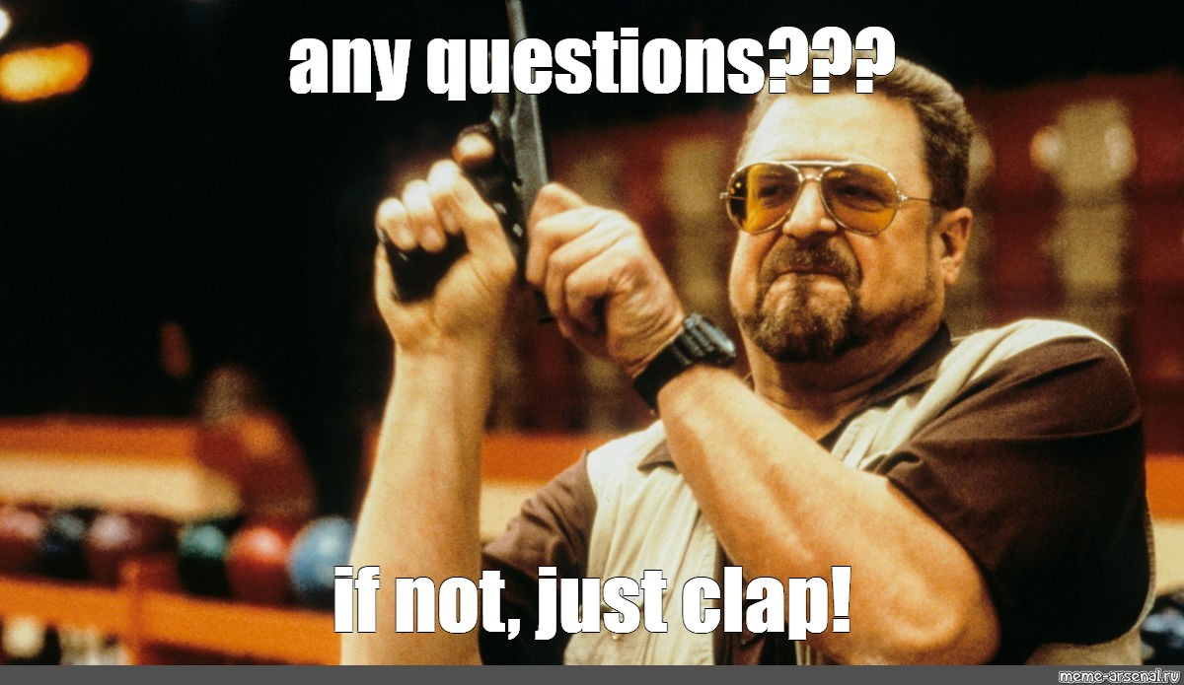

Slide 22
GROUP 009 :
Harika Pudota
Vishnu Sashank
Sanjeev Gowtham

