Slide 1
ABC Call Volume Trend Analysis
PROJECT DESCRIPTION :
This project delves into Customer Experience (CX) analytics for ABC, an insurance company, focusing on inbound calls. The dataset spans 23 days, capturing agent details, call times, durations, and statuses. The objectives include calculating average call duration per time bucket, visualizing call volume trends, and proposing manpower plans to reduce abandon rates. The challenge involves addressing night shift service gaps, optimizing agent allocation, and considering factors like working hours, leaves, and call time distribution. The ultimate goal is to enhance customer satisfaction and operational efficiency through data-driven insights and strategic planning.
APPROACH:
The project involved a systematic exploration of the dataset, application of Excel for data manipulation and analysis, and visualization tools for clear representation. Assumptions were integrated to enhance the practicality of proposed solutions, contributing to a comprehensive and actionable report for optimizing the CX team's efficiency.
Average Call Duration:
Task : What is the average duration of calls for each time bucket?
For this I have used pivot table and calculated the average duration.
Then plotted a bar chart using the pivot table.

Slide 2
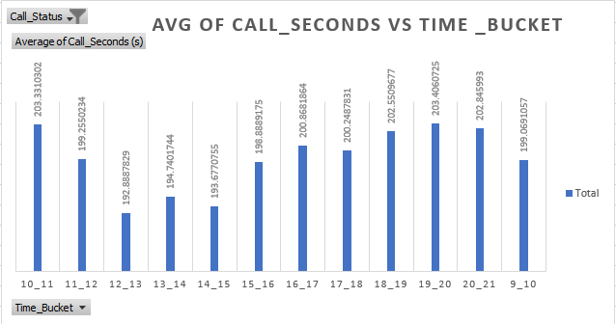
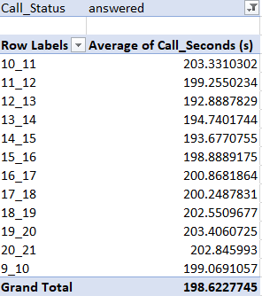
From the graph it can be incurred that, the average duration of calls made duration 7pm and 8pm highest and average duration of calls made during 12pm and 1 pm is the least

Slide 3
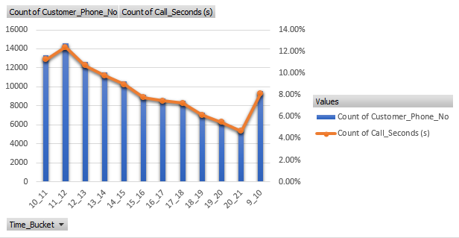
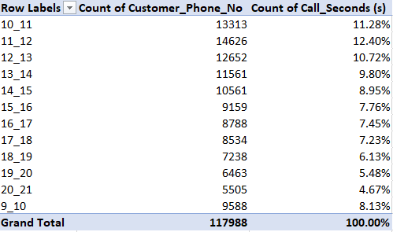
2. Call Volume Analysis:
Task : create a chart or graph that shows the number of calls received in each time bucket.
For this task I have used pivot table and calculated the count of Customer_Phone_No and Call_Seconds (as % of grand total).
Then I have plotted a combo chart using the pivot table.
From the graph it can be incurred that, most calls are made during 11am and 12pm and least calls are made during 8pm and 9pm

Slide 4



3. Manpower Planning:
Task : What is the minimum number of agents required in each time bucket to reduce the abandon rate to 10%?
Sum of Call_Seconds on 1st January and its conversion into hours:
Calculation of Working Hours:

Slide 5
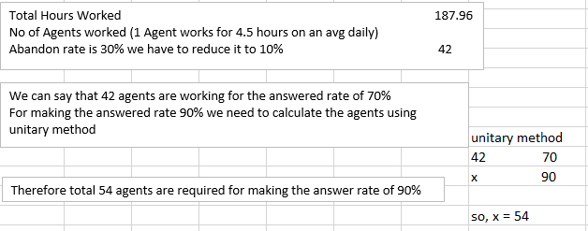
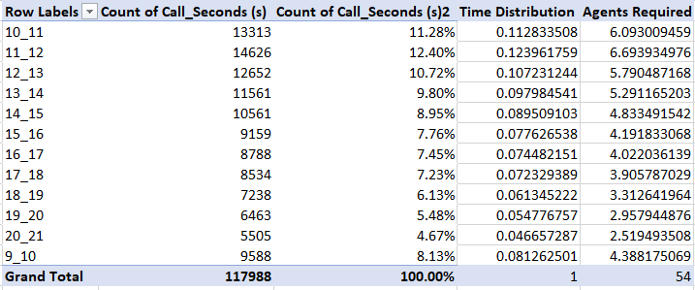
Calculation of total number of agents required for making the answer rate to 90%
Distribution of total no. of agents in each time bucket on the basis of the time distribution to make the answer rate to 90%

Slide 6
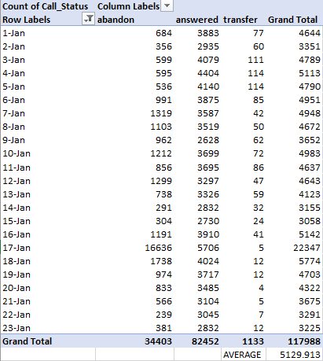
4. Night Shift Manpower Planning:
Task : Propose a manpower plan for each time bucket throughout the day, keeping the maximum abandon rate at 10%.
Overall status of all incoming calls between 1st January and 23rd January

Slide 7
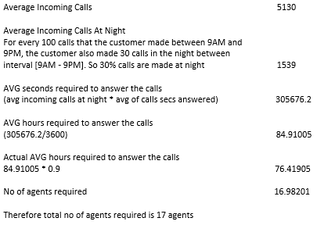
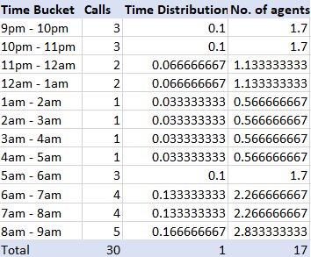
Calculation of total no. agents required for answering all the chats at night
Overall Distribution of total no. of agents (17) at night in each time bucket on the basis of time distribution

Slide 8
Tech-Stack Used:
For this project I have used Excel 2016 which is a spreadsheet application in the Microsoft Office 2016 suite. It is used for tasks like data entry, analysis, and visualization. Excel 2016 provides tools for creating tables, charts, and performing calculations. It's a widely used program for managing and analyzing data.
https://docs.google.com/spreadsheets/d/1v-1Ewp6KrDaZ4v0XIMlA4TU76sV_jhGr/edit?usp=sharing&ouid=112612761911126686527&rtpof=true&sd=true
Above is the hyperlink of the excel file that I have worked with.
Insights:
The insights and knowledge I have gained while working on this project are as follows:
Excel formulas automate calculations, saving time and reducing errors compared to manual calculations.
Excel formulas enable data analysis, summarization, and extraction of insights from large datasets.
Excel charts provide a visual representation of data, making it easier to understand and interpret complex information.
Excel charts help in identifying trends, outliers, and correlations within data, which may not be immediately apparent in raw numbers.
Result:
Through this project, I successfully conducted a comprehensive analysis of ABC's inbound call data, focusing on key aspects of Customer Experience (CX) analytics. Here are the notable achievements and contributions:
Average Call Duration:
Calculated the average duration of incoming calls for each time bucket, providing insights into peak and off-peak call durations. This information is crucial for optimizing agent scheduling and resource allocation.

Slide 9
2. Call Volume Analysis:
Developed a visually appealing chart representing the total number of calls against time, segmented into time buckets. This visualization aids in identifying patterns and trends in call volume, facilitating strategic decision-making.
3. Manpower Planning:
Proposed a detailed manpower allocation plan during each time bucket (9 am to 9 pm) to reduce the abandon rate from 30% to 10%. Calculated the minimum number of agents required in each time bucket to ensure a higher call answer rate, enhancing customer satisfaction.
4. Night Shift Manpower Planning:
Addressed the challenge of night shift calls by proposing a manpower plan throughout the day. This plan considers the distribution of 30 nightly calls for every 100 daytime calls, ensuring that the maximum abandon rate remains at 10%. This contributes to an improved customer experience by providing round-the-clock support.
Incorporated relevant assumptions, such as agent workdays, unplanned leaves, working hours, and call distribution percentages. These assumptions enhance the realism and practicality of the proposed manpower plans.
Overall, the project significantly contributed to a deeper understanding of ABC's call volume trends. The insights derived from average call durations, call volume analysis, and manpower planning are instrumental in optimizing the inbound calling team's efficiency, reducing abandon rates, and ultimately enhancing the overall customer experience. This analysis serves as a valuable guide for strategic decision-making within the CX team, aligning with the broader objectives of the organization. In conclusion, this project provided me with the practical exposure in using Formulas, Tables and Charts present in Excel.

