Slide 1
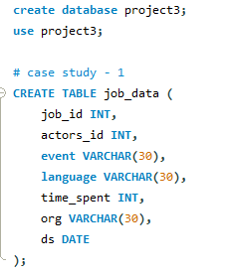
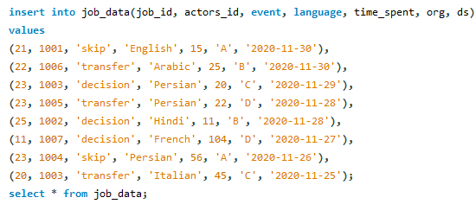
OPERATION ANALYTICS AND INVESTIGATING METRIC SPIKE
PROJECT DESCRIPTION :
Consisting of two case studies, this project involves Job Data Analysis and Investigating Metric Spike. The Job Data Analysis examines job-related data, including reviews, throughput, language distribution, and duplicate data detection. In the Investigating Metric Spike case, the focus is on user engagement, growth, retention, and email engagement analysis. SQL queries will be employed for data analysis in both cases.
APPROACH: (Case Study – 1 : Job Data Analysis)
Firstly, I have created a database named project3 in MySQL Workbench. Then created table named job_data for
Case Study - 1 with required columns and inserted the values respectively.
After the creation of tables I executed required SQL queries with respect to each task as follows:

Slide 2



JOBS REVIEWED OVER TIME:
OUTPUT:
This SQL query calculates the average number of distinct job reviews per hour in the month of November 2020. It counts the unique job IDs within the specified date range and divides this count by the total number of hours in November 2020 (30 days * 24 hours/day). The result, 'jobs_reviewed,' represents the average hourly job reviews during that month, providing insights into the review activity pattern.
THROUGHPUT ANALYSIS:
OUTPUT:
This SQL query calculates the weekly throughput for job_data, which is the ratio of the total count of events to the sum of time spent on those events, rounded to two decimal places. This metric represents the efficiency of processing events in terms of events completed per unit of time spent, giving an indication of system performance or workload.
This SQL query calculates the daily throughput for job_data by grouping data by date (ds). It computes the ratio of the total count of events to the sum of time spent on those events for each day. The result is ordered by date, providing a daily measure of efficiency in event processing, rounded to two decimal places, which can help identify performance trends over time.

Slide 3
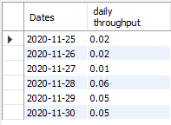
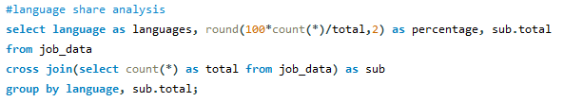
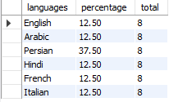
OUTPUT:
I would prefer daily metric over 7-day rolling average as it provides a granular view of system performance, allowing to pinpoint daily variations and trends.
LANGUAGE SHARE ANALYSIS:
This SQL query calculates the percentage share of each language in the job_data table, rounding the result to two decimal places. It does this by counting the occurrences of each language and dividing it by the total count of rows in the job_data table (sub.total). The "languages" column represents the languages, "percentage" shows their percentage share, and "sub.total" displays the total row count for reference. The CROSS JOIN with a subquery ensures the total count is available for all language groups.
OUTPUT:

Slide 4
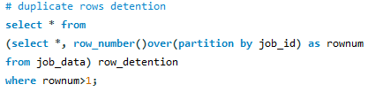


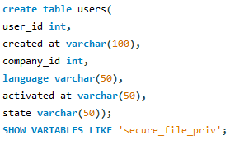
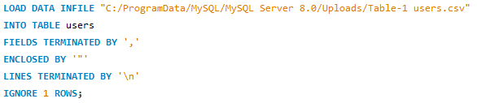
DUPLICATE ROWS DETENTION:
This SQL query employs the ROW_NUMBER() function with PARTITION BY to assign a unique row number to each row within its respective "job_id" group in the "job_data" table. The query then selects rows where the assigned row number (rownum) is greater than 1. This effectively retrieves duplicate rows based on the "job_id" column, allowing for the identification and retrieval of records with duplicate job IDs in the dataset.
(Case Study – 2 : Investigating Metric Spike)
For Case Study - 2 I have created tables named users, events and emails_events then used load data infile command to insert the values from the provided excel sheets.
users table:

Slide 5


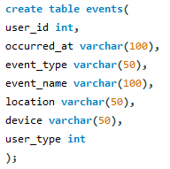
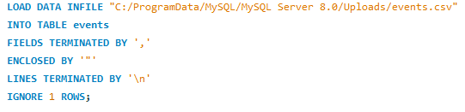

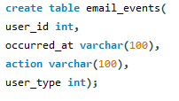
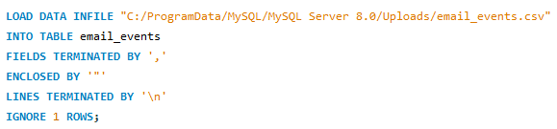
Altering the users table :
events table:
Altering the events table :
emails_events table:

Slide 6

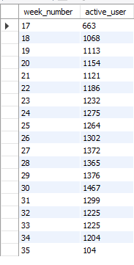
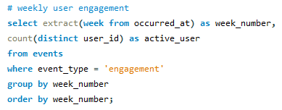
Altering the emails_events table :
After the creation, insertion and updating of the tables I executed required SQL queries with respect to each task as follows:
WEEKLY USER ENGAGEMENT:
OUTPUT:
This SQL query extracts the week number from the "occurred_at" timestamp and counts the distinct "user_id" values for events with the event type 'engagement.' It groups the results by week number and orders them accordingly. Essentially, this query provides a count of active users engaged with events for each week, allowing for the analysis of user activity trends over time.

Slide 7
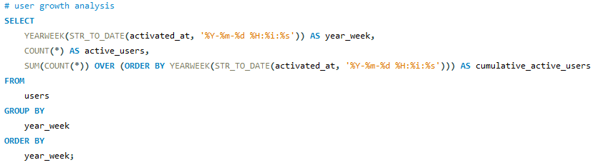
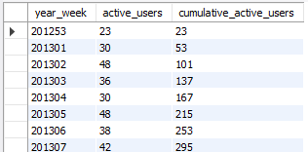

USER GROWTH ANALYSIS:
This SQL query calculates the count of active users for each week based on the "activated_at" timestamp in the "users" table. It uses the YEARWEEK function to extract the year and week from the timestamp, grouping the results by week. Additionally, it employs a window function with SUM to compute the cumulative count of active users over time, ordered by the week. The query provides insights into user activation trends and the cumulative growth of active users.

Slide 8
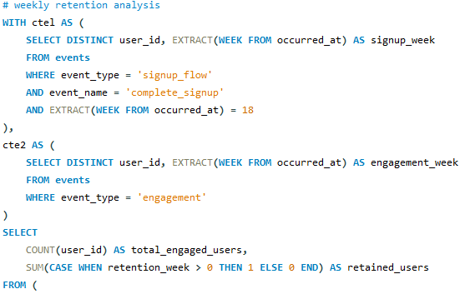

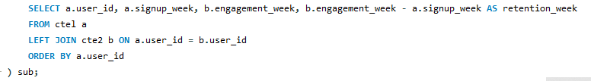
WEEKLY RETENTION ANALYSIS:
OUTPUT:
This SQL query calculates user retention by first identifying users who completed the signup flow in week 18 (ctel) and users who engaged with events (cte2). It then joins these two sets of users based on their user_id, computes the difference in weeks between signup and engagement, and counts the total engaged users and the number of users retained (those with a positive retention_week). This provides insights into user retention after completing the signup process during week 18.

Slide 9
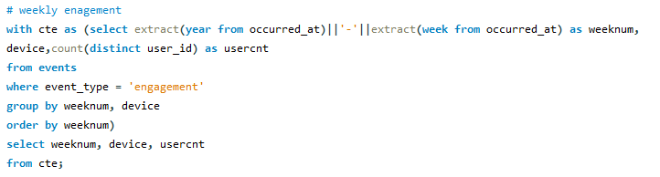
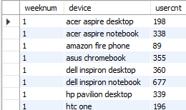
WEEKLY ENGAGEMENT PER DEVICE:
This SQL query first creates a common table expression (CTE) named "cte" to calculate the count of distinct users engaged with events per week and device type. It extracts the year and week from the "occurred_at" timestamp and groups the results by week and device. The final SELECT statement retrieves the week number, device type, and the count of distinct users from the CTE, providing insights into user engagement by week and device.
OUTPUT:

Slide 10
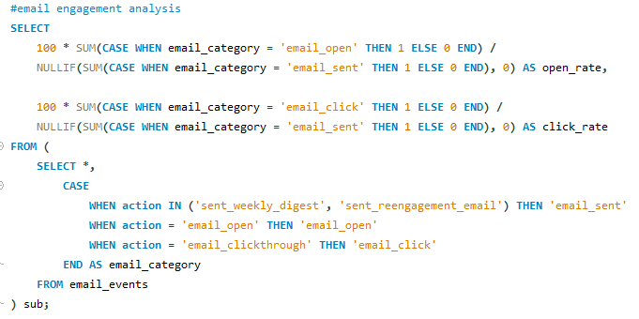

EMAIL ENGAGEMENT ANALYSIS:
This SQL query calculates email open rates and click-through rates by first categorizing email events into 'email_sent,' 'email_open,' and 'email_click.' It then uses conditional SUMs to calculate the percentages of email opens and clicks relative to the total number of emails sent (email_sent). The NULLIF function is used to handle cases where no emails were sent, preventing division by zero errors. This query provides insights into the effectiveness of email campaigns by measuring user engagement with emails.
OUTPUT:

Slide 11
Tech-Stack Used:
For this project I have used MySQL Workbench (Version : 8.0.33) as it is a user-friendly integrated development environment (IDE) for MySQL databases. It provides performance analysis tools, and facilitates database administration tasks like user management and backups.
Insights:
The insights and knowledge I have gained while working on this project are as follows:
SQL's aggregate functions and data manipulation capabilities facilitate complex calculations, grouping, and transformations.
SQL's JOIN operations enable the integration of data from multiple tables, allowing us to perform comprehensive analysis.
SQL's subquery capabilities enable us to build intricate queries for in-depth analysis and decision-making.
Result:
Job Data Analysis:
Job Reviews Over Time: Reveals patterns in job reviews during November 2020, providing insights into peak review times.
Throughput Analysis: Evaluates system performance by calculating a 7-day rolling average of throughput, offering insights into long-term trends.
Language Share Analysis: Analyzes language diversity in recent data, helping to understand language distribution.
Duplicate Rows Detection: Identifies and manages duplicate data entries, ensuring data quality.
Investigating Metric Spike:
Weekly User Engagement: Measures user activity on a weekly basis, allowing for the tracking of user engagement trends.
User Growth Analysis: Analyzes user growth over time, aiding in assessing the product's success and potential expansion.
Weekly Retention Analysis: Evaluates user retention on a weekly basis, providing insights into user loyalty and product stickiness.

Slide 12
Weekly Engagement Per Device: Measures user activeness weekly by device type, helping to identify device-specific trends.
Email Engagement Analysis: Analyzes user engagement with the email service, providing insights into email campaign effectiveness.
Overall, these analysis contribute to informed decision-making, product improvement, and a deeper understanding of user behavior and system performance. To conclude, this project benefited me in understanding when and how to use Advanced SQL queries in the analysis of the data and also gave practical exposure on working with SQL queries.

