Slide 1

A Mini Project Report on REAL-TIME GUN DETECTION USING MACHINE LEARNING
Presented By
P. Harsha vardhan (22911A05H4)
S. Pallavi (22911A05J2)
T. Harika (22911A05J5)
K. Vaishnavi (22911A05J7)
Guide Name:
Mr. PVK Subbaraya Sarma

Slide 2
Abstract
An AI-powered surveillance system built to detect guns and dangerous weapons in real-time.
Utilizes the YOLOv5 deep learning model for fast and accurate object detection.
Continuously monitors live video feeds and identifies firearms with bounding boxes.
Designed for integration with existing CCTV systems to enhance surveillance efficiency.
Aims to improve monitoring in high-risk or sensitive environments such as airports, schools, and public places.
Supports public safety efforts by providing an automated, intelligent layer of surveillance.

Slide 3
Introduction
In recent years, the rise in gun-related violence has raised significant concerns around public safety and security.
Traditional surveillance systems rely heavily on manual monitoring, which is often inefficient, labor-intensive, and prone to human error.
The need for automated and intelligent surveillance systems has become critical, especially in high-risk areas like airports, schools, and public gatherings.
Deep learning and computer vision technologies have advanced significantly, making it possible to detect objects such as firearms in real-time video feeds.
This project introduces a Gun Detection System that leverages the YOLOv5 model, known for its speed and accuracy in object detection tasks.
The system is designed to operate on live video input, providing real-time detection and highlighting detected guns with bounding boxes.
The goal is to offer a scalable, efficient, and cost-effective solution that can be easily integrated with existing CCTV infrastructure to enhance safety.

Slide 4
Existing Methodology
Manual Monitoring: Surveillance footage is observed manually by security personnel via CCTV systems, requiring constant human attention.
Complete Human Dependency: Detection of weapons or suspicious activities depends entirely on the vigilance and observational skills of individuals.
No Real-Time Detection Capability: Traditional systems lack AI-powered automation for identifying firearms or threats in live video feeds.
High Risk of Human Error: Fatigue, distractions, or overwhelming footage can lead to missed detections or delayed responses to critical threats.
Delayed Response Time: Without automated alerts or detection, the time taken to recognize and react to a threat is significantly longer.

Slide 5
Proposed Methodology
Deep Learning-Based Weapon Detection: Utilizes the YOLOv5 object detection model to accurately detect guns and potentially other dangerous weapons from video frames.
Real-Time Video Processing: Continuously processes input from live CCTV or webcam feeds to enable uninterrupted surveillance.
Visual Detection Output: Highlights detected firearms using bounding boxes and class labels overlaid on the video feed for easy identification.
Operator Assistance: Reduces manual workload and enhances monitoring efficiency by supporting security personnel with AI-assisted detection.
Seamless Integration: Can be deployed alongside existing CCTV systems without the need for extensive hardware upgrades.

Slide 6
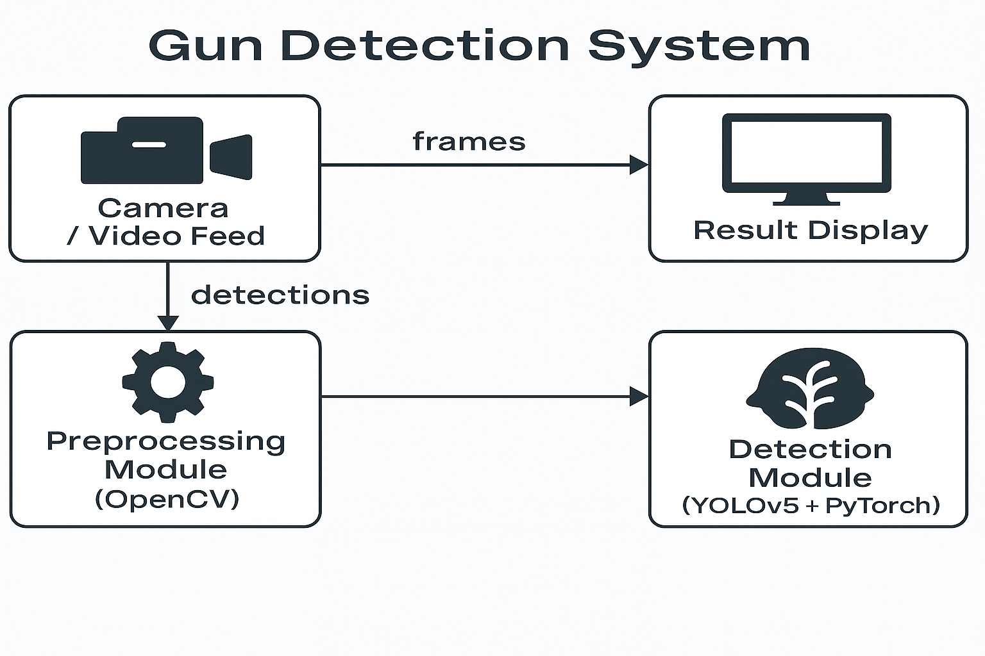
System Architecture

Slide 7
1. Camera / Video Feed
Function: Captures continuous real-time footage using a webcam or CCTV system.
Output: Streams individual video frames into the pipeline for further processing.
Connection:
Sends raw video frames to both the Preprocessing Module and the Result Display Module for visualization.
2. Preprocessing Module (OpenCV)
Function: Uses OpenCV to process and prepare raw frames for detection.
Tasks Include:
Resizing images
Normalization
Color space conversion
Frame extraction if using video file
Output: Cleaned and standardized frames suitable for input into the detection model.
Connection:
Forwards processed frames to the Detection Module.

Slide 8
3. Detection Module (YOLOv5 + PyTorch)
Function: Performs real-time detection of firearms (guns, knives, grenades) in the input frames using the YOLOv5 model implemented in PyTorch.
Tasks Include:
Running inference on each frame
Generating bounding box coordinates and class labels
Output: Detection results containing object positions and labels.
Connection:
Sends detection results to the Result Display Module.
4. Result Display / Alert Logging
Function: Displays the output video stream with overlaid bounding boxes and labels on the screen.
Current Scope:
Provides visual feedback only — detected objects are marked in the feed.

Slide 9
List of Modules
Detection Module
YOLOv5 model trained to recognize firearms, knives, and grenades in real-time video feeds.
Display Module
Shows bounding boxes and labels around detected weapons directly on the video screen.
System Integration Module
Simple setup to integrate with CCTV or webcam feeds for continuous monitoring.

Slide 10
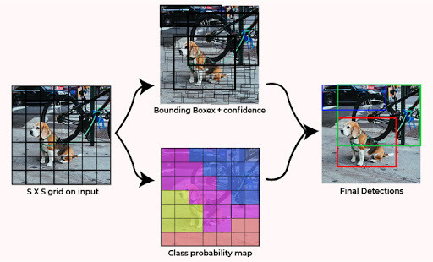
Working of YOLO
YOLO divides the image into a grid and predicts bounding boxes and class probabilities for each grid cell.
It uses a single neural network to make predictions, resulting in faster and more efficient processing.
YOLO utilizes a combination of convolutional layers and fully connected layers for object detection.

Slide 11
Training the yolo model
The YOLO model is trained using a large dataset of labeled images containing guns.
The model learns to detect guns by optimizing its parameters through a process called backpropagation.
Training involves adjusting the weights and biases of the neural network to minimize the detection errors.
LEGEND
0 - Grenades
1 - Knives
2&3 - Firearms
4 - Humans

Slide 12
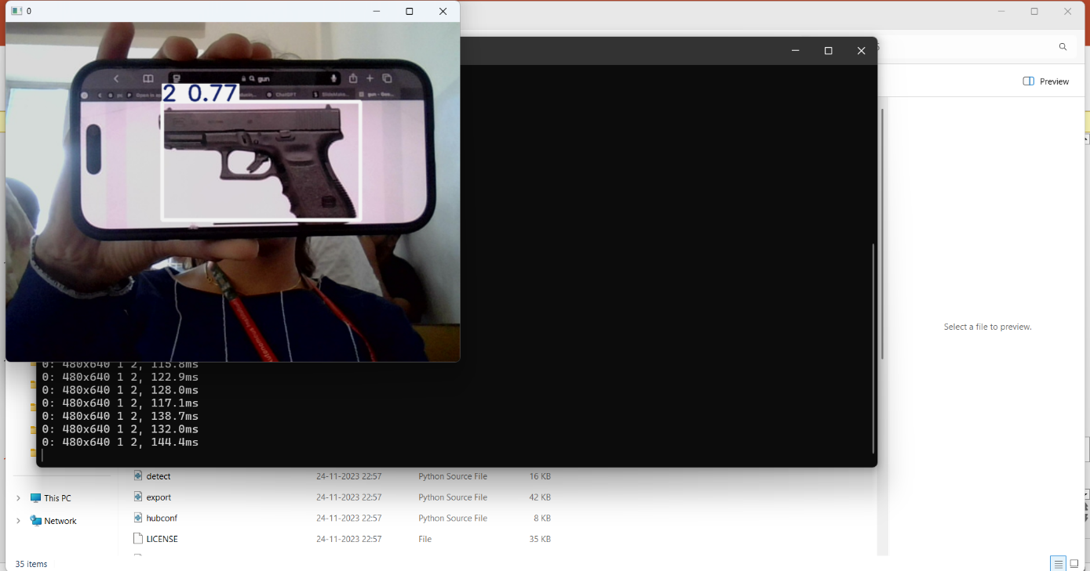
Output

Slide 13
Conclusion
The proposed Real-Time Gun Detection System provides an effective solution for automatically identifying firearms and dangerous weapons using deep learning. By automating the surveillance process, the system improves the speed and accuracy of monitoring activities. It focuses on simple, real-time detection without threat classification or alert generation, making it easy to integrate with existing CCTV infrastructure. In today’s security-challenged world, such AI-powered monitoring systems can play a key role in strengthening public safety.

