Slide 1

VERIFICATION OF AN AXI4-LITE
PROGRAMMABLE TIMER
WITH INTERRUPT OUTPUT
UVM Functional Verification + SpyGlass Static Lint / CDC Sign-off
SystemVerilog RTL • UVM-1.2 Testbench • VCS + Verdi • SpyGlass Lint & CDC
Keerthi | VLSI / Semiconductor Intern, NIELIT Chennai
29/07/2026

Slide 2
Agenda
Objective
DUT Architecture (Top Module)
Register Map
Timer Core — Counting Behaviour
Clock-Domain-Crossing Strategy
UVM Verification Environment
Tools & Verification Flow
Verdi Waveform Walkthrough
Static Sign-off — Lint & CDC (SpyGlass)
Bug-Injection Study — Method & Results
Coverage, Key Learnings & Summary
29/07/2026
Programmable Timer Verification
1

Slide 3
Objective
Verify a programmable timer peripheral with an AXI4-Lite slave port and a level-sensitive interrupt output, whose control logic and counter live in two independent, asynchronous clock domains — using a UVM testbench for functional closure and SpyGlass static analysis (lint + CDC) for structural sign-off. A set of deliberately injected bugs is then used to measure, with real data, what each method actually catches.
Dual-Clock DUT
AXI4-Lite Compliant
Two Verification Lenses
AXI bus clock (s_axi_aclk) and an independent timer_clk
Genuinely asynchronous — no shared source
Every crossing built from reusable, verified sync primitives
Full write-address / write-data / write-response FSM
Full read-address / read-data FSM
Word-aligned 4-register map, W1C status bit
Dynamic: UVM functional simulation (VCS)
Static: SpyGlass lint + CDC structural checks
Compared bug-for-bug across 7 injected defects
29/07/2026
Programmable Timer Verification
2

Slide 4
DUT Architecture — Top Module
AXI DOMAIN (s_axi_aclk)
CDC BRIDGE
TIMER DOMAIN
(timer_clk)
AXI4-Lite Master (TB Driver)
s_axi_aw / w / b / ar / r channels
u_cfg_sync
toggle_sync
u_en_sync / u_mode_sync
2FF sync
register_bank (u_regs)
CTRL / LOAD / COUNT / STATUS
Write + Read FSMs, cfg_update_pulse
timer_core (u_timer)
count_q: down-counter
irq_pulse: 1-cyc @ expiry
u_load_sync
2FF sync (32b)
irq = STATUS.INTR & CTRL.IE
(level interrupt to system)
u_count_sync
gray_ctr_sync
count_sync_axi (COUNT, read-back)
u_irq_sync
toggle_sync
irq_pulse_sync_axi → sets STATUS.INTR
cfg_en / cfg_mode / cfg_load (RW config)
cfg_update_pulse (1-cycle, on CTRL/LOAD write)
The Controller logic in register_bank owns the AXI protocol; every CTRL/LOAD write raises a one-cycle cfg_update_pulse that is toggle-synchronised into timer_clk as one atomic bundle, so timer_core never samples a half-updated configuration. count and irq return the same way.
29/07/2026
Programmable Timer Verification
3

Slide 5
Register Map
Word-aligned, addr[3:2] selects the register
Offset | Register | Bits | Access | Description
0x0 | CTRL | [0] EN [1] MODE [2] IE | RW | EN = enable, MODE (0=periodic,1=one-shot), IE = interrupt enable
0x4 | LOAD | [31:0] | RW | Reload / countdown-start value
0x8 | COUNT | [31:0] | RO | Live count, Gray-code synchronised from the timer domain
0xC | STATUS | [0] INTR | W1C | Sticky interrupt flag; write 1 to clear (write 0 = no effect)
Interrupt Generation
irq = STATUS.INTR AND CTRL.IE — a level output, not a pulse
STATUS.INTR is set by the synchronised irq_pulse arriving from timer_clk, and cleared only by an explicit write of 1 to STATUS[0] from software
Reading COUNT returns the live down-counter value, safely crossed from timer_clk using a Gray-coded synchroniser
29/07/2026
Programmable Timer Verification
4

Slide 6
Timer Core — What It's Actually Doing
Lives entirely in timer_clk, asynchronous to the AXI bus
On cfg_update_pulse (one synchronised cycle after a CTRL or LOAD write) the core latches EN, MODE and LOAD together, and loads count_q = LOAD — this is where counting starts, from whatever value software wrote
While EN = 1, count_q decrements by 1 on every timer_clk edge — it is counting timer_clk cycles down to zero, nothing else
The moment count_q reaches 0, irq_pulse is asserted for exactly one cycle
LOAD
N-1
…
1
0
count_q, one decrement per timer_clk edge
↓ count_q == 0
irq_pulse = 1 for exactly one timer_clk cycle
MODE = 0 : Periodic
MODE = 1 : One-shot
count_q reloads with LOAD automatically
EN stays 1 — the timer keeps free-running
irq_pulse repeats every LOAD+1 cycles
Used for heartbeat / periodic-tick style timers
count_q holds at 0 after expiry
EN is auto-cleared the same cycle — timer stops
A single irq_pulse fires, then silence
Used for one-time delays / watchdog-style timeouts
29/07/2026
Programmable Timer Verification
5

Slide 7
Clock-Domain-Crossing Strategy
Three reusable primitives bridge s_axi_aclk ↔ timer_clk
Primitive | Used For | Why It's Safe
sync2ff (2-flop sync) | cfg_en, cfg_mode, cfg_load level bits | Two-stage resynchronisation lets a metastable sample resolve before use
gray_ctr_sync | Live count_q → count_sync_axi (COUNT reg) | Binary→Gray means only one bit ever toggles per source edge — a 2FF sync can never sample a torn multi-bit value
toggle_sync | cfg_update_pulse, irq_pulse | Source domain toggles a flop instead of pulsing it, so a fast pulse can never be swallowed by a slower destination clock; destination edge-detects the toggle back into a clean 1-cycle pulse
Why EN / MODE / LOAD Cross as One Atomic Bundle
cfg_update_pulse is toggle-synced first; timer_core only samples EN, MODE and LOAD on that synchronised pulse, and register_bank holds them stable until it has propagated — so the three fields can never arrive “half-updated” relative to each other.
29/07/2026
Programmable Timer Verification
6

Slide 8
UVM Verification Environment
timer_test
timer_env
timer_agent
(sequencer + driver + monitor)
DUT
axi4lite_timer_top
(tb_top.dut)
timer_if
(virtual interface)
timer_scoreboard
(expected vs. actual)
timer_coverage
(functional coverage)
Reusable Components
timer_txn (transaction)
timer_driver / timer_monitor
timer_sequencer
timer_pkg (env package)
Test Sequences Driven Through the Agent
reg_write_seq
reg_read_seq
reg_readback_seq
timer_smoke_seq
periodic_seq
oneshot_seq
w1c_negative_seq
29/07/2026
Programmable Timer Verification
7

Slide 9
Verification Tools & Flow
RTL
VCS
Verdi
SpyGlass – Lint
SpyGlass – CDC
SystemVerilog design
(rtl/*.sv, bug_defines.svh)
Compile + elaborate + simulate the UVM-1.2 testbench; FSDB dump enabled
Waveform (nWave) + source-correlated debug against the live FSDB
Structural RTL rule checks (lint/lint_rtl goal)
Structural clock-domain-crossing verification against the SGDC constraints (cdc/cdc_verify_struct goal)
SGDC — SpyGlass Design Constraints (constraints/axi4lite_timer.sgdc)
current_design axi4lite_timer_top
clock -name s_axi_aclk clock -name timer_clk
reset -name s_axi_aresetn -value 0 reset -name timer_rst_n -value 0
Dynamic Verification (VCS + Verdi)
Static Verification (SpyGlass)
Constrained-random + directed UVM sequences
Scoreboard checks register behaviour and IRQ expiry timing
Verdi correlates waveform activity back to RTL source
Lint: structural RTL rule checking, no testbench needed
CDC: proves every clock crossing is properly synchronised
Runs once per RTL change — catches issues stimulus might miss
29/07/2026
Programmable Timer Verification
8

Slide 10
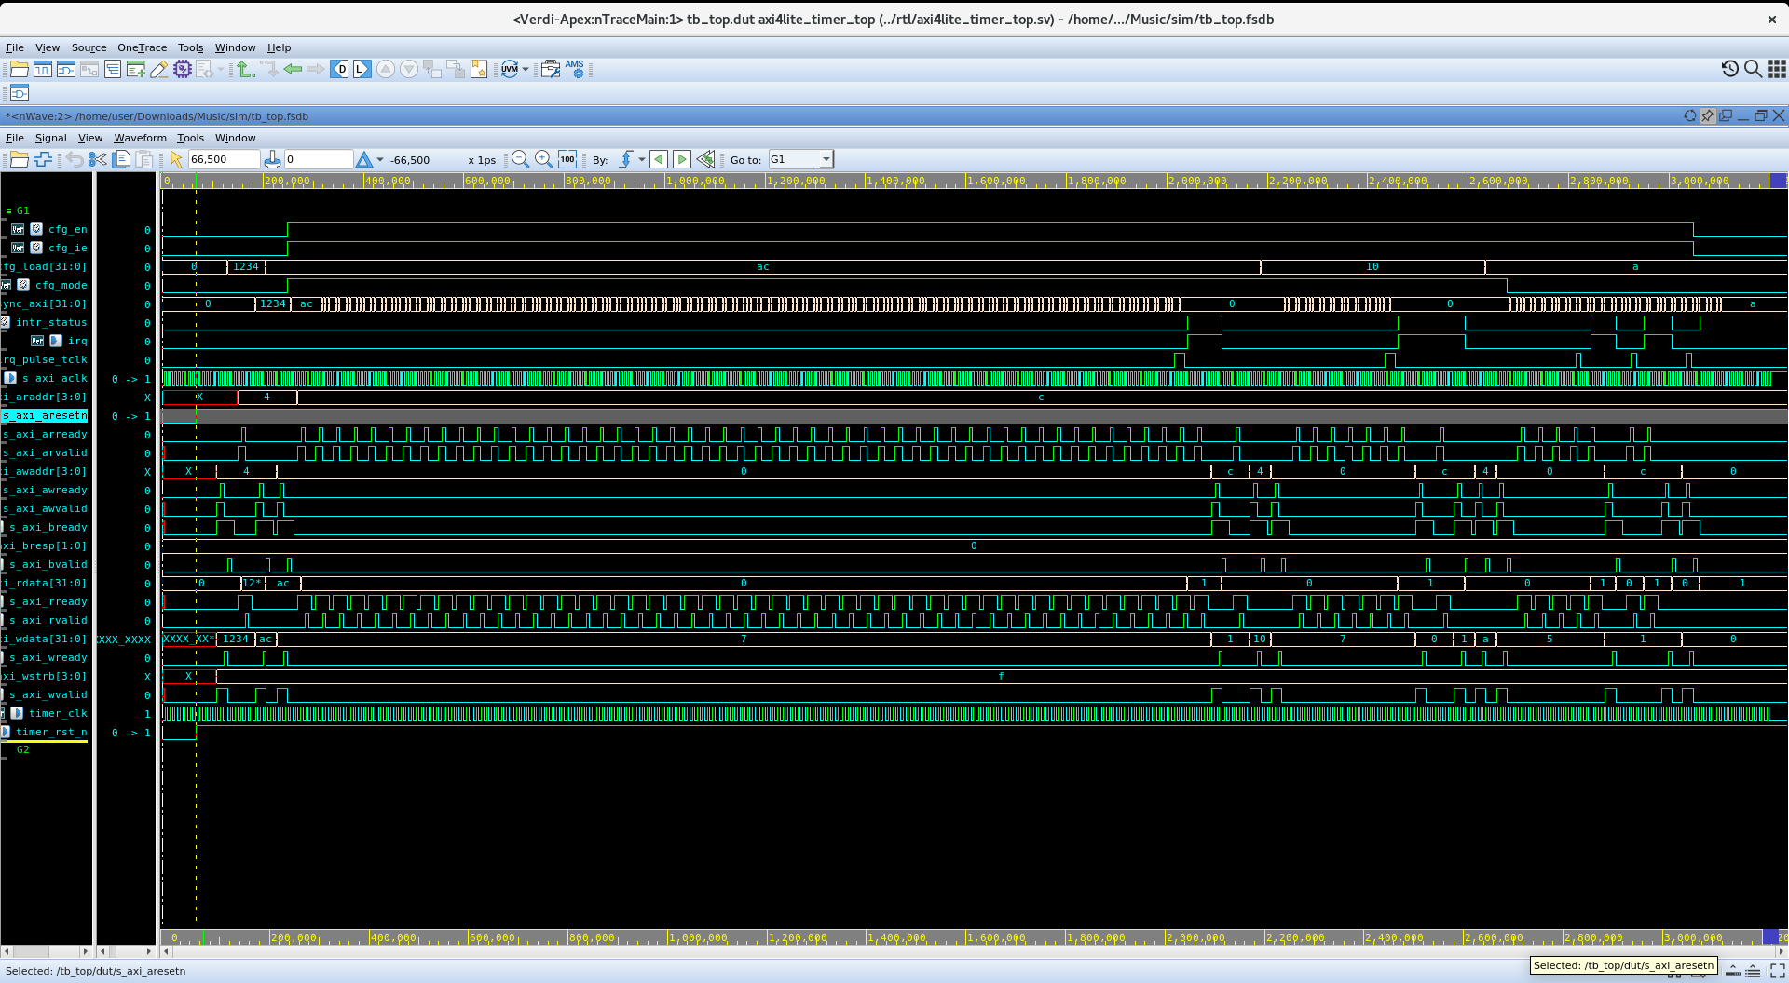
Verdi Waveform Walkthrough
AXI4-Lite writes push new LOAD values (0x1234, 0xAC, 0x10, 0xA) into the register bank; each write pulses cfg_update_pulse for one s_axi_aclk cycle
That pulse is toggle-synchronised into timer_clk, where timer_core loads count_q = LOAD and decrements every timer_clk edge — the dense toggling on count_sync_axi is the down-counter changing almost every cycle
When count_q reaches 0, irq_pulse fires for one cycle; toggle-synced back to the AXI domain it sets STATUS.INTR, which (with CTRL.IE=1) drives irq high — seen as the pulses on the irq trace
29/07/2026
Programmable Timer Verification
9

Slide 11
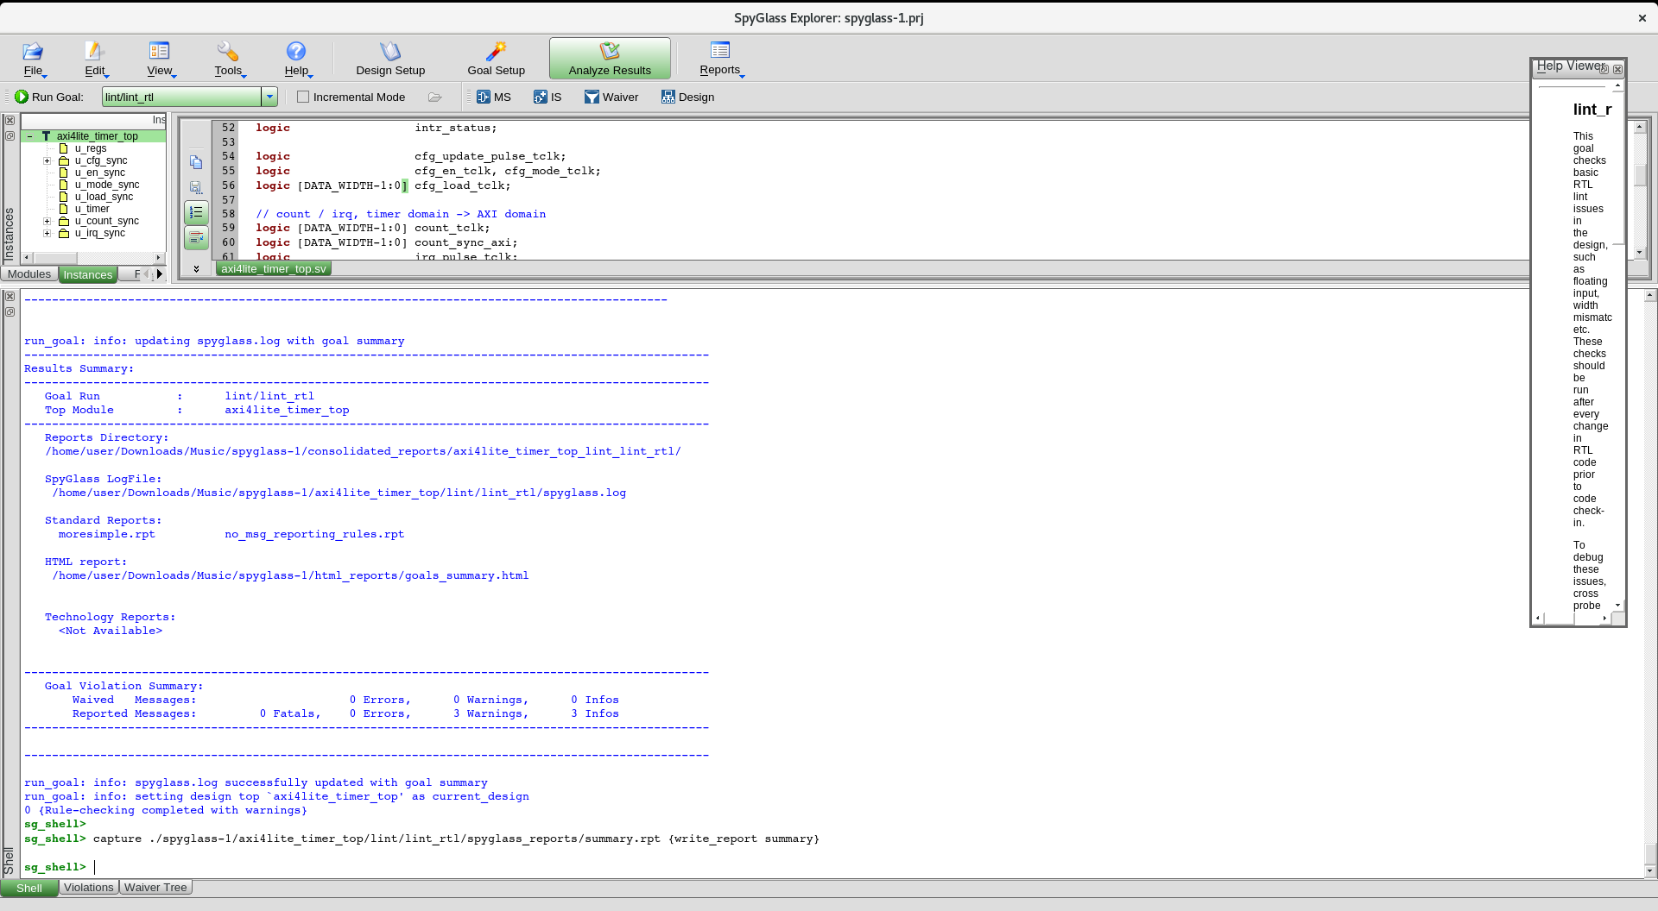
Static Sign-off — Lint (SpyGlass)
Goal lint/lint_rtl on top module axi4lite_timer_top — the SpyGlass instance tree mirrors the RTL hierarchy exactly: u_regs, u_cfg_sync, u_en_sync, u_mode_sync, u_load_sync, u_timer, u_count_sync, u_irq_sync
Clean baseline run: 0 errors, 0 warnings reported — confirms the RTL is structurally sound before any bug is injected
29/07/2026
Programmable Timer Verification
10

Slide 12
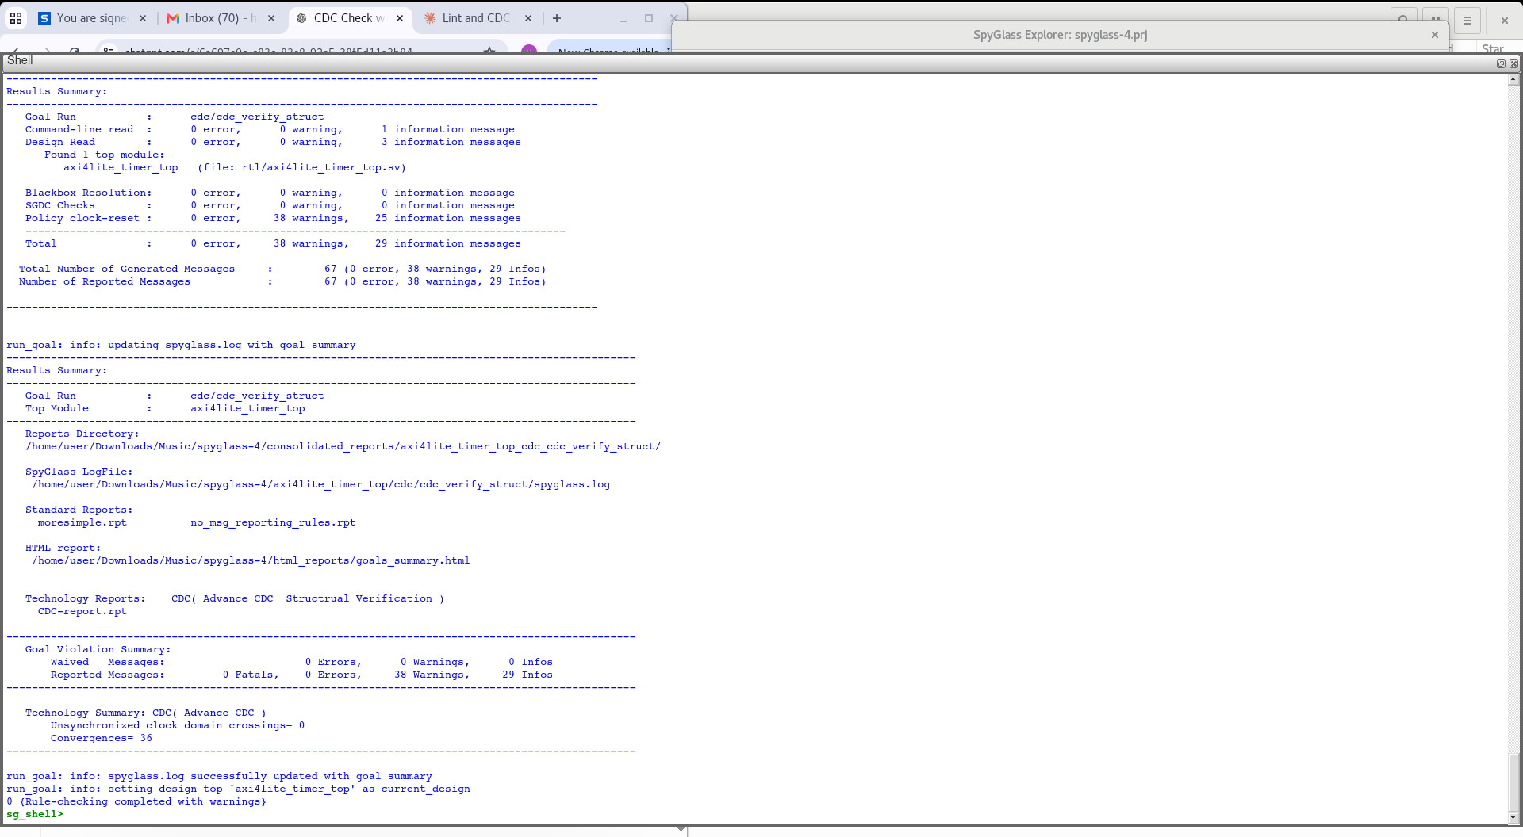
Static Sign-off — CDC (SpyGlass)
Goal cdc/cdc_verify_struct, Advance-CDC technology: Unsynchronised clock-domain crossings = 0 — every s_axi_aclk ↔ timer_clk path is properly synchronised
36 convergence points reported (informational) — the EN / MODE / LOAD bundle re-converging in timer_core, exactly the case the atomic toggle-sync scheme is designed to handle safely
0 errors, 38 warnings / 29 infos, all informational — no blocking CDC violations
29/07/2026
Programmable Timer Verification
11

Slide 13
Bug-Injection Study — Method & Catch Matrix
Seven bugs, each behind a compile-time `ifdef in bug_defines.svh, were injected one at a time and pushed through the full UVM regression and SpyGlass lint/CDC — to see, with real data, which method actually catches which class of defect.
Bug | Category | UVM Scoreboard Result | Caught By
BASELINE | — | 16 passed / 0 failed | — (clean)
BUG1 CDC_NO_SYNC | CDC | 11 passed / 3 failed | UVM + CDC tool
BUG2 CDC_SINGLE_FF | CDC | 12 passed / 3 failed | UVM + CDC tool
BUG3 LINT_WIDTH_MISMATCH | Lint | 16 passed / 0 failed | Lint tool only
BUG4 LINT_INFERRED_LATCH | Lint | 16 passed / 0 failed | Lint tool only
BUG5 LINT_MULTIDRIVEN | Lint | VCS elaboration error | Compiler + Lint
BUG6 FUNC_OFFBYONE | Functional | 14 passed / 2 failed | UVM scoreboard only
BUG7 FUNC_W1C_BROKEN | Functional | 16 passed / 1 failed | UVM scoreboard only
The Headline Result
BUG3 and BUG4 pass UVM exactly like the clean baseline (16/0) — pure structural lint defects are functionally invisible to simulation and are caught only by static analysis; BUG5 never even reaches simulation, failing at VCS elaboration.
29/07/2026
Programmable Timer Verification
12

Slide 14
Coverage & Scoreboard Summary — Baseline
16 / 16
0
79.2%
Scoreboard checks passed
UVM_ERROR reports
Register-access coverage
93.8%
100%
0 : 0
CTRL-field coverage
STATUS write-1-to-clear coverage
SpyGlass lint errors : warnings
Reading the Numbers
The baseline (no injected bug) run is fully clean: every scoreboard check passes and SpyGlass lint reports zero errors and zero warnings on the RTL.
Coverage highlights reg_access as the area with the most remaining headroom — a natural next step is adding sequences that exercise the untouched address/strobe combinations.
29/07/2026
Programmable Timer Verification
13

Slide 15
Key Learnings & Summary
Skills Demonstrated
Design & CDC
Verification
CDC-safe design: 2FF, Gray-code, toggle synchronisers
Atomic multi-signal configuration crossing
AXI4-Lite write/read FSM implementation
UVM environment: agent, scoreboard, coverage
Directed + scenario sequences (periodic, one-shot, W1C)
Static vs. dynamic method comparison, data-backed
This project verifies a dual-clock AXI4-Lite programmable timer using a UVM testbench (VCS + Verdi) alongside SpyGlass static lint and CDC sign-off, then quantifies each method's blind spots by injecting seven real bugs across CDC, lint, and functional categories — showing concretely why sign-off VLSI verification needs both dynamic simulation and static structural analysis, not just one.
29/07/2026
Programmable Timer Verification
14

Slide 16
THANK YOU
Questions & Discussion

