Slide 1
TASK-4
This task was quite freestyle and we where allowed to have a free hand and choose our own topic. So we planned and finally chose Robotics….

Slide 2
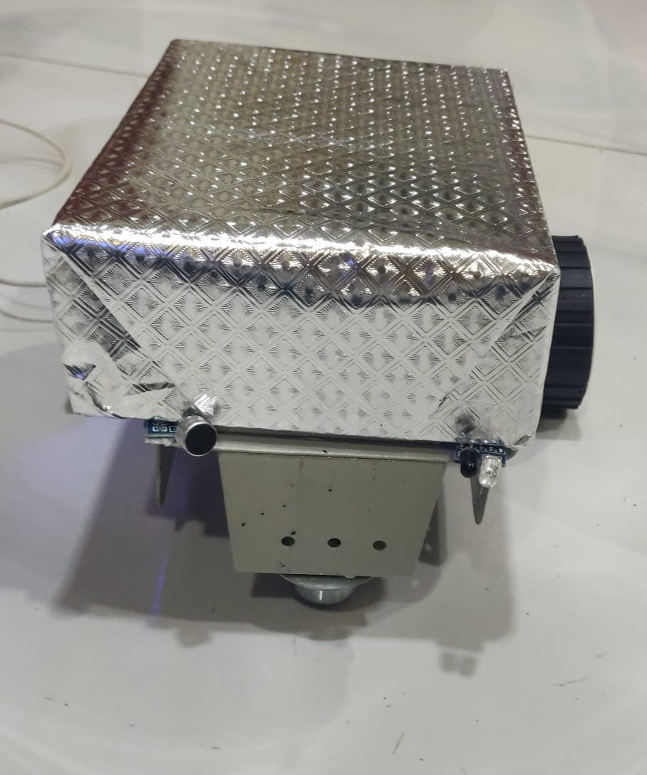
HAI-BOT [PROTOTYPE]

Slide 3
Inspiration
Necessity is the mother of any Invention, People who had lived in an apartment would have faced a situation where our classmates talk about having pet dogs or cats but we wouldn’t have got the permission to buy them in our homes. This bot tries to give you the feel to a certain extent and could be made as a prototype using many more features. All robots made our inspired from nature this robot’s inspired from a four legged pet.

Slide 4
Inspiration
The robot has been designed in such a way that it comes when we give a sound, and stops when we keep our hand and reacts using random lights(in my perspective giving a taste of feelings).It also stops in its custom made stall and does not get hurt.
The robot’s name is chosen in a way to represent the first letters of the creators in a rather funny order “Hari kheshav” “Abinaya” “Indhumathi” –BOT…➔HAI-BOT

Slide 5
Budget Analysis
Proximity Infrared Sensor (1):Rs.80
Microphone Sensor: Rs.90
DC Motor:Rs.300
LED(3):Rs:1.50
Wheels(2):Rs.40
Wires(few):Rs.10
Battery:Rs.900
Motor Driver: Rs.60
7805 Regulator:Rs.50
Arduino UNO:Rs.527
Breadboard:Rs.160
Designing:Rs.31
Total:Rs.2249.50

Slide 6
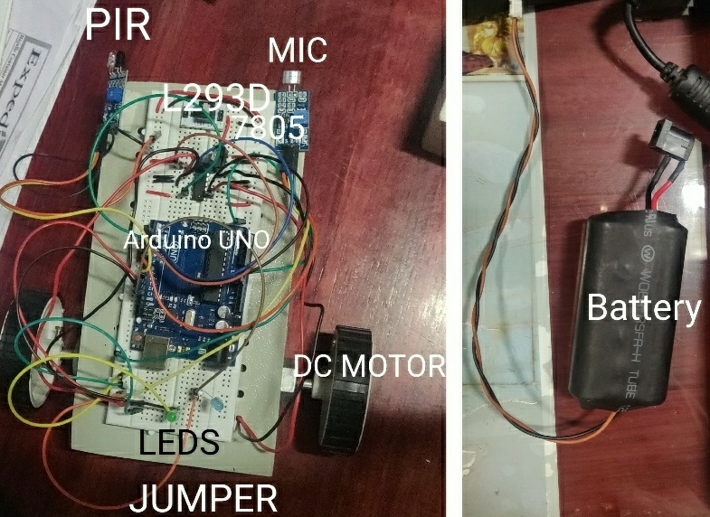
Labelled BOT

Slide 7
Working of Parts
Arduino UNO Board: A microcontroller board with many number of pins which uses an IDE in embedded C to control the amount of voltage passed out of the pins using regulators and frequency oscillators(for timing or clock functions).
7805 Regulator: Regulates the given voltage(Vcc) to a specified value(here 5V) as Vout and releases other energy is form of heat.
IR Proximity Sensor : It consists of two types of diodes with a common ground(or cathode terminal). As it is the heart of this project we try to understand the working better, we learn the working of a diode.

Slide 8
Diode:(For Better Understanding)
A diode is a device made of an PN Junction (P-type majority carriers=holes and N-type majority carriers=electrons)which works differently on different voltage conditions.
No Bias: When no external energy is applied(in terms of voltage,heat,light) the holes in P side and electrons in N side join creating a potential barrier.

Slide 9
Diode:(For Better Understanding)
Forward Bias: When the P side is connected to the anode and N side is connected to the cathode the potential barrier is overcome and current moves from P to N and releases some energy(type depends on the material).
Reverse Bias: When the P side is connected to the cathode and N side is connected to the anode the potential barrier increases created creating high amount of energy resulting in a breakdown.

Slide 10
Working of Parts
The two parts are:
Infrared Light Emitting Diode:
It works in Forward Bias condition. As the current flows, electrons fall from one part of the diode into holes on another part. In order to fall into these holes, these electrons must shed energy in the form of photons, which produce infrared light(compound semiconductors like GaAs).

Slide 11
Working of Parts
Photodiode:
A photodiode is a p–n junction in reverse bias. When a photon of sufficient energy strikes the diode, it creates an electron–hole pair. This mechanism is also known as the inner photoelectric effect. If the absorption occurs in the junction's depletion region, or one diffusion length away from it, these carriers are swept from the junction by the built-in electric field of the depletion region. Thus holes move toward the anode, and electrons toward the cathode, and a photocurrent is produced. The total current through the photodiode is the sum of the dark current (current that is generated in the absence of light) and the photocurrent, so the dark current must be minimized to maximize the sensitivity of the device.

Slide 12
Working of Parts
Microphone Sensor[LM393]:
A microphone sensor is used to convert acoustic vibrations into electrical signals. When the moving plate (diaphragm) vibrates in time with the sound wave, the distance between the plates and hence the capacitance is changed. The changes in capacitance can then be converted to an electrical signal.

Slide 13
Working of Parts
Light Emitting Diode:
It works similar to an IR LED except that it sheds energy in the form of photons, which produce visible light.
Buzzers:
When voltage signal is passed the electromagnet coil produces a magnetic field which vibrates the disk at a frequency to that drive signal produces the sound.

Slide 14
Working of Parts
DC-Motor:
A simple DC motor has a stationary set of magnets in the stator and an armature with one or more windings of insulated wire wrapped around a soft iron core that concentrates the magnetic field. The windings usually have multiple turns around the core, and in large motors there can be several parallel current paths. The ends of the wire winding are connected to a commutator. The commutator allows each armature coil to be energized in turn and connects the rotating coils with the external power supply through brushes. (Brushless DC motors have electronics that switch the DC current to each coil on and off and have no brushes.)

Slide 15
Working of Parts
L293D-Motor Driver:
L293D contains two inbuilt H-bridge driver circuits. In its common mode of operation, two DC motors can be driven simultaneously, both in forward and reverse direction. The motor operations of two motors can be controlled by input logic at pins 2 & 7 and 10 & 15. Input logic 00 or 11 will stop the corresponding motor. Logic 01 and 10 will rotate it in clockwise and anticlockwise directions, respectively.
They act as amplifiers(using inbuilt transistors as given +5V input won’t be enough for running +8V DC Motors.

Slide 16
Working of Parts
Breadboard:
It is a construction base for prototyping of electronics.
Connecting Wires:
It is a pin-type wires useful in connecting wires with pins in Arduino or other type of boards.

Slide 17
Working of Parts
Li-Ion 8V Battery:
Used for working of robots and it is also re- chargable.

Slide 18
Code
const int leftForward = 2; //Left motor pin1
const int leftBackward = 3; //Left motor pin2
const int rightForward = 4; //Right motor pin1
const int rightBackward = 5; //Right motor pin2
const int soundsensor=6; //Detecting Clap
const int IR_RECV=10; //Detecting Obstacle
int F=0;//Flag var
void setup()
{
//DIFF COLOURED LEDS
pinMode(11,OUTPUT);
pinMode(12,OUTPUT);
pinMode(13,OUTPUT);
//motor pins

Slide 19
Code
pinMode(leftForward , OUTPUT);
pinMode(leftBackward , OUTPUT);
pinMode(rightForward , OUTPUT);
pinMode(rightBackward , OUTPUT);
//Detecting Clap
pinMode(soundsensor,INPUT);
//Detecting Obstacle
pinMode(IR_RECV,INPUT);

Slide 20
Code
//Increasing the Randomness
randomSeed(analogRead(1));
}
void loop()
{
if(digitalRead(soundsensor)==HIGH||F==1)//clap detection and sustaining of condition[flag]
{ F=1;
digitalWrite(leftForward , HIGH);
digitalWrite(leftBackward , LOW);
digitalWrite(rightForward , HIGH);
digitalWrite(rightBackward , LOW); } //Move Forward

Slide 21
Code
if(digitalRead(IR_RECV)==LOW) //Obstacle Detection
{
digitalWrite(leftForward , LOW);
digitalWrite(leftBackward , LOW);
digitalWrite(rightForward , LOW);
digitalWrite(rightBackward , LOW); //Stop
int n=random(7);
int m=random(6);
digitalWrite(m+9,HIGH); //Random Lights
delay(n*500); //Random gaps
digitalWrite(m+9,LOW);
}
}

Slide 22
Singularity
In a bid to add a brain to the robot three LEDs are added to the robot’s back.
The robot glows LEDs depending on its mood where three LEDS represent three moods(in its own robotic body language).
According to me the ability to show random reactions is the base of giving a machine communicative skills which I hope have achieved a bit.

Slide 23
Advantages
This gives good company to young children and engages them in a varied source of enjoyment rather than cell phones
It is obstacle avoiding and thus prevents from the wiring getting broken.
IR Proximity Sensor is less lethal and more economical than Ultrasound Sensor.

Slide 24
Disadvantage and Remedy
Disadvantage:
This is only a prototype made using a breadboard , Arduino and lots of wires leading to difficulties due to the risk of wires getting worn out during movement and preventing reuse of Arduino.
Remedy:
This can be avoided by using boot-loaded microcontroller for embedding the code and creating a PCB layout and solder wires and sensors externally.

