Slide 1
PROJECT REPORT
SUBMITTED TO:PRESIDENT,RAIC
SUBMITTED BY:ECE DEVILS
1.Hari Kheshav
2.Abinaya
3.Indhumathi

Slide 2
Task
The Task 3 Project is to build an embedded system prototype where you build a Motion Sensor Alarm System using Arduino Uno and
(A.)If a motion is detected you need turn on alarm for 5 seconds
(B.)Turn ON the LED till the motion detected + 2 seconds.

Slide 3
Budget Involved:
LED (4 pcs) : Rs:2
Buzzer (2 pcs) :Rs.30
Arduino UNO : Rs:527
IR Proximity Sensor (2pcs):Rs:161
BreadBoard :Rs:160
Jumper Wires(10 pcs) :Rs:17.50
TOTAL :Rs:857.50/-
Note:
All spares except the Arduino UNO board and BreadBoard were bought extra in surplus.

Slide 4
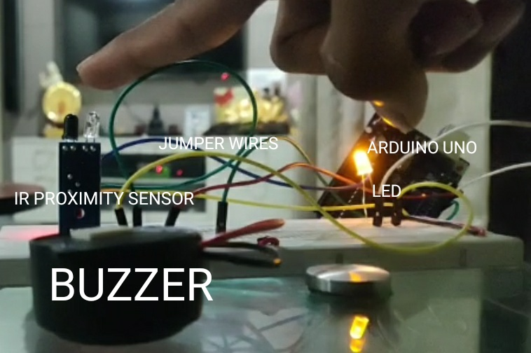
Labelled Prototype

Slide 5
Working of Parts
Arduino UNO Board: A microcontroller board with many number of pins which uses an IDE in embedded C to control the amount of voltage passed out of the pins using regulators and frequency oscillators(for timing or clock functions).
IR Proximity Sensor : It consists of two types of diodes with a common ground(or cathode terminal). As it is the heart of this project we try to understand the working better, we learn the working of a diode.

Slide 6
Diode:(For Better Understanding)
A diode is a device made of an PN Junction (P-type majority carriers=holes and N-type majority carriers=electrons)which works differently on different voltage conditions.
No Bias: When no external energy is applied(in terms of voltage,heat,light) the holes in P side and electrons in N side join creating a potential barrier.

Slide 7
Diode:(For Better Understanding)
Forward Bias: When the P side is connected to the anode and N side is connected to the cathode the potential barrier is overcome and current moves from P to N and releases some energy(type depends on the material).
Reverse Bias: When the P side is connected to the cathode and N side is connected to the anode the potential barrier increases created creating high amount of energy resulting in a breakdown.

Slide 8
Working of Parts
The two parts are:
Infrared Light Emitting Diode:
It works in Forward Bias condition. As the current flows, electrons fall from one part of the diode into holes on another part. In order to fall into these holes, these electrons must shed energy in the form of photons, which produce infrared light(compound semiconductors like GaAs).

Slide 9
Working of Parts
Photodiode:
A photodiode is a p–n junction in reverse bias. When a photon of sufficient energy strikes the diode, it creates an electron–hole pair. This mechanism is also known as the inner photoelectric effect. If the absorption occurs in the junction's depletion region, or one diffusion length away from it, these carriers are swept from the junction by the built-in electric field of the depletion region. Thus holes move toward the anode, and electrons toward the cathode, and a photocurrent is produced. The total current through the photodiode is the sum of the dark current (current that is generated in the absence of light) and the photocurrent, so the dark current must be minimized to maximize the sensitivity of the device.

Slide 10
Working of Parts
First the IR LED starts shining when the voltage is applied(from Vcc wrt ground pin)
When obstacle comes in front of the sensor the IR LED gets reflected in turn sensed by the photodiode.
The photodiode thus gives out photocurrent inturn sending a +5V from Vout wrt ground pin.

Slide 11
Working of Parts
Light Emitting Diode:
It works similar to an IR LED except that it sheds energy in the form of photons, which produce visible light.
Buzzers:
When voltage signal is passed the electromagnet coil produces a magnetic field which vibrates the disk at a frequency to that drive signal produces the sound.

Slide 12
Working of Parts
Breadboard:
It is a construction base for prototyping of electronics.
Connecting Wires:
It is a pin-type wires useful in connecting wires with pins in Arduino or other type of boards.

Slide 13
Code
int sound=12; //The buzzer's positive pin int light=13; //The LED's positive pin int detect=2; //The IR Proximity Sensor's Vout pin int f=0; //flag variable to avoid fluctuations void setup() { // put your setup code here, to run once: pinMode(detect, INPUT); pinMode(sound,OUTPUT); pinMode(light,OUTPUT); }

Slide 14
Code
void loop() { // put your main code here, to run repeatedly: while(digitalRead(detect)==LOW) //When Motion Starts { while(f==0) //When Clear motion starts(without Fluctuations) { digitalWrite(sound,HIGH);//(A.)Alarm is ON delay(2000); if(digitalRead(detect)==HIGH)//If motion stops in 2s the Light should not even switch ON(the below code should not work) break;

Slide 15
Code
digitalWrite(light,HIGH); //(B.)After 2 seconds lights switch ON delay(3000); digitalWrite(sound,LOW); //(A.)After 5 seconds (2+3) Alarm is switched OFF f++;//So that slight fluctuations do not get considered as new movement and lead to prolonged periods of buzzer sound...(in multiples of 5) } } digitalWrite(light,LOW);//When no motion detected light and sound is expected to be OFF digitalWrite(sound,LOW); delay(500); //To prevent slight fluctuations due to minor movements considered as evident motion... f=0; //So that motion detection can restart again }

Slide 16
Learning Outcomes
Since I am new to Arduino and Embedded C I learnt a lot of functions thier uses and most importantly the working of an Arduino Uno Board in Brief and gave me the satisfaction of the preparation of a complete code.
I also learnt about the working OF IR Proximity Sensor which is the heart of the prototype and helped me in achieving the goal easily.
This process of making a prototype helped me in increasing my wiring capabilities as I designed the whole circuit by myself.

Slide 17

Working

Slide 18
Advantages
This small prototype can be used as a means to a bigger motion alarm system with residential or commercial purposes.
IR Proximity Sensor is less lethal and more economical than Ultrasound Sensor.

Slide 19
Disadvantage and Remedy
Disadvantage:
It cannot be used without certain delays and hence might lead to the escape of organisms of moving in high speed.
Remedy:
This is more a advantage than disadvantage because those characteristics mostly suit only to very less microorganisms or sound or light sensing which isn't really wanted and infact deteriorates our mission in real life.

