Slide 1
POPULARITY BASED MUSIC PREDICTION SYSTEM
HARI KHISSAN B
22L219

Slide 2
PROBLEM STATEMENT
The goal of this project is to develop a Music Popularity prediction system that classifies songs as popular or non-popular based on various audio and descriptive features extracted from Spotify's API.
The dataset consists of songs with features such as energy, tempo, danceability, loudness, valence, speechiness, acousticness, and metadata like artist, album, and playlist information.

Slide 3
METHODOLOGY
Data Collection: Extracted song data from Kaggle and supplemented it with Spotify’s Developer API.
Data Preprocessing: Removed unnecessary columns and encoded categorical features using One-Hot, Label, and Target Encoding.
Feature Engineering: Converted track release dates into numerical features, normalized data, and selected relevant features for prediction.
Model Training: Split data into training and testing sets, trained a Random Forest Classifier model to predict the song’s popularity.
Evaluation: Assessed the model’s performance using accuracy, classification reports, and confusion matrices.
Deployment: Built a Streamlit web application that allows users to input song details and obtain predictions on song popularity.

Slide 4
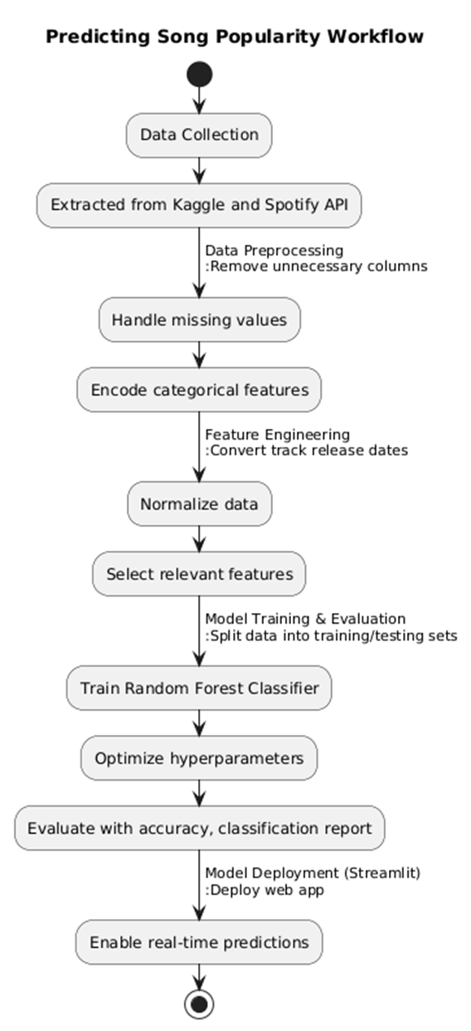
WORKFLOW:

Slide 5
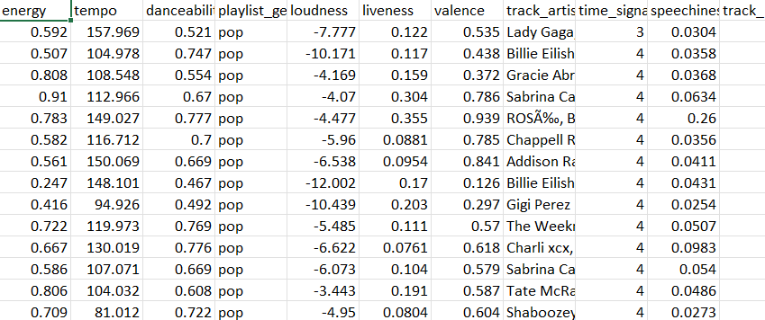
INPUT DATASET
The input dataset used for this project consists of 4,831 songs with 30 features extracted from Spotify’s API.
The dataset contains two types of features:
Audio Features: These features describe various musical characteristics of the tracks, derived from Spotify’s audio analysis.
Descriptive Features: These provide metadata about the songs, such as artist name, album details, and playlist information.

Slide 6

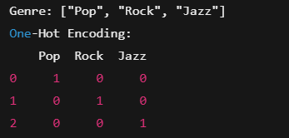
PREPROCESSING:
ENCODING:
Encoding is the process of converting categorical (text-based) data into numerical values so that machine learning models can process them effectively.
ENCODING USED IN PREPROCESSING ARE:
Label Encoding:
Converts each unique category in a feature into a numerical label (0, 1, 2, …).
One-Hot Encoding:
Creates a new binary column for each category.

Slide 7
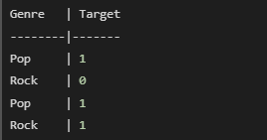
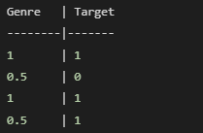

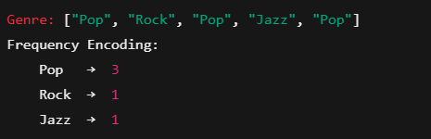
TARGET ENCODING:
Replaces a categorical value with the mean of the target variable.
FREQUENCY ENCODING:
Assigns values based on how often a category appears in the dataset.

Slide 8
DATE PARSING
Date parsing ensures consistency, prevents errors, and enables time-based analysis. It handles multiple formats (DD-MM-YYYY, YYYY-MM-DD) using pd.to_datetime().
Invalid dates are assigned NaT and managed via imputation or removal for a clean dataset

Slide 9
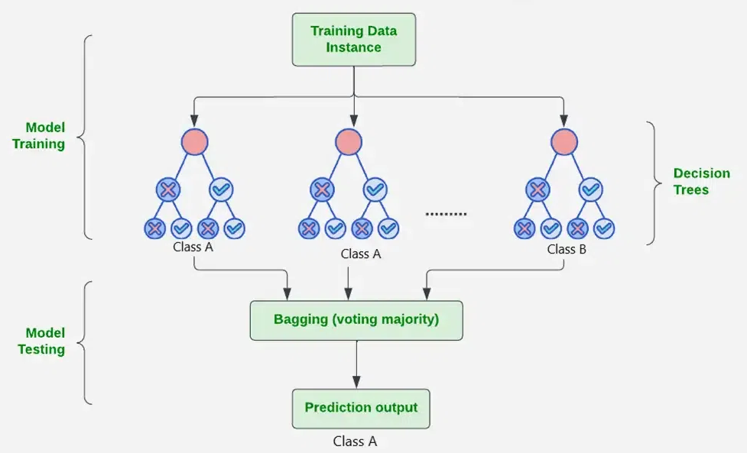
MODEL TRAINING:
RANDOM FOREST MODEL:
Random Forest is an ensemble learning algorithm that builds multiple decision trees and combines their outputs to improve prediction accuracy and reduce overfitting.
It is commonly used for classification and regression tasks.

Slide 10
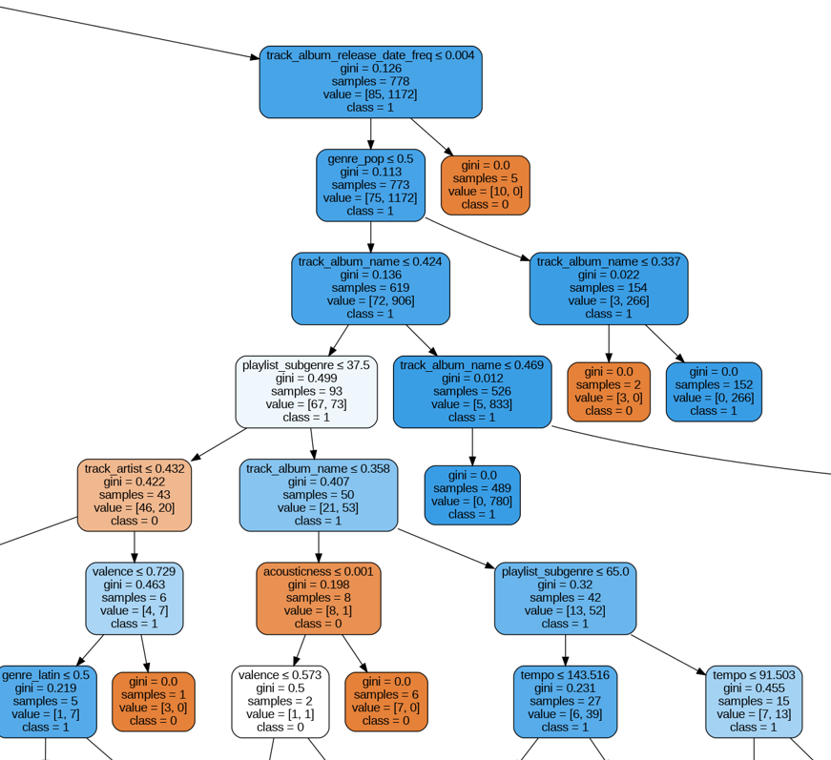
RANDOM FOREST TREE:
Hyperparameters in Random Forest MODEL:
n_estimators – Number of trees in the forest.
max_depth – Maximum depth of each tree to prevent overfitting.
min_samples_split – Minimum samples required to split a node.
max_features – Number of features to consider at each split.

Slide 11
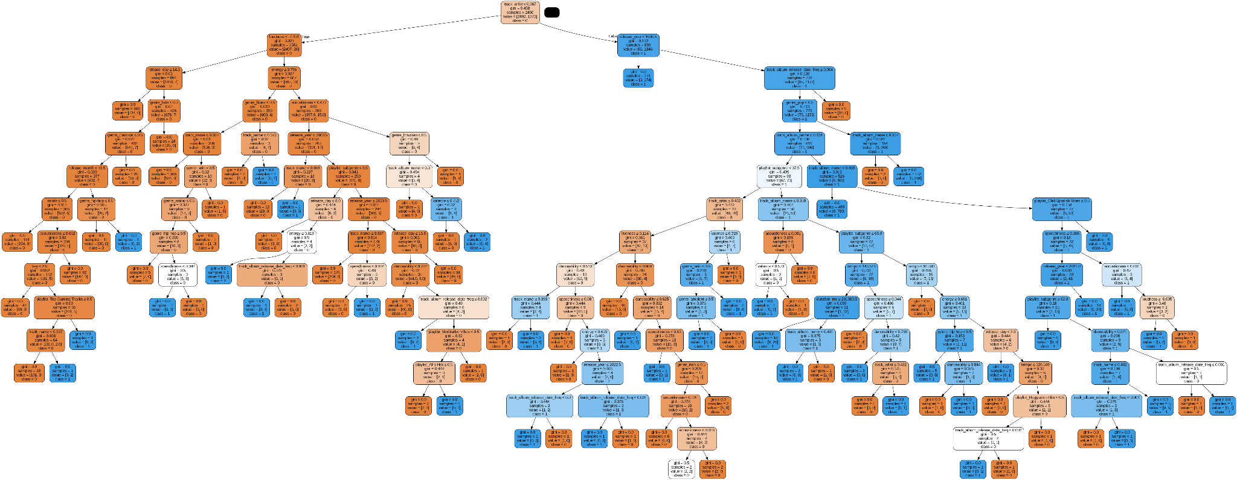
RF TREE WITH MAXIMUM ACCURACY:

Slide 12

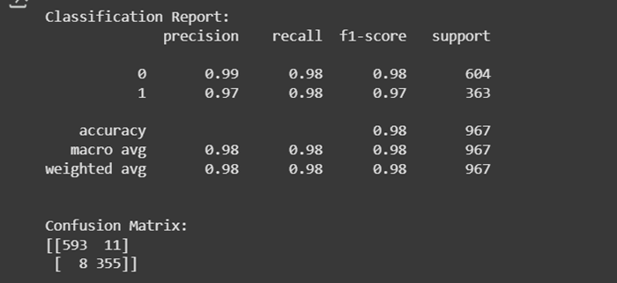
METRICS:
A trained Random Forest Classifier that achieved an accuracy of 98.03%.
A confusion matrix and classification report to validate model predictions.

Slide 13
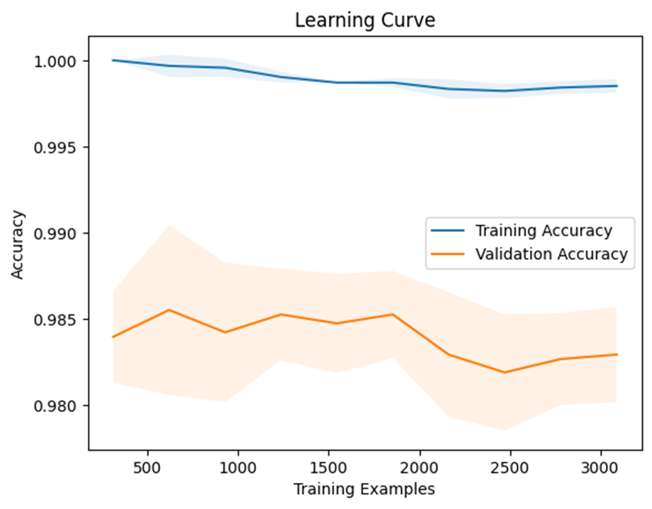
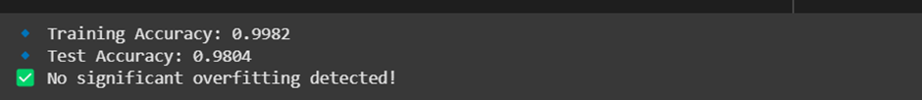
RESULT:
The Random Forest model performed well with high accuracy, precision, and recall.
Features like danceability, loudness, and tempo played a significant role in determining song popularity.

Slide 14
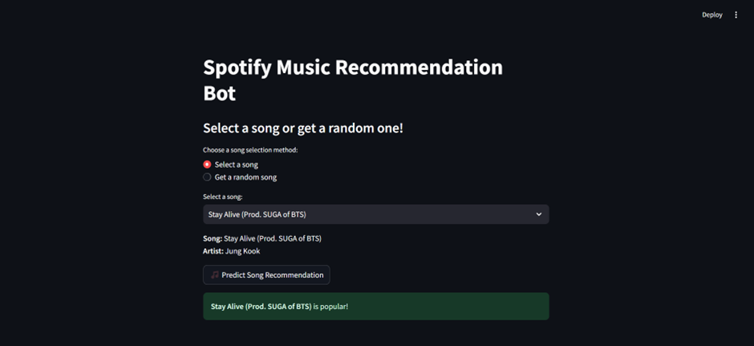
WEB APPLICATION:
A Streamlit web app where users can input audio features and get predictions on song popularity.

Slide 15
CONCLUSION:
The Spotify analysis script loads and preprocesses a dataset of song attributes, removes irrelevant columns, and to predict song popularity.
If results are accurate, the model can assist in trend analysis and recommendations.
Enhancements like feature selection, hyperparameter tuning may improve prediction performance.

