Slide 1




We and our 21 IAB TCF partners store and access information on your device for the following purposes: store and/or access information on a device, advertising and content measurement, audience research, and services development, personalised advertising, and personalised content.
Personal data may be processed to do the following: use precise geolocation data and actively scan device characteristics for identi cation.
Our third party IAB TCF partners may store and access information on your device such as IP address and device characteristics. Our IAB TCF Partners may process this personal data on the basis of legitimate interest, or with your consent. You may change or withdraw your preferences at any time by clicking on the cookie icon or link; however, as a consequence, you may not see relevant ads or personalized content. You may change your settings at any time or accept the default settings. You may close this banner to continue with only essential cookies. Privacy Policy
Storage Preferences Third Parties
Storage
Targeted Advertising Personalization Analytics
SMARTSMART INDIAINDIA HACKATHONHACKATHON 20242024
TITLETITLE PAGEPAGE
•• ProProbleblemm SStattatemeementnt IDID ––
•• ProProbleblemm StStateatemenmentt TTitlitle-e-
•• TThheemmee--
•• PS CatePS Categorgory- Softy- Softwarware/Hae/Hardwrdwareare
•• TTeeaamm IIDD--
•• TTeameam NNameame ((RegisRegisteredtered onon poportal)rtal)
Save preferences
Accept All

Slide 2





We and our 21 IAB TCF partners store and access information on your device for the following purposes: store and/or access information on a device, advertising and content measurement, audience research, and services development, personalised advertising, and personalised content.
Personal data may be processed to do the following: use precise geolocation data and actively scan device characteristics for identi cation.
Our third party IAB TCF partners may store and access information on your device such as IP address and device characteristics. Our IAB TCF Partners may process this personal data on the basis of legitimate interest, or with your consent. You may change or withdraw your preferences at any time by clicking on the cookie icon or link; however, as a consequence, you may not see relevant ads or personalized content. You may change your settings at any time or accept the default settings. You may close this banner to continue with only essential cookies. Privacy Policy
Storage Preferences Third Parties
Storage
Targeted Advertising Personalization Analytics
_{IDEAIDEA TITLETITLE}CODESTRIXCODESTRIX
Problem Resolution :Problem Resolution :
IDEA / SOLUTION :IDEA / SOLUTION :
Multifactor authentication systemMultifactor authentication system delivers seamlessdelivers seamless Implementation of aImplementation of a Time-based itunique One-timeTime-based itunique One-time securitysecurity, excelling even in, excelling even in the most challengingthe most challenging lowlow Handshake (OTH)Handshake (OTH) Mechanism specialized for lowMechanism specialized for low network zones.network zones.
network zonesnetwork zones ❖❖ Eliminates vulnerabilities of traditional 6-digit OTPs,Eliminates vulnerabilities of traditional 6-digit OTPs, offering unbreachable security that redefines industryoffering unbreachable security that redefines industry
USSD triggeredUSSD triggered offline authentication mechanismoffline authentication mechanism standards.standards.
Advanced QR based high speedAdvanced QR based high speed multi-factormulti-factor❖❖
authenticationauthentication Unique Value Propositions (UVP) :Unique Value Propositions (UVP) :
Unique UID,phone number and stamp toUnique UID,phone number and stamp to autoauto❖❖
authenticate/authorizeauthenticate/authorize useruser Dynamic prompt StampDynamic prompt Stamp for every Authenticationfor every Authentication
AlternativeAlternative IMEI based OTHIMEI based OTH methodology for buttonmethodology for button❖❖ Authenication done inAuthenication done in less than a secondless than a second❖❖
phone usesphone uses Functions with full efficiency evenFunctions with full efficiency even without Internetwithout Internet❖❖
Capability to work efficiently without internet evenCapability to work efficiently without internet even❖❖ Quad LevelQuad Level CustomCustom EncryptionEncryption AlgorithmAlgorithm in low network zonesin low network zones Distinct API's enhanceDistinct API's enhance Security standardsSecurity standards❖❖
22@SIH Idea submission- Template@SIH Idea submission- Template
Save preferences
Accept All

Slide 3
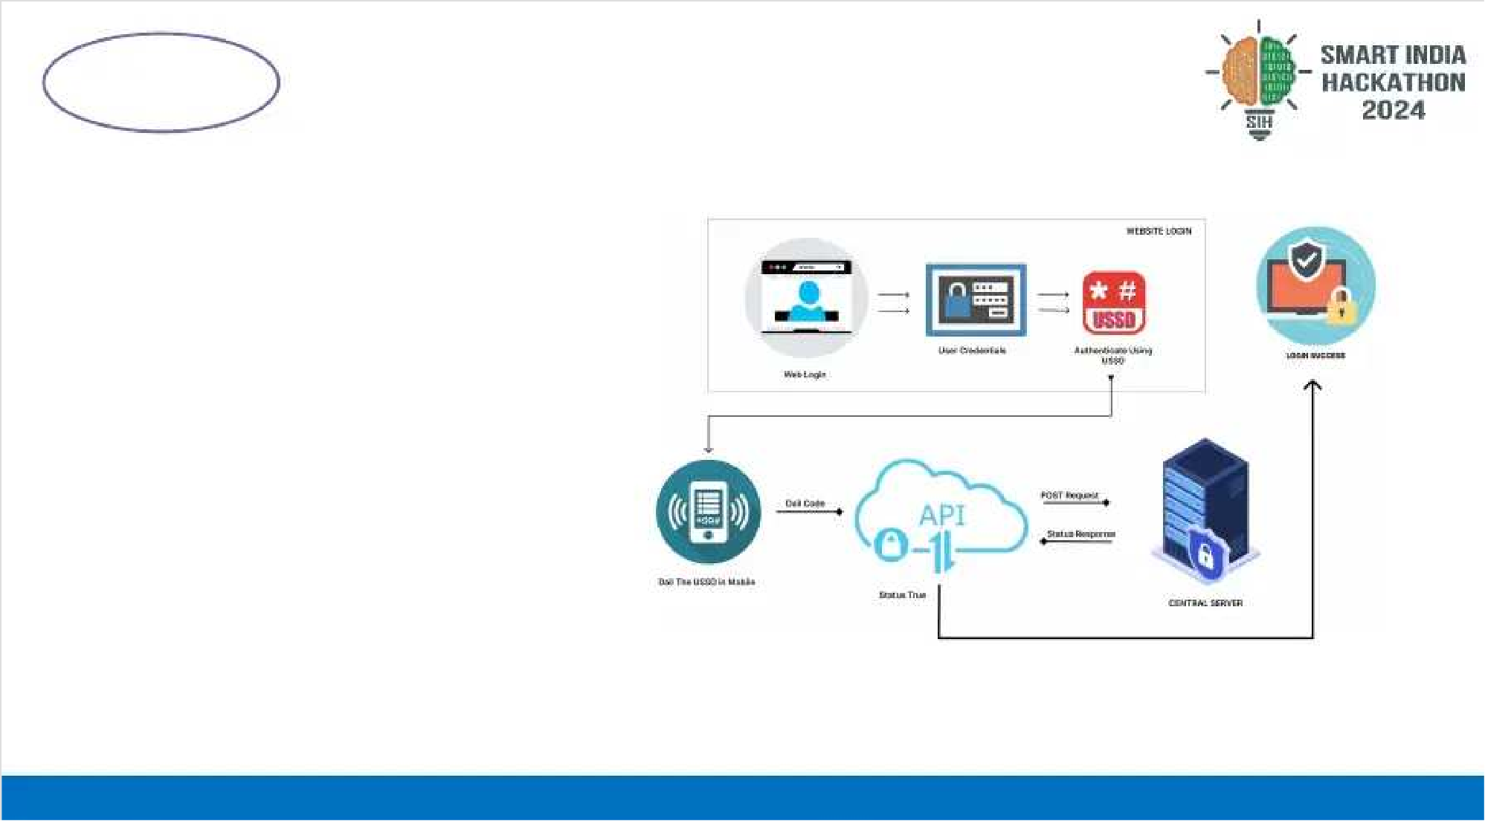


We and our 21 IAB TCF partners store and access information on your device for the following purposes: store and/or access information on a device, advertising and content measurement, audience research, and services development, personalised advertising, and personalised content.
Personal data may be processed to do the following: use precise geolocation data and actively scan device characteristics for identi cation.
Our third party IAB TCF partners may store and access information on your device such as IP address and device characteristics. Our IAB TCF Partners may process this personal data on the basis of legitimate interest, or with your consent. You may change or withdraw your preferences at any time by clicking on the cookie icon or link; however, as a consequence, you may not see relevant ads or personalized content. You may change your settings at any time or accept the default settings. You may close this banner to continue with only essential cookies. Privacy Policy
Storage Preferences Third Parties
Storage
Targeted Advertising Personalization Analytics
TECHNICAL APPROACHTECHNICAL APPROACH_{CODESTRIXCODESTRIX}
PROCESS FLOW ARCHITECTUREPROCESS FLOW ARCHITECTURE
Algorithm Development:Algorithm Development:
Next.js & Express.js - Core technologies usedNext.js & Express.js - Core technologies used for developing the OTH Algorithm.for developing the OTH Algorithm.
Mobile Application Development:Mobile Application Development:
Flutter - Framework used for buildingFlutter - Framework used for building thethe mobile application, ensuring cross-platformmobile application, ensuring cross-platform
compatibility.compatibility.
Encryption and Security:Encryption and Security:
Custom encryption algorithm powered by 8Custom encryption algorithm powered by 8
layer octa 512 bit encryption for secure datalayer octa 512 bit encryption for secure data transmission and atransmission and authentication.uthentication.
Cloud Services:Cloud Services:
MySQL - Relational database managementMySQL - Relational database management
PHP - High responsive Rest APIsPHP - High responsive Rest APIs Product Status:Product Status: 80% product built completed and further build is on80% product built completed and further build is on progress. Tprogress. Testing and validation process areesting and validation process are next to be undergonenext to be undergone
33@SIH Idea submission- Template@SIH Idea submission- Template
Save preferences
Accept All

Slide 4

We and our 21 IAB TCF partners store and access information on your device for the following purposes: store and/or access information on a device, advertising and content measurement, audience research, and services development, personalised advertising, and personalised content.
Personal data may be processed to do the following: use precise geolocation data and actively scan device characteristics for identi cation.
Our third party IAB TCF partners may store and access information on your device such as IP address and device characteristics. Our IAB TCF Partners may process this personal data on the basis of legitimate interest, or with your consent. You may change or withdraw your preferences at any time by clicking on the cookie icon or link; however, as a consequence, you may not see relevant ads or personalized content. You may change your settings at any time or accept the default settings. You may close this banner to continue with only essential cookies. Privacy Policy
Storage Preferences Third Parties
Storage
Targeted Advertising Personalization Analytics
TECHNICAL APPROACHTECHNICAL APPROACH_{CODESTRIXCODESTRIX}
PROCESS FLOW ARCHITECTUREPROCESS FLOW ARCHITECTURE
Algorithm Development:Algorithm Development:
Next.js & Express.js - Core technologies usedNext.js & Express.js - Core technologies used for developing the OTH Algorithm.for developing the OTH Algorithm.
Mobile Application Development:Mobile Application Development:
Flutter - Framework used for buildingFlutter - Framework used for building thethe mobile application, ensuring cross-platformmobile application, ensuring cross-platform
compatibility.compatibility.
Encryption and Security:Encryption and Security:
Custom encryption algorithm powered by 8Custom encryption algorithm powered by 8
layer octa 512 bit encryption for secure datalayer octa 512 bit encryption for secure data transmission and atransmission and authentication.uthentication.
Cloud Services:Cloud Services:
MySQL - Relational database managementMySQL - Relational database management
PHP - High responsive Rest APIsPHP - High responsive Rest APIs Product Status:Product Status: 80% product built completed and further build is on80% product built completed and further build is on progress. Tprogress. Testing and validation process areesting and validation process are next to be undergonenext to be undergone
33@SIH Idea submission- Template@SIH Idea submission- Template
Save preferences
Accept All

Slide 5


We and our 21 IAB TCF partners store and access information on your device for the following purposes: store and/or access information on a device, advertising and content measurement, audience research, and services development, personalised advertising, and personalised content.
Personal data may be processed to do the following: use precise geolocation data and actively scan device characteristics for identi cation.
Our third party IAB TCF partners may store and access information on your device such as IP address and device characteristics. Our IAB TCF Partners may process this personal data on the basis of legitimate interest, or with your consent. You may change or withdraw your preferences at any time by clicking on the cookie icon or link; however, as a consequence, you may not see relevant ads or personalized content. You may change your settings at any time or accept the default settings. You may close this banner to continue with only essential cookies. Privacy Policy
Storage Preferences Third Parties
Storage
Targeted Advertising Personalization Analytics
TECHNICAL APPROACHTECHNICAL APPROACH_{CODESTRIXCODESTRIX}
PROCESS FLOW ARCHITECTUREPROCESS FLOW ARCHITECTURE
Algorithm Development:Algorithm Development:
Next.js & Express.js - Core technologies usedNext.js & Express.js - Core technologies used for developing the OTH Algorithm.for developing the OTH Algorithm.
Mobile Application Development:Mobile Application Development:
Flutter - Framework used for buildingFlutter - Framework used for building thethe mobile application, ensuring cross-platformmobile application, ensuring cross-platform
compatibility.compatibility.
Encryption and Security:Encryption and Security:
Custom encryption algorithm powered by 8Custom encryption algorithm powered by 8
layer octa 512 bit encryption for secure datalayer octa 512 bit encryption for secure data transmission and atransmission and authentication.uthentication.
Cloud Services:Cloud Services:
MySQL - Relational database managementMySQL - Relational database management
PHP - High responsive Rest APIsPHP - High responsive Rest APIs Product Status:Product Status: 80% product built completed and further build is on80% product built completed and further build is on progress. Tprogress. Testing and validation process areesting and validation process are next to be undergonenext to be undergone
33@SIH Idea submission- Template@SIH Idea submission- Template
Save preferences
Accept All

Slide 6

We and our 21 IAB TCF partners store and access information on your device for the following purposes: store and/or access information on a device, advertising and content measurement, audience research, and services development, personalised advertising, and personalised content.
Personal data may be processed to do the following: use precise geolocation data and actively scan device characteristics for identi cation.
Our third party IAB TCF partners may store and access information on your device such as IP address and device characteristics. Our IAB TCF Partners may process this personal data on the basis of legitimate interest, or with your consent. You may change or withdraw your preferences at any time by clicking on the cookie icon or link; however, as a consequence, you may not see relevant ads or personalized content. You may change your settings at any time or accept the default settings. You may close this banner to continue with only essential cookies. Privacy Policy
Storage Preferences Third Parties
Storage
Targeted Advertising Personalization Analytics
TECHNICAL APPROACHTECHNICAL APPROACH_{CODESTRIXCODESTRIX}
PROCESS FLOW ARCHITECTUREPROCESS FLOW ARCHITECTURE
Algorithm Development:Algorithm Development:
Next.js & Express.js - Core technologies usedNext.js & Express.js - Core technologies used for developing the OTH Algorithm.for developing the OTH Algorithm.
Mobile Application Development:Mobile Application Development:
Flutter - Framework used for buildingFlutter - Framework used for building thethe mobile application, ensuring cross-platformmobile application, ensuring cross-platform
compatibility.compatibility.
Encryption and Security:Encryption and Security:
Custom encryption algorithm powered by 8Custom encryption algorithm powered by 8
layer octa 512 bit encryption for secure datalayer octa 512 bit encryption for secure data transmission and atransmission and authentication.uthentication.
Cloud Services:Cloud Services:
MySQL - Relational database managementMySQL - Relational database management
PHP - High responsive Rest APIsPHP - High responsive Rest APIs Product Status:Product Status: 80% product built completed and further build is on80% product built completed and further build is on progress. Tprogress. Testing and validation process areesting and validation process are next to be undergonenext to be undergone
33@SIH Idea submission- Template@SIH Idea submission- Template
Save preferences
Accept All

Slide 7

We and our 21 IAB TCF partners store and access information on your device for the following purposes: store and/or access information on a device, advertising and content measurement, audience research, and services development, personalised advertising, and personalised content.
Personal data may be processed to do the following: use precise geolocation data and actively scan device characteristics for identi cation.
Our third party IAB TCF partners may store and access information on your device such as IP address and device characteristics. Our IAB TCF Partners may process this personal data on the basis of legitimate interest, or with your consent. You may change or withdraw your preferences at any time by clicking on the cookie icon or link; however, as a consequence, you may not see relevant ads or personalized content. You may change your settings at any time or accept the default settings. You may close this banner to continue with only essential cookies. Privacy Policy
Storage Preferences Third Parties
Storage
Targeted Advertising Personalization Analytics
IMPORTANTIMPORTANT INSTRUCTIONSINSTRUCTIONS
Please ensure below pointers arePlease ensure below pointers are met while submitting the Idea PPTmet while submitting the Idea PPT::
1.1. Kindly keep the maximum slides limit upKindly keep the maximum slides limit up to sixto six (6).(6). ( Including the title slide)( Including the title slide)
2.2. TTry to avoidry to avoid paragraphs and post yourparagraphs and post your idea in points /diagrams / Infographics /picturesidea in points /diagrams / Infographics /pictures
3.3. Keep your explanation precise and easy to understandKeep your explanation precise and easy to understand
4.4. Idea should be unique and novel.Idea should be unique and novel.
5.5. YYouou cancan onlyonly useuse providedprovided templatetemplate forfor makingmaking thethe PPTPPT withoutwithout changingchanging thethe ideaidea detailsdetails pointerspointers (mentioned in previous slides).(mentioned in previous slides).
6.6. YYouou needneed toto savesave thethe filefile inin PDFPDF andand uploadupload thethe samesame onon portal.portal. NoNo PPTPPT,, WordWord DocDoc oror anyany otherother
format will be supported.format will be supported.
NoteNote -- YouYou cancan deletedelete thisthis slideslide (Important(Important Pointers)Pointers) whenwhen youyou uploadupload thethe detailsdetails ofof youryour ideaidea onon SIHSIH portal.portal.
77@SIH Idea submission- Template@SIH Idea submission- Template
Save preferences
Accept All

