Slide 1

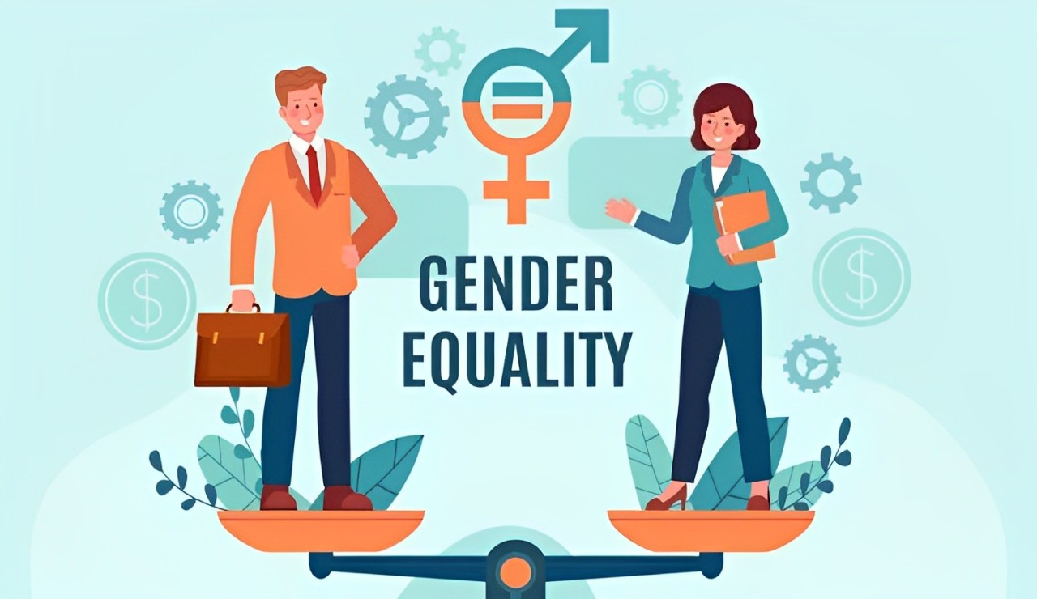
#SDG5
GENDER EQUALITY
BY
NITHILLAKRISHI
ARJUN

Slide 2
“Achieve gender equality and empower all women and girls”

Slide 3
OVERVIEW
INTRODUCTION
UN TARGETS
PROMOTING GENDER EQUALITY:A SHARED RESPONSIBILITY
CONCLUSION

Slide 4
WHAT IS GENDER EQUALITY?
GENDER EQUALITY, ALSO KNOWN AS SEXUAL EQUALITY OR EQUALITY OF THE SEXES, IS THE STATE OF EQUAL EASE OF ACCESS TO RESOURCES AND OPPORTUNITIES REGARDLESS OF GENDER, INCLUDING ECONOMIC PARTICIPATION AND DECISION-MAKING, AND THE STATE OF VALUING DIFFERENT BEHAVIORS, ASPIRATIONS, AND NEEDS EQUALLY, ALSO REGARDLESS OF GENDER.

Slide 5
UN TARGETS
TARGET 5.1
END ALL FORMS OF DISCRIMINATION AGAINST ALL WOMEN AND GIRLS EVERYWHERE.
TARGET 5.2
ELIMINATE ALL FORMS OF VIOLENCE AGAINST ALL WOMEN AND GIRLS IN THE PUBLIC AND PRIVATE SPHERES, INCLUDING TRAFFICKING AND SEXUAL AND OTHER TYPES OF EXPLOITATION.

Slide 6
UN TARGETS
TARGET 5.3
ELIMINATE ALL HARMFUL PRACTICES, SUCH AS CHILD, EARLY AND FORCED MARRIAGE AND FEMALE GENITAL MUTILATION.
TARGET 5.4
RECOGNIZE AND VALUE UNPAID CARE AND DOMESTIC WORK THROUGH THE PROVISION OF PUBLIC SERVICES, INFRASTRUCTURE AND SOCIAL PROTECTION POLICIES AND THE PROMOTION OF SHARED RESPONSIBILITY WITHIN THE HOUSEHOLD AND THE FAMILY AS NATIONALLY APPROPRIATE.

Slide 7
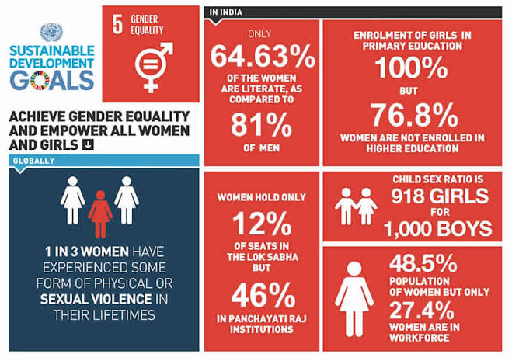
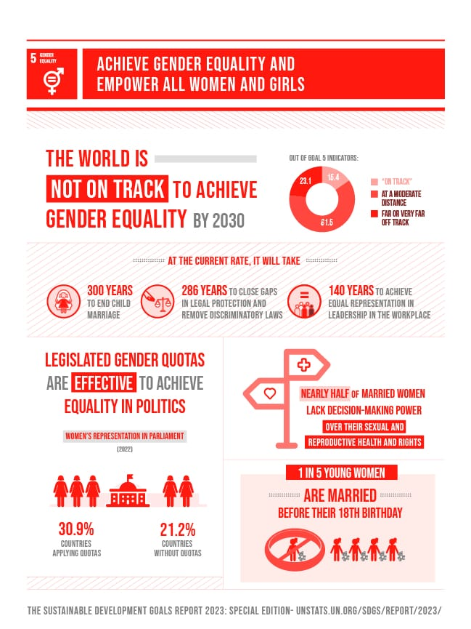


Slide 8
UN TARGETS
TARGET 5.5
ENSURE WOMEN’S FULL AND EFFECTIVE PARTICIPATION AND EQUAL OPPORTUNITIES FOR LEADERSHIP AT ALL LEVELS OF DECISION-MAKING IN POLITICAL, ECONOMIC AND PUBLIC LIFE.
TARGET 5.6
ENSURE UNIVERSAL ACCESS TO SEXUAL AND REPRODUCTIVE HEALTH AND REPRODUCTIVE RIGHTS AS AGREED IN ACCORDANCE WITH THE PROGRAMME OF ACTION OF THE INTERNATIONAL CONFERENCE ON POPULATION AND DEVELOPMENT AND THE BEIJING PLATFORM FOR ACTION AND THE OUTCOME DOCUMENTS OF THEIR REVIEW CONFERENCES.

Slide 9
UN TARGETS
TARGET 5.7
UNDERTAKE REFORMS TO GIVE WOMEN EQUAL RIGHTS TO ECONOMIC RESOURCES, AS WELL AS ACCESS TO OWNERSHIP AND CONTROL OVER LAND AND OTHER FORMS OF PROPERTY, FINANCIAL SERVICES, INHERITANCE AND NATURAL RESOURCES, IN ACCORDANCE WITH NATIONAL LAWS.

Slide 10
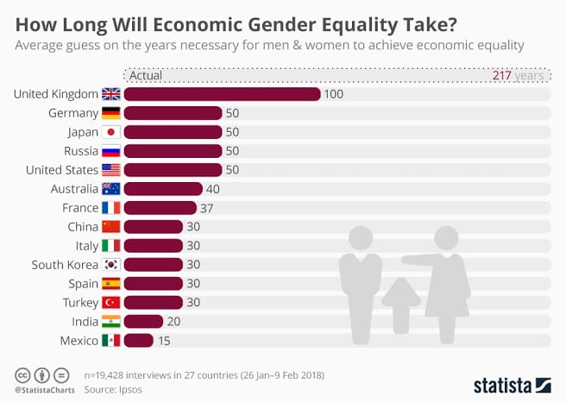
STATISTICS

Slide 11
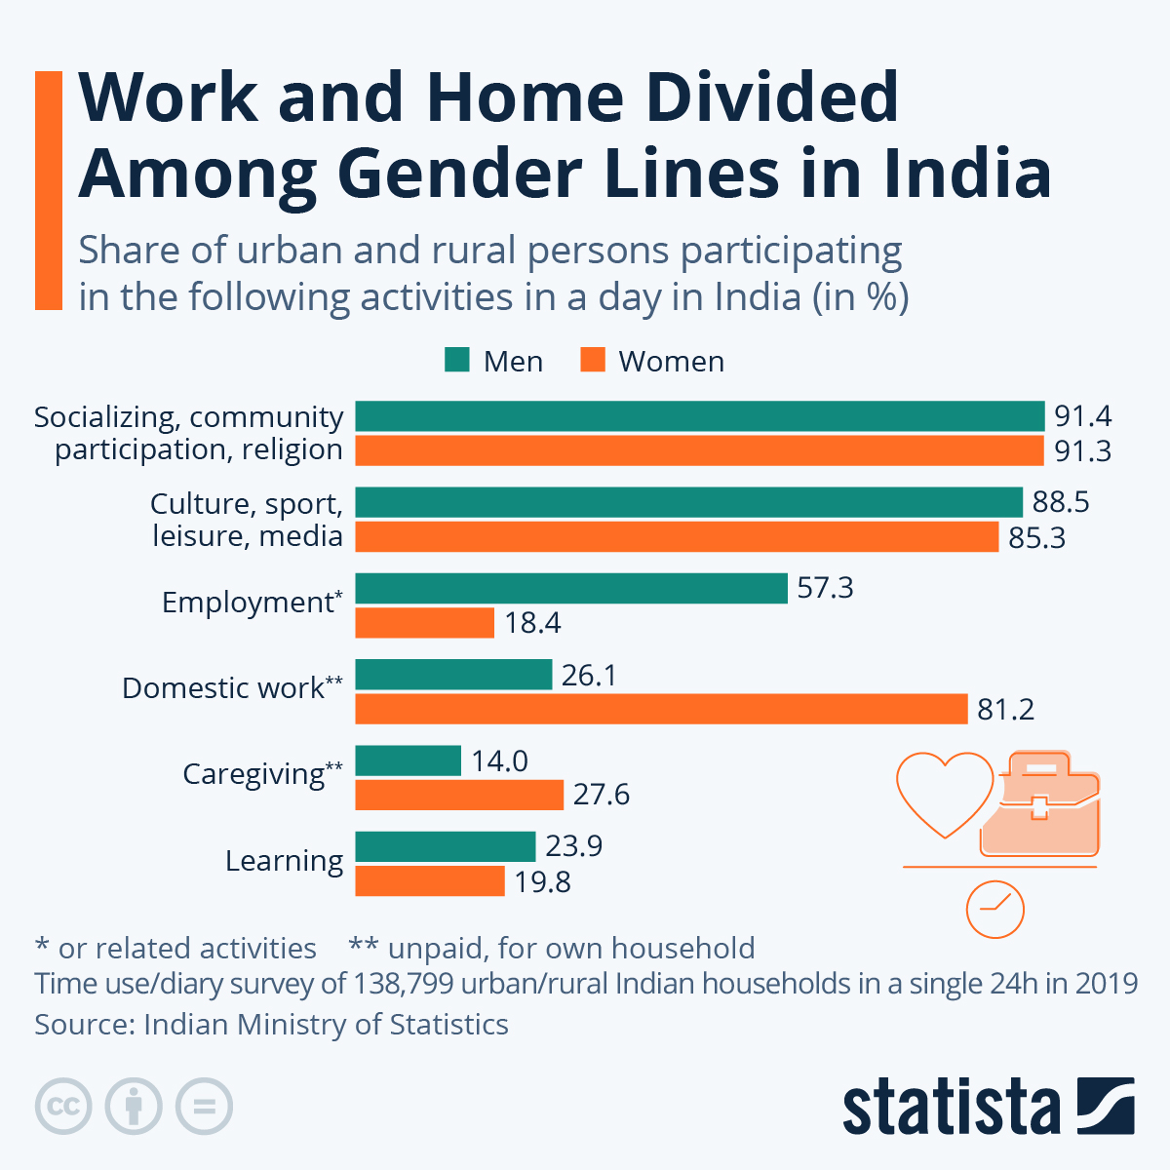
STATISTICS

Slide 12
PROMOTING GENDER EQUALITY:A SHARED RESPONSIBILITY
MEN HAVE THE RIGHT TO NURTURING ROLES AND SHOULD BE SUPPORTED IN THIS.
THEY ALSO BEAR RESPONSIBILITIES FOR CHILD HEALTH AND SEXUAL/REPRODUCTIVE HEALTH.
RECOGNIZING MEN’S SPECIFIC HEALTH ISSUES IS ESSENTIAL.
A GENDER PERSPECTIVE REVEALS:
1)DISADVANTAGES MEN FACE FROM GENDER NORMS.
2)THE IMPORTANCE OF ADDRESSING BOTH MEN’S AND WOMEN’S NEEDS.

Slide 13
PROMOTING GENDER EQUALITY:A SHARED RESPONSIBILITY
MORE WOMEN IN THE LABOR MARKET, BUT INEQUALITIES REMAIN.
WOMEN FACE DENIED WORK RIGHTS COMPARED TO MEN.
MAJOR BARRIERS:
1)SEXUAL VIOLENCE AND EXPLOITATION.
2)UNEQUAL UNPAID CARE AND DOMESTIC WORK.
3)DISCRIMINATION IN PUBLIC OFFICE.
CLIMATE CHANGE AND DISASTERS DISPROPORTIONATELY AFFECT WOMEN AND GIRLS.

Slide 14
CONCLUSION
REGARDLESS OF WHERE YOU LIVE IN, GENDER EQUALITY IS A FUNDAMENTAL HUMAN RIGHT. ADVANCING GENDER EQUALITY IS CRITICAL TO ALL AREAS OF A HEALTHY SOCIETY, FROM REDUCING POVERTY TO PROMOTING THE HEALTH, EDUCATION, PROTECTION AND THE WELL-BEING OF GIRLS AND BOYS.

Slide 15
Thank you
Any questions?

