Slide 1
Gen AI Orchestrator for Email and Document Triage/Routing
Team: AIvengers

Slide 2

Team Members
Captain: Gadde, Uma bhargavi
R, Pavithra
Thopireddy, Harikishan reddy
Y, Sristhi
Chennupati, Rishika K.

Slide 3

PROBLEM STATEMENT
Commercial Bank Lending Service teams handle a high volume of servicing requests via email, often with attachments. These emails require manual triage by gatekeepers who read, classify request types, extract key details, and assign tasks to the right teams. This process is time-consuming, error-prone, and inefficient, especially at scale.
The challenge is to automate email classification and data extraction using Generative AI (LLMs) to improve accuracy, efficiency, and turnaround time while minimizing manual effort. The solution should classify emails, extract relevant information for service requests, and enable skill-based auto-routing to the appropriate processing teams.

Slide 4

SOLUTION PROPOSED
AI-Powered Email Processing: Automates email extraction, classification, and analysis, including attachments, using LLMs and GenAI Agents.
Multi-Format Support: Processes email text along with PDFs, images, PowerPoint slides, and Excel sheets.
Advanced LLM, AI Agents: Uses LLM for scanned images/PDFs and Agents for intent classification and prioritization.
RAG : Check duplicate emails by using vector store technique .
Holistic Analysis: Merges structured (Excel, PPT) and unstructured (text, images) email content for better insights.

Slide 5

TECH STACK/TOOLS
1. Python
2. Frontend - Streamlit
3. LLM
4. CrewAI (Agentic AI)
5. GMail API -Python client
6. Text Extraction
i. Pdfplumber - Document
ii. Pptx - Powerpoint
iii. Pandas - Excel
iv. PyTesseract - Image
7. Vector store – Fiass (cpu)

Slide 6
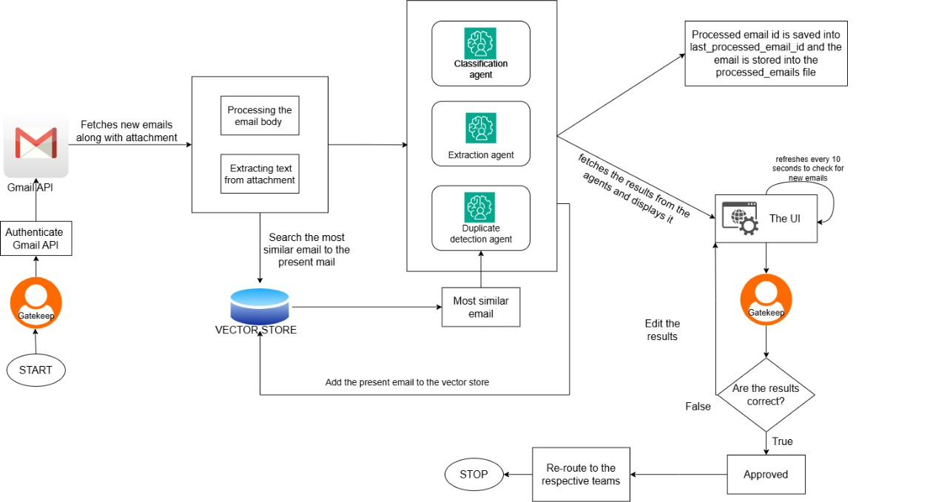
ARCHITECTURE DIAGRAM

Slide 7

WORKFLOW
The process consists of 5 key stages:
1. Gmail Authentication & Email Fetching
2. Email Processing (Classification, Duplicate Check, Field Extraction)
3. Storing Processed Emails
4. Displaying Emails in UI
5. Auto-Refresh & Continuous Processing

Slide 8
CHALLENGES FACED
Handling Different Attachment Formats
Extracting Text from Images and Scanned PDFs
Efficient Email Retrieval
Categorizing Diverse Email Content
Handling Large-Scale Email Processing

Slide 9
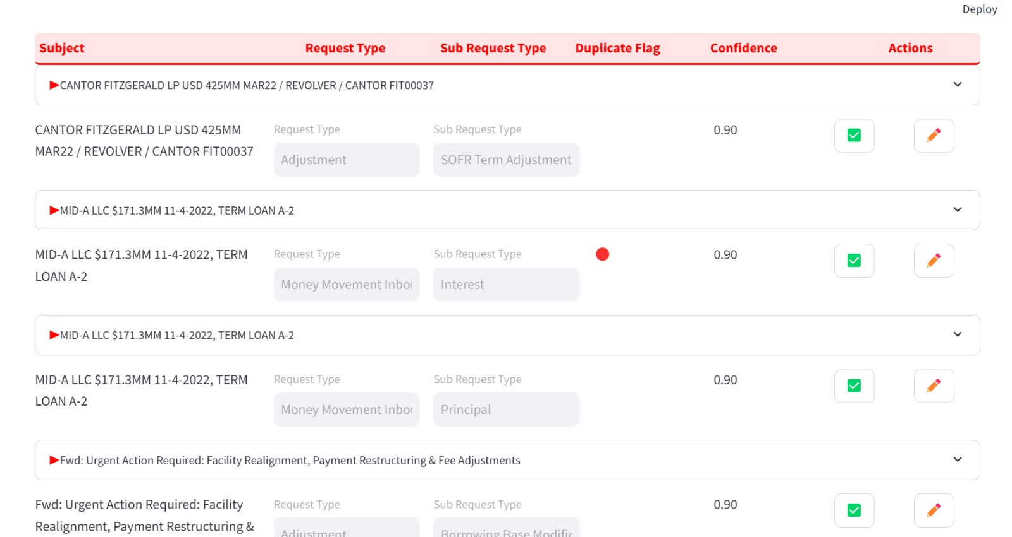
USER INTERFACE

Slide 10
FUTURE SCOPE
Voice and Audio Email Processing – Adding speech-to-text (STT) capabilities to process voice emails, voicemail transcriptions, and support calls embedded in emails.
Enhanced Security and Compliance – Implementing AI-powered threat detection for phishing, spam, and fraudulent emails, while ensuring compliance with regulations.
Advanced LLMs – Fine-tuning larger transformer-based models like GPT-4, BERT, or T5 to improve accuracy in intent classification, named entity recognition (NER), and contextual understanding of emails.

Slide 11
CONCLUSION
The implemented solution efficiently processes and categorizes emails by leveraging a combination of format-specific parsers, OCR technologies, optimized API calls, fine-tuned AI models and AI agents, and scalable processing techniques.
By incorporating the enhancements, the system can evolve into an enterprise-grade, AI-powered email management solution, capable of automating classification, response generation, and real-time insights for businesses across industries.

Slide 12
Thank You!
We’d be happy to answer any questions you may have!

