Slide 1
Improved Source of Drinking Water
CAPSTONE PROJECT
Presented By:
Student Name - KOKKILIGADDA HARI KISHORE
College Name - R.V.R & J.C COLLEGE OF ENGINEERING
Department - CSE(Computer science and engineering)

Slide 2
OUTLINE
Problem Statement (Should not include solution)
Proposed System/Solution
System Development Approach (Technology Used)
Algorithm & Deployment
Result (Output Image)
Conclusion
Future Scope
References

Slide 3
Problem Statement
The Challenge: Access to safe and improved sources of drinking water remains a critical issue in India, especially in rural and underdeveloped regions. Despite ongoing efforts under the Sustainable Development Goals (SDGs), inequalities persist in water accessibility across states and socio-economic groups. This project aims to analyze data from the 78th Round of the Multiple Indicator Survey (MIS) to assess the percentage of the population with access to improved drinking water sources. It will also explore related indicators such as use of clean cooking fuel and migration trends. By identifying patterns and disparities, the study will generate actionable insights to support evidence-based policymaking. The ultimate goal is to help ensure equitable access to clean water and contribute to India's progress on SDG targets.

Slide 4
Proposed Solution
To address the disparities in access to safe drinking water and related SDG targets, the following data-driven and policy-supporting solution is proposed:
1. Data Collection & Preprocessing
Source: Use publicly available microdata from the 78th Round of the Multiple Indicator Survey (MIS) conducted by the National Sample Survey Office (NSSO).
Clean and preprocess the data to handle missing values, ensure consistency, and standardize variables (e.g., type of water source, region, income group).
2. Data Analysis & Visualization
Perform descriptive and inferential statistical analysis to:
Estimate the percentage of population with access to improved vs. unimproved drinking water sources.
Compare urban vs. rural access levels.
Analyze regional disparities across states and union territories.

Slide 5
Cont…
3. Geo-Spatial Mapping
Create state-wise or district-wise heatmaps to identify hotspots lacking improved water sources.
Use GIS tools or libraries (e.g., GeoPandas, Folium) for geographic analysis.
4. Disparity & Vulnerability Analysis
Segment data by income levels, social groups (SC/ST/OBC), gender, and educational background.
Identify vulnerable populations most affected by lack of water access.
Perform inequality indexing using tools like the Gini coefficient or Lorenz curve where applicable.
5. Predictive Modeling (Optional Advanced Step)
Develop predictive models (e.g., logistic regression, decision trees) to identify risk factors for inadequate water access.
Forecast potential future water stress zones based on migration and access patterns.

Slide 6
Cont…
6. Policy Recommendations:
Based on findings, propose:
Targeted interventions in under-served regions.
Prioritized resource allocation for clean water infrastructure.
Integration of clean water and cooking fuel policies to maximize impact.
Recommendations for improving data collection in future MIS rounds to enhance granularity.

Slide 7
System Approach
1.System Requirements:
Hardware Requirements:
Operating System: Windows 10
Processor: Intel Core i5
RAM: 8 GB minimum recommended
Disk Space: 10+ GB of free storage for data processing
Software Requirements:
Python Version: 3.8 or higher
Development Environment: Jupyter Notebook / VS Code / Anaconda

Slide 8
Cont...
2. Libraries Required to Build the Model:
The following Python libraries are used to perform data cleaning, analysis, visualization, and optional machine learning:
pandas | Data manipulation and tabular analysis
numpy | Numerical computations
matplotlib | Basic plotting
seaborn | Statistical visualization (bar charts, heatmaps, etc.)
plotly | Interactive charts and graphs
geopandas | Spatial data handling and mapping
folium | Interactive maps and regional visualizations
scikit-learn | (Optional) Modeling, clustering, prediction tasks
openpyxl | Read/write Excel files if needed

Slide 9
Algorithm & Deployment
Multi-Class Classification Approach:
Data Collection
Load MIS 78th Round dataset from AIKOSH
Data Preprocessing
Handle missing and inconsistent values
Encode categorical features (e.g., water source type, income group)
Feature Selection
Identify key features (e.g., region, household income, cooking fuel type, education level)
Model Training
Apply Multi-Class Classification using:
Logistic Regression / Decision Tree / Random Forest / XGBoost
Use IBM Watson Studio AutoAI
Model Evaluation
Use metrics: Accuracy, Precision, Recall, F1-Score
Visualize confusion matrix for class-wise performance
Prediction
Predict the type of drinking water source access (e.g., tap, hand pump, well, others)

Slide 10
Cont…
Deployment on IBM Cloud:
Platform Used
IBM Cloud with Watson Studio / Cloud Pak for Data
Model Hosting
Deploy trained model as a web service API
Use IBM Machine Learning instance for real-time predictions
User Interface
Integrated with a front-end (Streamlit / simple Flask app)
Accepts inputs: Region, income group, fuel usage
Displays: Predicted water source category + visualization
Scalability & Access
Hosted on IBM Cloud, accessible via public endpoint
Supports multiple users for policy or field use

Slide 11
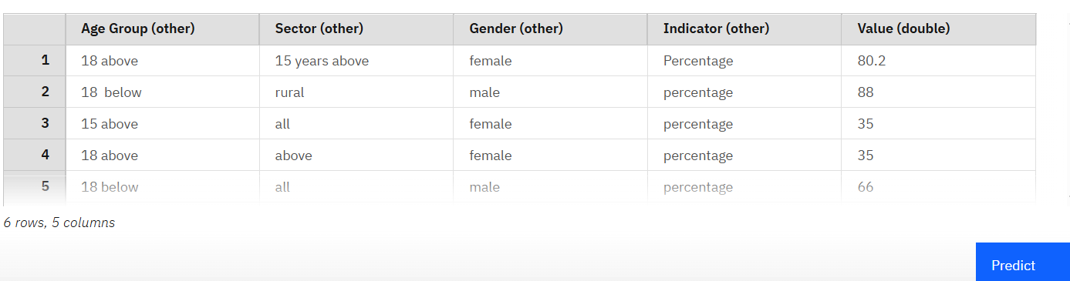
Result

Slide 12
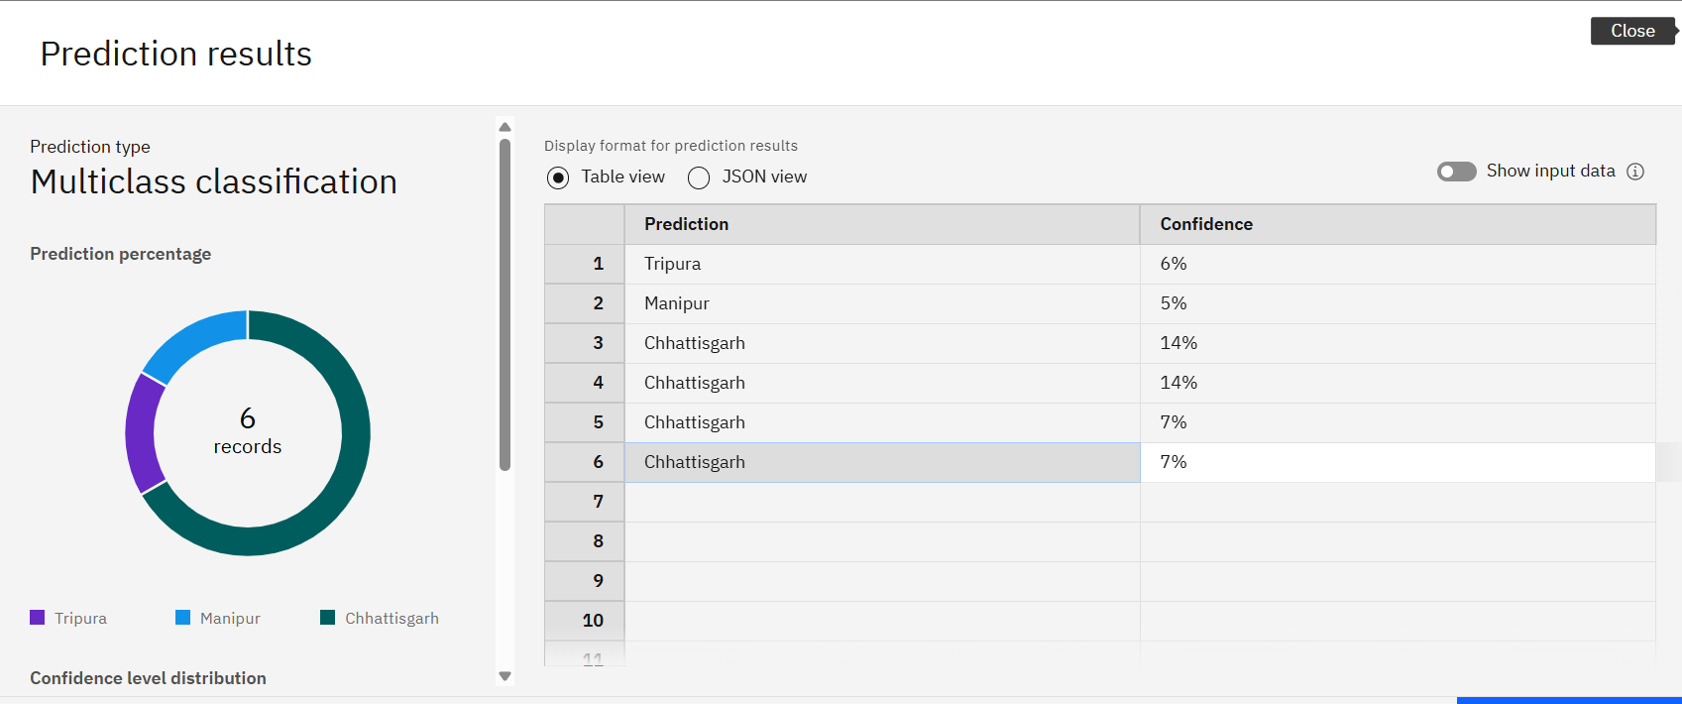
cont…

Slide 13
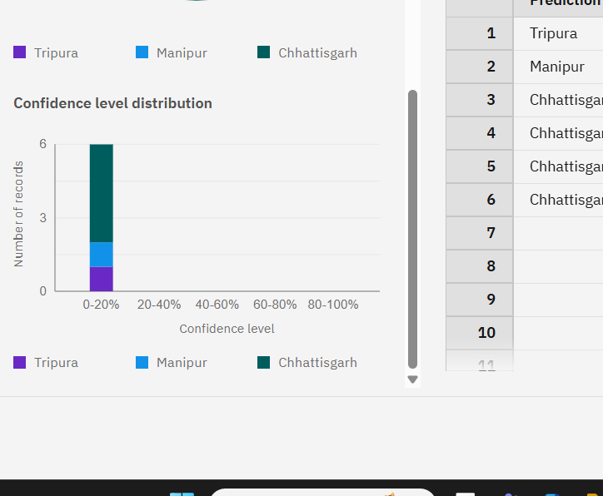
Cont…
Multi-class classification model predicted Indian states based on water quality indicators and demographics, with low confidence suggesting data imbalance. Highest water access seen in rural males under 18 (88%), while older females showed lowest (35%). Model tuning and feature engineering recommended to improve accuracy.

Slide 14
Conclusion
The project highlights critical disparities in access to improved drinking water across various states, sectors, age groups, and genders in India.
Data analysis reveals that rural areas and certain social groups still face significant challenges in accessing safe drinking water.
The insights generated from this study can support evidence-based policymaking and targeted resource allocation.
This work aligns with the goals of Sustainable Development Goal 6 (Clean Water and Sanitation) and can help monitor India's progress toward achieving equitable access to water.

Slide 15
Future scope
Scalability Across Regions:
The model can be expanded to include more granular data (district/village level), allowing policymakers to target interventions more effectively.
It can also be adapted for other countries with similar demographic and water access issues.
Integration with Real-Time Data:
The model can be integrated with IoT or smart sensors in the future to receive real-time water quality and availability data, enhancing prediction accuracy.
Real-time alerts can help authorities act promptly in regions showing signs of water scarcity.
Policy and Planning Tool:
Government agencies and NGOs can use the model’s insights to design water distribution systems and plan infrastructure development.
It can help prioritize high-risk areas for urgent attention.

Slide 16
Cont…
Machine Learning Model Enhancement:
With additional data and training, the model’s accuracy can be improved using advanced algorithms like ensemble models or deep learning.
Features like seasonality, climate data, or economic indicators could also be added for better predictions
Public Dashboard & Awareness:
A user-friendly dashboard could be developed for public access, enabling citizens to understand water accessibility in their areas.
This increases public awareness and encourages local-level action.
Support for SDG Goals:
Aligns with the United Nations Sustainable Development Goal 6: Clean Water and Sanitation.
Can help track progress toward ensuring universal and equitable access to safe and affordable drinking water.

Slide 17
References
Ministry of Jal Shakti, Government of India. National Drinking Water Program – Survey Reports
https://jalshakti-ddws.gov.in
IBM Watsonx Platform – Official Documentation
https://www.ibm.com/products/watsonx
IBM Cloud – AI and Machine Learning Services
https://cloud.ibm.com
AI Kosh Dataset Link – https://aikosh.indiaai.gov.in/web/datasets/details/improved_source_of_drinking_water_ multiple_indicator_survey_78th_round.html
Scikit-learn Documentation (for classification model reference).
https://scikit-learn.org/stable/
GIT-HUB Link : https://github.com/Harikishore71/IBM-Cloud-Project

Slide 18
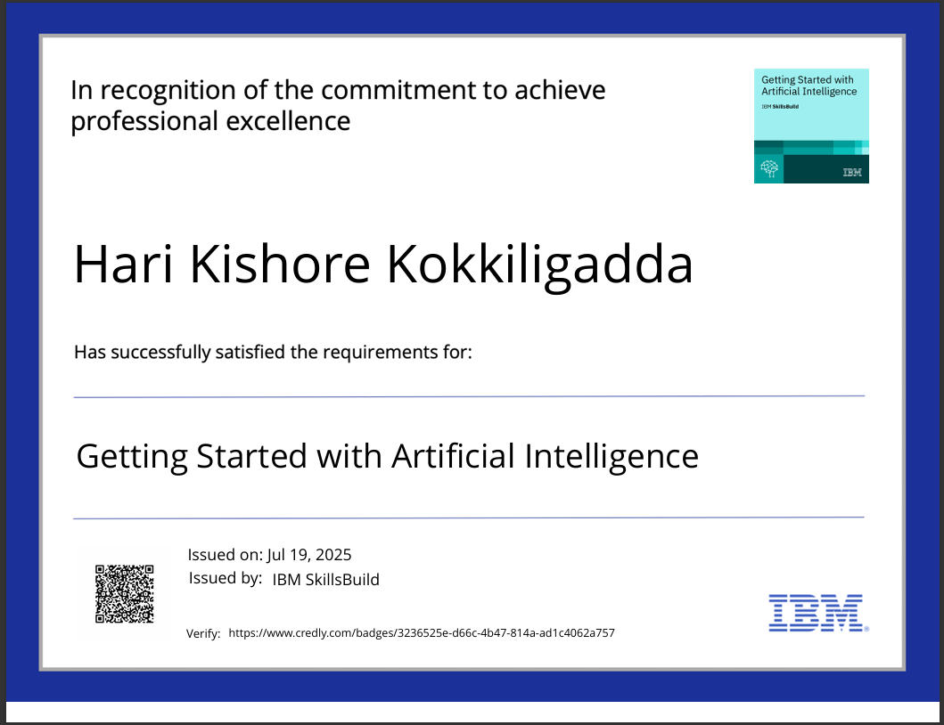
IBM Certifications

Slide 19
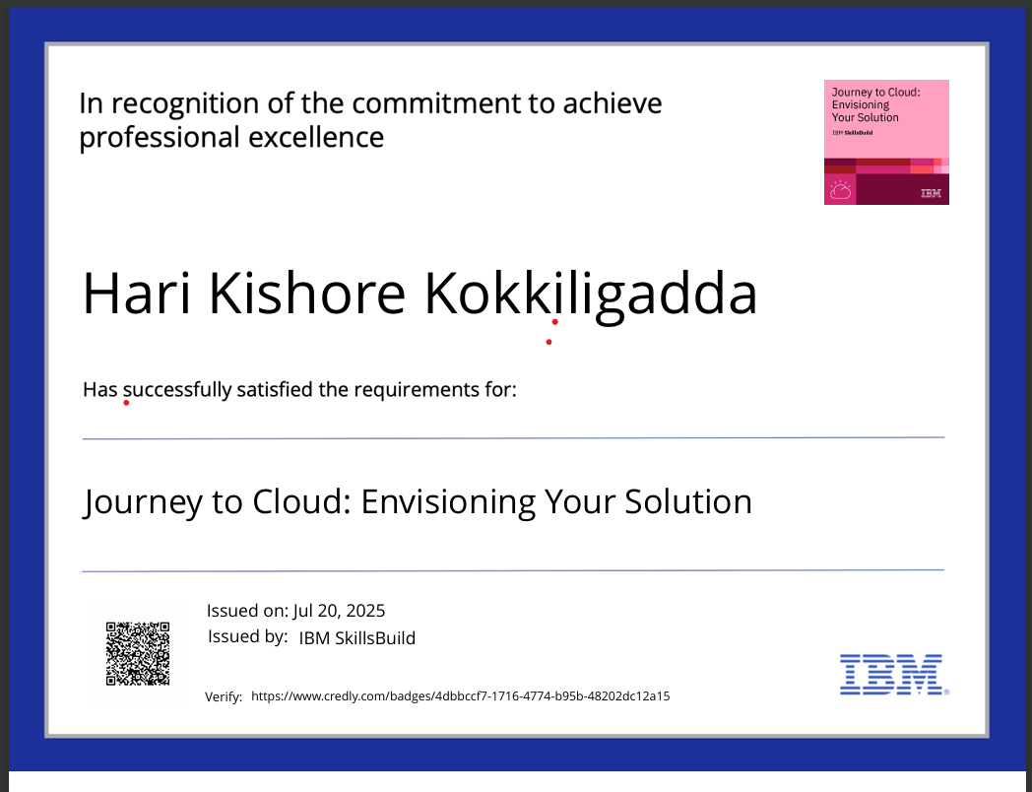
IBM Certifications

Slide 20
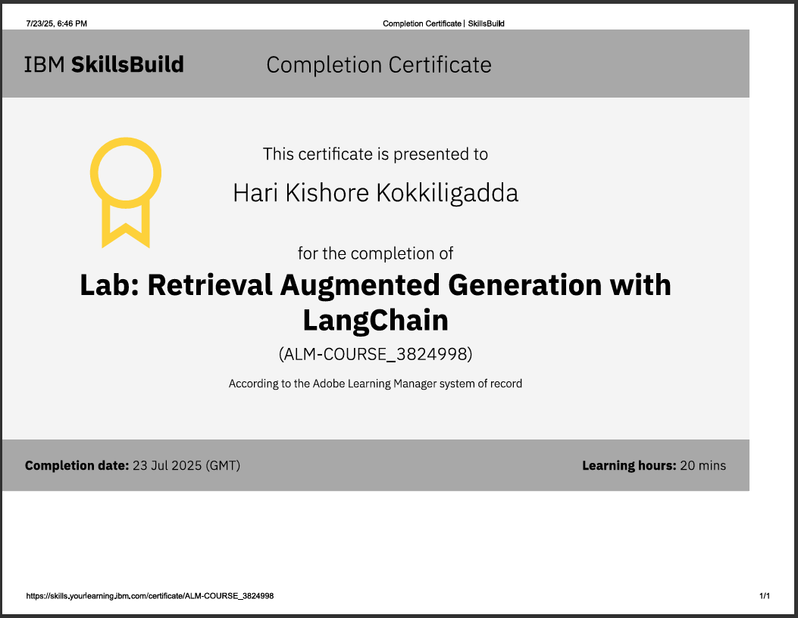
IBM Certifications

Slide 21
THANK YOU

