Slide 1


PROJECT : SMART IRRIGATION
KOKKILIGADDA HARI KISHORE
AICTE_ID:STU672b98afc2ebe1730910383
STUDENT_ID:y23cs071

Slide 2

Learning Objectives:
Understand how to use environmental sensor data (e.g., temperature, humidity, soil moisture) for decision-making in irrigation.
Learn to preprocess and analyze data using Python libraries such as Pandas and NumPy.
Apply machine learning techniques to predict irrigation needs.
Evaluate model performance using metrics like accuracy and confusion matrix.
Gain practical experience in developing an automation pipeline for agriculture using data-driven methods.
GOAL
Source :
www.freepik.com/

Slide 3
.
.
).
Pandas – Data manipulation and preprocessing.
Pandas – Data manipulation and preprocessing.
Tools and Technology used :
Python – Core programming language for scripting and automation.
Jupyter Notebook – For writing and testing code in an interactive environment.
Pandas – Data manipulation and preprocessing.
NumPy – Numerical computing and array operations.
Matplotlib / Seaborn – Data visualization.
Scikit-learn – Machine learning algorithms and model evaluation.
Streamlit (optional) – For building a user interface (dashboard).
IoT Sensor Simulation or Real Sensors – Soil moisture, temperature, humidity (hardware or simulated).
CSV or Sensor Data Files – As input for training/testing models

Slide 4
.
Apply classification algorithms (e.g., Decision Tree, Random Forest) using Scikit-learn.
Methodology
Data Collection:
Gather environmental data such as soil moisture, temperature, and humidity.
Data may be simulated or collected from real IoT sensors.
2. Data Preprocessing:
Handle missing values, encode categorical variables, and normalize features using libraries like Pandas and Scikit-learn
3. Train-Test Split:
Divide the dataset into training and testing sets to evaluate model performance effectively.
4. Model Training:
Apply classification algorithms (e.g., Decision Tree, Random Forest) using Scikit-learn.
5. Model Evaluation:
Assess model accuracy and performance using metrics like confusion matrix, accuracy score, etc.
6. Decision Logic:
Use the trained model to decide whether irrigation is needed based on new input data.
7. Output / Visualization:
Display the prediction and relevant data using print statements or a UI tool like Streamlit.

Slide 5
Problem Statement:
Traditional irrigation methods often lead to over-irrigation or under-irrigation,
which results in:
Reduced crop yields
Increased manual labor
Lack of real-time decision making
Wastage of water resources
With climate variability and growing water scarcity, there's a pressing need for a smart, automated
irrigation system that makes data-driven decisions using environmental inputs like soil moisture,
temperature, and humidity.
GITHUB link:
https://github.com/Harikishore71/Smart_irrigation_AICTE_Shell.git

Slide 6
Solution:
The proposed Smart Irrigation System uses a machine learning-based approach to automate the irrigation process by:
Collecting real-time environmental data (e.g., soil moisture, temperature, humidity).
Preprocessing the data to ensure it's clean and usable.
Applying a trained machine learning model to predict whether irrigation is needed
Making automated irrigation decisions based on model output
Optionally, using a Streamlit-based dashboard to visualize predictions and data
This solution enables efficient water use, reduces human effort, and promotes
sustainable agriculture

Slide 7
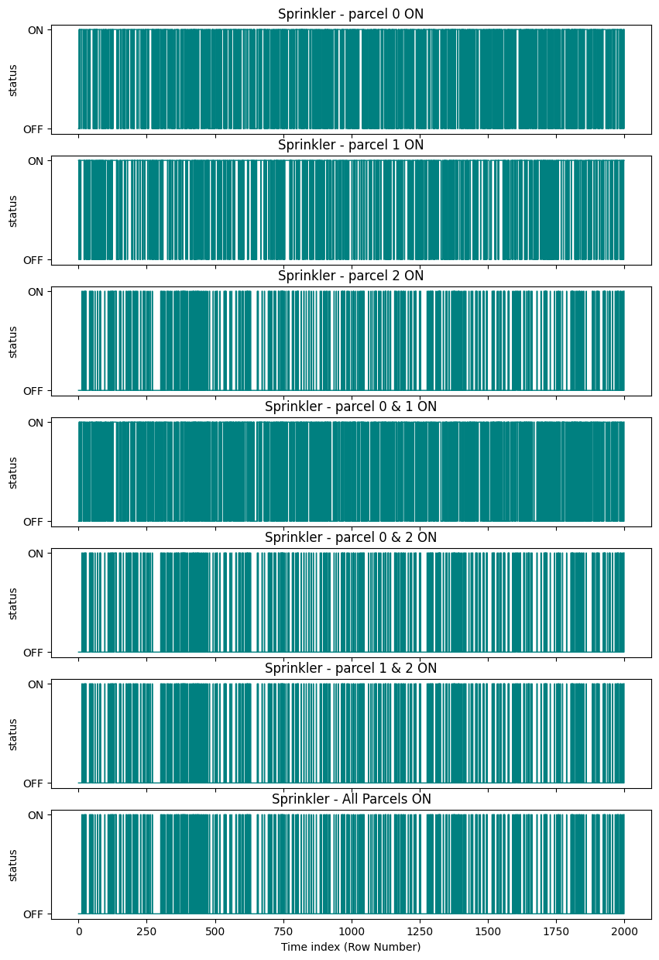
Screenshot of Output:

Slide 8
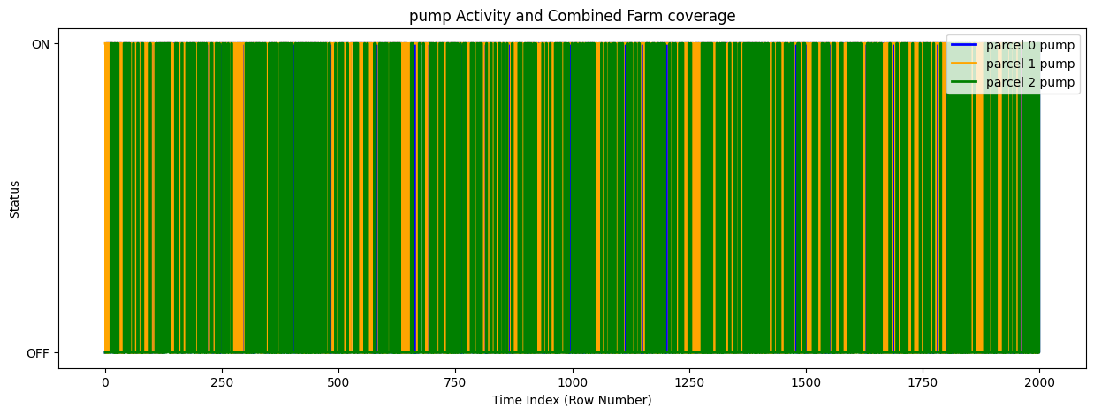
Screenshot of Output:

Slide 9
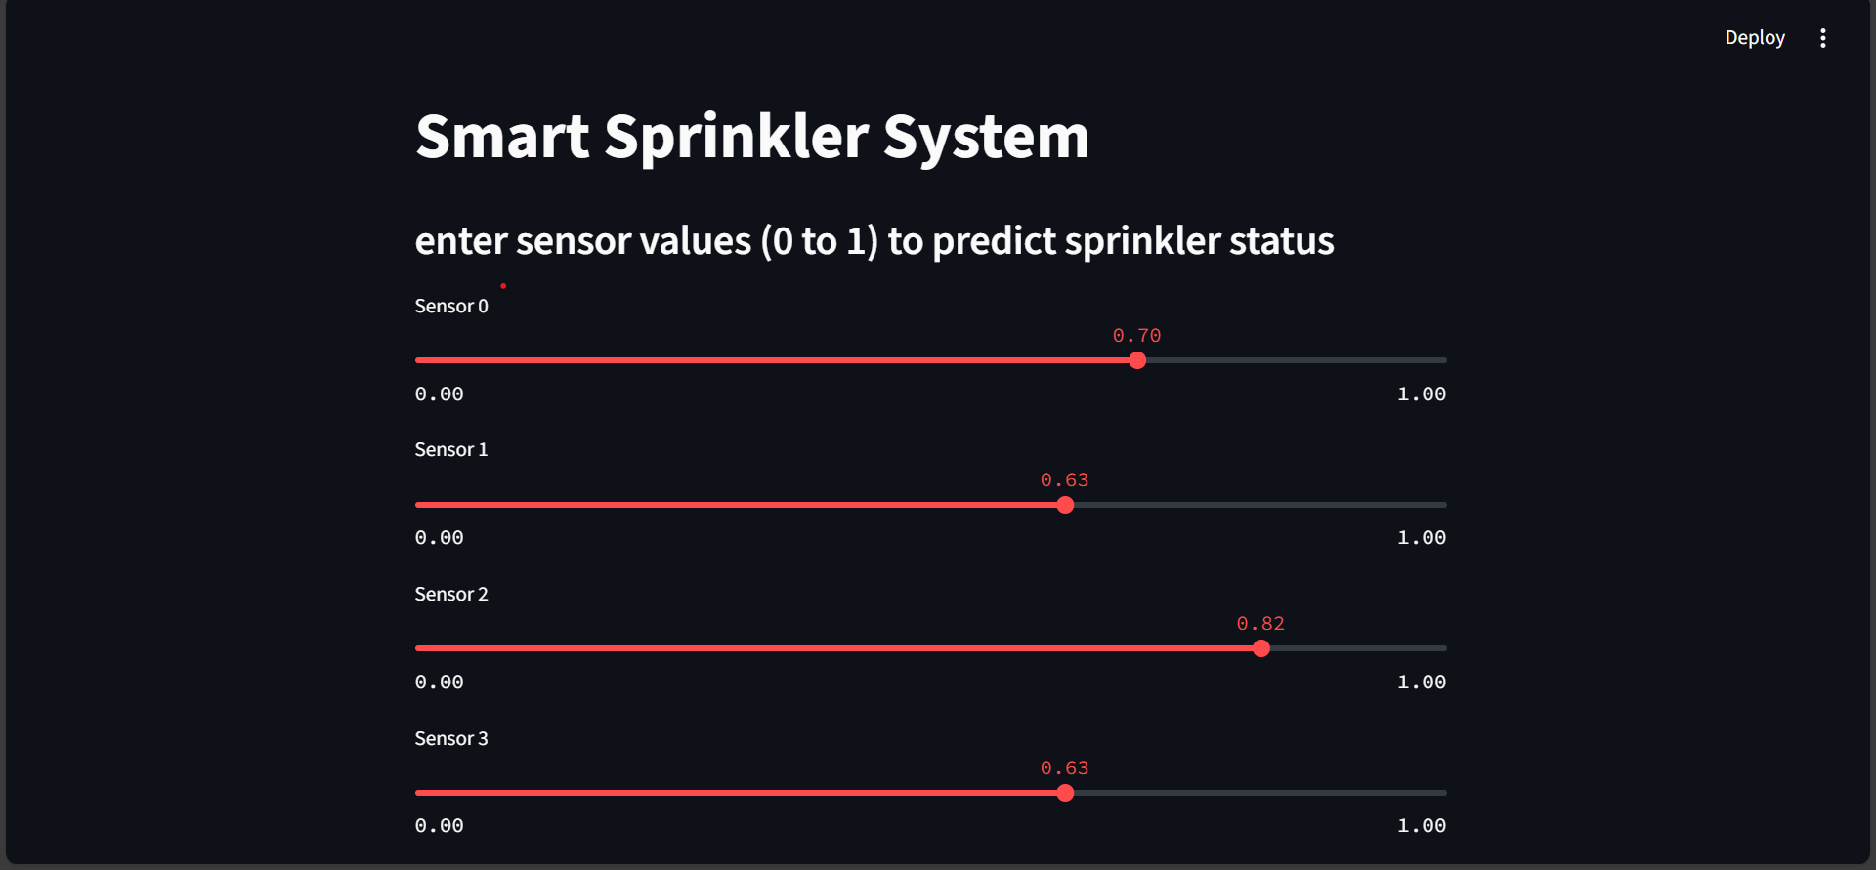
Screenshot of Output:

Slide 10
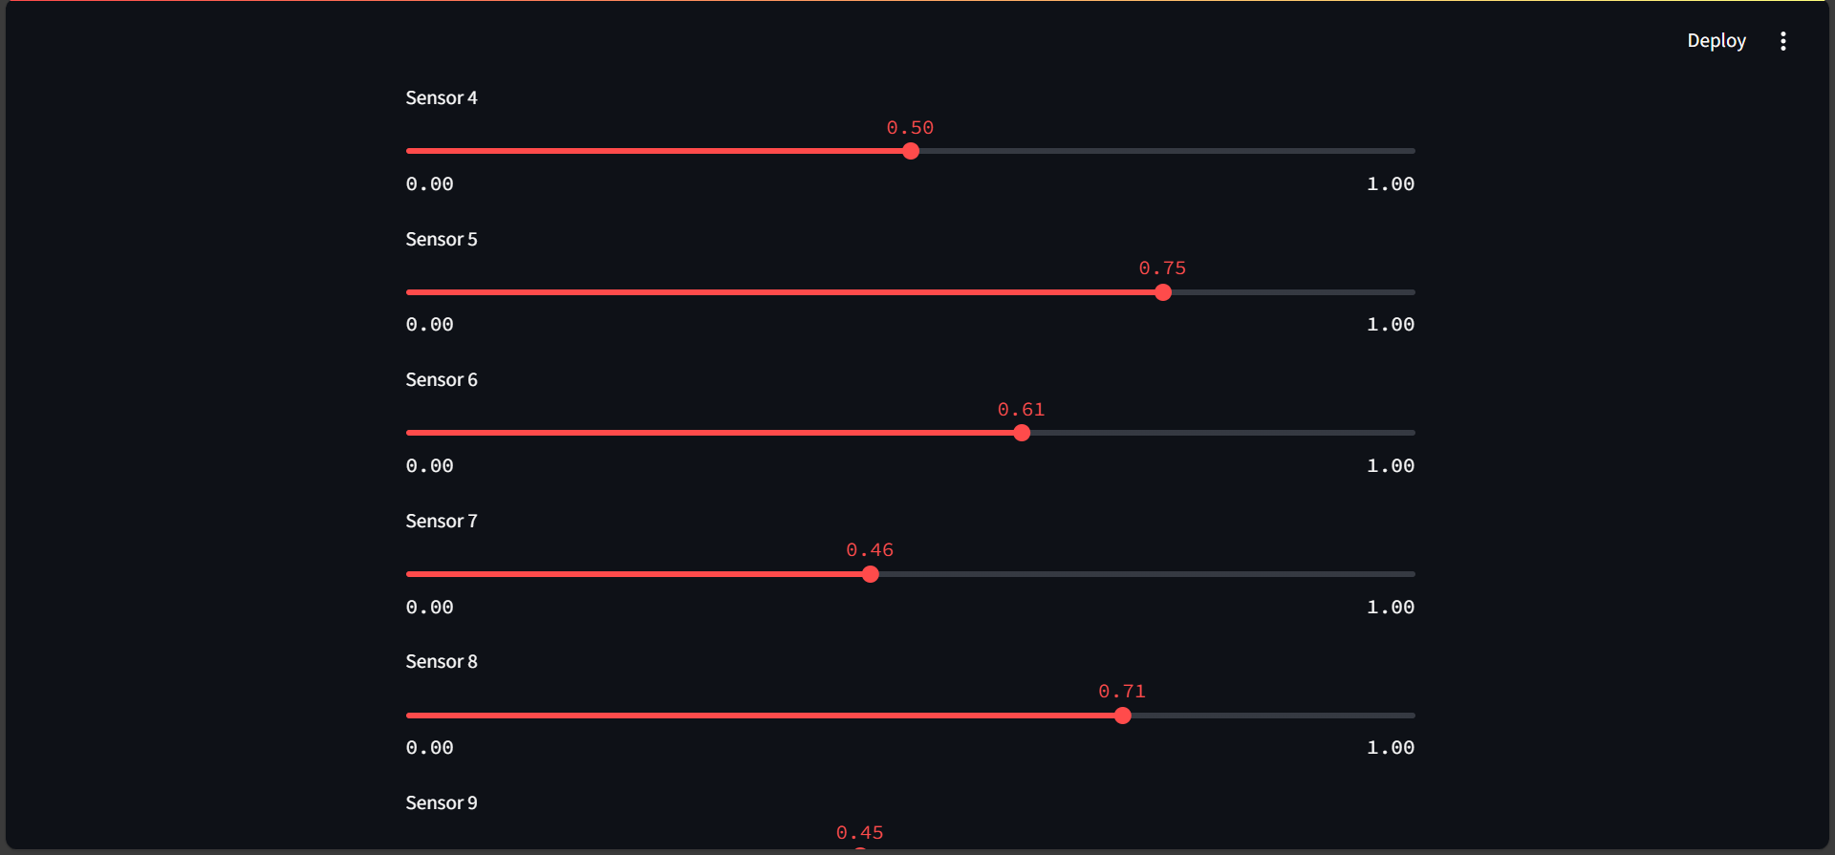
Screenshot of Output:

Slide 11
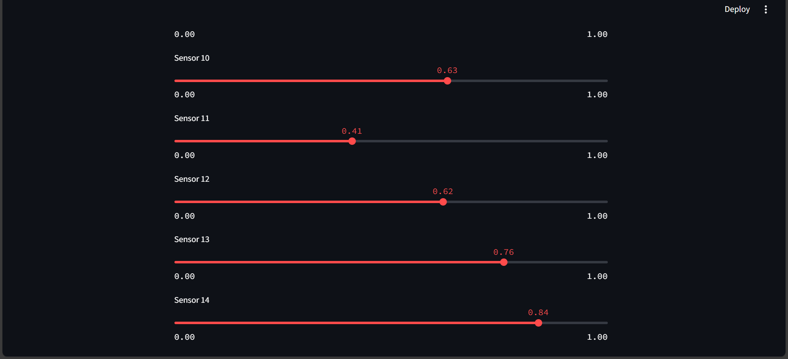
Screenshot of Output:

Slide 12
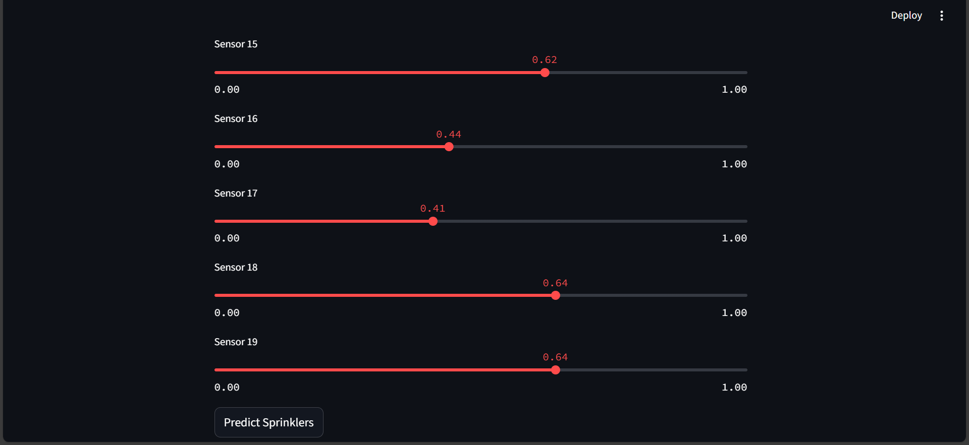
Screenshot of Output:

Slide 13
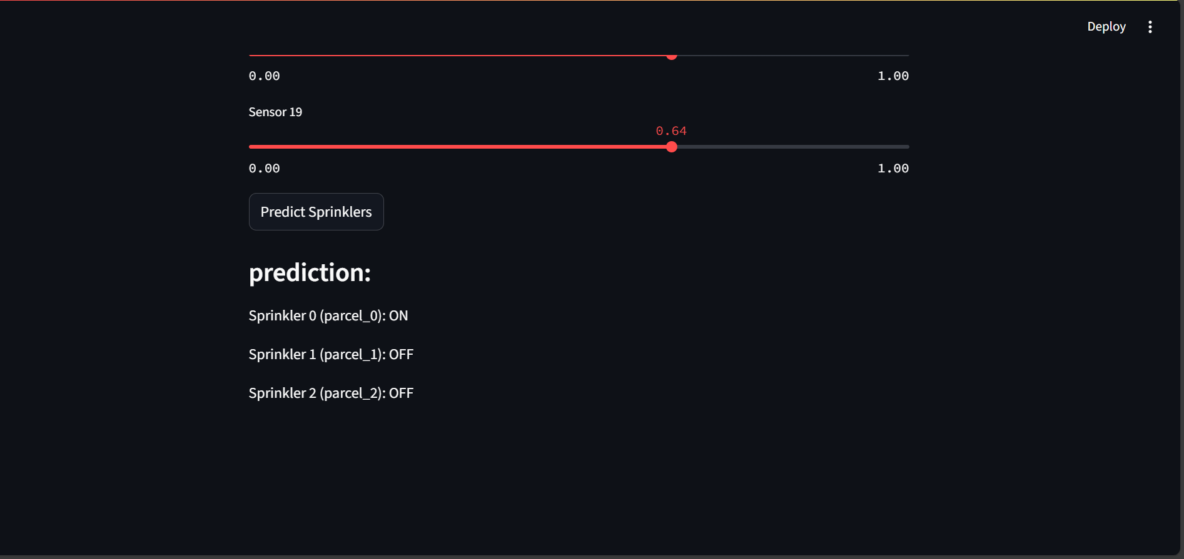
Screenshot of Output:

Slide 14
Conclusion:
The Smart Irrigation System project showcases a practical application of machine learning in agriculture to automate water management. By leveraging environmental data (e.g., temperature, soil moisture), this system makes intelligent irrigation decisions, promoting both efficiency and sustainability.
The project used a Random Forest Classifier with a MultiOutputClassifier to predict multiple irrigation outcomes at once.
The input data was normalized using MinMaxScaler, ensuring balanced feature contribution.
The dataset was split using train_test_split to fairly evaluate the model's generalization.
The model’s structure allows integration into real-world IoT systems, making irrigation decisions based on live sensor data.
This project not only demonstrates technical competency in data science and machine learning but also emphasizes real-world impact through resource conservation and agricultural productivity.

