Slide 1
FINANCIAL DASHBOARD
HARIKRISHNAN GOPALAKRISHNAN

Slide 2
Prologue
Streamlit Library is used to create the Yahoo financial dashboard Application,which allows the user to enter a company stock ticker and get financial ratios based on the company’s most recent financial data.
Python Libraries imported:
-import pandas as pd
-import matplotlib.pyplot as plt
-from datetime import datetime, timedelta,date
-import yahoo_fin.stock_info as si
-import streamlit as st
-import pandas_datareader.data as web
-import datetime as dt
-import numpy as np
-import mplfinance as mpf

Slide 3
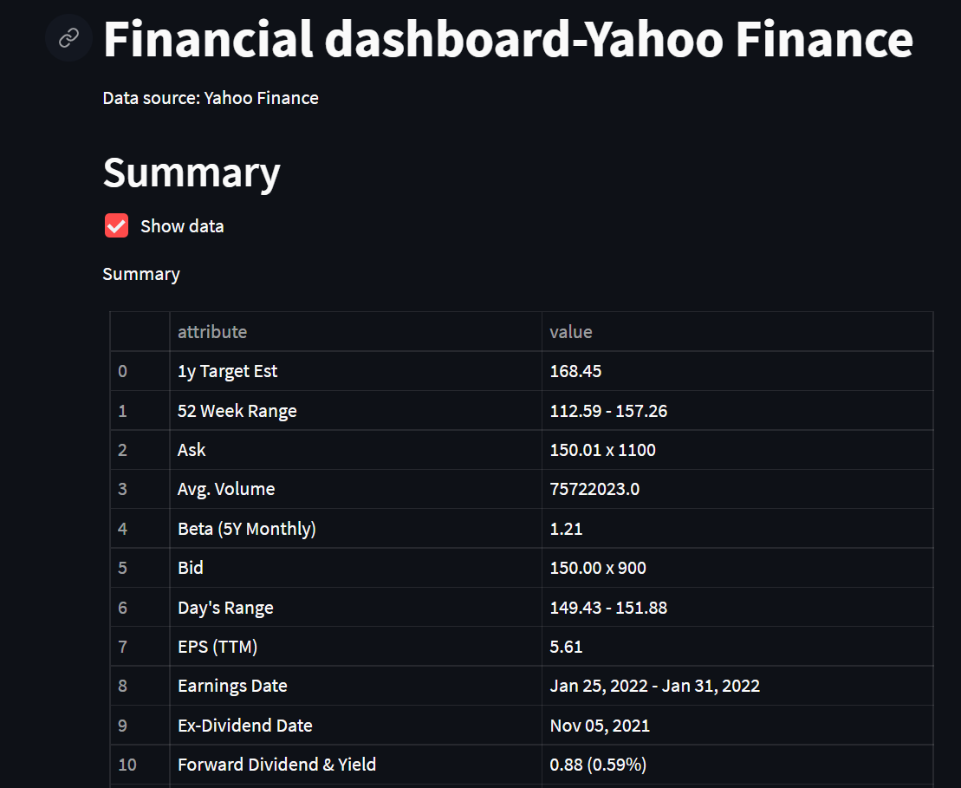
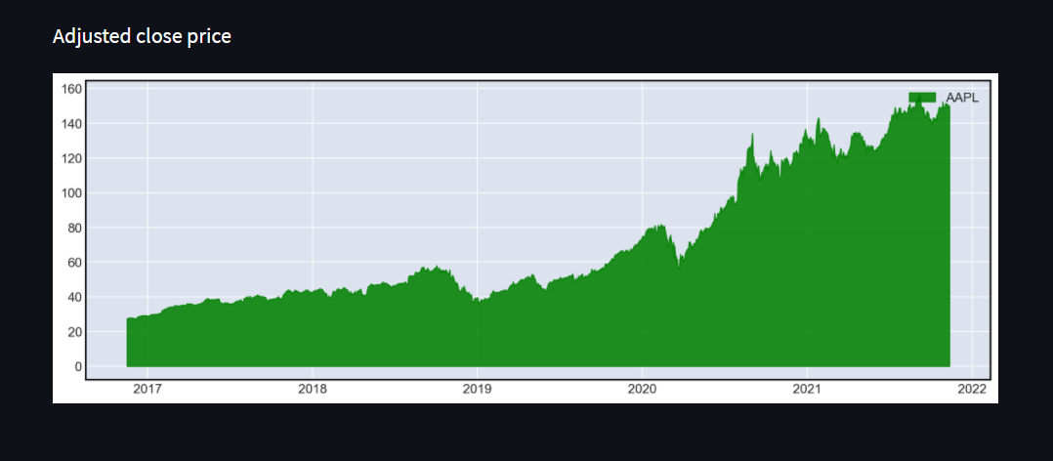
Tab 1-Summary
Functions
- This tab is used to present the summary information of the stock.
-In the chart, there is an option to select different duration of time i.e. 1M, 3M, 6M, YTD, 1Y, 3Y, 5Y, MAX.
-The stock changes over a period of time can be observed in this tab

Slide 4
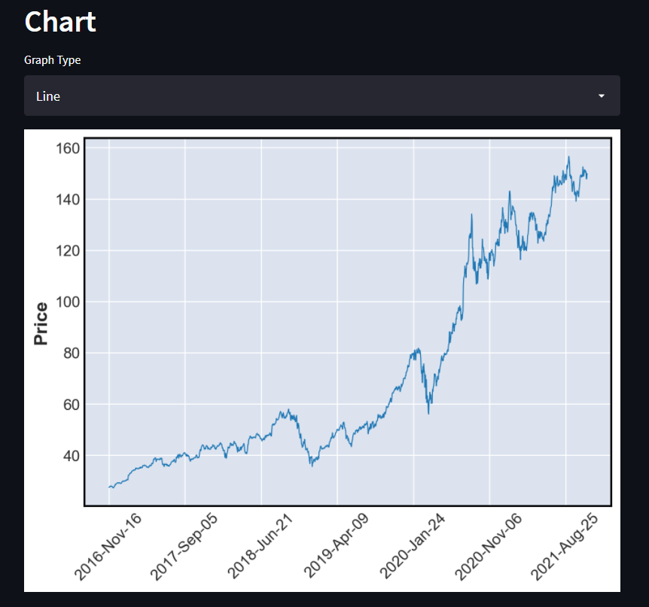
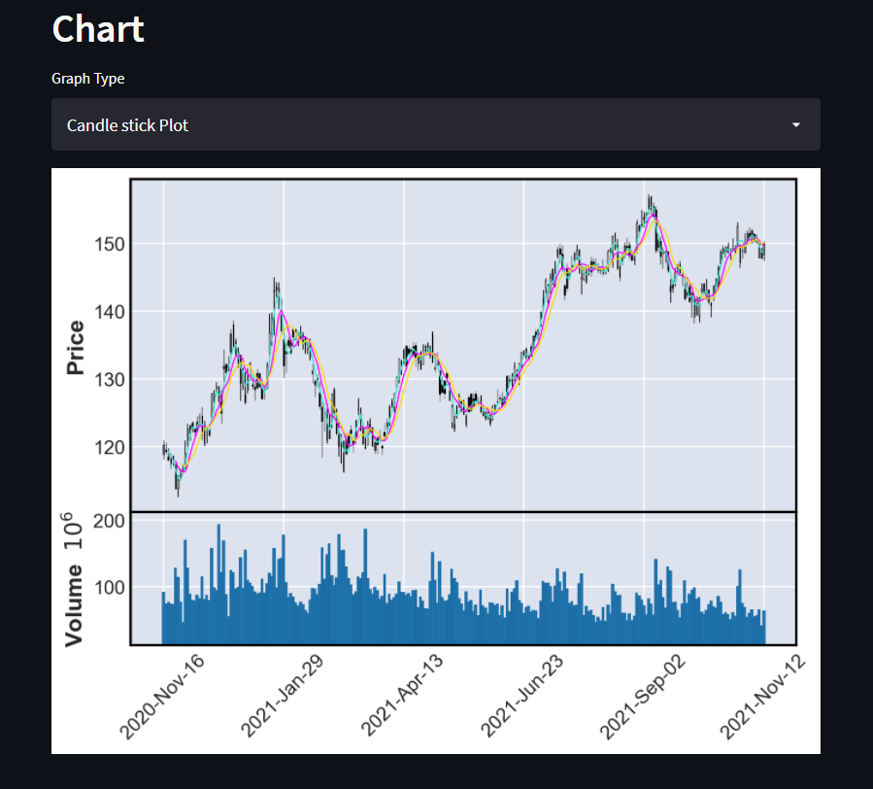
Tab 2-Chart
Functions:
-In this Tab we can select the Date range and duration of time.
-Switching between Line and Candlestick plots enables the user to notice the fluctuations of the stocks.
-Simple moving average is displayed
-Trading volume of the stock is displayed in the bottom of the candlestick plot.

Slide 5
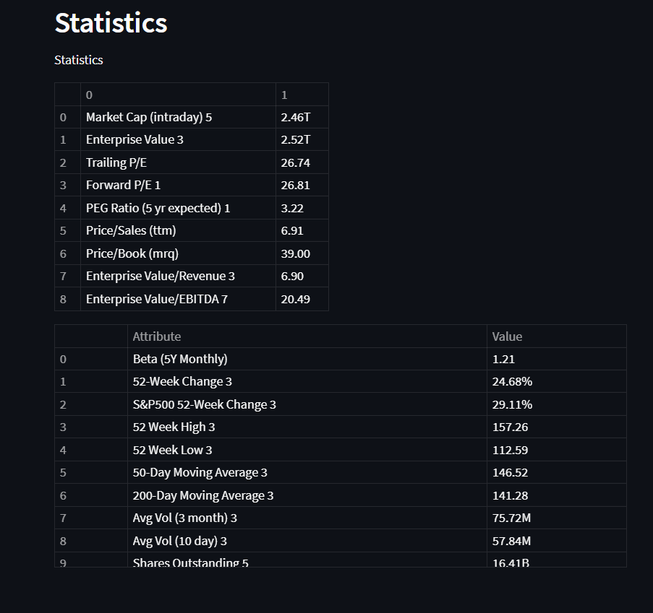
Tab 3-Statistics
Functions:
-This tab displays the basic stats and numerical valuations of the stocks.

Slide 6
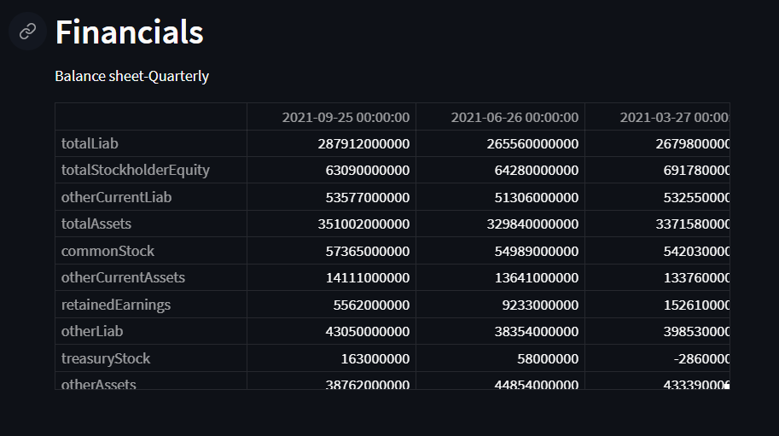
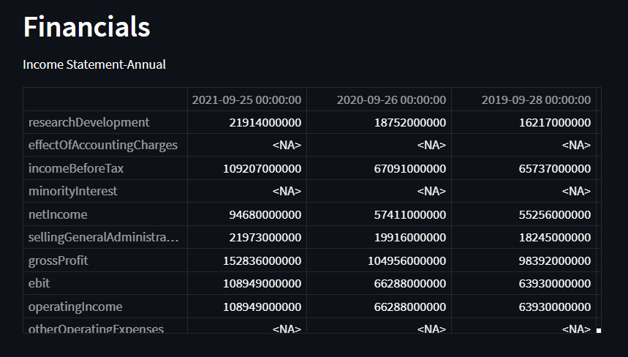
Tab 4-Financials
Functions:
-This tab presents the financial information of the stock
-There is an option to select between Income Statement, Balance Sheet and Cash Flow.
- There is also an option to select between Annual and Quarterly period.

Slide 7
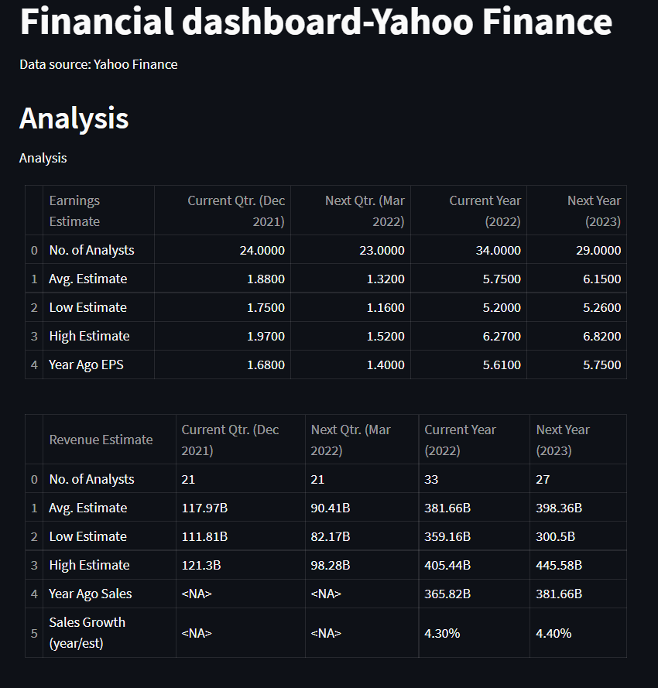
Tab 5-Analysis
Functions:
-This tab present the analysis information of the stock.
-The user can get the overview of Earnings estimate,Revenue Estimate,EPS trend,EPS revisions and Growth Estimates.

Slide 8
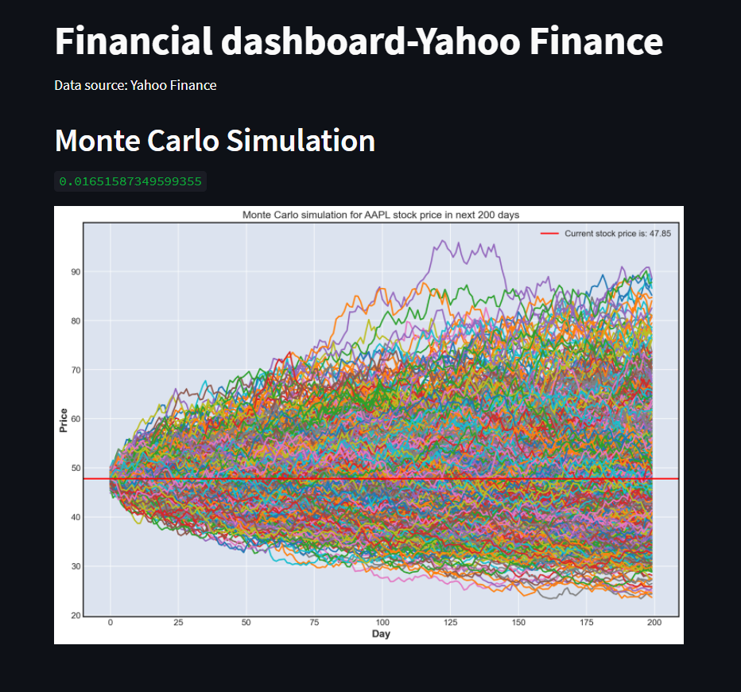
Tab 6-Monte Carlo Simulation
Functions:
-This tab presents a Monte Carlo simulation for the stock price in the next n-days from today.
-The number of simulations and time horizon can be selected .
-The Value at Risk (VaR) at 95% confidence interval is displayed

Slide 9
References:
https://www.python-graph-gallery.com/area-plot/
https://algotrading101.com/learn/yfinance-guide/
https://www.codegrepper.com/code-examples/python/importing+financial+data
https://www.slidescarnival.com/messala-free-presentation-template/14696#preview
https://github.com/matplotlib/mplfinance

