Slide 1

ML
REINFORCEMENT
HYPERTENSION-PREDICTION
HARIKRISHNAN N T
DADS JULY OFFLINE

Slide 2
What is in the Dataset
Dataset contains different features that attribute to predict the if an individual will diagnose with hypertension or not.
Age – Age of the person
Salt Intake – salt intake g/day
Stress Score – stress score of the person out of 10
BP History – BP history of individual(normal, prehypertension, hypertension)
Sleep Duration – Sleep duration of the individual(0-12 hours)
Medication – Do the individual have any medication(No medication, ace inhibitor, beta blocker, other)
Family History – If the individual have any family history of hypertension
Exercise Level – Exercise level of the individual(low, moderate, high)
Smoking Status – Is the individual a smoker or not
Has Hypertension – Is the person have hypertension or not (Target Column)

Slide 3
What We Analyze
Basic Overview of the dataset
Correlation of different features on hypertension
How a new set of data predict the hypertension

Slide 4
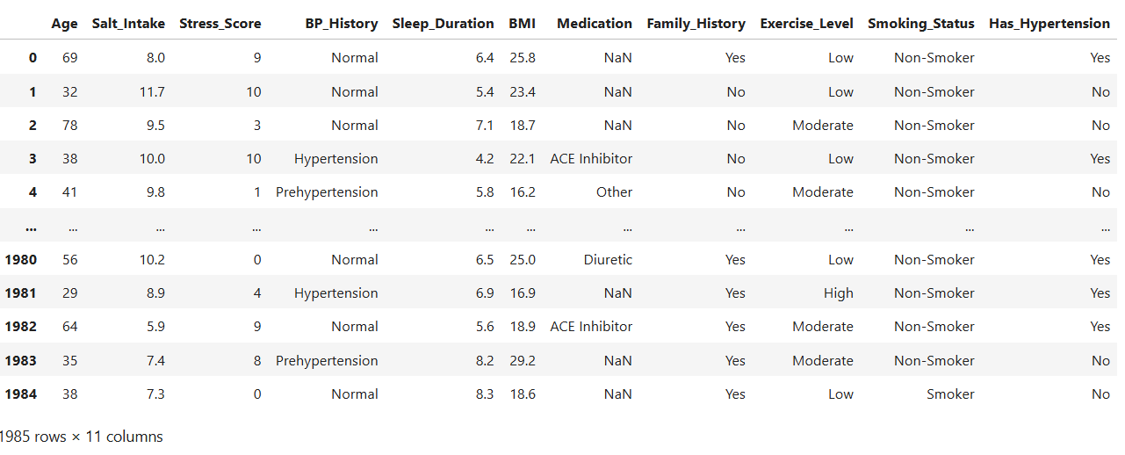
Data Overview

Slide 5
Data Cleaning
Steps performed on the dataset
Null value handling
Outlier handling

Slide 6
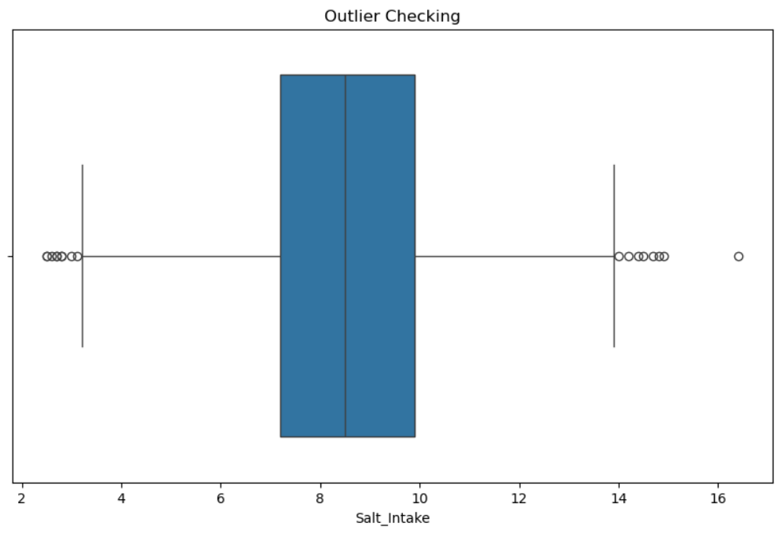
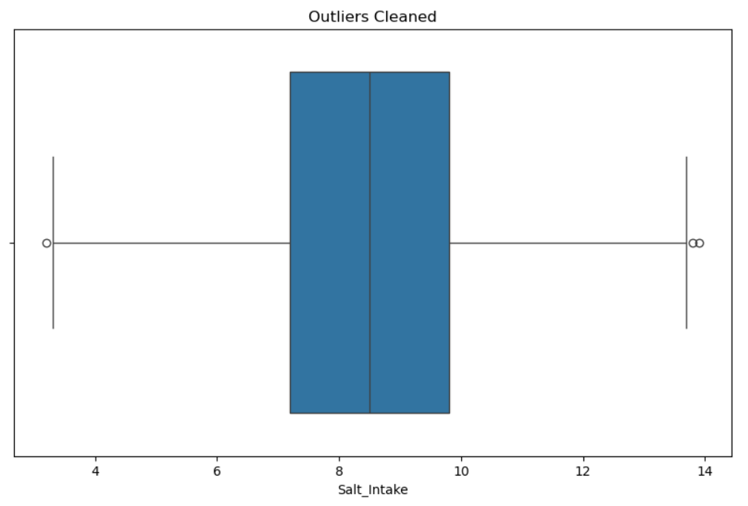
Exploratory Data Analysis

Slide 7
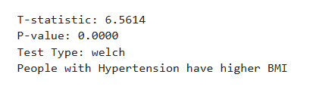
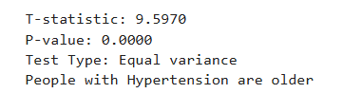
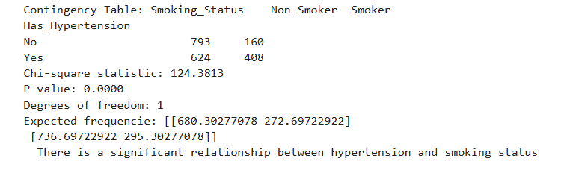
Hypothesis Testing

Slide 8
Insights
Age, BMI, Smoking Status have high influence on Hypertension.
Salt Intake, Sleep Duration, Exercise level have different distribution status in comparing to Age.
Distribution of Has Hypertension and Family History is similar.

Slide 9
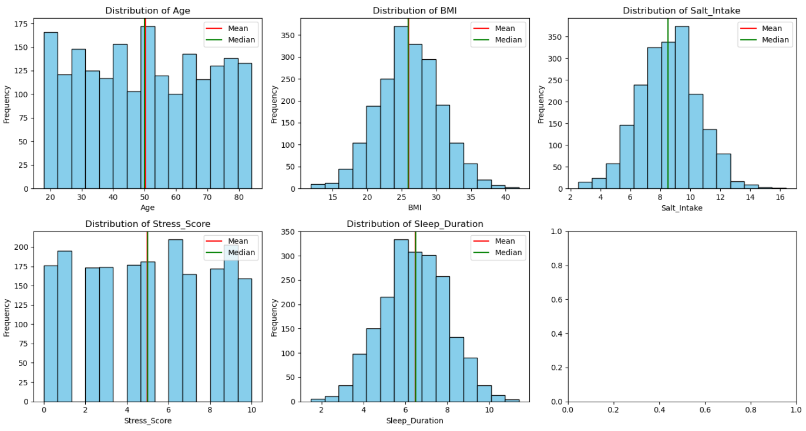
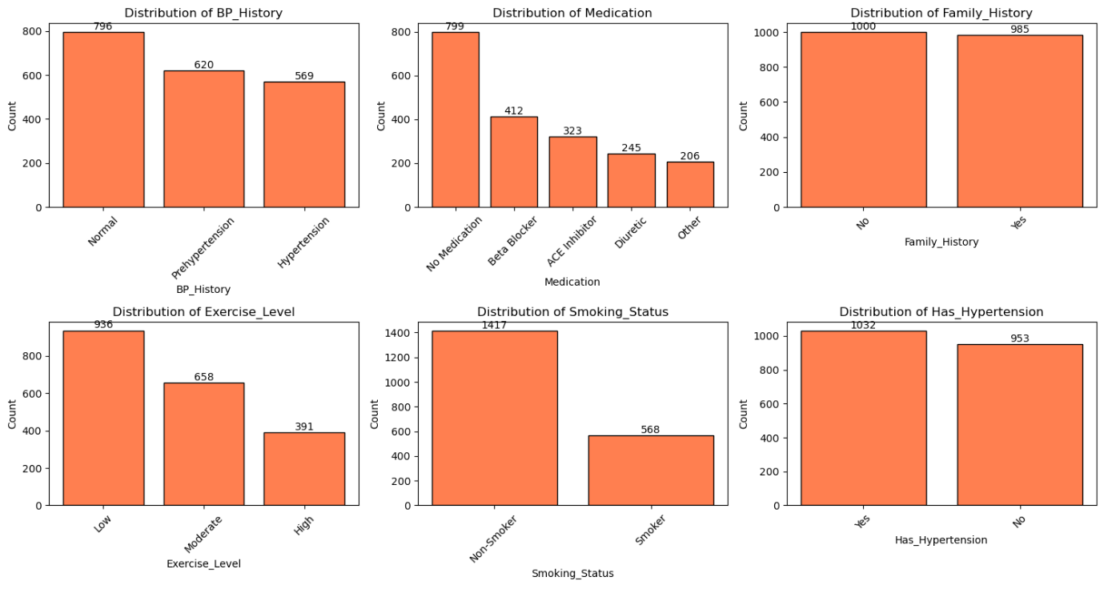
Visualization

Slide 10
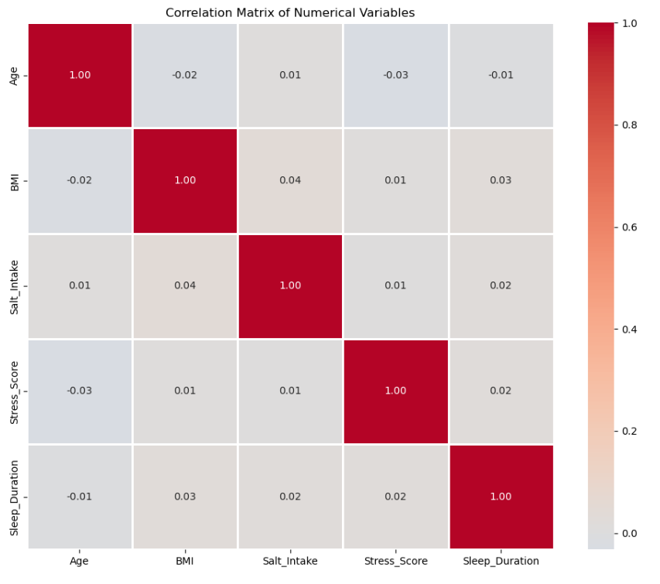
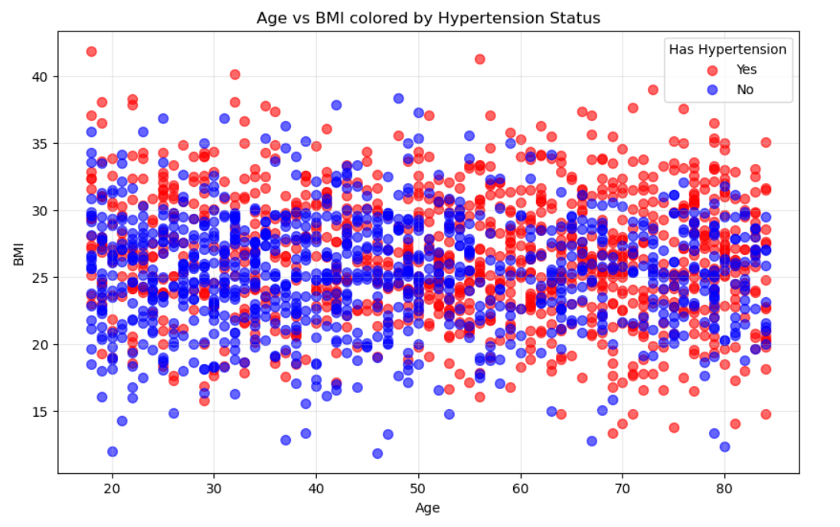
Visualization

Slide 11
ML Models
Model’s Using for Prediction
Logistic Regression
Support Vector Machine(SVM)
K-Nearest Neighbour(KNN)
Decision Tree
Random Forest
XG-Boost

Slide 12
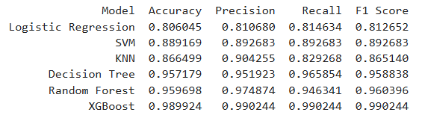
Model Evaluation
Evaluating all models to pick the most accurate model

Slide 13
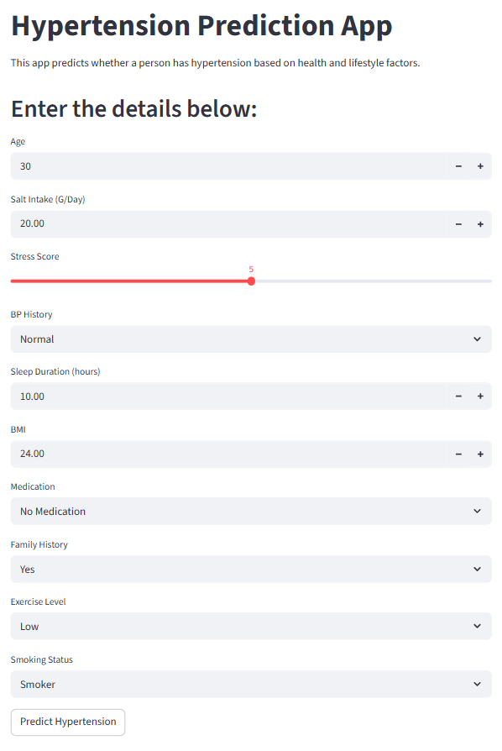
Web App
Using PyCharm creating web app for the Prediction

