Slide 1

Zeroth Review
SignTalk
®
AI sign language detection and interpretation.
GROUP 12
Harikrishnan 31
Naveen Krishna 42
Nitheesh Shaju 44
Shyamkrishnan 57

Slide 2
1
Convolutional Neural Networks
They are fully connected feed forward networks which are very effective in reducing the number of parameters without affecting the quality of output of models.
Images have high dimensionality, as each pixel is conceded a feature
CNN’s are trained to identify edges of objects.
Data processing is one of the main steps in an image recognition system
Convolution Layer of CNN plays the role of future extractor as through the training process the convolution filter, kernel or weights are desired on
High level convolution layers higher level features

Slide 3
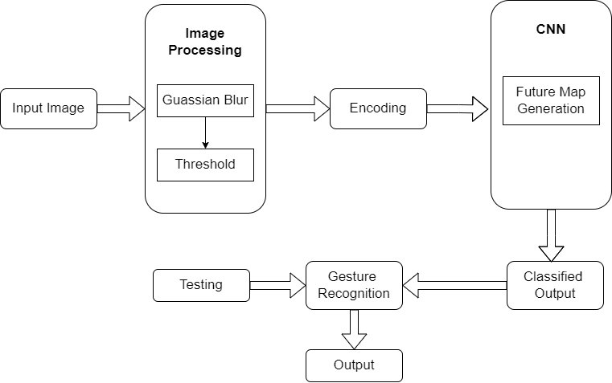
2
System Architecture

Slide 4
3
Thank you
GROUP 12
Shyamkrishnan S N
Harikrishnan B A
Naveen Krishna
Nitheesh Shaju

