Slide 1
ONLINE MOVIE TICKET BOOKING
​​​
Group ID : PG19CS15
Project Guide: Sudheesh K P
Submitted By : Harikrishnan V B
Kaveri Umesh
Bertin Kuriakose
Kalidas K

Slide 2
OVERVIEW
This project is aimed at developing an online ticket reservation system for
Cinema Halls. The Ticket Reservation System is an Internet based application that
can be accesses throughout the Net and can be accessed by any one who has a
net connection. This application will automate the reservation of tickets and
Enquiries about availability of the tickets. This application includes email
confirmation for the tickets.

Slide 3
Product Functions : User
User application with individual login that provides facility to view details of available movies in the selected area.
Facility to buy movie tickets without going to the theatre or standing in a queue.
The user can download the movie ticket from the site.
The user can also show the ticket with QR code generated for verification.

Slide 4
Product Functions : Admin
The Admin page will contain all the records of movies or users who have booked
the ticket.
It provides an overview of the platform including list of movies and venues, data about the booking, total no. of users, total earnings, etc.
It also has options to manage the shows, venues and earnings.
Admin has an in-build scanner to scan the QR code generated to verify the ticket booking.

Slide 5
Specific Requirements
A first-time user of the website should see the log-in page when he/she opens
the website.
If the user has not registered, he/she should be able to do that on the log-in page.
It will also have a ‘Remember me’ button.
Users can be able to get the booking details by selecting the location, theatre, date and time.
Every user should have a editable personal profile.

Slide 6
Functional Requirements
Unique login credentials.
The user can choose his/her own password.
The user can view or edit his personal profile.
Facility to view details regarding available movies, ticket cost and show timings
in a selected location.
Facility to buy tickets by choosing seats which the user wants.
Facility for online payment.
Digital pass with auto-generated QR code for verification.

Slide 7
Functional Requirements
Admin has option to alter all the information about movies.
Admin has option to alter all the information about venues.
Admin has option to alter all the information about shows.

Slide 8
Non - Functional Requirements
Reliability : This application is a web based application that runs on any device
that has a browser.
Availability : The application will be available for 99% of the time and security.
Security of the users information is also safe as there is a login facility.
Maintainability : Maintenance is typically done after the software development
has been completed. As the time evolves, so do the requirements and needs.
Portability : As it is a web application, the application is portable.

Slide 9
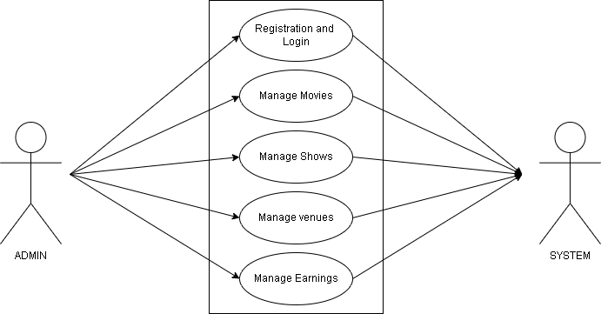
UML Use Case Diagram

Slide 10
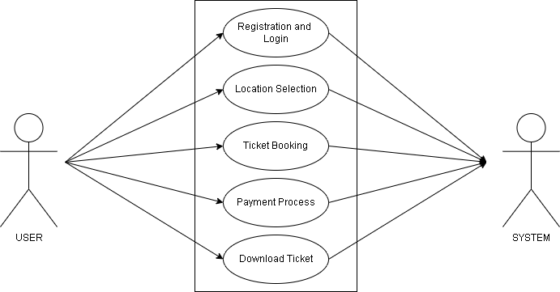
UML Use Case Diagram

Slide 11
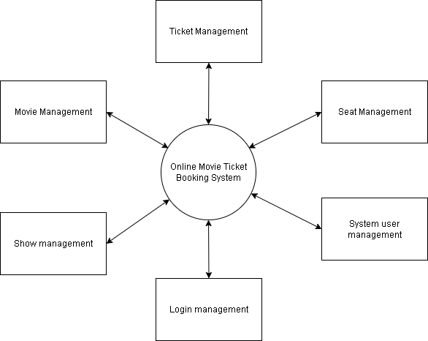
Data Flow Diagram

Slide 12
Technology Stack
Visual Studio Code : Visual Studio Code, also commonly referred to as VS Code, is
a source-code editor made by Microsoft. Front end of the application is done
using this software. HTML and CSS are used for developing front end.
XAAMP : XAMPP is a free and open-source cross-platform web server solution
stack package developed by Apache Friends, consisting mainly of the Apache HTTP
Server, MariaDB database, and interpreters for scripts written in the PHP and Perl
programming languages.
MySQL : MySQL is an open-source relational database management system.

Slide 13
Advantages
Ease of use.
Digital payment.
Easy ticket verification.

Slide 14
THANK YOU

