Slide 1
Domain Name System

Slide 2
Domain Name System
DNS is a host name to IP Address translation service.
It converts the names we type in our web browser address bar to the IP Address of web servers hosting those sites.
helps to resolve the domain name to numeric address.
Domain names are alphanumeric names for IP addresses e.g., neon.cs.virginia.edu, www.google.com, ietf.org
For eg.Consider the following translation:
www.google.com = 209.85.225.104

Slide 3
Need for DNS
IP Addresses are a complex series of numbers.
So, it is difficult to remember IP Addresses directly while it is easy to remember names.
IP Addresses are not static and may change dynamically.
So, a mapping is required which maps the domain names to the IP Addresses of their web servers.

Slide 4
HISTORY OF DNS
In the beginning, there was the hosts.txt
– A file containing the names and addresses of all hosts in the network
– Problems: maintainability, size
with increase in number of hosts of internet, the size of host file also increased.
This resulted in increased traffic on downloading this file.
To solve this problem the DNS system was introduced.

Slide 5
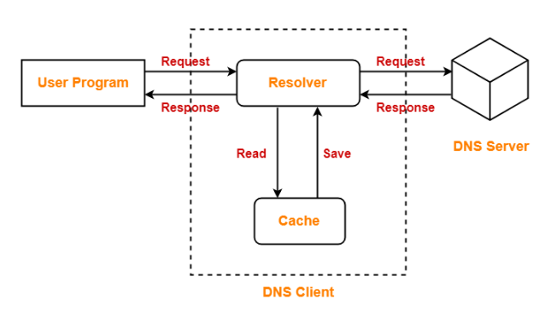
DNS Resolution
DNS Resolution is a process of resolving a domain name onto an IP Address.

Slide 6
The steps involved in DNS Resolution
Step-01:
A user program sends a name query to a library procedure called the resolver.
Step-02:
Resolver looks up the local domain name cache for a match.
If a match is found, it sends the corresponding IP Address back.
If no match is found, it sends a query to the local DNS server.
Step-03:
DNS server looks up the name.
If a match is found, it returns the corresponding IP Address to the resolver.
If no match is found, the local DNS server sends a query to a higher level DNS server.
This process is continued until a result is returned.
Step-04:
After receiving a response, the DNS client returns the resolution result to the application.

Slide 7
Domain Name System Architecture
The Domain name system comprises of
Domain Names
Domain Name Space
Name Server

Slide 8
Domain Names
Domain Name is a symbolic string associated with an IP address.
There are several domain names available; some of them are generic such as com, edu, gov, net etc, while some country level domain names such as au, in, za, usetc.

Slide 9
Domain Namespace
The naming system on which DNS is based is a hierarchical and logical tree structure called the domain namespace
In this design the names are defined in an inverted-tree structure with the root at the top.
The tree can have only 128 levels: level 0 (root) to level 127
In the Internet, the domain name space (tree) is divided into two different sections:
generic domains
countrydomains

Slide 10
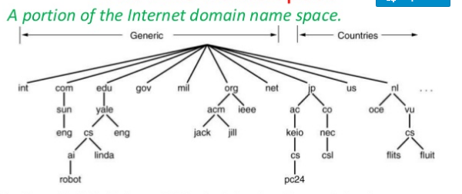

Slide 11
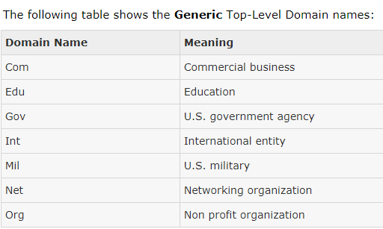

Slide 12
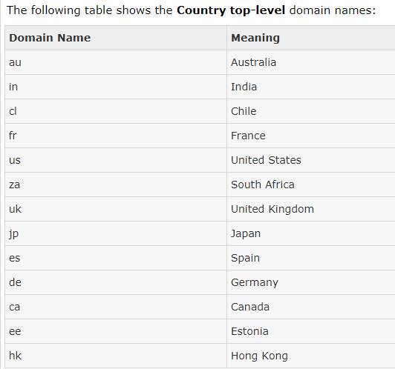

Slide 13
Name Servers
Contain the entire DNS database and respond to all queries about it.
In practice, this server would be so overloaded as to be useless.
Furthermore, if it ever went down, the entire Internet would be crippled.
To avoid the problems associated with having only a single source of information, the DNS name space is divided into nonoverlapping zones.
The server maintains a database called zone file for every zone.
One possible way to divide the name space of is shown
Each circled zone contains some part of the tree.

Slide 14
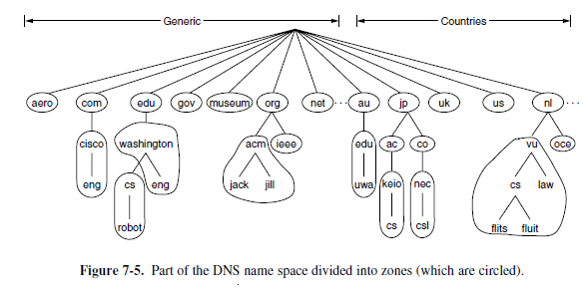

Slide 15
Each zone is also associated with one or more name servers.
These are hosts that hold the database for the zone.
Normally, a zone will have one primary name server, which gets its information from a file on its disk, and one or more secondary name servers, which get their information from the primary name server.
To improve reliability, some of the name servers can be located outside the zone.

Slide 16
Types of name servers
Local NS
Root NS
Top level domain NS(TLD )
Authoritative NS

Slide 17
Local Name Server
when host makes DNS query, query is sent to its local DNS server
It is closer to client
acts as proxy, forwards query into hierarchy
does not strictly belong to hierarchy

Slide 18
DNS: Root name servers
contacted by local name server that cannot resolve name
root name server:
contacts authoritative name server if name mapping not known
gets mapping
returns mapping to local name server
There are 13 root name servers worldwide

Slide 19
TLD and Authoritative Servers
Top-level domain (TLD) servers:
responsible for com, org, net, edu, etc, and all top-level country domains uk, fr, ca, jp.
About 200 TLD in internet
Authoritative DNS servers:
Can provide an authoritative answer to a DNS query not just a cached answer
organization’s DNS servers, providing authoritative hostname to IP mappings for organization’s servers (e.g., Web, mail).
can be maintained by organization or service provider

Slide 20
Dns resource record

Slide 21
Domain Resource Records
The DNS data is stored in the database in the form of resource records (RR).
Every domain, whether it is a single host or a top-level domain, can have a set of resource records associated with it.
For a single host, the most common resource record is just its IP address, but many other kinds of resource records also exist.
When a resolver gives a domain name to DNS, what it gets back are the resource records associated with that name.
Thus, the primary function of DNS is to map domain names onto resource records.

Slide 22
The format of RR
A resource record is a five-tuple
The format of RR:
Domain name Time to live Class Type Value
Eg:
www.google.com 86400 IN A 130.37.36.23
The Domain name tells the domain to which this record applies.

Slide 23
The Time to live field gives an indication of how stable the record is.
Information that is highly stable is assigned a large value, such as 86400 (the number of seconds in 1 day).
Information that is highly volatile is assigned a small value, such as 60 (1 minute).
Class Field .
For Internet information, it is always IN.
For non-Internet information, other codes can be used, but in practice these are rarely seen.

Slide 24
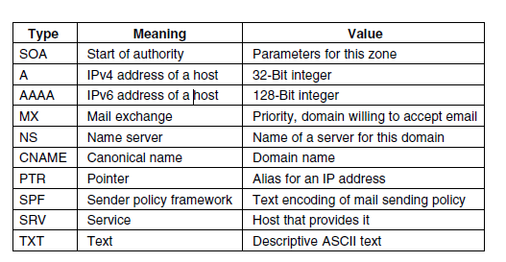
The Type field tells what kind of record this is. There are many kinds of DNS records. The important types are listed in Fig

Slide 25
Value field.
This field can be a number, a domain name, or an ASCII string.
The semantics depend on the record type.

Slide 26
Working of DNS
When a resolver has a query about a domain name, it passes the query to a local name server.
If the domain being sought falls under the jurisdiction of the name server, such as flit.cs.vu.nl falling under cs.vu.nl, it returns the authoritative resource records.

Slide 27
when the domain is remote, such as when flits.cs.vu.nl wants to find the IP address of robot.cs.washington.edu at University of Washington( UW)
In this case, and if there is no cached information about the domain available locally, the name server begins a remote query.

Slide 28
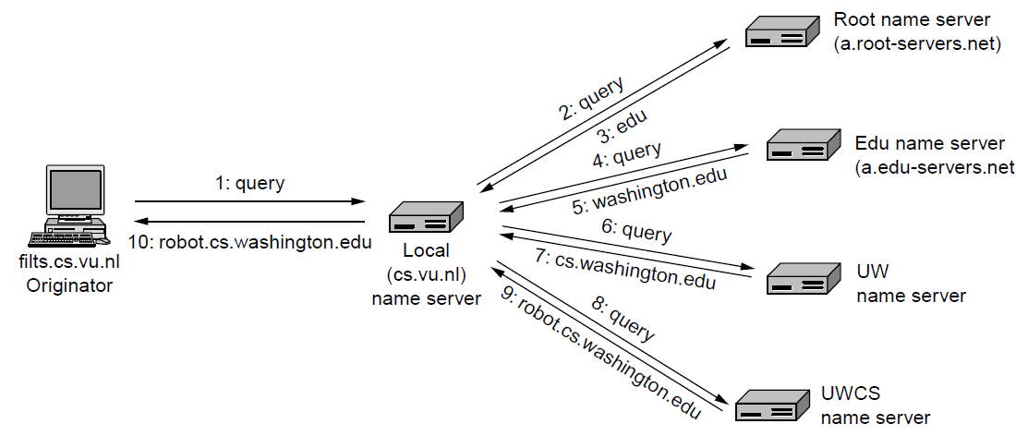
This query follows the procedure as shown in figure
Example of a resolver looking up a remote name in 10 steps.

Slide 29
Step 1 shows the query that is sent to the local name server.
The query contains the domain name sought, the type (A), and the class(IN).
Step 2
Local name server forward the request to root name servers. These name servers have information about each top-level domain.
There are 13 root DNS servers

Slide 30
Step 3
The root name server is unlikely to know the address of a machine at University of Washington(UW), and probably does not know the name server for University of Washington either.
But it must know the name server for the edu domain, in which cs.washington.edu is located.
It returns the name and IP address for that domain.

Slide 31
Step 4.
It sends the entire query to the edu name server (a.edu-servers.net).
Step5
That name server returns the name server for University of Washington

Slide 32
step 6
The local name server sends the query to the University of Washington name server .
If the domain name being sought was in the English department, the answer would be found, as the UW zone includes the English department.
But the Computer Science department has chosen to run its own name server.
step 7
The query returns the name and IP address of the UW Computer Science name server .

Slide 33
step 8
The local name server queries the UW Computer Science name server
This server is authoritative for the domain cs.washington.edu, so it must have the answer.
step 9
Cs name server returns the final answer .
step 10
The local name server forwards the final answer as a response to flits.cs.vu.nl

Slide 34
DNS Caching
Each time a server receives a query for a name that is not in its domain, it needs to search its database for a server IP address.
Reduction of this search time would increase
efficiency.
DNS handles this with a mechanism called caching.
When a server asks for a mapping from another server and receives the response, it stores this information in its cache memory before sending it to the client.
If the same or another client asks for the same mapping, it can check its cache memory and solve the problem.

Slide 35
T o inform the client that the response is coming from the cache memory and not from an authoritative source, the server marks the response as unauthoritative.
Caching speeds up resolution, but it can also be problematic.
If a server caches a mapping for a long time, it may send an outdated mapping to the client.

Slide 36
DNS caching problems can be solved using two techniques.
First, the authoritative server always adds information to the mapping called time-to-live (TTL).
It defines the time in seconds that the receiving server can cache the information.
After that time, the mapping is invalid and any query must be sent again to the authoritative server.
Second, DNS requires that each server keep a TTL counter for each mapping it caches.
The cache memory must be searched periodically, and those mappings with an expired TTL must be purged.

Slide 37
DNS MESSAGES
DNS has two types of messages: query and response.
Both types have the same format.
The query message consists of a header and question records;
The response message consists of a header, question records, answer records, authoritative records, and additional records.

Slide 38
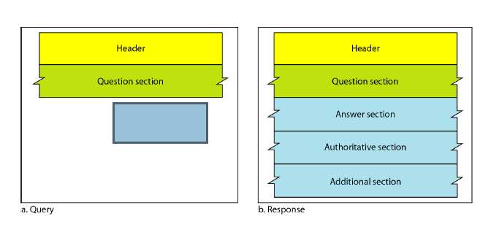
DNS MESSAGE format Query and response messages

Slide 39
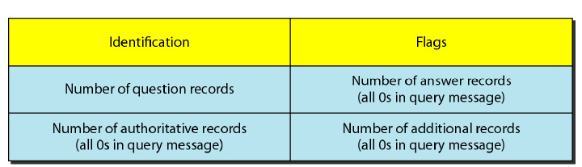
DNS header section

Slide 40
Question Section:
This is a section consisting of one or more question records.
It is present on both query and response messages.
Answer Section:
This is a section consisting of one or more resource records.
It is present only on response messages.
This section includes the answer from the server to the client (resolver).

Slide 41
Authoritative Section:
This is a section consisting of one or more resource records.
It is present only on response messages.
This section gives information (domain name) about one or more authoritative servers for the query.
Additional Information Section:
This is a section consisting of one or more resource records.
It is present only on response messages.
This section provides additional information that may help the resolver.

