Slide 1
FTP(FILE TRANSFER PROTOCOL)

Slide 2
FILE TRANSFER
Transferring files from one computer to another is one of the most common tasks expected from a networking or internetworking environment.
The greatest volume of data exchange in the Internet today is due to file transfer

Slide 3
File Transfer Protocol (FTP)
File Transfer Protocol (FTP) is the standard mechanism provided by TCP/IP for copying a file from one host to another.
Although transferring files from one system to another seems simple and straightforward, some problems must be dealt with first.
For example, two systems may use different file name conventions.
Two systems may have different ways to represent text and data.
Two systems may have different directory structures.
All these problems have been solved by FTP in a very simple and elegant approach.

Slide 4
FTP differs from other client/server applications in that it establishes two connections between the hosts.
One connection is used for data transfer, the other for control information (commands and responses).
Separation of commands and data transfer makes FTP more efficient.
FTP uses two well-known TCP ports: Port 21 is used for the control connection, and port 20 is used for the data connection.

Slide 5
FTP Clients
FTP client is a program that implements a file transfer protocol which allows you to transfer files between two hosts on the internet.
It allows a user to connect to a remote host and upload or download the files.
It has a set of commands that we can use to connect to a host, transfer the files between you and your host and close the connection.
The FTP program is also available as a built-in component in a Web browser.
This GUI based FTP client makes the file transfer very easy and also does not require to remember the FTP commands.

Slide 6
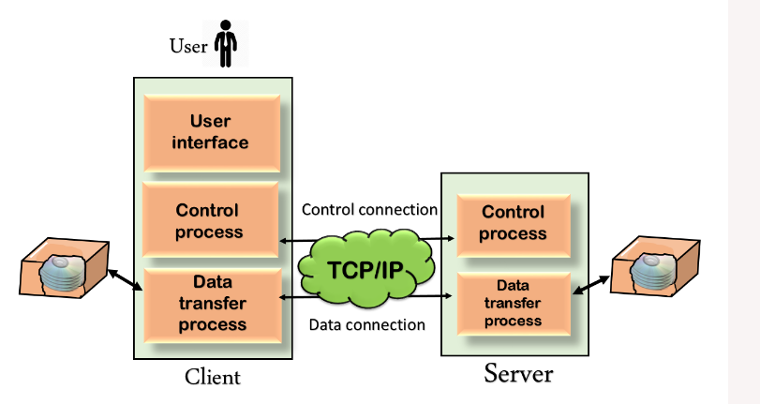
FTP MODEL

Slide 7
model of FTP.
The FTP client has three components:
user interface,
client control process
the client data transfer process.
The server has two components:
the server control process
the server data transfer process.
The control connection is made between the control processes.
The data connection is made between the data transfer processes.

Slide 8
For sending control information like user identification, password, commands to change the remote directory, commands to retrieve and store files, etc., FTP makes use of a control connection.
The control connection remains connected during the entire interactive FTP session.
The data connection is opened and then closed for each file transferred.
It opens each time commands that involve transferring files are used, and it closes when the file is transferred. In other words, when a user starts an FTP session, the control connection opens.
While the control connection is open, the data connection can be opened and closed multiple times if several files are transferred

Slide 9
Communication over Control Connection
FTP uses the same approach as SMTP to communicate across the control connection.
It uses the 7-bit ASCII character set .
Communication is achieved through commands and responses.
Through control connection, we can transfer a line of command or line of response at a time.
Each command or response is only one short line
Each line is terminated with a two-character (carriage return and line feed) end-of-line token.
The control connection remains connected during the entire interactive FTP session.

Slide 10
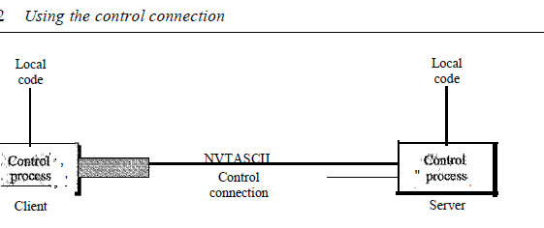

Slide 11
Communication over Data Connection
The purpose of the data connection is different from that of the control connection.
Need to transfer files through the data connection.
The data connection opens when a command comes for transferring the files and closes when the file is transferred.
file transfer in FTP means one of three things:
A file is to be copied from the server to the client. This is called retrieving a file . It is done under the supervision of the RETR command,
A file is to be copied from the client to the server. This is called storing a file . It is done under the supervision of the STOR command.
A list of directory or file names is to be sent from the server to the client. This is done under the supervision of the LIST command.

Slide 12
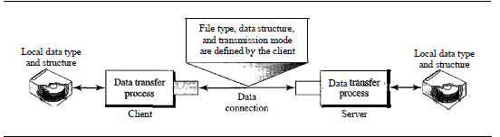
Using Data connection

Slide 13
FTP Modes
FTP works in two different modes:
Active Mode
Passive Mode
In active FTP, client establishes the command channel and the server establishes the data channel.
In passive FTP, both the command channel and the data channel are established by the client.

Slide 14
FTP Commands
Some of the FTP commands are :
USER – This command sends the user identification to the server. PASS – This command sends the user password to the server. RMD – This command causes the directory specified in the path name to be removed as a directory. MKD – This command causes the directory specified in the pathname to be created as a directory. PWD – This command causes the name of the current working directory to be returned in the reply. RETR – This command causes the remote host to initiate a data connection and to send the requested file over the data connection. STOR – This command causes to store of a file into the current directory of the remote host. LIST – Sends a request to display the list of all the files present in the directory. ABOR – This command tells the server to abort the previous FTP service command and any associated transfer of data. QUIT – This command terminates a USER and if file transfer is not in progress, the server closes the control connection.

Slide 15
FTP Replies
Some of the FTP replies are :
200 Command okay. 530 Not logged in. 331 User name okay, need a password. 225 Data connection open; no transfer in progress. 221 Service closing control connection. 551 Requested action aborted: page type unknown. 502 Command not implemented. 503 Bad sequence of commands. 504 Command not implemented for that parameter.

Slide 16
FTP types
There are several different ways an FTP server and client software can conduct a file transfer using FTP:
Anonymous FTP.
Password-protected FTP.
FTP Secure (FTPS).
FTP over explicit SSL/TLS (FTPES).
Secure FTP (SFTP).

Slide 17
FTP types
Anonymous FTP. This is the most basic form of FTP. It provides support for data transfers without encrypting data or using a username and password. It's most commonly used for download of material that is allowed for unrestricted distribution.
Password-protected FTP. This is also a basic FTP service, but it requires the use of a username and password, though the service might not be encrypted or secure. It also works on port 21.
FTP Secure (FTPS). Sometimes referred to as FTP Secure Sockets Layer (FTP-SSL), this approach enables implicit Transport Layer Security (TLS) as soon as an FTP connection is established. FTPS was initially used to help enable a more secure form of FTP data transfer. It typically defaults to using port 990.
FTP over explicit SSL/TLS (FTPES). This approach enables explicit TLS support by upgrading an FTP connection over port 21 to an encrypted connection. This is a commonly used approach by web and file sharing services to enable secure file transfers.
Secure FTP (SFTP). This is technically not an FTP protocol, but it functions similarly. Rather, SFTP is a subset of the Secure Shell (SSH) protocol that runs over port 22. SSH is commonly used by systems administrators to remotely and securely access systems and applications, and SFTP provides a mechanism within SSH for secure file transfe

