Slide 1
NAT

Slide 2
Network address translation
Network Address Translation (NAT) is a service that is used in routers or firewall
Address Translation (NAT) is a process in which one or more local IP address(private ip address) is translated into one or more Global IP address and vice versa in order to provide Internet access to the local hosts.
Translation (NAT), is a method designed to conserve IP addresses in a private network, by using a unique IP address to represent the whole private network to access internet services for the network model

Slide 3
Network address translation
Network Address Translation (NAT) is a service that is used in routers
Its purpose is to translate a set of IP addresses to another set of IP addresses
help preserve the Limited amount of IP version 4 public IP addresses that we have available around the world
When the IP version 4 address was created engineers didn't realize how big the internet will become
Because even though there were over 4 billion IP version 4 addresses available the engineers thought that that would be enough, but obviously they were wrong
so in order to prevent a shortage of public IP version 4 addresses engineers developed private IP addresses and network address translation

Slide 4
Network address translation
There are two different types of IP version 4 addresses
Public
Private IP address
Public IP address
Public IP addresses are publicly registered on the Internet .
To access internet public IP address is required
There are approximately 4 billion public IP addresses available and are limited
Private IP addresses
Private IP addresses are not publicly registered.
Cannot access the internet with a private IP
Private IP addresses are only used internally such as inside a home or business
They are not used out on the public Internet

Slide 5
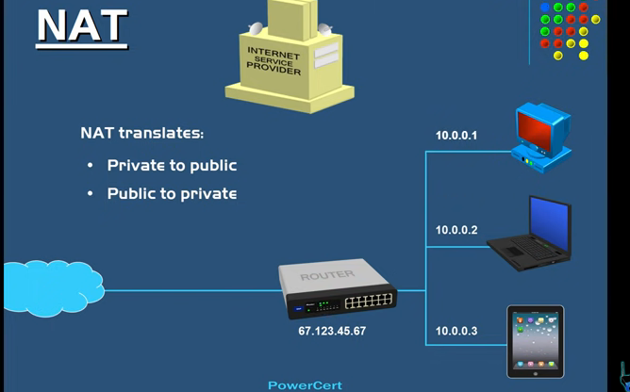

Slide 6
Network address translation
Most homes and businesses are not going to have just one device that needs internet access
Chances are that they are going to have multiple devices that need access to the Internet
So those devices need a public IP address if they want to access the Internet
You could contact your internet service provider and ask them for these additional public IP addresses for all of your devices
But it is more expensive
It would also be a waste of public IP addresses
if every device in the world had their own public IP address we would have ran out of public IP addresses already
To solve this issue router will assign Private IP addresses to the devices inside the network
when the devices need to access the Internet their private IP address will be translated by NAT in the router to public IP address that we have been given.
NAT not only translate private to public but also translates public to private

Slide 7
NAT
Because if a computer out on the internet wants to communicate with a computer on this private network then the public IP address needs to be translated by NAT to the private IP address for that computer
now in the future there is no need of NAT or private IP addresses and this is because of the new generation of an IP address called IP version 6
with IP version 6 every single device in the world will have its own public IP address So there is no need for IP address translation and this is because IP version 6 is able to produce over 340 decillion IP addresses and so we will never run out of IP addresses

Slide 8
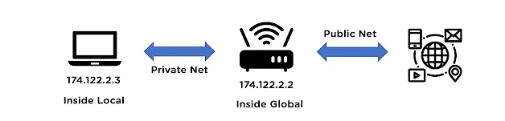
Addresses of NAT
NAT addresses can be differentiated as inside and outside addresses, where inside address refers to the private addresses to be translated.
The outside addresses refer to as the ones used to access the internet.

Slide 9
Addresses of NAT
Inside local address:
Inside global address:
Outside global address:
Outside local address:

Slide 10
Addresses of NAT
Inside local address: This IP address represents the host of the private network. This address cannot be used by a private network to access the internet directly.
Inside global address: This IP address represents the whole private network, by using a globally recognized public IP address. It is used to access the internet services for the private network.
Outside global address: This IP address represents the outside network address for the host before the NAT translation process.
Outside local address: This IP address represents the actual address representing the host on the internet, after the NAT translation process.

Slide 11
Working of NAT
The working of NAT begins with configuring the network router or NAT firewall, for the network translation to take place. The network router has an interface that acts as a connection between the inside (local) network, and the outside (global) network.
The inside network address has to go through the router for the translation process and gets converted to an outside globally recognized IP address to access internet services and the same translation process when moving from outside network to inside network.

Slide 12
Types of NAT
Static NAT
Dynamic NAT
Port Address Translation

Slide 13

Static NAT
In this NAT process, one single private network is mapped to an individual public IP address.
This process of translation is also known as one-to-one NAT, used generally for private network connections.

Slide 14
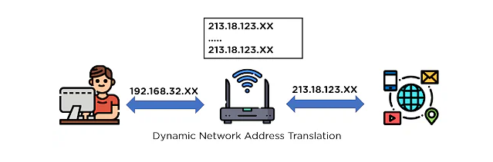
Dynamic NAT -
For this NAT translation process, the private network address is converted to a public IP address by choosing it from a pool of public IP addresses available to the network model.

Slide 15

Port Address Translation -
This translation process is configured to convert all the private IP addresses available to a single public IP address, but with a different port number assigned to each of the public addresses.
Due to the process of translation, it is also known as NAT Overload.

