Slide 1
ICMP-Internet Control Message Protocol

Slide 2
Supporting protocols of IP
IP uses four supporting protocols:
ARP-Address Resolution Protocol
RARP- Reverse Address Resolution Protocol
ICMP-Internet Control Message Protocol
IGMP-Internet Group Message Protocol

Slide 3
ICMP-Internet Control Message Protocol
The ICMP stands for Internet Control Message Protocol.
It is a network layer protocol.
It is used for error handling in the network layer, and it is primarily used on network devices such as routers.
It is used for reporting errors and management queries.
It is a supporting protocol

Slide 4
Need for ICMP
The IP protocol does not have any error-reporting or error-correcting mechanism, so it uses a message to convey the information.
It depends on Internet Control Message Protocol(ICMP) to provide an error control.
It is used for reporting errors and management queries.
It is a supporting protocol and is used by networks devices like routers
for sending error messages and operations information.
e.g. the requested service is not available or that a host or router
could not be reached.

Slide 5
ICMP Messages
The ICMP messages are usually divided into two categories:
Error-reporting messages
Query messages

Slide 6
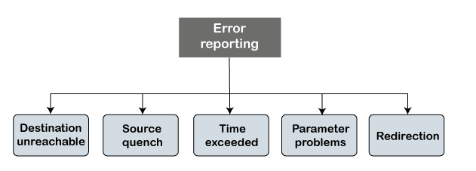
Error-reporting messages and types
The error-reporting message means that the router encounters a problem when it processes an IP packet then it reports a message.

Slide 7
Query messages
The query messages are those messages that help the host to get the specific information of another host.
For example, suppose there are a client and a server, and the client wants to know whether the server is live or not, then it sends the ICMP message to the server.

Slide 8
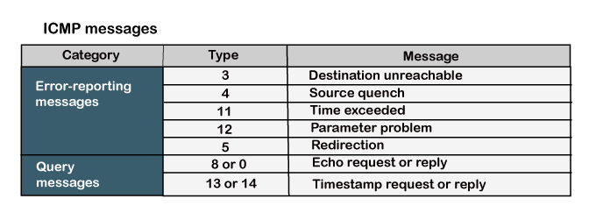
ICMP message types

Slide 9
ICMP Messages
Destination un-reachable : Destination unreachable is generated by the host or its inbound gateway to
inform the client that the destination is unreachable for some reason.
Source quench message :
There is no flow control or congestion control mechanism in the network layer or the IP protocol.
The sender is concerned with only sending the packets
Source quench message is a request to decrease the traffic rate for messages sending to the host(destination).
Then source will reduce the speed of transmission so that router will be free from congestion

Slide 10
ICMP Messages
Time exceeded message :
This message is sent when the TTL value of an IP packet reaches zero
Parameter problem :
Whenever packets come to the router then the calculated header checksum should be equal to the received header checksum then the only the packet is accepted by the router.
If there is a mismatch packet will be dropped by the router.
ICMP will take the source IP from the discarded packet and informs to the source by sending a parameter problem message.

Slide 11
Error-reporting messages
Redirection
When the packet is sent, then the routing table is gradually augmented and updated.
The tool used to achieve this is the redirection message.
For example, A wants to send the packet to B, and there are two routers exist between A and B. First, A sends the data to the router 1. The router 1 sends the IP packet to router 2 and redirection message to A so that A can update its routing table

Slide 12
ICMP Query Messages
The ICMP Query message is used for error handling or debugging the internet. This message is commonly used to ping a message.
Echo-request and echo-reply message
A router or a host can send an echo-request message. It is used to ping a message to another host that "Are you alive".
If the other host is alive, then it sends the echo-reply message. An echo-reply message is sent by the router or the host that receives an echo-request message.
Timestamp-request and timestamp-reply message
Suppose the computer A wants to know the time on computer B, so it sends the timestamp-request message to computer B. The computer B responds with a timestamp-reply message.

Slide 13
ICMP Message Format
The message format has two things
one is a category that tells us which type of message it is.
If the message is of error type, the error message contains the type and the code.
The type defines the type of message while the code defines the subtype of the message.

Slide 14
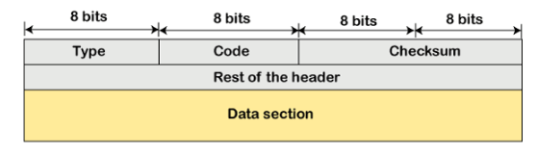
ICMP Message Format

Slide 15
ICMP Message Format
Type: It is an 8-bit field. It defines the ICMP message type. The values range from 0 to 127 are defined for ICMPv6, and the values from 128 to 255 are the informational messages.
Code: It is an 8-bit field that defines the subtype of the ICMP message
Checksum: It is a 16-bit field to detect whether the error exists in the message or not.
Rest of header
Content depends on ICMP type and code.
Data
ICMP error messages contain a data section that includes a copy of the entire IPv4 header, plus at least the first eight bytes of data from the IPv4 packet that caused the error message.

