Slide 1
SNMP

Slide 2
SNMP
SNMP stands for Simple Network Management Protocol.
SNMP is a framework used for managing devices on the internet.
It provides a set of operations for monitoring and managing the internet.
SNMP provides a set of fundamental operations in order to monitor and maintain the Internet.
It is an application layer protocol.
This protocol is mainly used to monitor the network, detect the faults in the Network, and sometimes it is also used to configure the remote devices.

Slide 3
SNMP
SNMP stands for Simple Network Management Protocol.
SNMP is a framework used for managing devices on the internet.
It provides a set of operations for monitoring and managing the internet.
SNMP provides a set of fundamental operations in order to monitor and maintain the Internet.
It is an application layer protocol.
This protocol is mainly used to monitor the network, detect the faults in the Network, and sometimes it is also used to configure the remote devices.

Slide 4
SNMP COMPONENTS
SNMP's client-server architecture has the three following components:
SNMP manager
SNMP agent
Management information base (MIB).

Slide 5
SNMP COMPONENTS
SNMP manager
The SNMP manager acts as the client
It is also known as Network Management Station (NMS)
It is a centralized system used to monitor network
SNMP agent
the SNMP agent acts as the server
It is a software module installed on a managed device.
Managed devices can be network devices like PC, routers, switches, servers, etc.
MIB
acts as the server's database.
When the SNMP manager asks the agent a question, the agent uses the MIB to supply the answer.
MIB consists of information on resources that are to be manage

Slide 6
SNMP messages
GetRequest
GetNextRequest
GETBULK Request:
SetRequest
GetResponse
Trap.
InformRequest:
Report

Slide 7
SNMP messages
GetRequest:
The GetRequest message is sent from a manager (client) to the agent (server) to retrieve the value of a variable.
GetNextRequest:
The GetNextRequest message is sent from the manager to agent to retrieve the value of next variable.
This type of message is used to retrieve the values of the entries in a table.
GETBULK Request:
Sent by the SNMP manager to the agent to efficiently obtain a potentially large amount of data, especially large tables.

Slide 8
SNMP messages
GetResponse:
The GetResponse message is sent from an agent to the manager in response to the GetRequest and GetNextRequest message.
This message contains the value of a variable requested by the manager.
SetRequest:
The SetRequest message is sent from a manager to the agent to set a value in a variable.
Trap:
The Trap message is sent from an agent to the manager to report an event.
For example, if the agent is rebooted, then it informs the manager as well as sends the time of rebooting.

Slide 9
SNMP messages
InformRequest:
Sent from one manager to another remote manager to get the value of some variables
Report
To report errors between managers

Slide 10
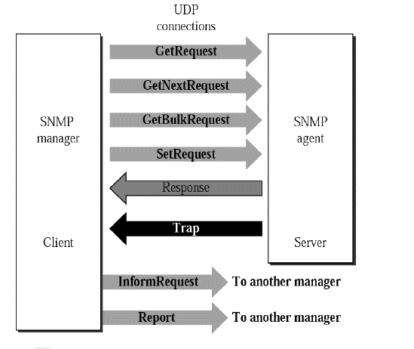
SNMP messages

Slide 11
SNMP Architecture
As SNMP is a client/server protocol, SNMP nodes can be classified as either clients (SNMP managers) or servers (SNMP agents).
SNMP managers, also called network management systems (NMSs), have a more central role in the network.
It will actively query and collect messages from SNMP agents in the network.
The agent also has the controls on the access to the agent’s Management Information Base (MIB), MIBs are nothing but text files, and values of MIB data objects are the topic of conversation between Managers and Agents.

Slide 12
SNMP Architecture
MIBs describe the structure of the management data of a device subsystem; they use a hierarchical namespace containing object identifiers (OID).
Each MIB object definition has a unique OID; the concept of OID is very similar to Modbus Register in Modbus Protocol.
An OID consists of a dotted list of integers. For example, within the MIB of a particular UPS, the OID for data object.

Slide 13
When Managers and Agents communicate, they refer to MIB data objects using OID’s. An OID sent with a corresponding value {OID,Value} is referred to as “binding”.
As SNMP agents are individual SNMP processes running on a host, multiple agents can be active on a single network node at any given time. The SNMP agent provides the interface between the manager and the physical device(s) being managed.

Slide 14
