Slide 1
MULTIPURPOSE INTERNET MAIL EXTENSION (MIME)

Slide 2
Drawbacks of SMTP
SMTP, which emerged in 1981, is a standard protocol for delivering messages via email.
The original SMTP protocol supported only 7-bit ASCII text communications that were both unauthenticated and unencrypted.
Pure SMTP also does not accommodate sending video or audio data.
The default design of every SMTP server was an open mail relay that lets anyone send emails through it, not just those from or to known users.

Slide 3
WHAT IS MIME?
MIME represents Multi-Purpose Internet Mail Extensions.
MIME is basically a supplementary protocol that mainly allows the non-ASCII data to be sent through E-mail.
It basically transforms the non-ASCII data at the sender site NVT ASCII data and then delivers them to the client in order to be sent through the Internet.
At the receiver side, the message is transformed back to the original data.

Slide 4
MIME
MIME is basically a set of software functions that mainly transforms the Non-ASCII data to ASCII data and vice-versa,
Following are the different kinds of data files that can be exchanged on the Internet using MIME:
audio
images
text
video
Other application-specific data(it can be pdf, Microsoft word document, etc).

Slide 5
Need of MIME Protocol
The MIME protocol supports multiple languages in e-mail, such as Hindi, French, Japanese, Chinese, etc.
Simple protocols can reject mail that exceeds a certain size, but there is no word limit in MIME.
Images, audio, and video cannot be sent using simple e-mail protocols such as SMTP. These require MIME protocol.

Slide 6
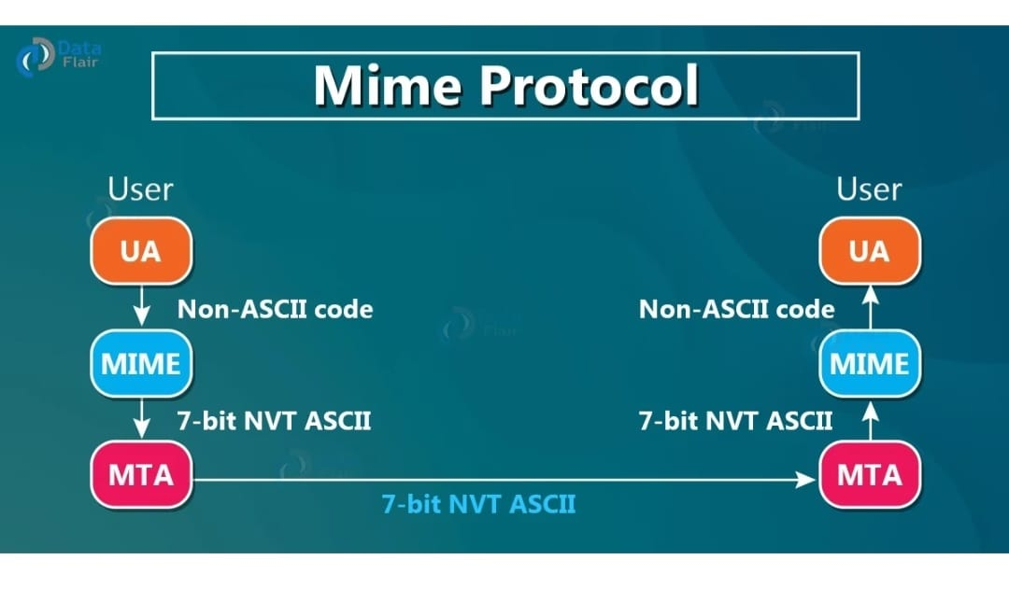

Slide 7
Example:
Let us take an example where a user wants to send an Email through the user agent, and this email is in a non-ASCII format.
So here we use the MIME protocol that mainly converts this non-ASCII format into the 7-bit NVT ASCII format.
The message is transferred via email system to the other side in the 7-bit NVT ASCII format and then again the MIME protocol will convert it back into the Non-ASCII code.
At the receiver side so that receiver can read it.
At the beginning of any email transfer basically, there is an insertion of the MIME header.

Slide 8
MIME Header
MIME Version
Content -Type
Content-transfer Encoding
Content -Id
Content -description

Slide 9
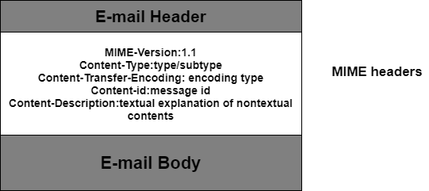
Mime Header

Slide 10
MIME HEADER
Mime Version: It denotes the MIME version being used. The current version is 1.1. It is defined as MIME-version: 1.1.
Content -Type: It defines the type and subtype of the data in the body of the message. The content type and content subtype are divided by a slash. This field defines how the object in the body is to be executed.
Content -transfer encoding: It defines how the object inside the body has been encoded to US ASCII to create it acceptable for mail transfer.

Slide 11
MIME HEADER
Content-Description − This field tells what the message is. It is the form of ASCII recipient will know whether it is worth decoding and reading the message.
Content-ID: This field identifies the contents. Its format is the same as the format of the standard Message-Id header.

Slide 12
Features of MIME Protocol
It supports multiple attachments in a single e-mail.
It supports the non-ASCII characters.
It supports unlimited e-mail length.
It supports multiple languages.
It provides support of compound documents
It also provides support for non-textual content in the email message.

Slide 13
MIME has several advantages over SMTP.
Users can send different kinds of binary attachments via email.
Multiple attachments of different types can be Included in the same email.
There are no limits on message length.
Multipart messages are supported.

