Slide 1
Subnetting
and
Supernetting

Slide 2
In subnetting, a network is divided into smaller subnetworks with each subnet having its own subnet address
In supernetting, a organization can combine several class C to create a large range of addresses. In other word, several networks are combined to create a supernetwork

Slide 3
INTRODUCTION
IP address – The identifier used in the IP layer of the TCP/IP PROTOCOL suit to identify each device connected to the internet
32 bit long

Slide 4
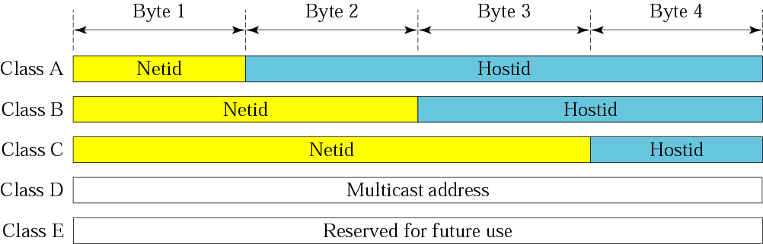
INTRODUCTION
Classful addressing – An architecture that defines the IP address space

Slide 5
INTRODUCTION
Generally: class A, B, C → two levels of
hierarchy
Sometimes two levels is not enough
Solution - subnetting

Slide 6
SUBNETTING
Subnetting – A network is divided into smaller networks with each network having its own addresses

Slide 7
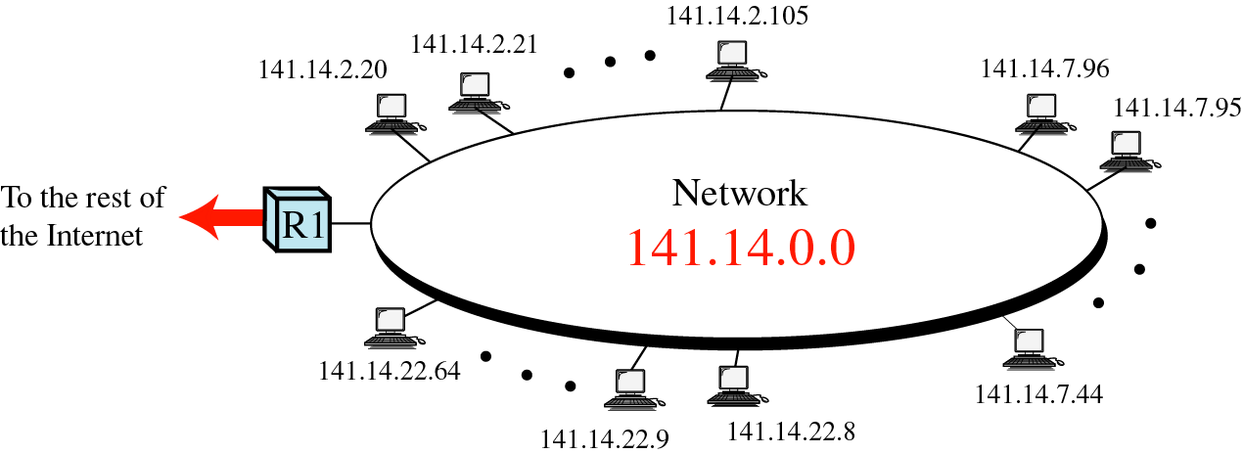
Without subnetting

Slide 8
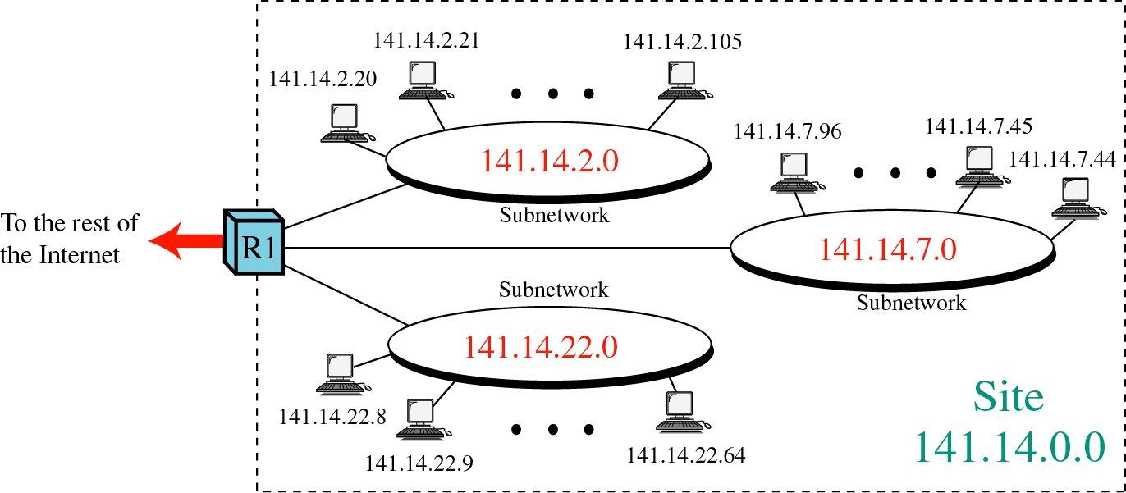
With subnetting

Slide 9
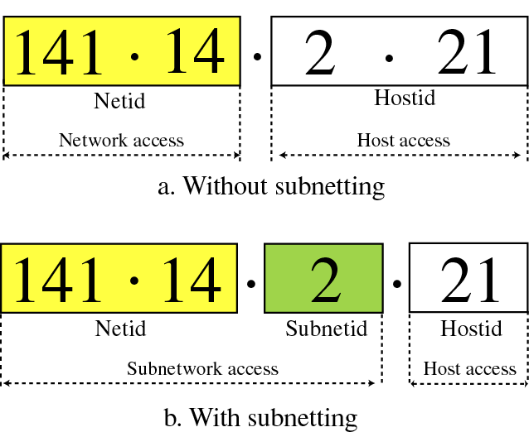
Three levels of heirachy

Slide 10
Masking
A process that extracts the address of the physical network from IP address
Can be done whether we have subnet or not.
Not have subnet: masking extract the network address from an IP address.
Have subnet: masking extract the subnet address from IP address.

Slide 11
Subnet Mask
A 32 bit number used for masking
Part of masking containing 1s defines netid orcombination of netid and subnetid
Part of making containing 0s defines hostid
To get the network and subnet address, we must apply the bit-wise-and operation on IP address and the mask

Slide 12
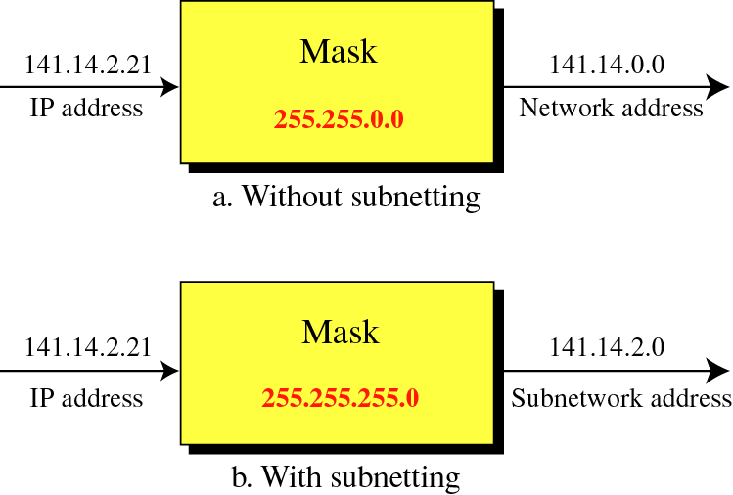

Slide 13
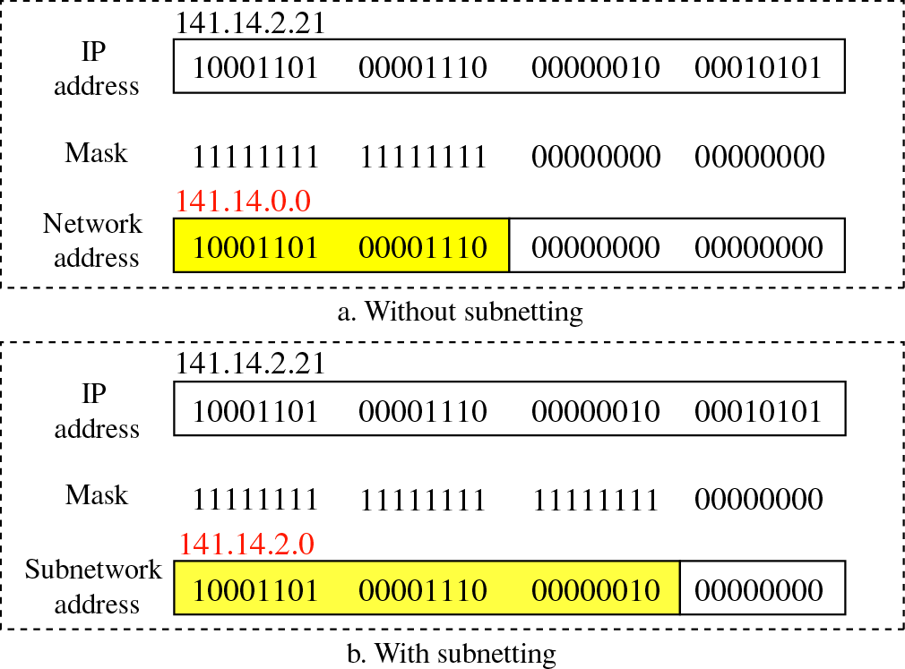
Applying bit-wise-and operation to achieve masking

Slide 14
Subnetting
In subnetting, add bits from the host part to network part to define subnet address

Slide 15
Designing Subnets
Deciding the number of subnets
The number of subnets must be a power of 2
Finding the subnet mask
Finding the range of address in each subnet

Slide 16
Example :
A organization with a class A needs a least 1000 subnetworks. Find the subnet mask and configuration of each network
Solution:
This means that the minimum number of bits to be allocated for subnetting should be 10 (2⁹ < 1,000< 2¹⁰)
Fourteen bits are left to define the hostid

Slide 17
Example :
A company is granted the site address 201.70.64.0 (class C). The company needs 8 subnets. Design the subnets.

Slide 18
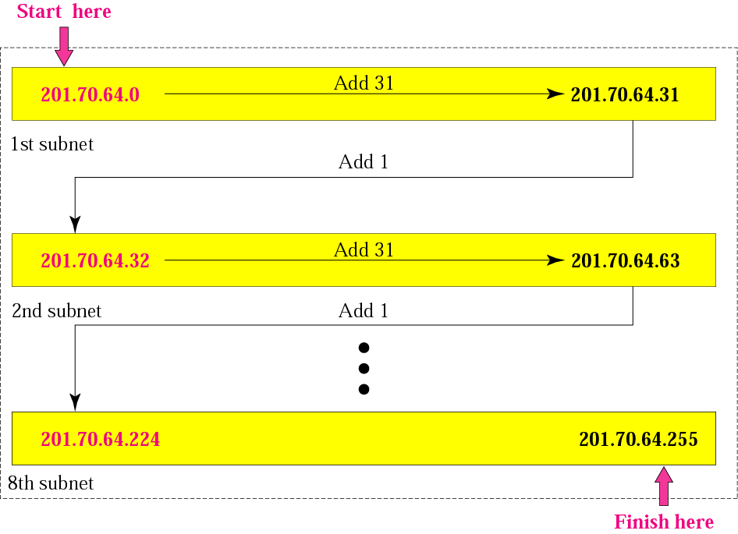

Slide 19
Variable-length subnetting
The internet allows a site to use variable-length subnetting.
For an example of when this may be desirable, consider a site that is granted a class C address and needs to have five subnets with the following number of host: 60,60,60,30,30
This site can not use a subnet mask with only two bits in the subnets section because this allows only four subnet with 62 hosts ( 256/4 - 2 = 62).
Nor can the site use a subnet mask with three bits in the subnet section, because this allows 8 subnets with 30 hosts (256/8 -2 = 30)

Slide 20
Variable-length subnetting
Solution for the problem: variable length subnetting.
The router uses two different masks, one applied after the other
First mask uses the mask with 26 1s (11111111 11111111 11111111 1100000 or 255.255.255.255.192) to divide the network into four subnets
Then it applies the second mask with 27 1s (255.255.255.224) to one of the subnets to divide it into two smaller subnets

Slide 21
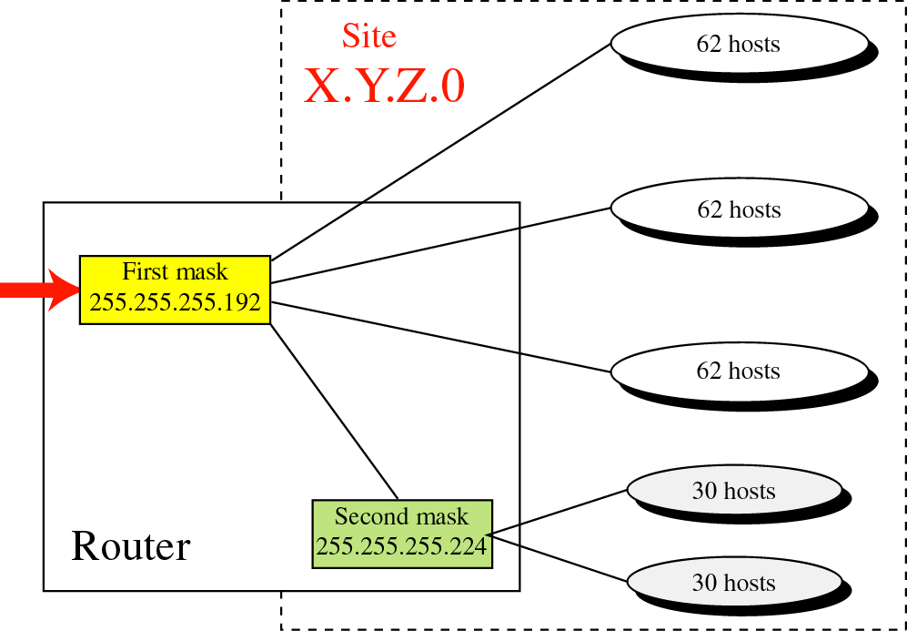
Variable length subnetting

Slide 22
Supernetting
Depend on the need of an organization
One or more classes c can be jointed to make one supernetwork
Example: an organization that needs 1000 address can be granted four class c addresses. The organization can then use these address in one supernetwork, in four network, or in more then four networks.

Slide 23
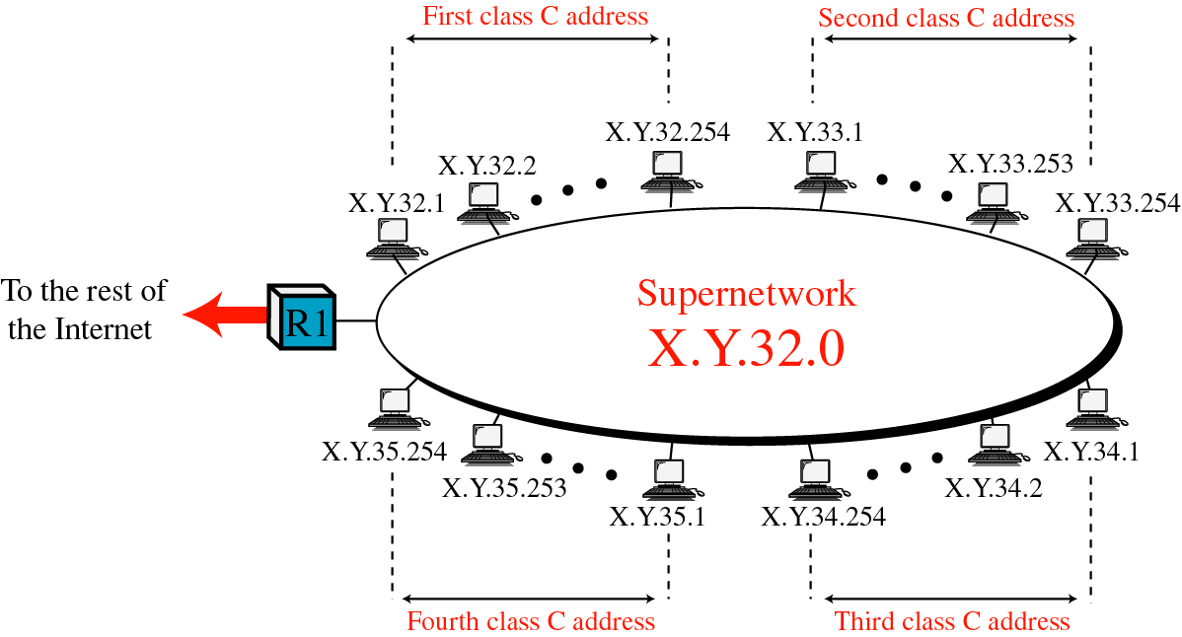
Figure 5-18

Slide 24
Assigning addresses
When combine set of c blocks into a large network
2 choices
1. choose the blocks randomly based on some rules
if do so, the routers outside the organaization treat
each block separately

Slide 25
Assigning addresses
2. Make a superblock out of the block, so that each routing table has only one entry in the table
follow a set of rules

Slide 26
Assigning addresses
The number of blocks must be a power of 2
The blocks must be contiguous in the address space
The third byte of the first address in the superblock must be evenly divisible by the number of blocks

Slide 27
Supernet mask
In supernetting, need the first address of the supernet and the supernet mask to define the range of addresses.

Slide 28
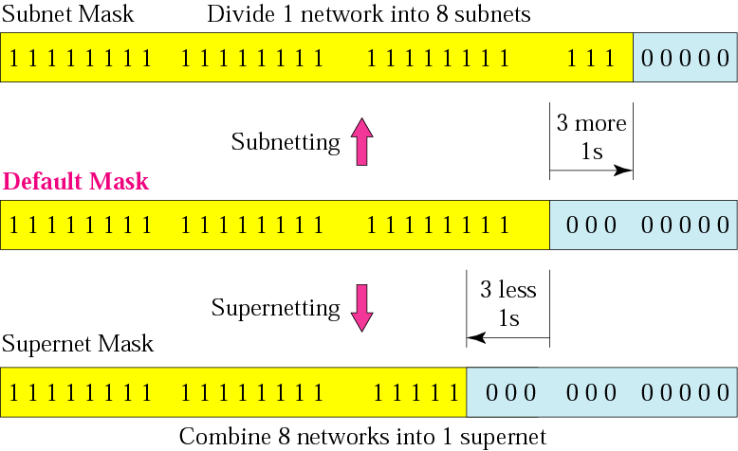
Comparison of subnet, default, and supernet masks

Slide 29
Example :
We need to make a supernetwork out of 16 class C blocks. What is the supernet mask?
Solution:
We need 16 blocks. For 16 blocks we need to change four 1s to 0s in the default mask. So the mask is
11111111 11111111 11110000 00000000
or
255.255.240.0

Slide 30
Example :
A supernet has a first address of 205.16.32.0 and a supernet mask of 255.255.248.0. How many blocks are in this supernet and what is the range of addresses?
Solution:
The supernet has 21 1s. The default mask has 24 1s. Since the difference is 3, there are 2³ or 8 blocks in this supernet. The blocks are 205.16.32.0 to 205.16.39.0. The first address is 205.16.32.0. The last address is 205.16.39.255.

