Slide 1

GANADIPATHY TULSIS JAIN ENGINEERING COLLEGE
A PREDICTIVE SYSTEM FOR IDENTIFYING BOT-GENERATED AD CLICKS
Batch No: 09
Team Members:
Hari Krishnan S - 510822104012
Sufiyan S - 510822104047
Theerthagiri S - 510822104050
Vedeshkumar M - 510822104055
Project Coordinator :
Mrs.Santhanalakshmi,
H.O.D.
Computer Science Department,
GTEC

Slide 2
OBJECTIVE
Main objective of this project is to design and develop an intelligent Ad Click Fraud Detection. The system aims to analyze large volumes of click data and detect abnormal patterns associated with bot-driven or malicious activities. To detect the abnormal Ad Click activities.

Slide 3
ABSTRACT
Ad Click fraud detection : It is a general issue in digital marketing, where automated bots or malicious actors generate false clicks on advertisements. This project leverages machine learning models. This models can accurately distinguish between Human clicks or Bot clicks.
The models are evaluated using performance metrics such as accuracy, precision, recall, and F1-score to determine how effectively they detect fraudulent clicks.

Slide 4
INTRODUCTION
Online advertising has become a dominant revenue model for digital platforms and businesses worldwide.
Ad click fraud typically involves repeated or abnormal clicking behaviour.
We Introduced the machine learning model for detecting this kind of abnormal clicking behaviour.
Machine learning techniques provide to learn about hidden patterns from historical click data.

Slide 5
EXISTING SYSTEM
Uses rule-based and manual filtering techniques
Relies on static thresholds (IP block list, click limits)
Detects fraud using basic statistical methods
Disadvantages :
No intelligent learning mechanism
Cannot adapt to new or evolving bot behaviors
High false positives, misclassifying human clicks
Poor performance on imbalanced datasets
Not suitable for real-time fraud detection

Slide 6
LITERATURE SURVEY
TITLE | AUTHOR | PROPOSED SYSTEM | LIMITATIONS
Ad Click Fraud Detection Using Machine Learning and Deep Learning Algorithms | Reem A. Alzahrani, Malak Aljabri, And Rami Mustaf A. Mohammand, 2025 | Machine Learning models to detect the online advertisement fraud. | Weak Privacy Guarantees. Lack of Robust Representation Learning and Limited Adaptability.
Online Ad Click Fraud Detection Using Graph-Based Methods | K. Sharma, R. Patel, V. Kumar, 2024 | Detects fraudulent patterns. | Computationally intensive on very large networks. Requires high-quality and complete relational data.
A Survey on Ad Fraud Detection Techniques | A. Gupta, P. Roy, S. Mehta, 2023 | Comprehensive survey of ad click fraud detection methods. | Scalability issues due to massive click data volumes. Real-time detection remains computationally demanding.

Slide 7
LITERATURE SURVEY
TITLE | AUTHOR | PROPOSED SYSTEM | LIMITATIONS
Real-Time Detection of Ad Click Fraud Using Ensemble Learning | Sneha Reddy, Manish Jain, Abhishek Verma, 2022 | Detects automated bots and coordinated human-assisted fraud. | Requires careful feature selection and preprocessing. Performance depends on high-quality labeled data.
Machine Learning Based Click Fraud Detection in Online Advertising | Pooja Gupta, Rakesh Sharma, Anil Kumar, 2021 | Machine learning framework to detect click fraud in online advertising. | Requires well-preprocessed feature data. Performance depends on classifier selection and tuning.

Slide 8
PROPOSED SYSTEM
Uses Machine Learning–based ad fraud detection
Classifies clicks into Human and Bot
Employs Random Forest and XGBoost models
Performs behavioral feature extraction ( Feature Engineering )
Click time gap
IP click frequency
Night-time activity

Slide 9
Advantages :
Handles imbalanced data effectively
Provides real-time prediction using Flask web app
Reduces false positives and false negatives
Scalable and adaptable to new fraud patterns
Improves overall accuracy and reliability

Slide 10
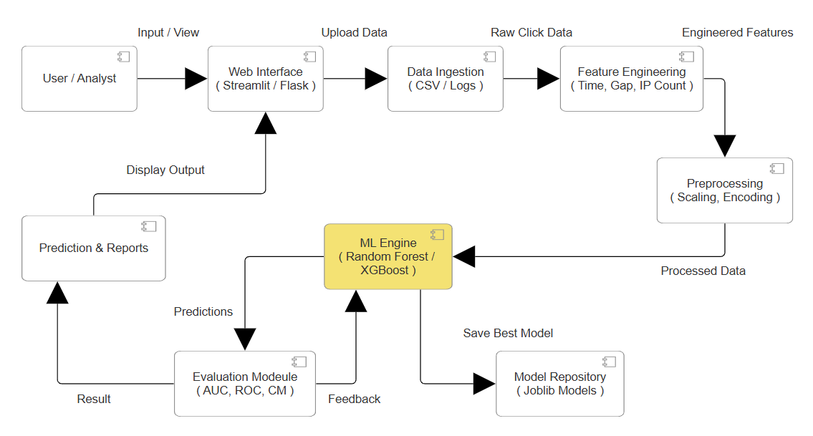
Architecture Diagram

Slide 11
SYSTEM REQUIREDMENT
HARDWARE REQUIREDMENT
PROCESSOR : INTEL CORE I5 / I7 OR EQUIVALENT
RAM : MINIMUM 8 GB (RECOMMENDED 16 GB)
STORAGE : 500 GB HDD OR SSD
GPU : NVIDIA GPU WITH CUDA SUPPORT
SOFTWARE REQUIREDMENT
OPERATING SYSTEM : WINDOWS 10 / 11 (64-BIT)
PROGRAMMING LANGUAGE : PYTHON 3.9+
FRAMEWORKS : TENSORFLOW, KERAS, SCIKIT-LEARN, TRANSFORMERS
LIBRARIES : NUMPY, PANDAS, OPENCV, SEABORN, MATPLOTLIB
DEVELOPMENT ENVIRONMENT : JUPYTER NOTEBOOK / ANACONDA
DEPLOYMENT : FLASK (FOR USER INTERFACE)

Slide 12
MODULES
DATA LOADING
DATA ACQUISITION
DATA PREPROCESSING
DATA CLEANING
MODEL TRAINING
DATA SPLITTING

Slide 13
MODULES DESCRIPTION
DATA LOADING
Data loading is the process of copying and loading data sets from a source file.
Source file extract from Kaggle.com.
Database application, the data format is changed from .doc or .txt to a .CSV format.
Data loading is used in database-based extraction and loading techniques.

Slide 14
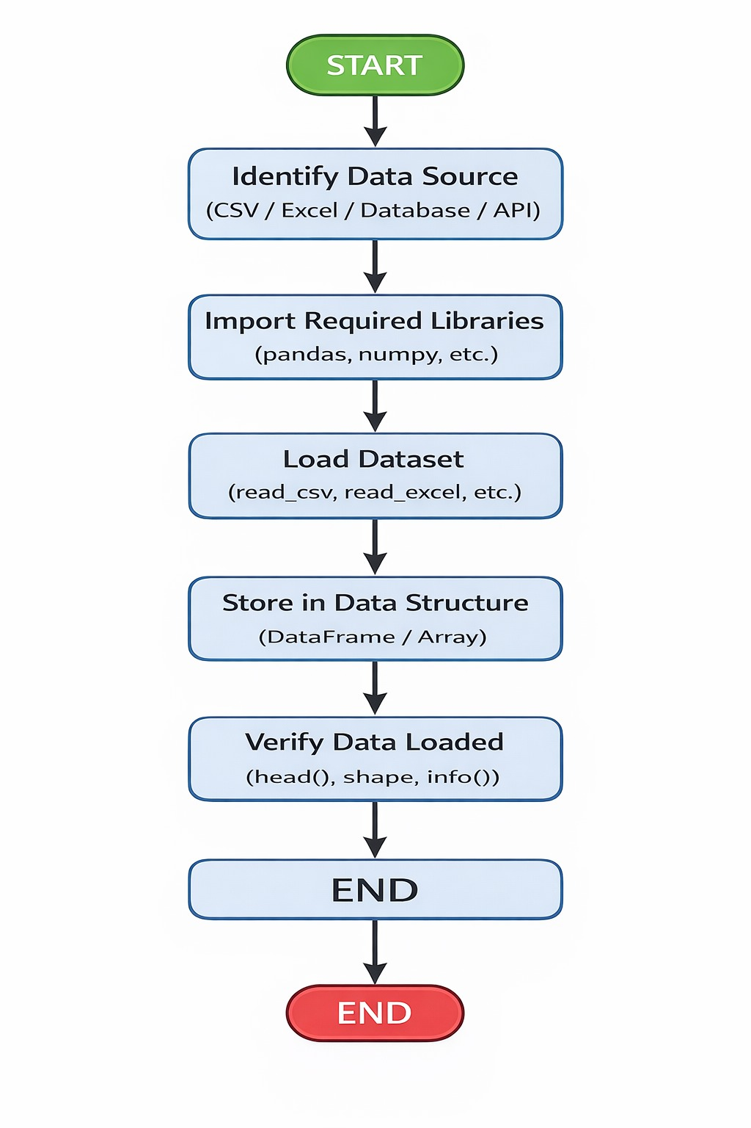
DATA LOADING

Slide 15
Continued...
DATA ACQUISITION
The data acquisition module is responsible for collecting click data from online advertising campaigns.
This includes attributes such as IP addresses, device types, operating systems, timestamps, app identifiers, and user session behavior.

Slide 16
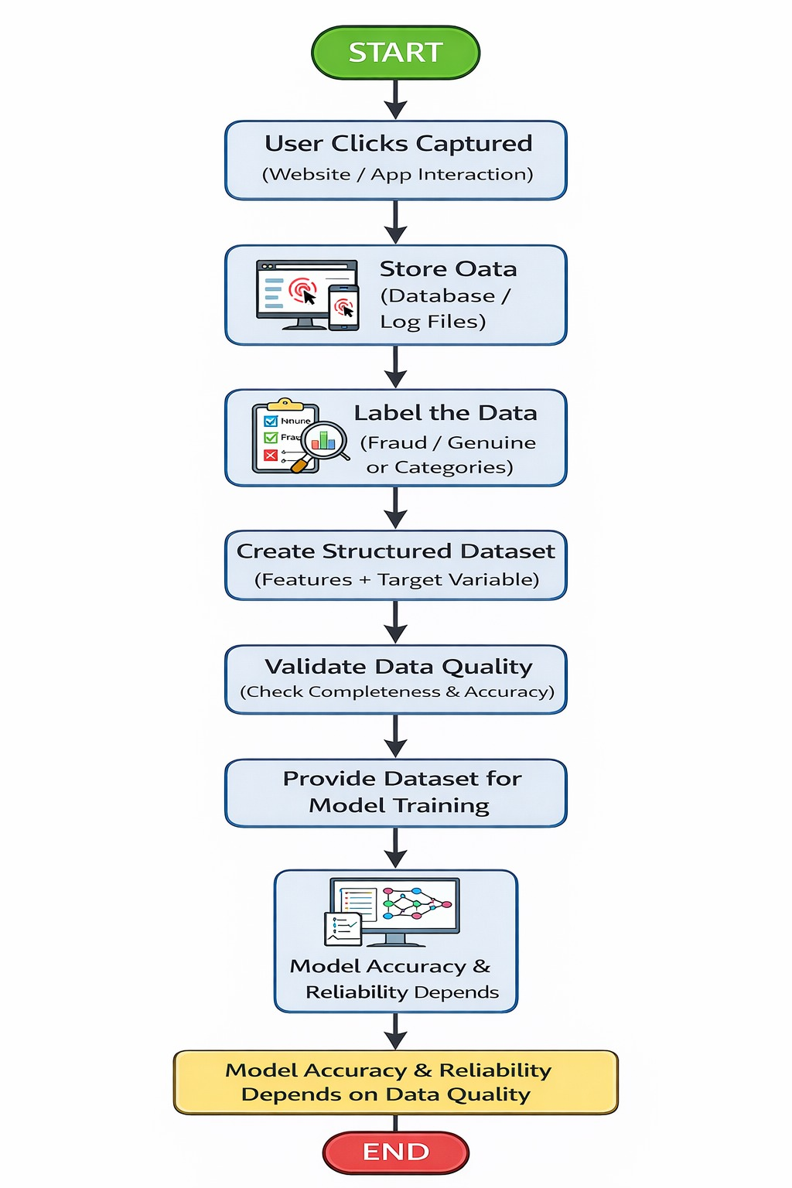
DATA ACQUISITION

Slide 17
Continued…
DATA PREPROCESSING
Once the raw data is collected, the preprocessing module cleans and formats it for analysis.
Missing values are handled through imputation, and categorical features.
Data preprocessing encoded data into numeric formats suitable for machine learning algorithms.

Slide 18
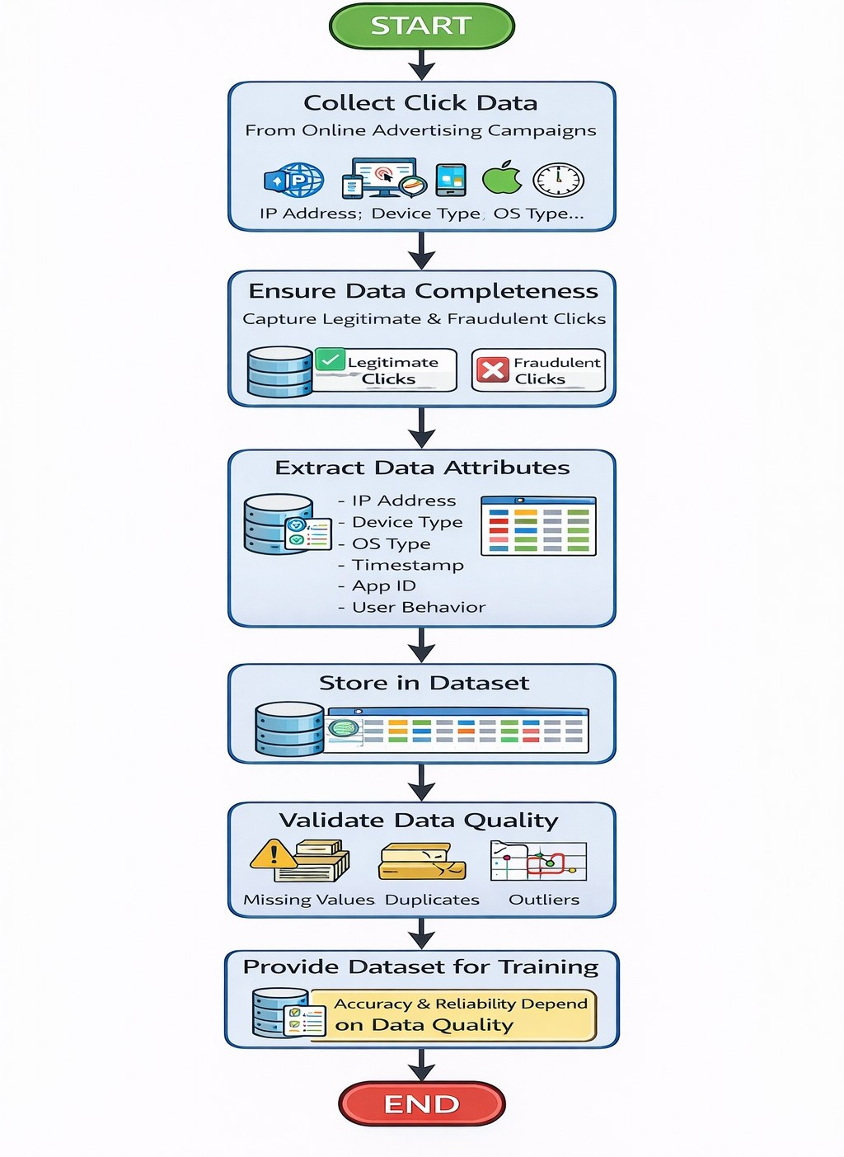
DATA PREPROCESSING

Slide 19
Continued…
DATA CLEANING
In this data cleaning module the data is cleaned.
After cleaning of the data, the data is grouped as per requirement.
This grouping of data is known as data clustering.
Then check if there is any missing value in the data set or not.
It there is some missing value then change it by any default value.

Slide 20
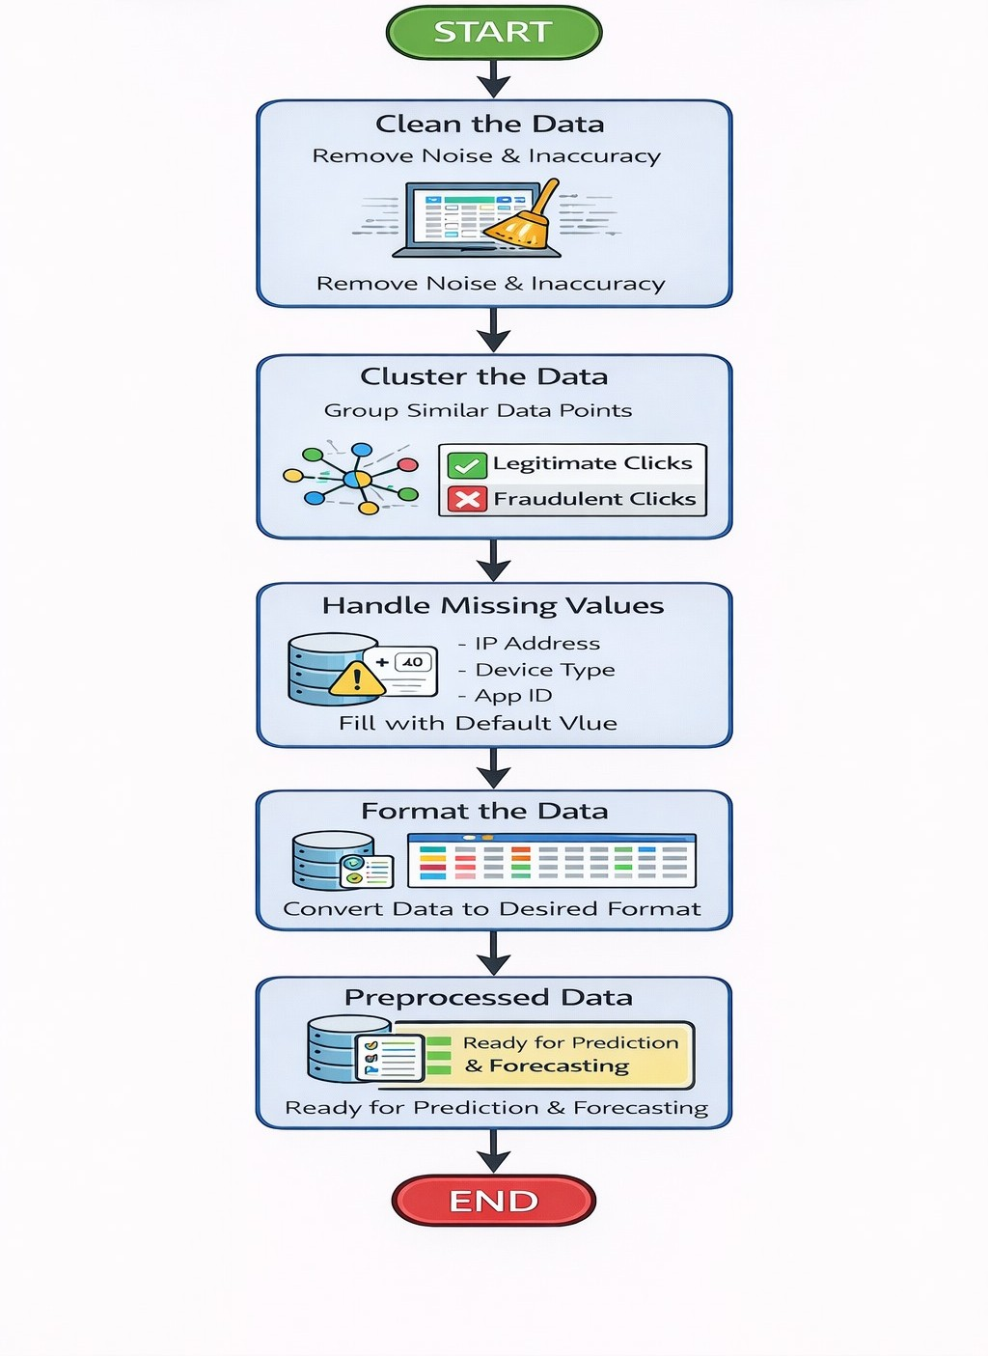
DATA CLEANING

Slide 21
Continued…
MODEL TRAINING
We split the entire dataset into 70% training set and 30% test set.
We used the training set for resampling, hyper parameter tuning, and training the model.
While splitting the data, we specified a random seed (any random number).
It ensured the same data split every time the program executed.

Slide 22
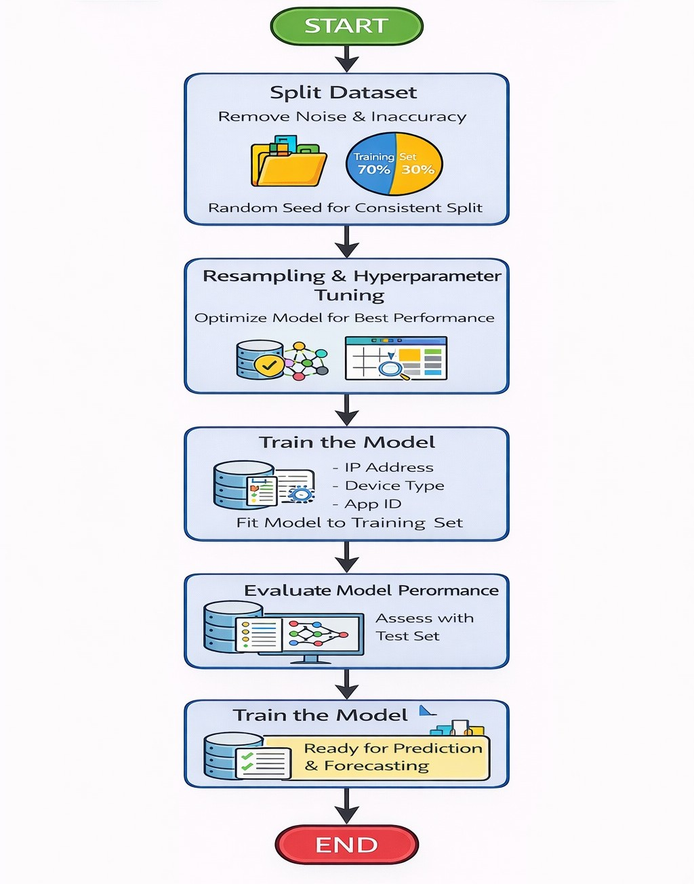
MODEL TRAINING

Slide 23
Continued…
DATA SPLITTING
Training set : A data scientist uses a training set to train a model and define its optimal parameters — parameters it has to learn from data.
It have 70 % data sets and 8 features.
Test set : A test set is needed for an evaluation of the trained model and its capability for generalization.
It have 30 % data sets and 7 features.

Slide 24
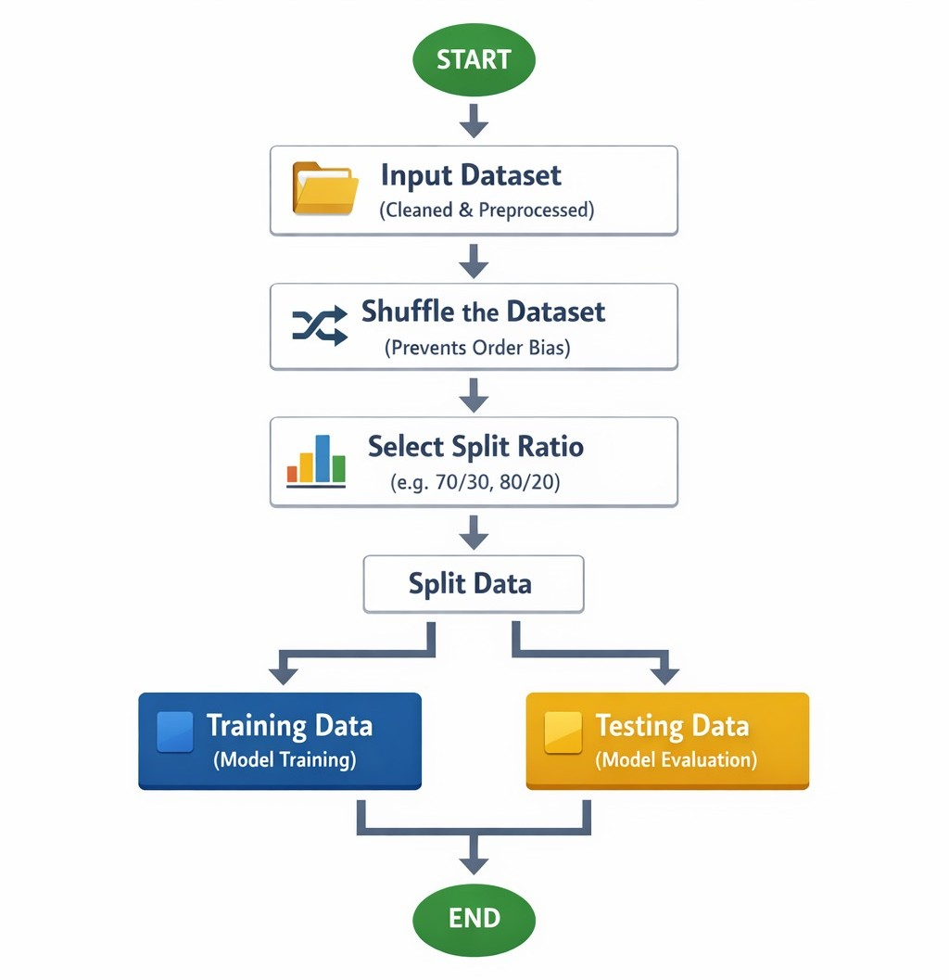
DATA SPLITTING

Slide 25
MODULES ALGORITHM
Random Forest is an ensemble learning algorithm that constructs multiple decision trees during training and combines their outputs to produce a final prediction.
XGBoost (Extreme Gradient Boosting) is a powerful boosting-based algorithm that builds decision trees sequentially, where each new tree focuses on correcting the errors made by previous ones.

Slide 26
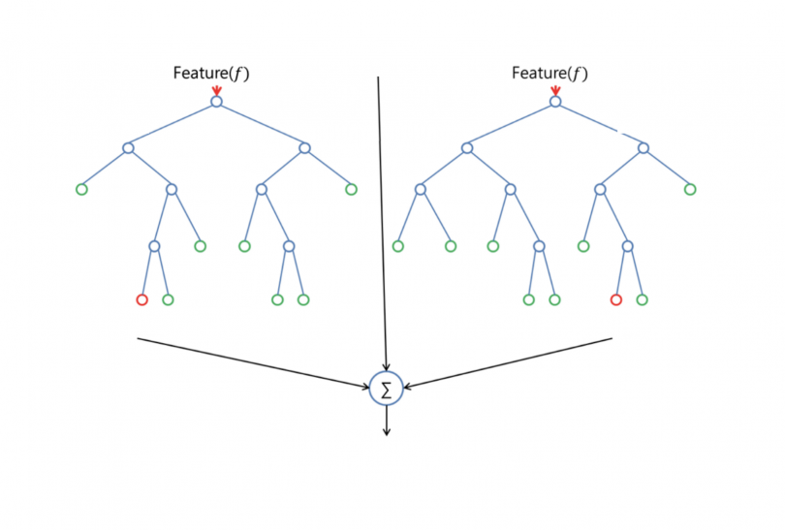
SYSTEM MODULES TREE
Random Forest
XGBoost
Output

Slide 27
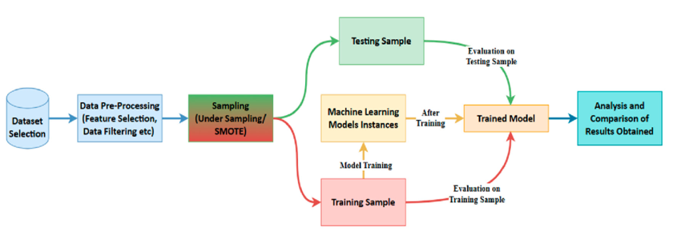
Work Flow Diagram

Slide 28
PERFORMANCE MATRICES
Data was divided into two portions, training data and testing data, both these portions consisting 70% and 30% data.
Accuracy = ( TP + TN ) / ( P + N )

Slide 29
CONFUSION MATRIX
It is a evaluation metrics in predictive analysis.
It is an NxN matrix that describes the model.
True Negative ( TN ) | False Positive ( FP )
False Negative ( FN ) | True Positive ( TP )
Negative ( 0 )
Positive ( 1 )
Negative ( 0 )
Positive ( 1 )
Predicted

Slide 30
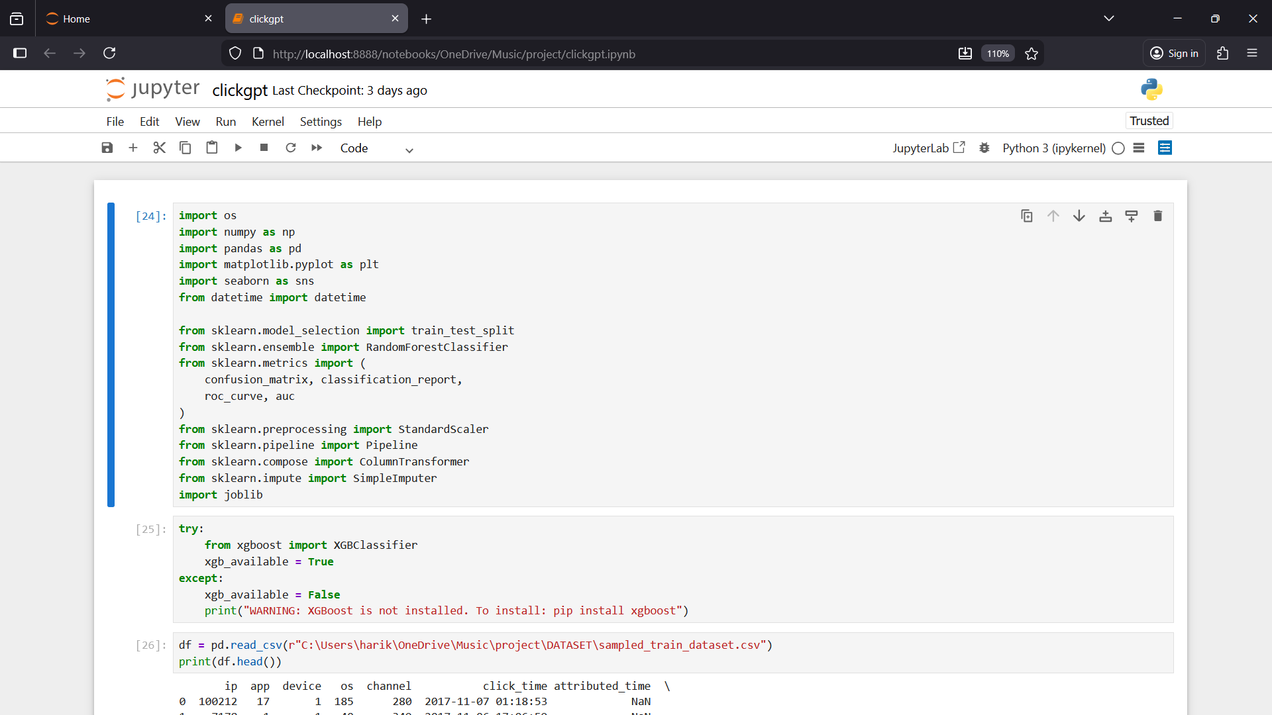
Program and Output

Slide 31
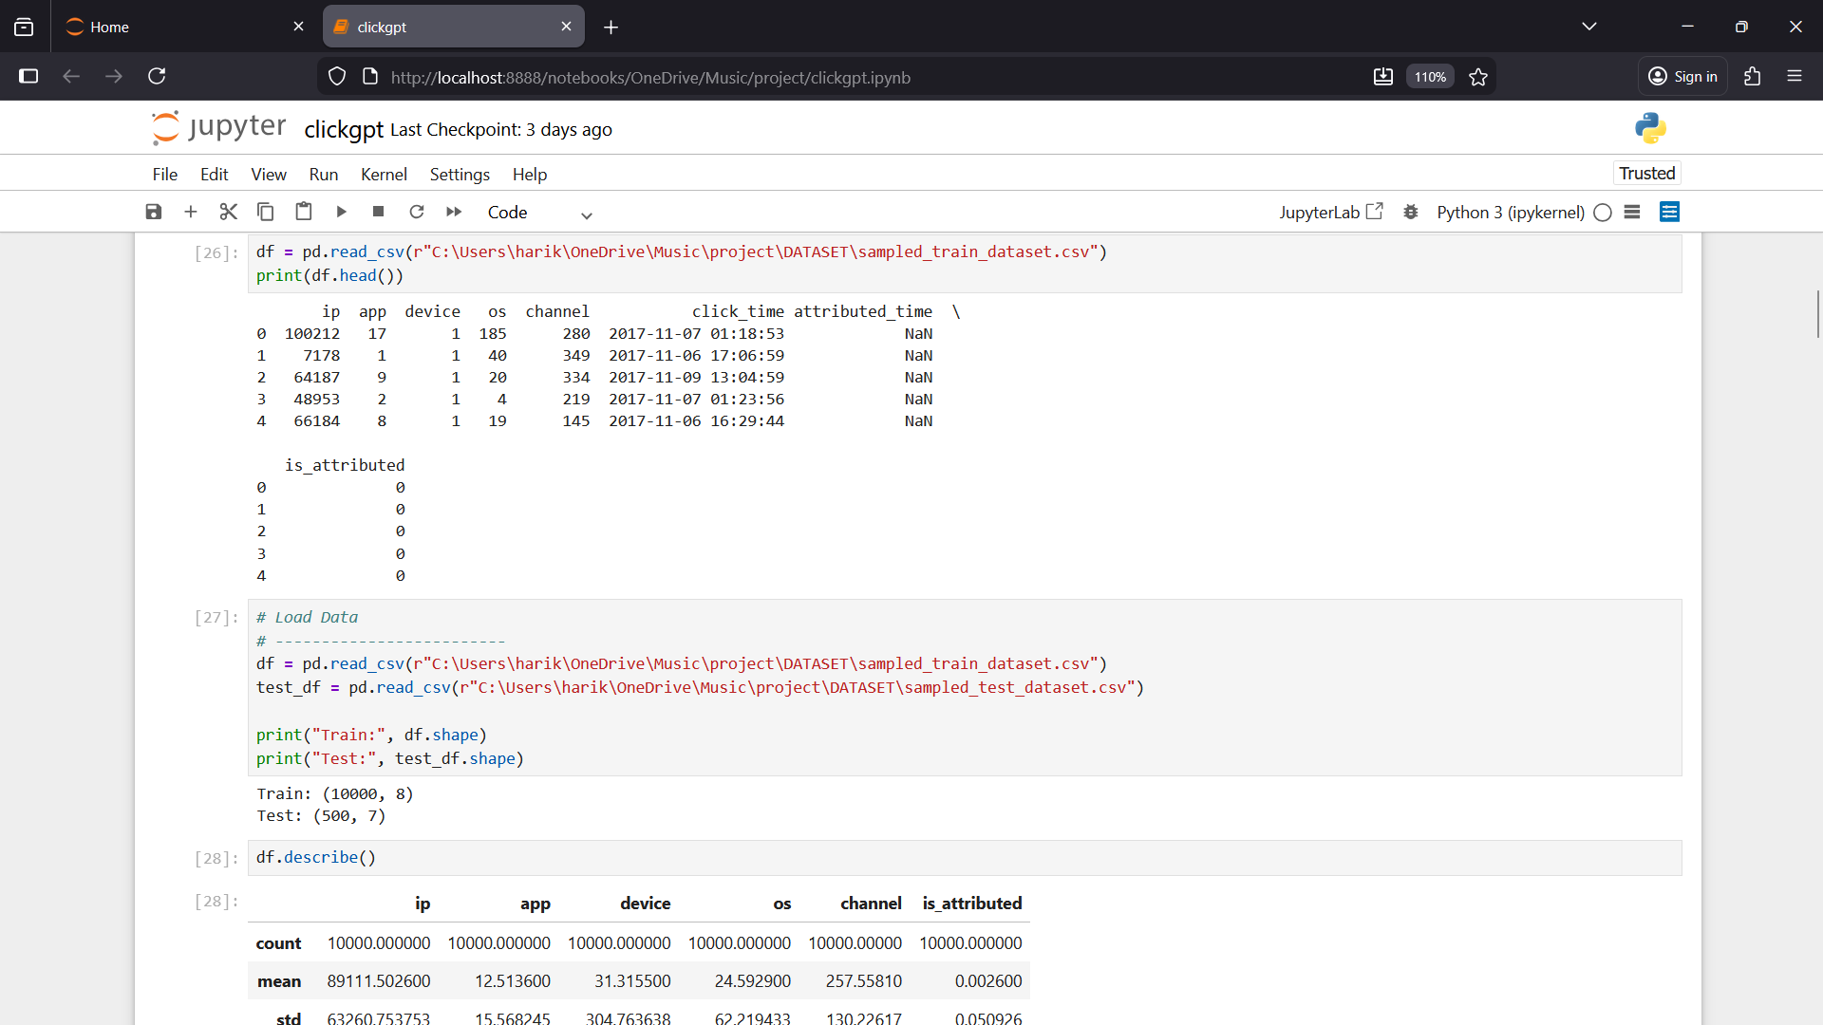

Slide 32
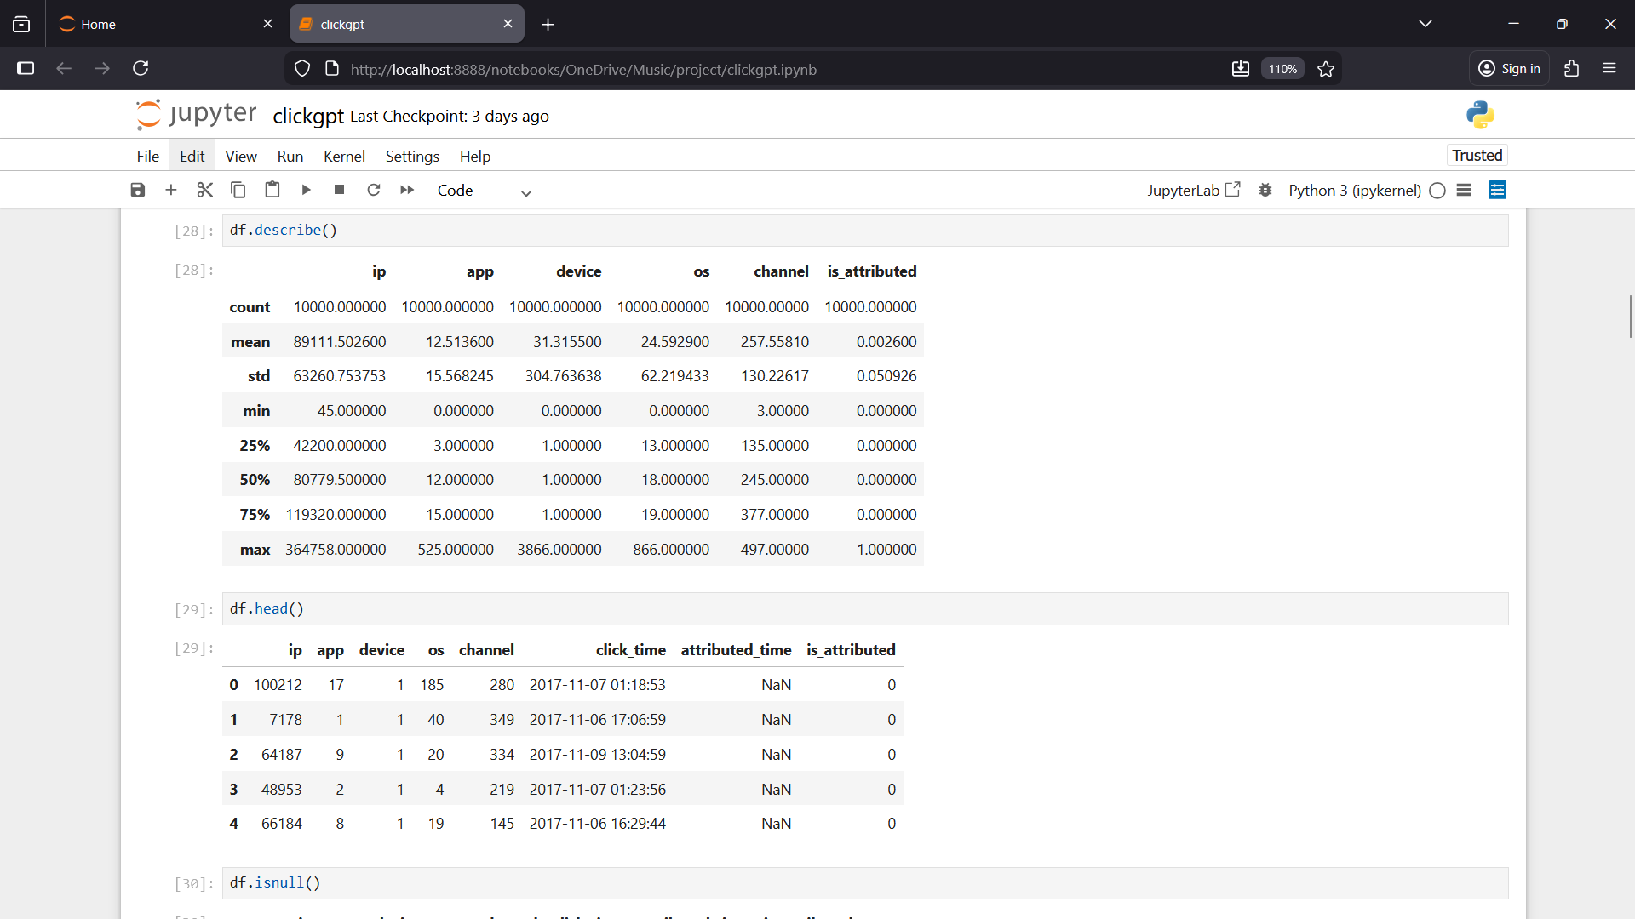

Slide 33
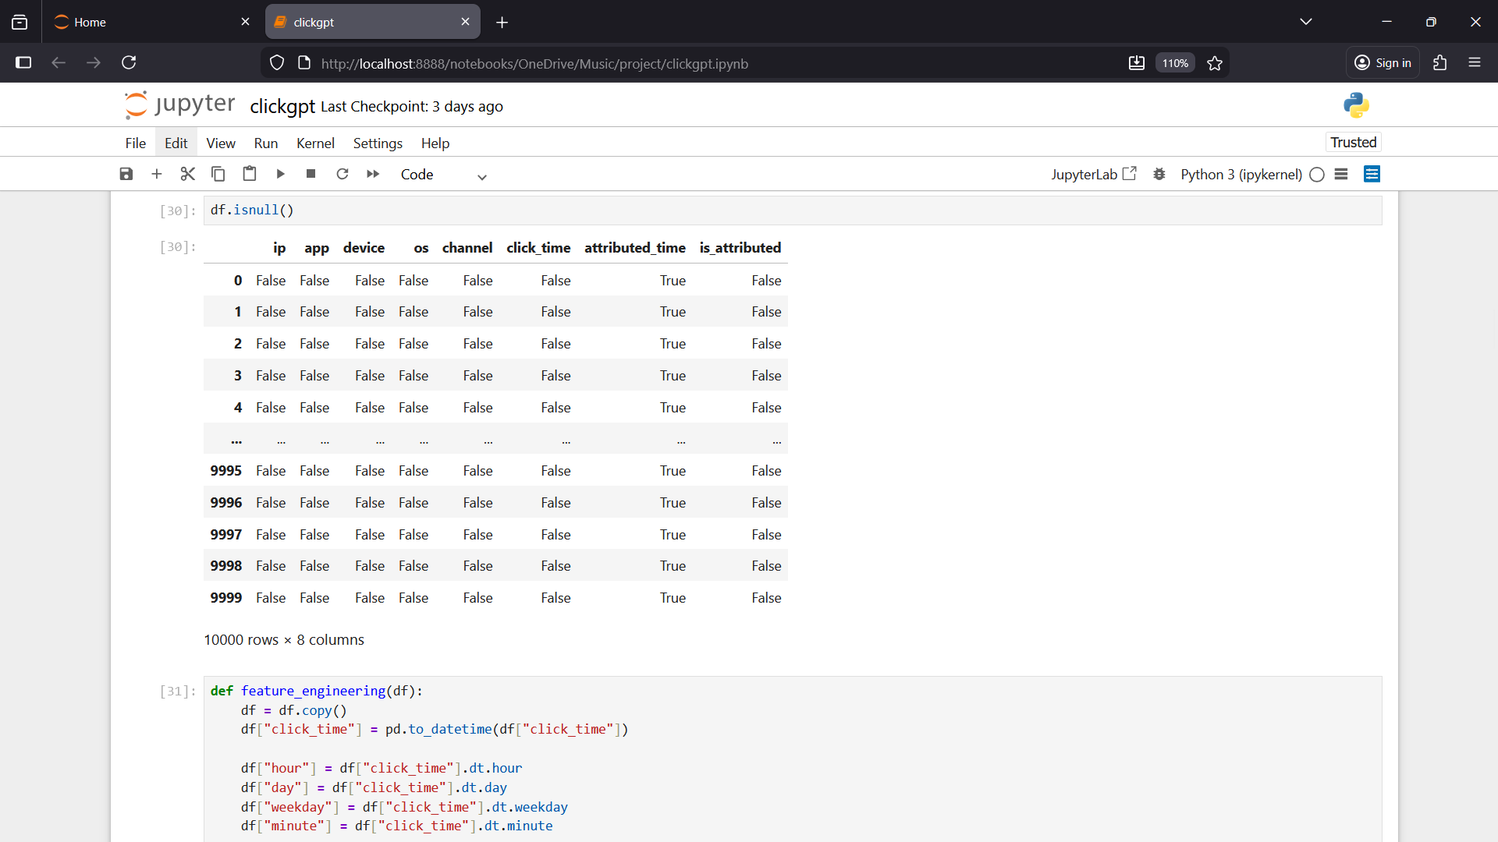

Slide 34
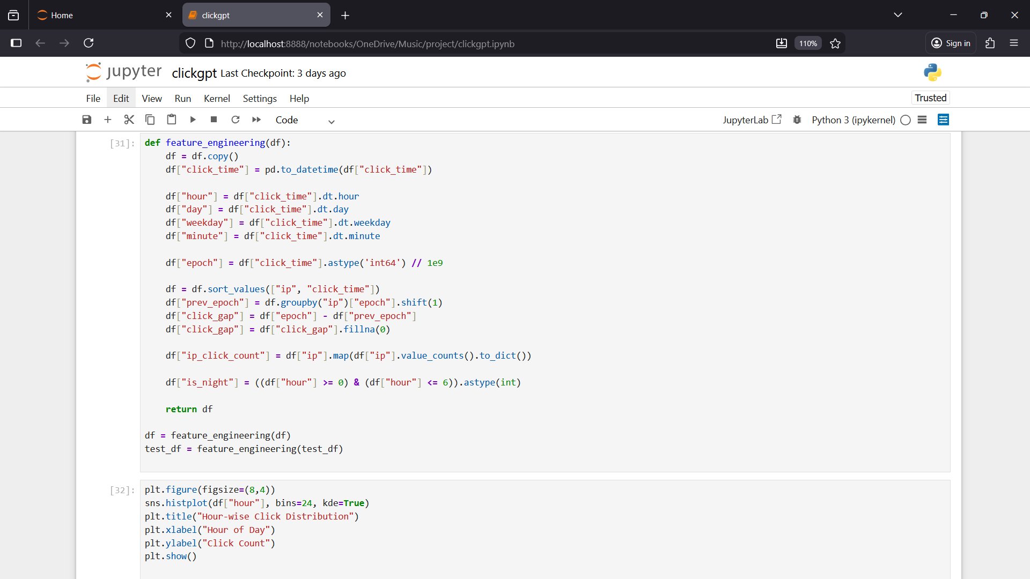

Slide 35
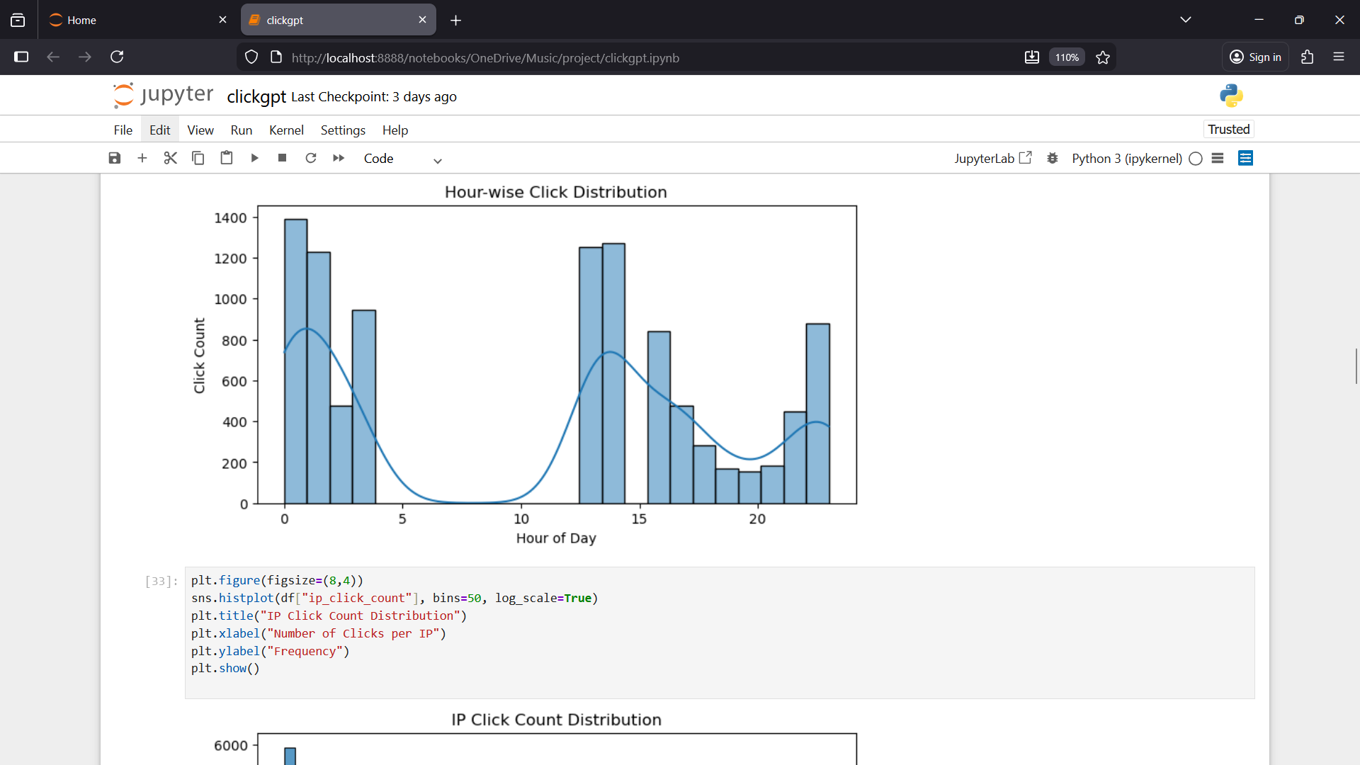

Slide 36
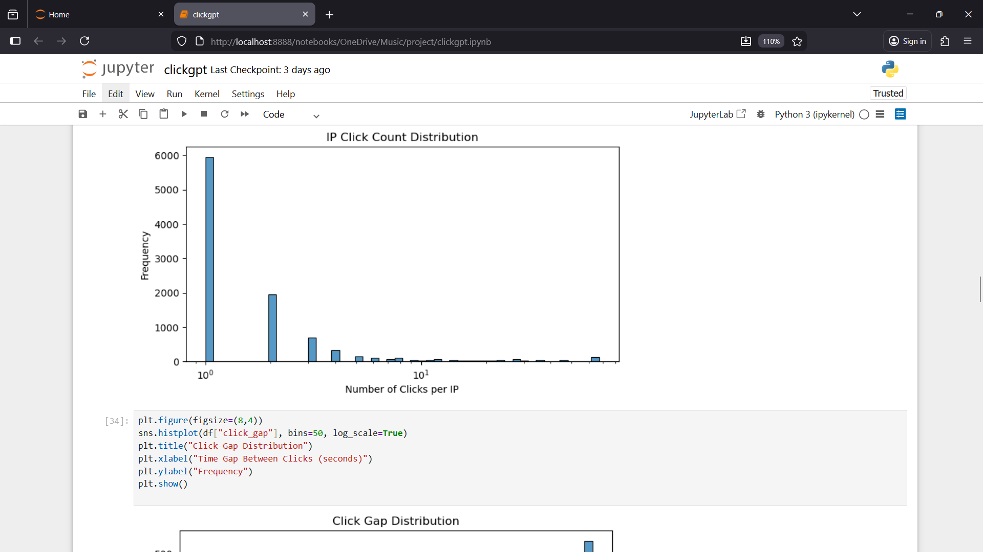

Slide 37
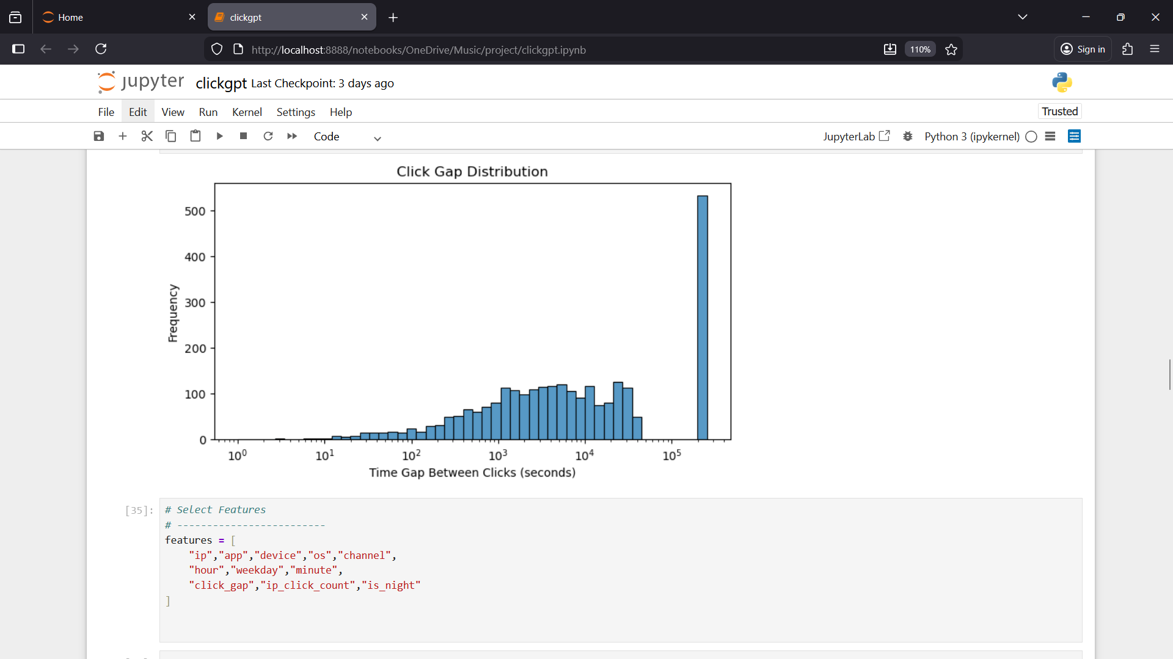

Slide 38
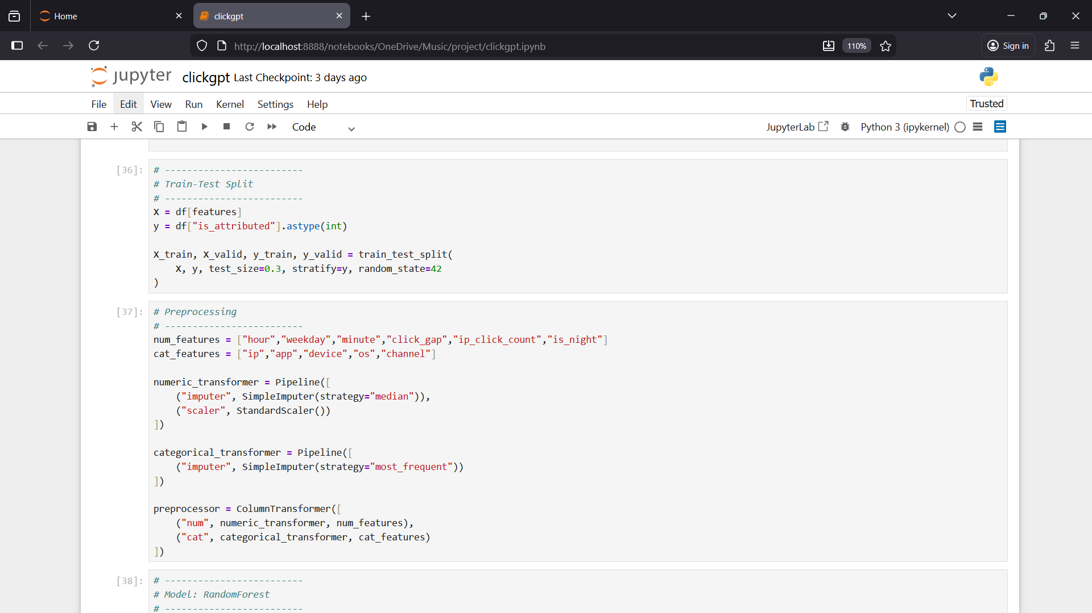

Slide 39
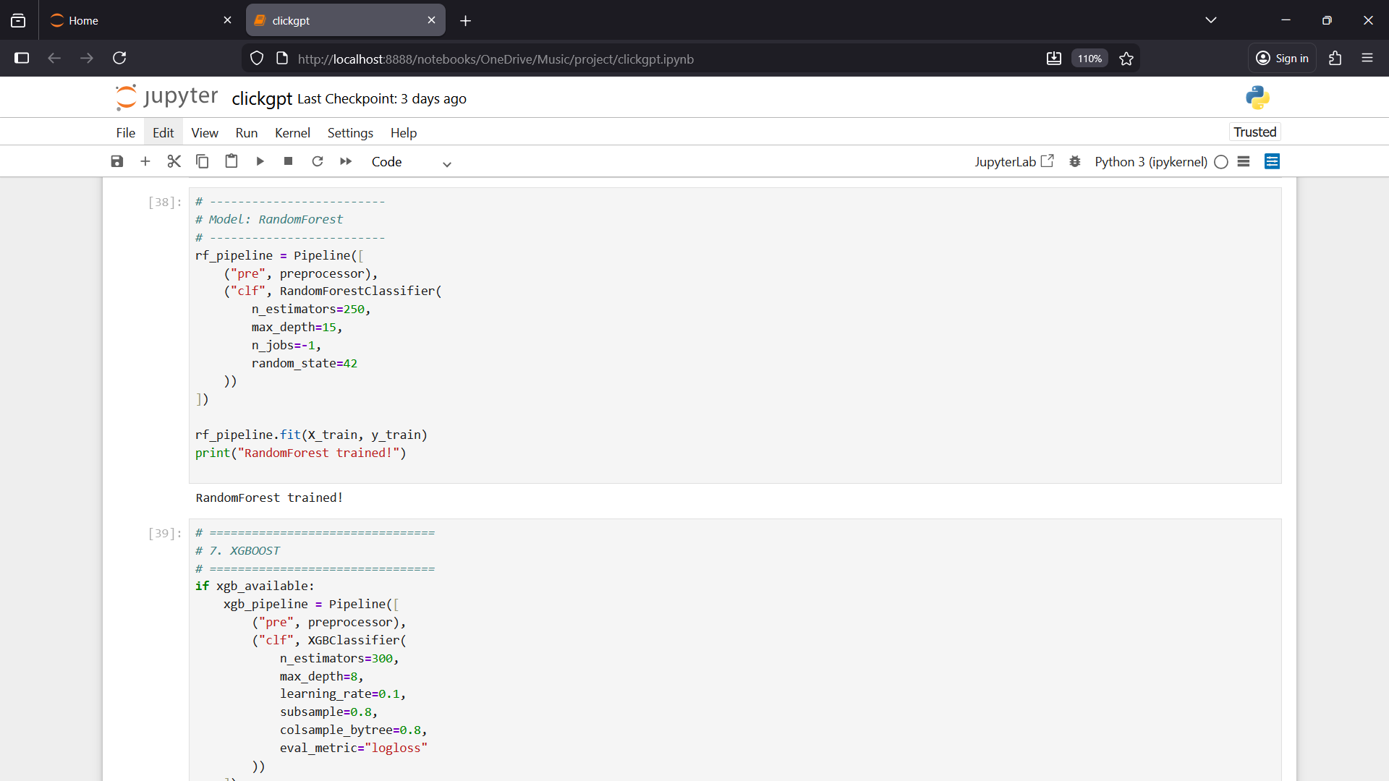

Slide 40
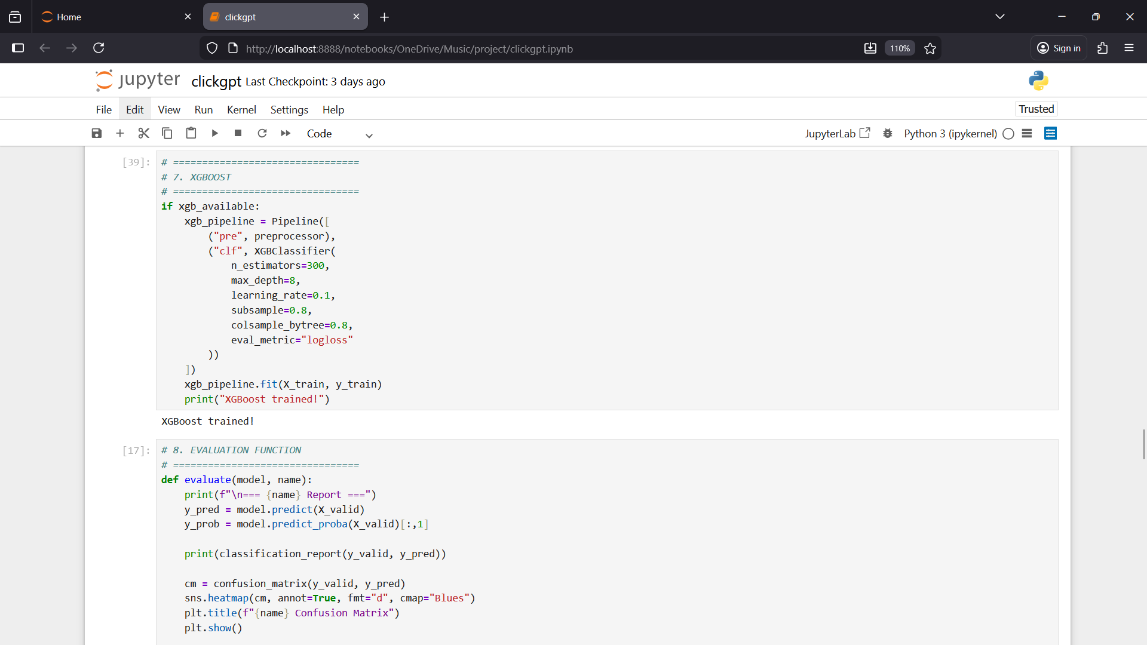

Slide 41
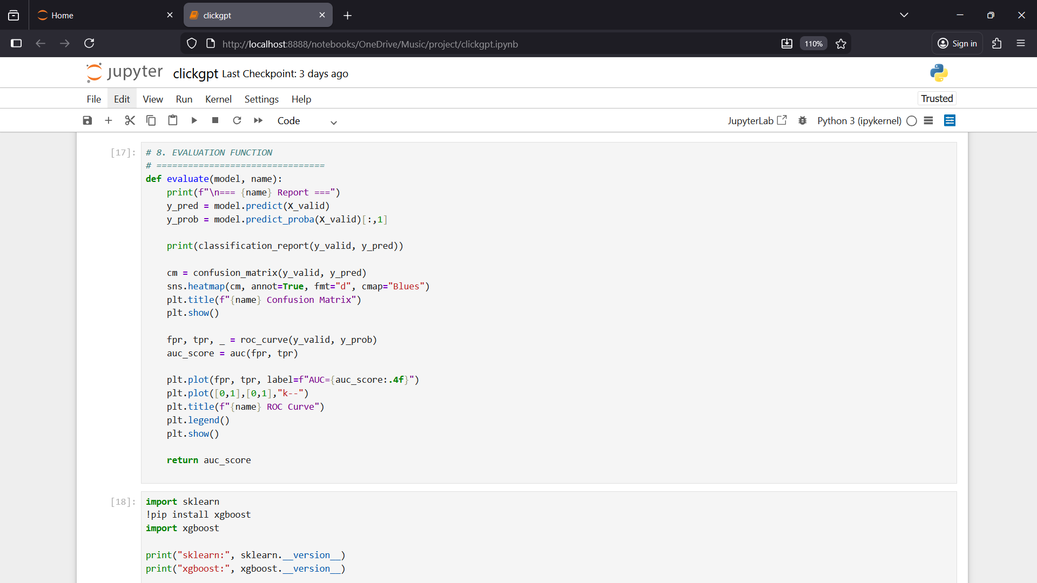

Slide 42
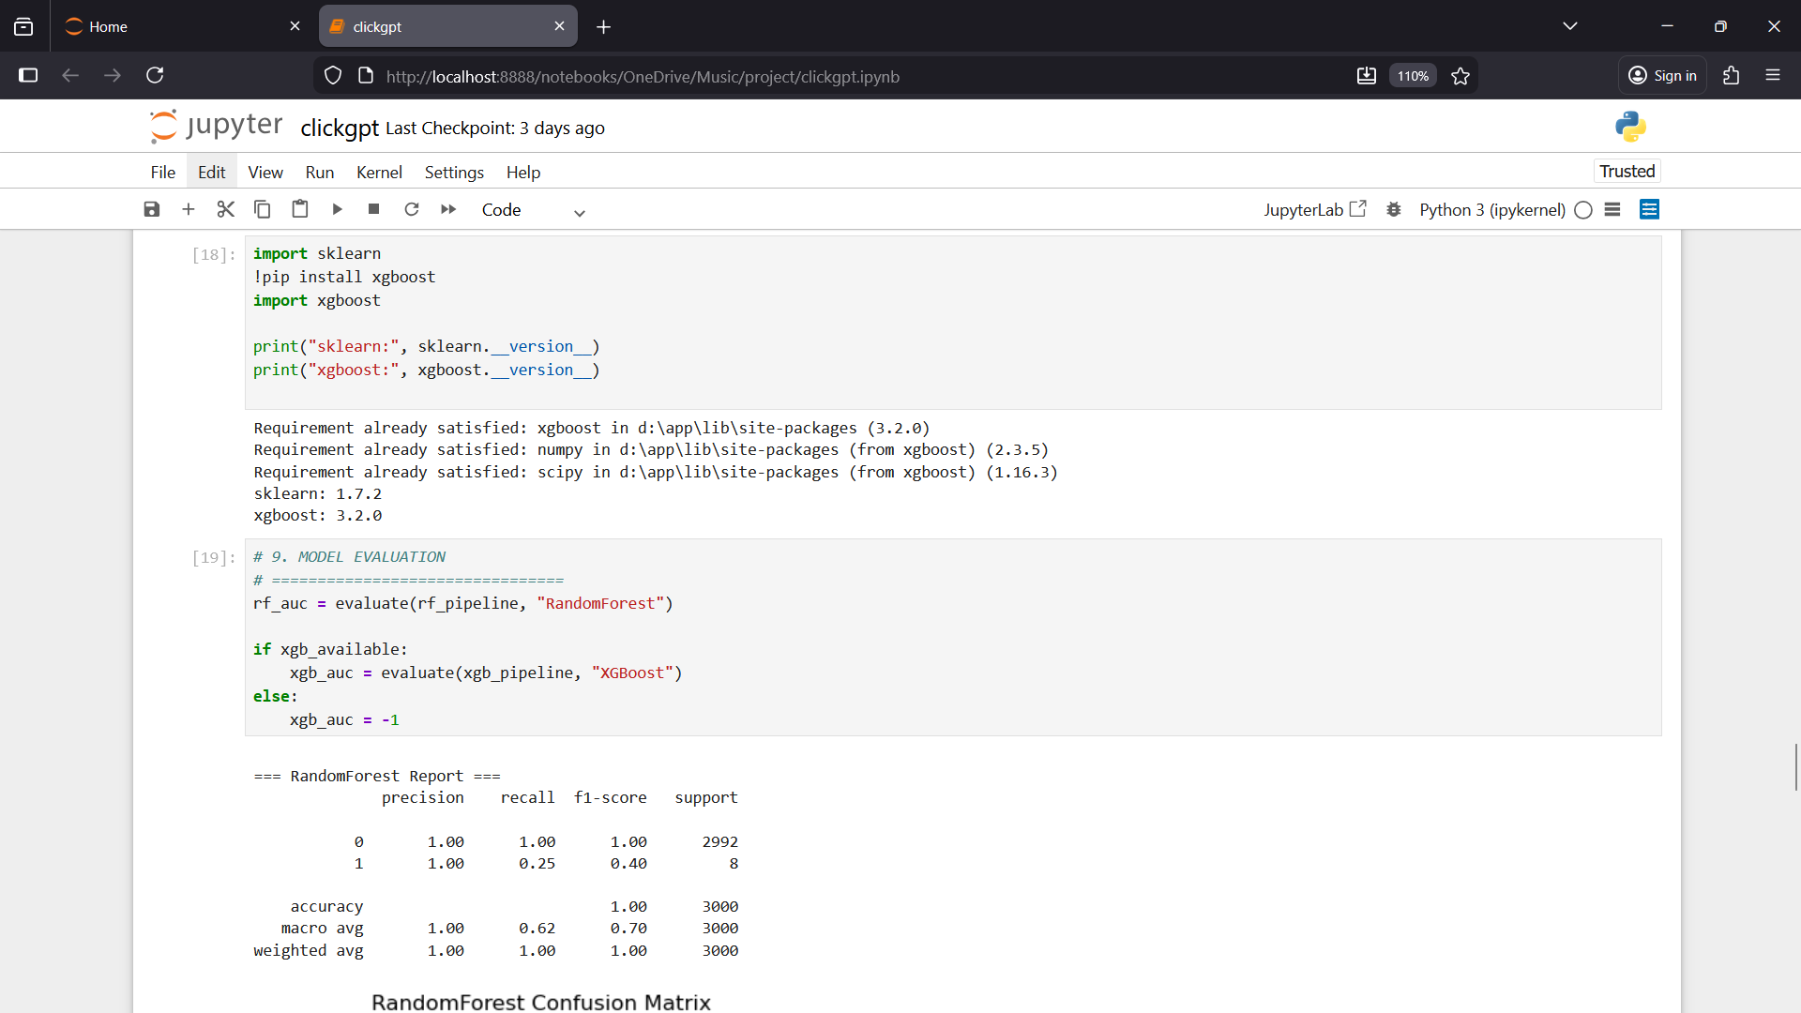

Slide 43
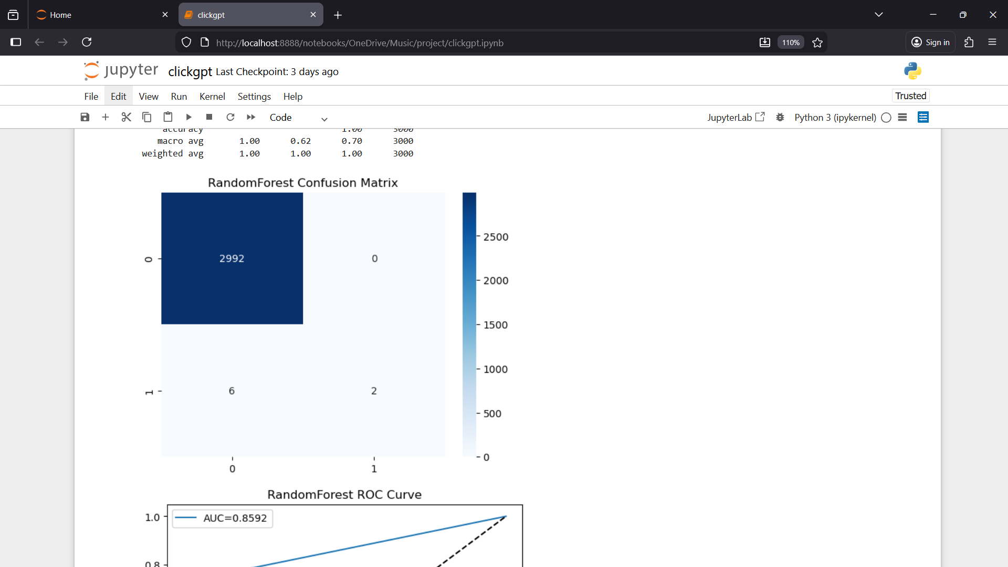

Slide 44
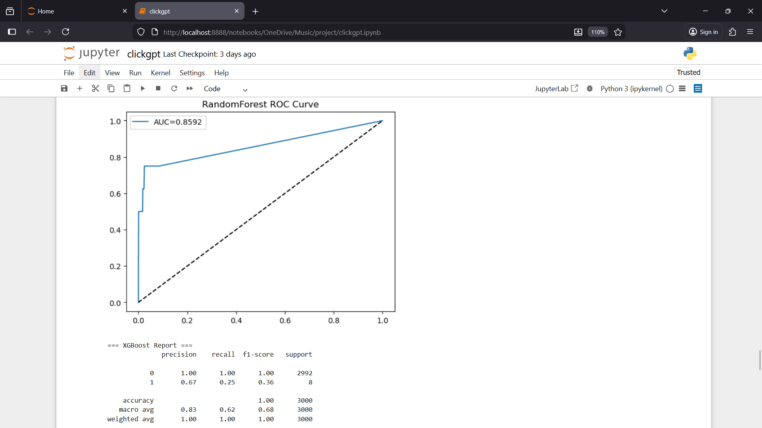

Slide 45


Slide 46
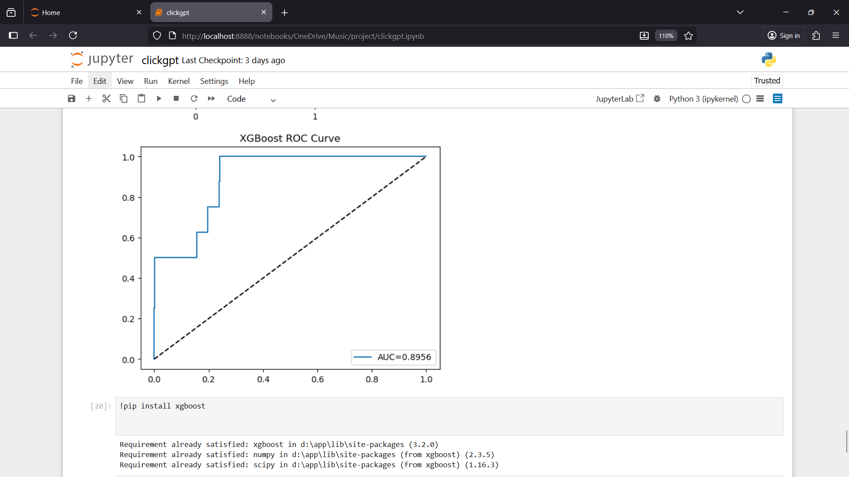

Slide 47
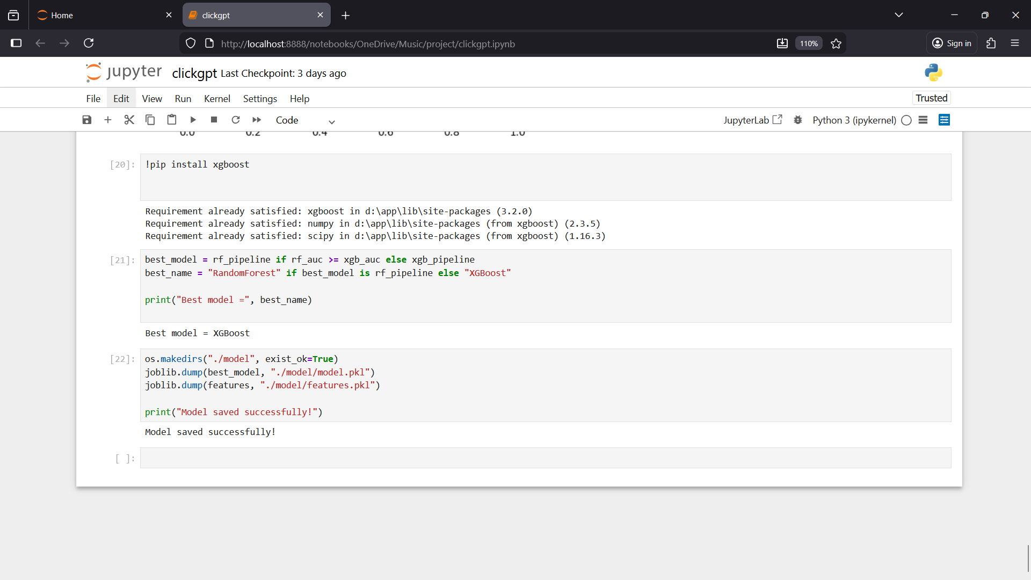

Slide 48
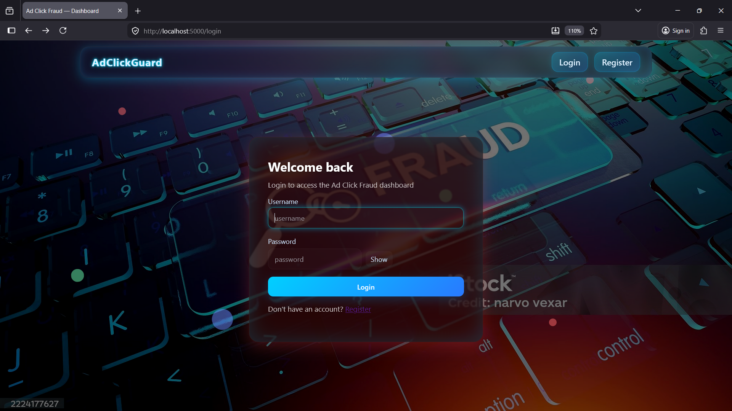

Slide 49
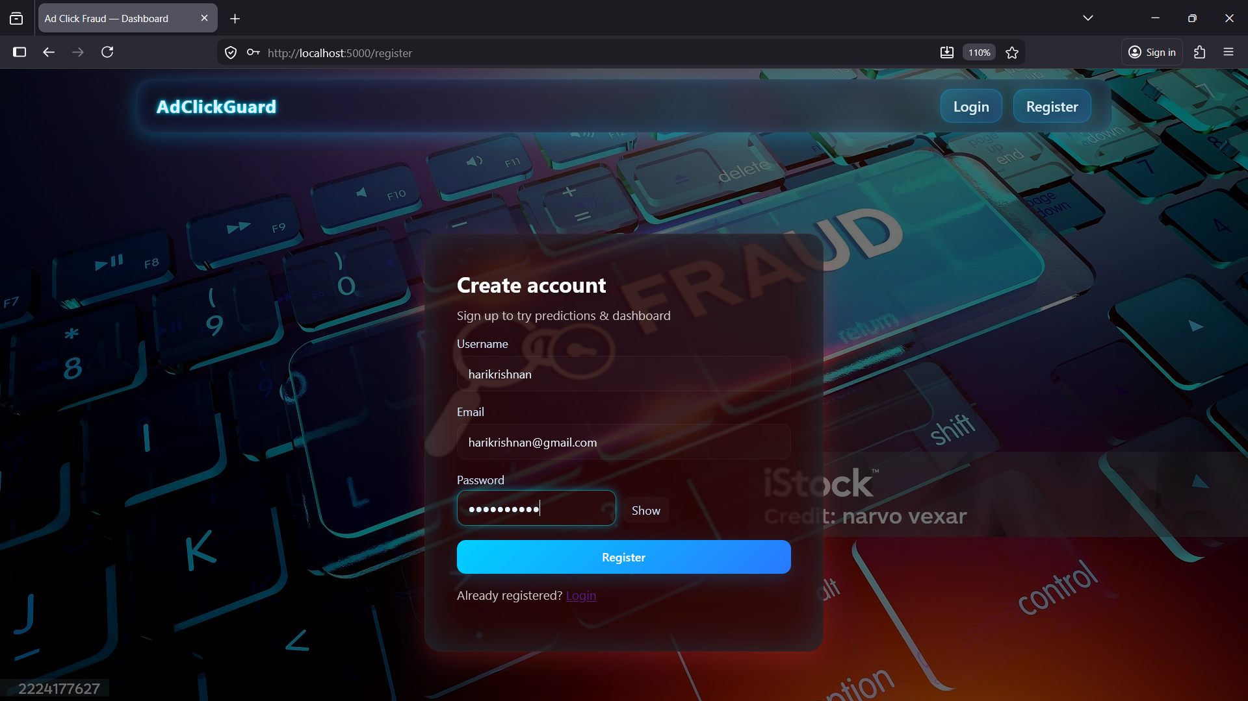

Slide 50
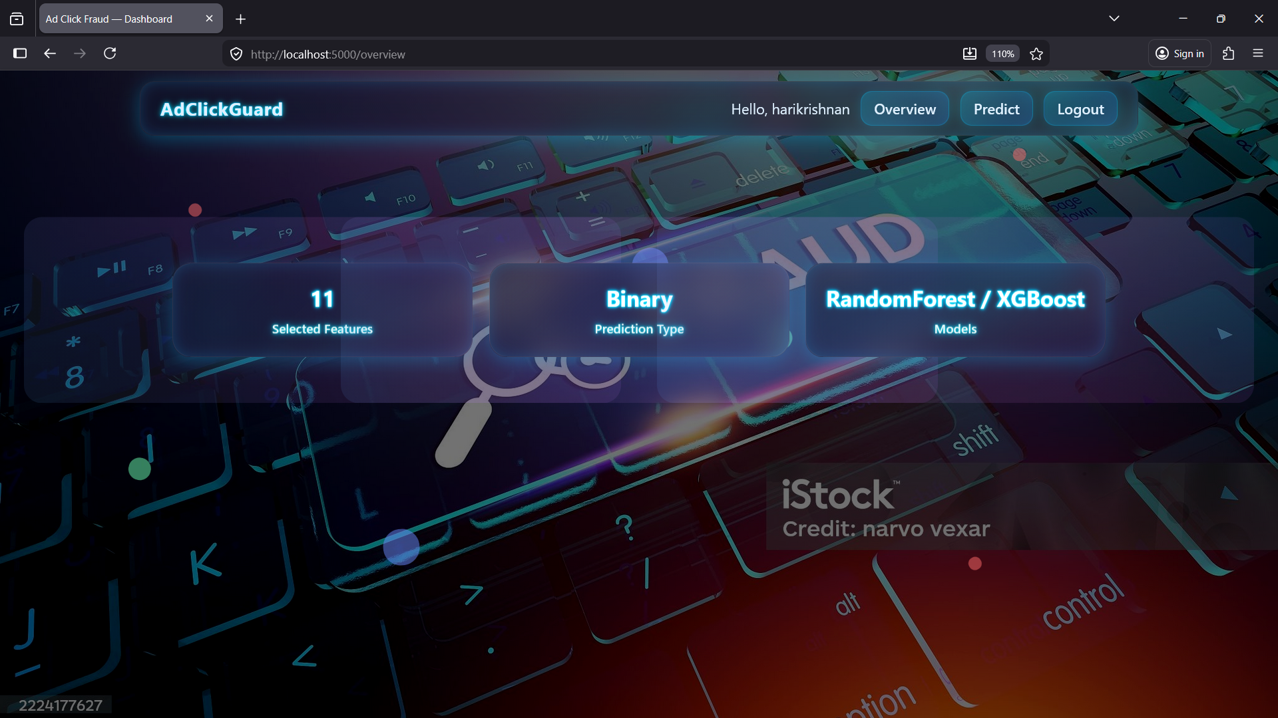

Slide 51
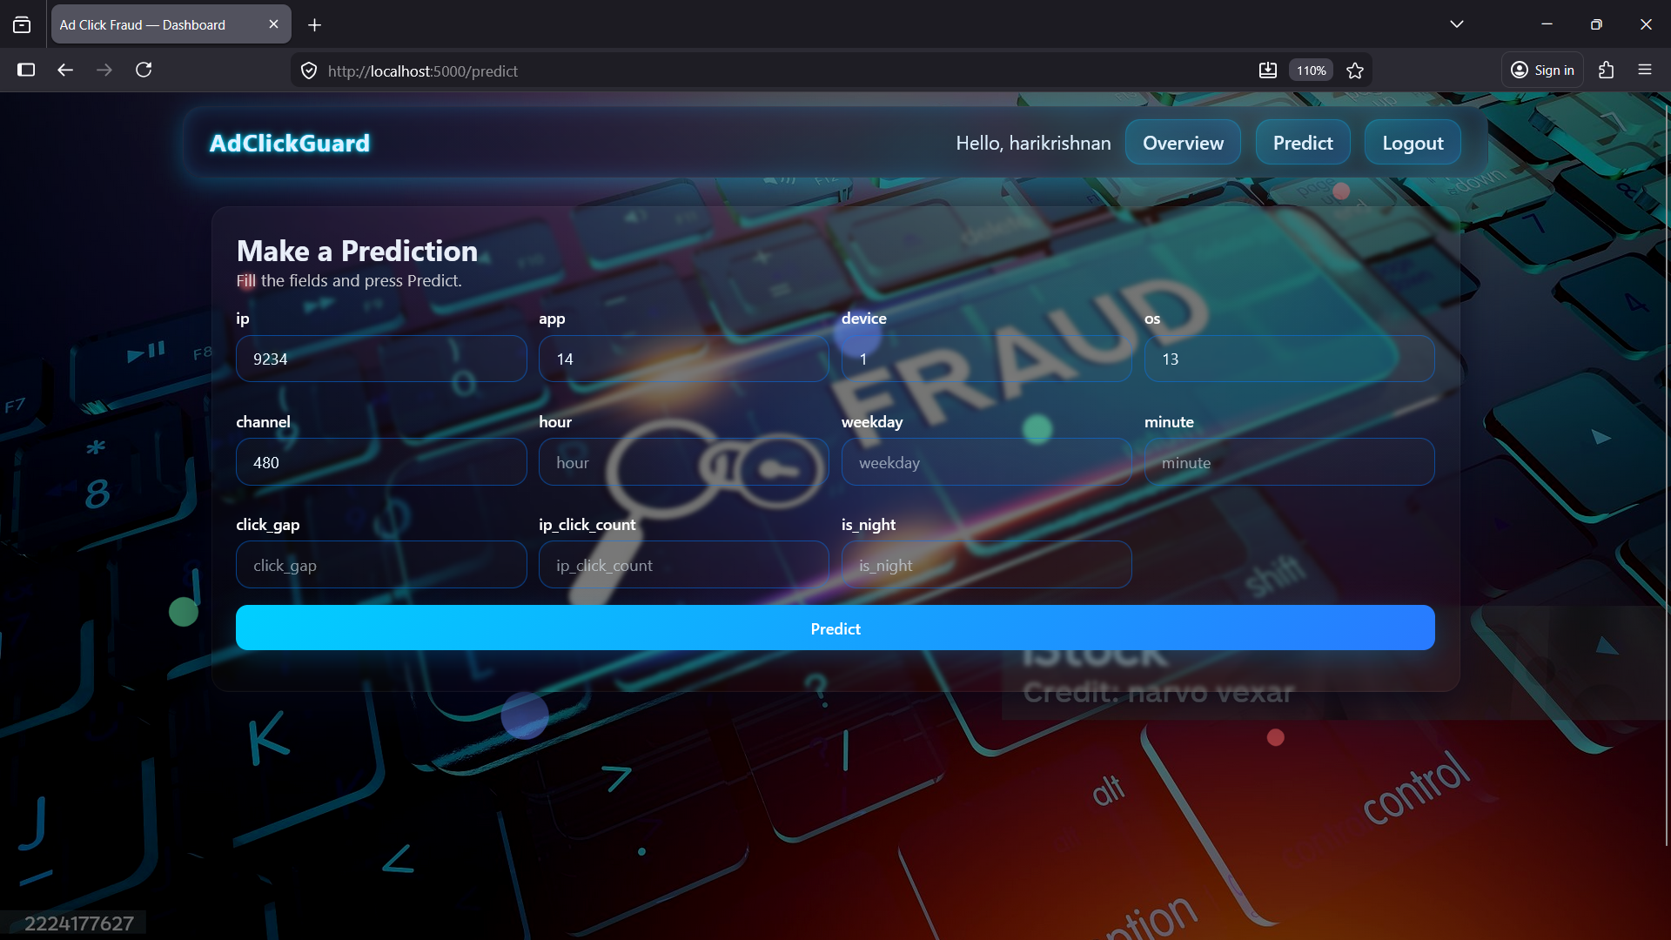

Slide 52
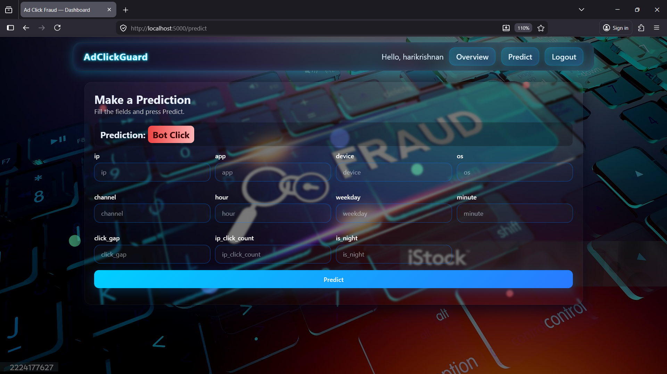

Slide 53
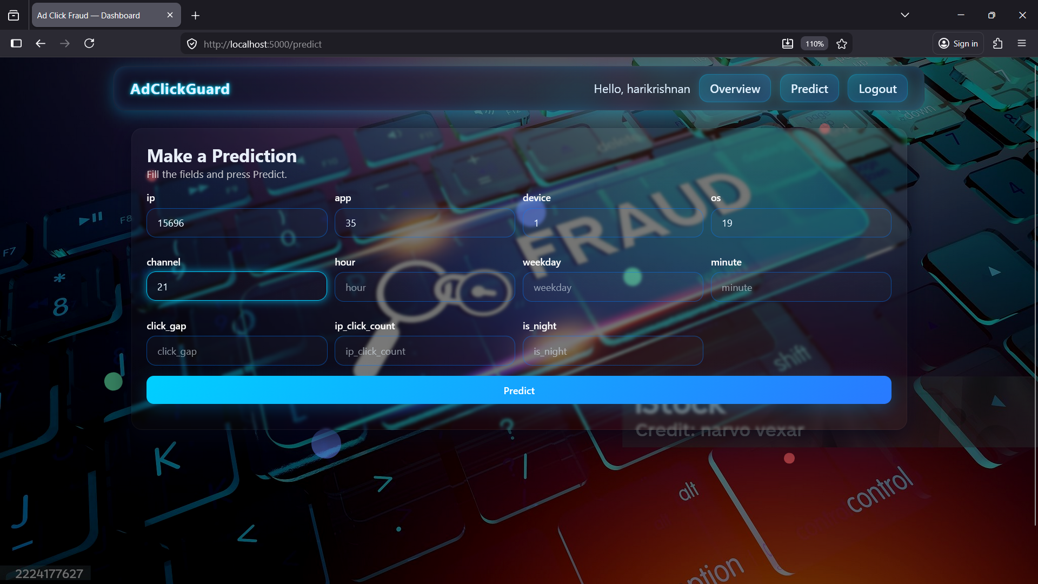

Slide 54
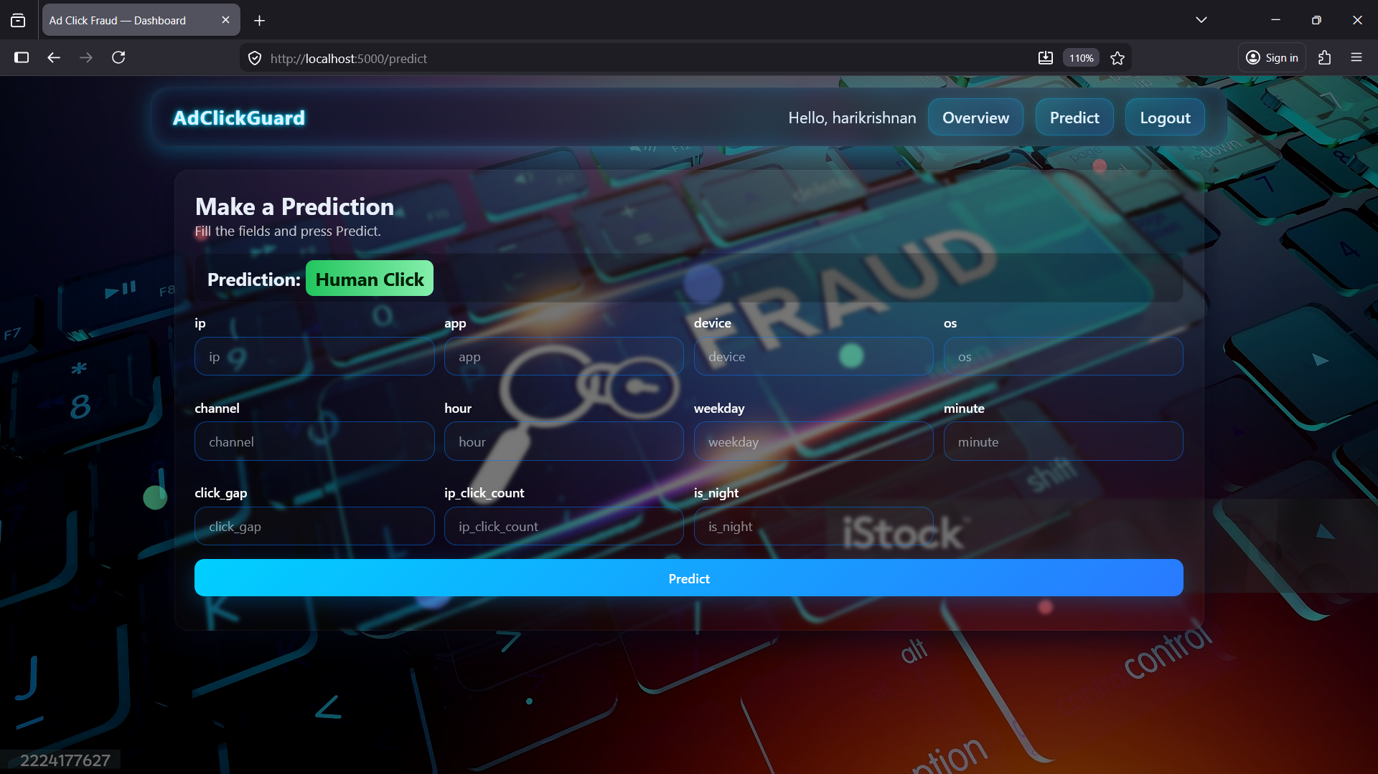

Slide 55
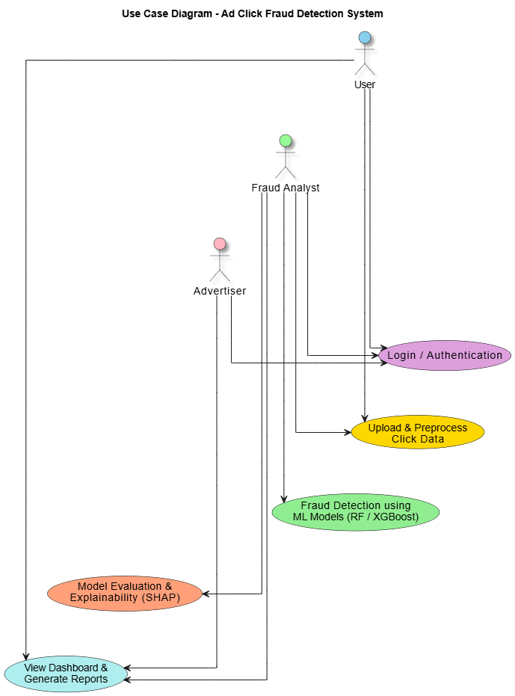

Slide 56
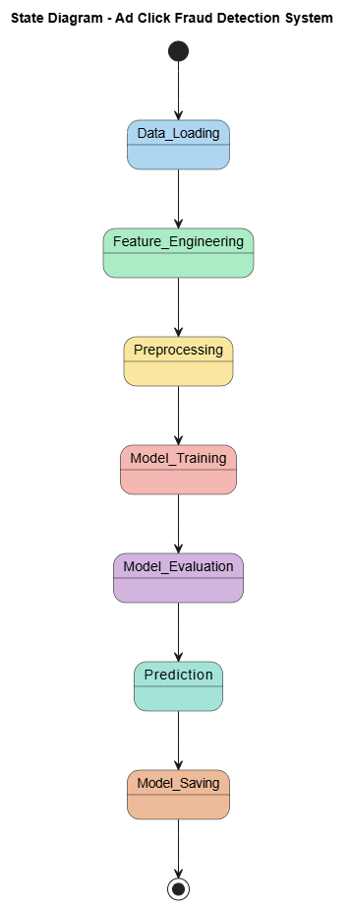

Slide 57
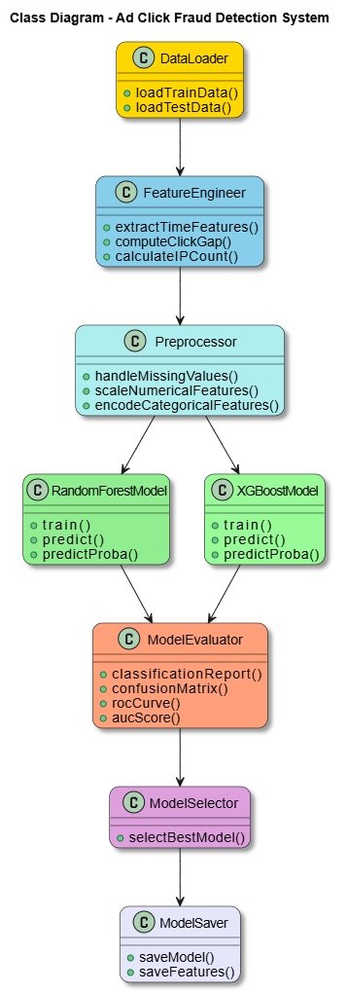

Slide 58
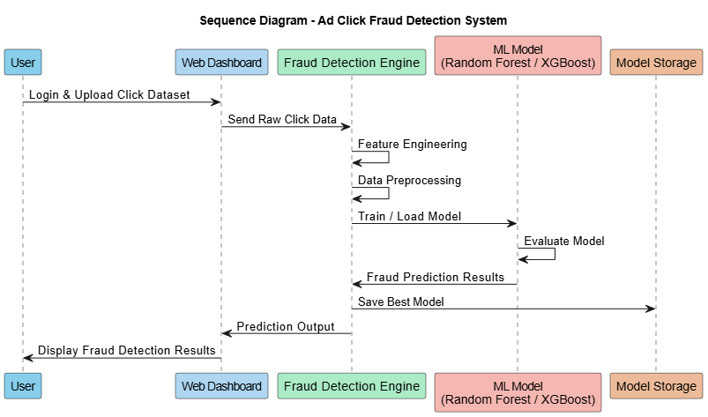

Slide 59
Conclusion
The Ad Click Fraud Detection System developed in this project presents a reliable and intelligent solution to one of the major challenges faced by modern digital advertising platforms.
By utilizing advanced feature engineering techniques and supervised machine learning algorithms, the system effectively learns complex click behavior patterns and accurately distinguishes between genuine user interactions and fraudulent clicks generated by bots or malicious sources.

Slide 60
Continued…
In conclusion, the Ad Click Fraud Detection System offers a scalable, adaptable, and practical solution for real-world deployment in online advertising environments.

Slide 61
References
[1] Reem A. Alzahrani, Malak Aljabri, And Rami Mustaf A. Mohammand, 2025, "Ad Click Fraud Detection Using Machine Learning and Deep Learning Algorithms“, Imam Abdulrahman Bin Faisal University of Computer Science and Information Technology 2025.
[2] R. Gupta and P. R. Patel, “Ensemble learning approach for ad click fraud detection in Indian digital markets,” International Journal of Intelligent Systems and Applications, vol. 15, no. 6, pp. 55–65, 2024.
[3] S. Kumar, A. Verma, and R. Singh, “Behavioral feature extraction for ad click fraud detection using supervised learning,” IEEE International Conference on Signal Processing, Computation, and Control, pp. 211–218, 2024.
[4] P. Mohanty and S. Rao, “Real-time click fraud detection using online learning algorithms,” Journal of Advanced Research in Dynamical & Control Systems, vol. 14, no. 5, pp. 747–756, 2022.
[5] A. Jain, K. D. Kumar, and M. Sharma, “Click fraud detection in digital advertising using feature non-linear patterns,” International Conference on Big Data Analytics and Intelligent Systems, pp. 329–336, 2023.

Slide 62
Continued…
[6] M. Singh and R. Bhatia, “Lightweight feature engineering for click fraud detection on resource-constrained systems,” ACM India Joint International Conference on Data Science & Security, pp. 99–108, 2024.
[7] T. Das and A. K. Saha, “Hybrid anomaly and supervised model framework for detecting coordinated ad fraud,” Journal of Information Security and Applications, vol. 65, pp. 1–15, 2024.
[8] V. Sharma, A. Choudhary, and R. Agarwal, “Explainable machine learning for ad fraud detection using SHAP and ensemble models,” Indian Journal of Artificial Intelligence & Machine Learning, vol. 2, no. 3, pp. 29–38, 2025.
[9] R. Nair and S. Menon, “Deep learning based ad click fraud detection with temporal sequence modeling,” International Conference on Artificial Intelligence & Data Science, pp. 451–458, 2025.
[10] K. Reddy and S. K. Mishra, “Adaptive thresholding and time-based features for real-time ad click fraud detection,” IEEE Region 10 Symposium (TENSYMP), pp. 101–108, 2023.

Slide 63
Thank You

