Slide 1
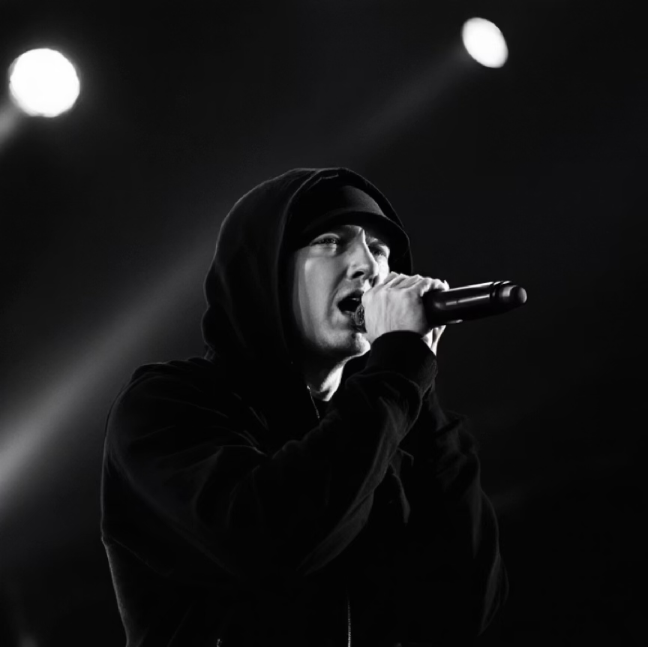
Zipf's Law in Eminem's Lyrics
Fundamentals of AI Project
Student Names:
Progyan Sen - (progyan.sen@adypu.edu.in)
Aditya Chopra - (aditya.chopra@adypu.edu.in)
Hariksh Mahendra Suryawanshi - (hariksh.suryawanshi@adypu.edu.in)
Ankit Kumar - (ankit.kumar2@adypu.edu.in)

Slide 2
Introduction to Zipf's Law
Zipf's Law describes a fascinating pattern in natural language: the frequency of any word is inversely proportional to its rank in the frequency table. More simply, the most common word appears roughly twice as often as the second most common word, three times the third, and so on. This phenomenon appears consistently across many languages and text types.
The mathematical formula expressing this is f(r) ≈ 1 / ra, where f(r) is the frequency of the word ranked r, and a is close to 1. For example, the word "the" is typically about twice as frequent as the second-ranked word in English.
1.Word rank and frequency show an inverse power relationship
2.Common in natural language corpora
3.Foundation for multiple linguistic and AI studies

Slide 3
Project Objective
Verify Zipf's Law​​
Determine if the distribution follows Zipf's predicted pattern.
Analyze Lyrics
Examine Eminem's song lyrics for word frequency distribution.
Explore Deviations:
Investigate any departures from Zipf’s law and hypothesize reasons.

Slide 4

Data Collection and Preprocessing :
Gather Data: Compiled a comprehensive dataset from Eminem.csv file as a college project.
Clean Lyrics: Removed extraneous characters, punctuation, and formatting irregularities to standardize input.
Tokenize and Filter: Split lyrics into individual words (tokens) and excluded common stop words to focus on meaningful terms.

Slide 5
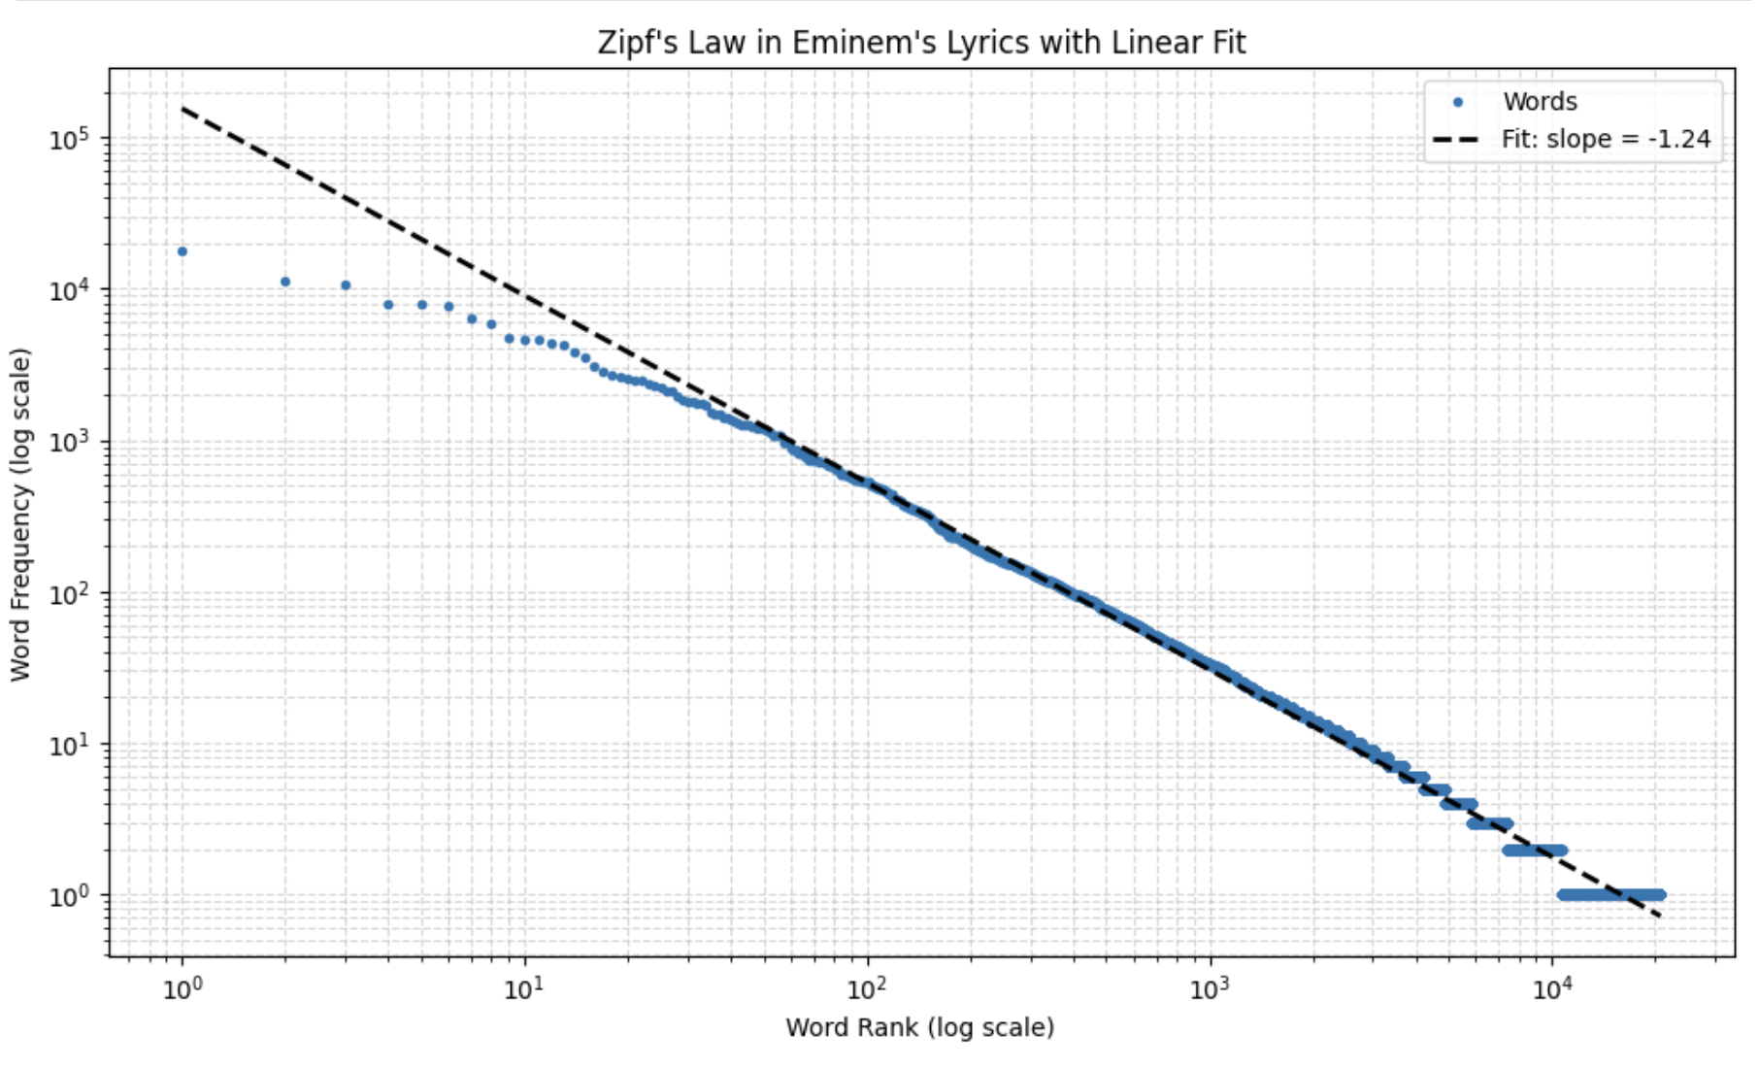
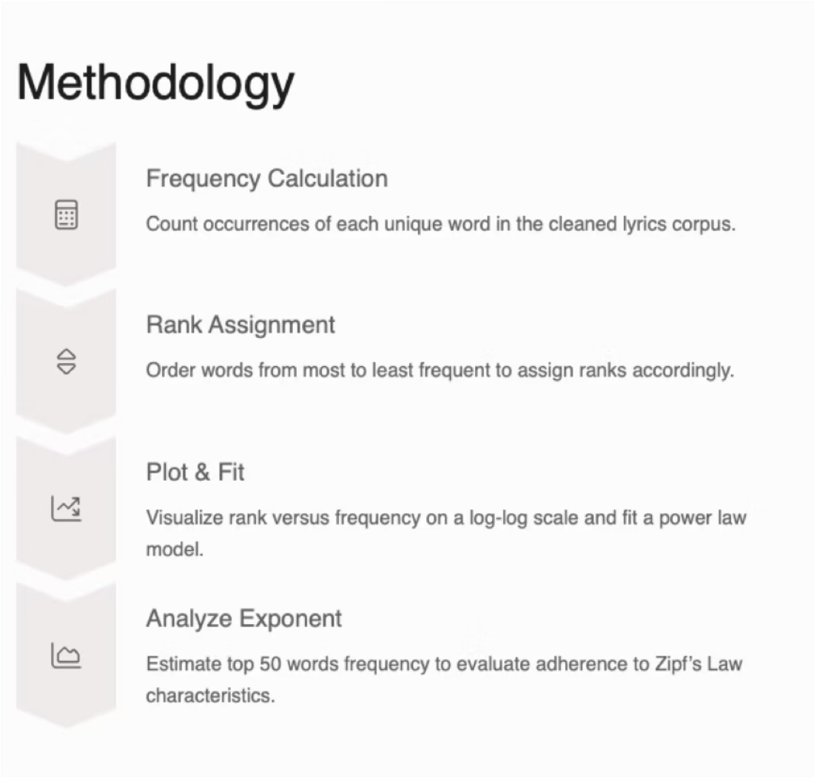

Slide 6
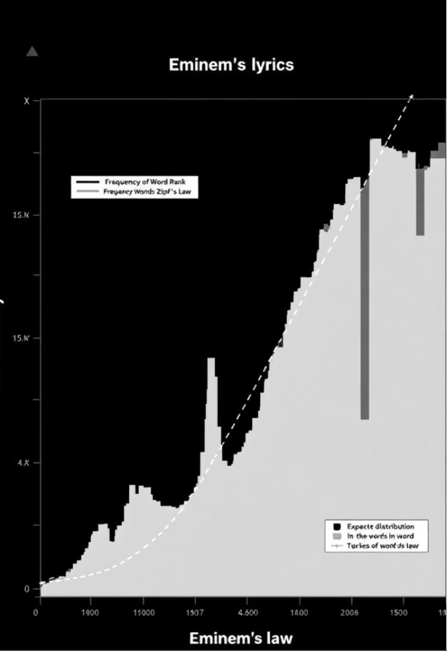
Results and Analysis
Rank-Frequency Plot : The distribution generally follows a Zipfian trend but shows slight deviations at high and low ranks. Exponent Measurement :
The log-log plot approximates a straight line, supporting Zipf's Law.- Lyrics slightly deviate due to artistic repetition and unique vocabulary. Deviation Factors Eminem’s stylistic choices, such as use of slang and complex rhyme structures, may cause deviations. Below mentioned in the iPython notebook link are the top 50 most occurring words in order.

Slide 7
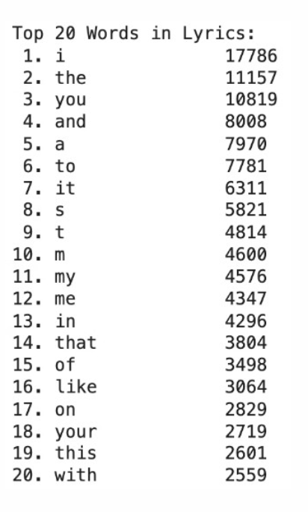
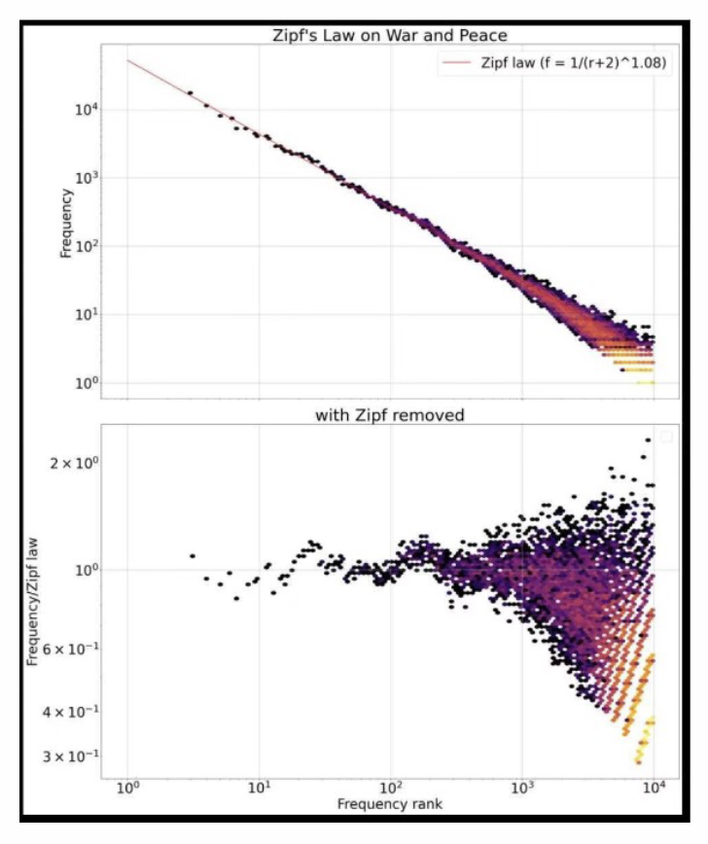
Top 20 most repeating words and Zipf's Application using graph :

Slide 8
Conclusion
1. Summary Eminem’s lyrics largely conform to Zipf’s Law, reaffirming its relevance in stylized natural language.
2. Implications This supports AI and NLP models using Zipfian assumptions in handling artistic text data.
3.Future Work Comparative study on other artists’ lyrics to explore genre and personal style effects on Zipf’s distribution.

Slide 9

Team Contributions
Progyan Sen Worked on writing and organizing the Jupyter Notebook, implemented Zipf’s Law visualizations, and contributed to the research on word frequency analysis. Also helped refine the final results.
Hariksh Mahendra Suryawanshi Focused on data preprocessing, regex-based text cleaning, and plotting log-log graphs. Contributed significantly to exploring Zipf's Law and structuring the notebook flow.
Aditya Chopra Designed and structured the PowerPoint presentation. Summarized technical content into easy-to-understand slides and helped with visual storytelling of the project.
Ankit Kumar Contributed to the presentation design, formatted charts and explanations, and ensured the project message was communicated clearly. Also assisted in final content polishing.

Slide 10
THANK YOU
Assigned Project File - Eminem.csv (access it on github)
GitHub Repo - https://github.com/Hariksh/Maths_Project
Ipython Notebook - https://github.com/praggCode/Maths_Project/blob/main/HAIGURE.ipynb

