Slide 1

Notes:
Hi Everyone,
Good Morning
Before we start with the presentation today, I would like to share a small recital.
We have been a part of Publicis Sapient for almost 3months now, and there is this fact that everyone of us would agree upon.
We all started as fresh graduates, underwent 5weeks or so of rigorous training followed by what…5 weeks now of a Hands On project, and what has transpired in these days is a fact that we all are really proud of. A transformation from someone who could code, to someone who can not only code, but add value to everything he does.
So have we succeeded at becoming a Product engineer?
Hi, I am Rajat, a small part of our big team here.
I am here with my colleagues Aman and Chinmay and we are here to give you a walkthrough of our Transformation, our Journey and the project we have been working for sometime now.

Slide 2
1
The Ask – Where we started?
…..

Slide 3
Framework for 1.5 Weeks
1.5 weeks plan
Everyday Discussion about topics / Technologies / doubt clearance .
Introduction to new technologies such as GitHub, git, Spring framework, and micro services.
Every day with SME/Trainer discussion of Project progress and transformation based on UML and Technologies

Slide 4
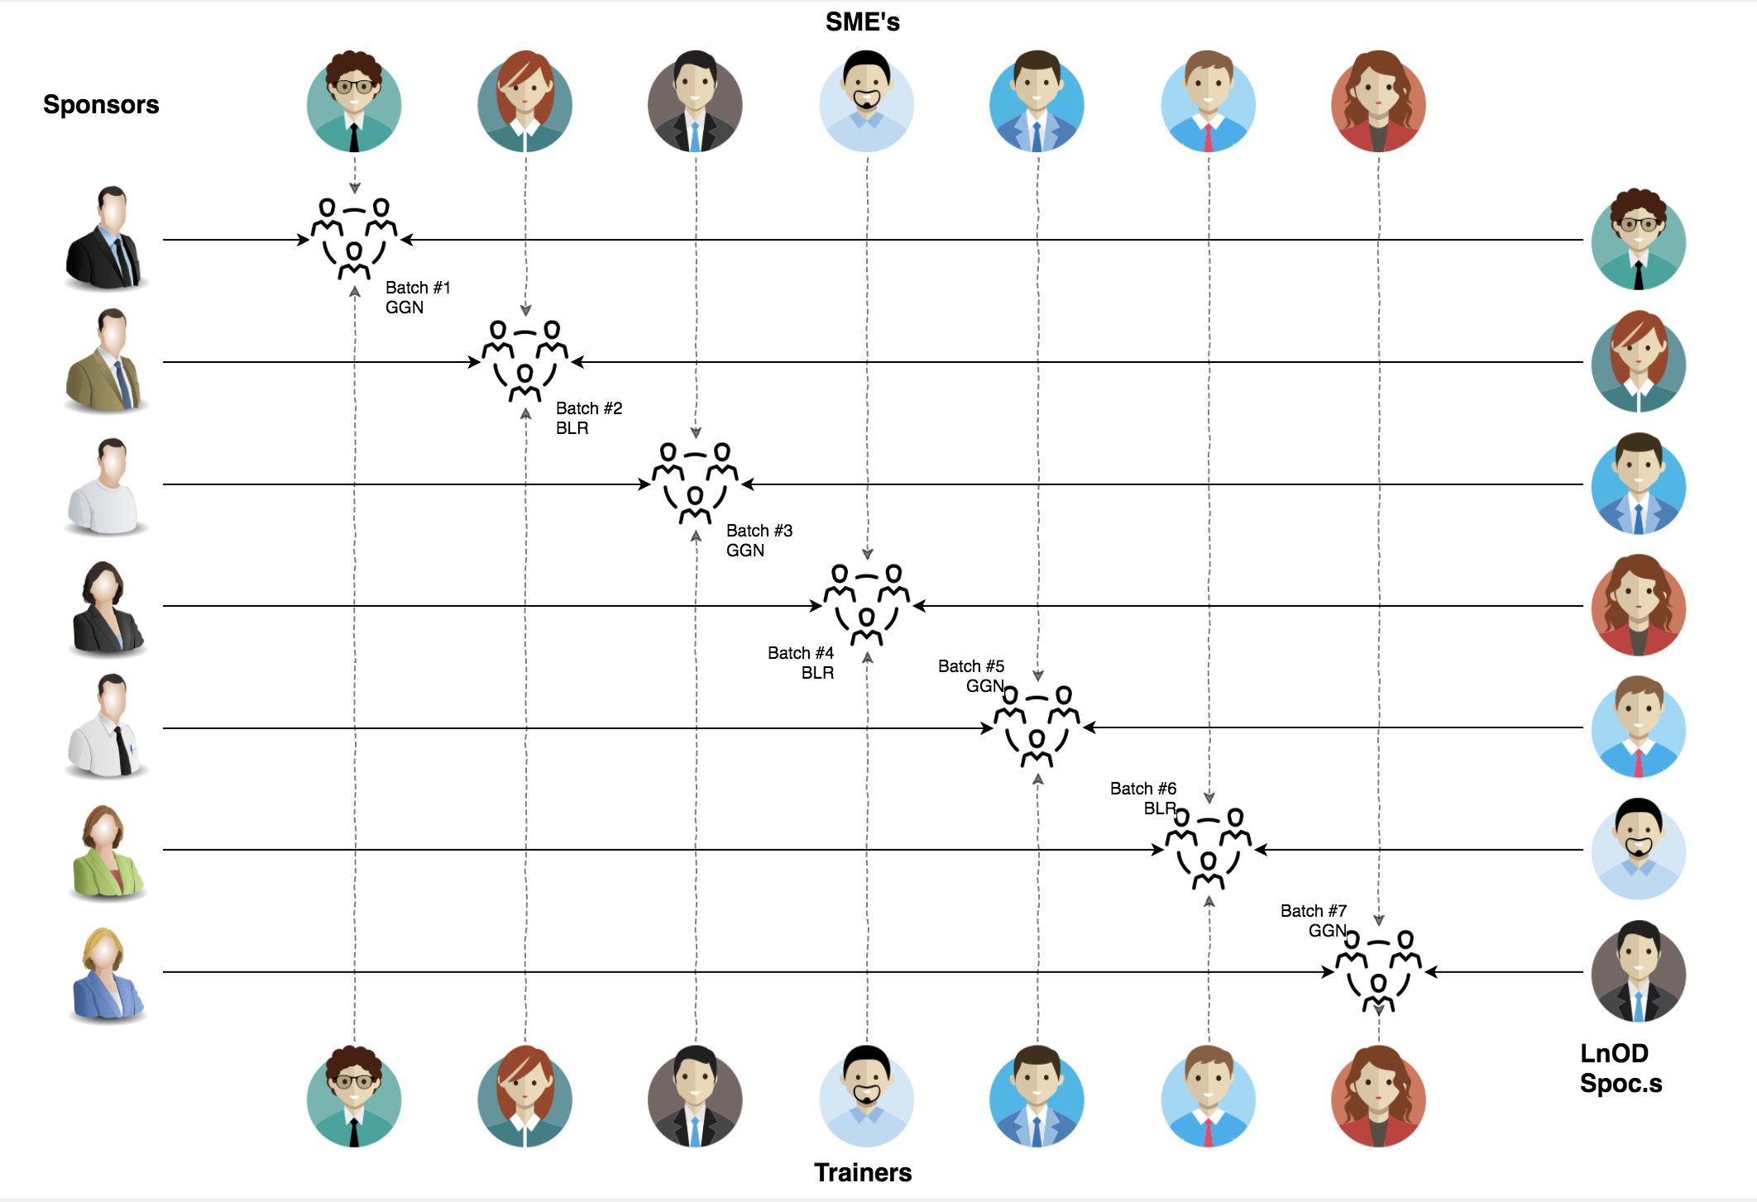
Stakeholders
Sponsors
Tata Consultancy Services
SME’s
Amit Balyan
Coordinators
Prudhvi Raj Bhashakarla

Slide 5
Our next starts
NOW
Notes:
Time – 1 min
Swati

Slide 6
1.5 WEEKS OF TRAINING + PROJECT DEMO
10 DAYS
240 HOURS
14,400 MINUTES
8,64,000 SECONDS
LIMITLESS KNOWLEDGE

Slide 7

Agenda
01
Our Journey
02
Our Team
03
Team Structure
04
Project Goals
05
Engineering Practices
06
Tech Stack
07
Development
08
Challenges & Learnings
09
Demo
10
Questions
Notes:
Time – 1 min

Slide 8

Our Journey
Notes:
Time - 2 mins

Slide 9
Demo
Mindset
5
project Demo
Process
4
Adapting to a developer
Mindset
conversion to micro services
Tools
3
Design UML artifacts and implementation of methods
Comprehend
2
Decide the attributes
and methods to be implemented
1
Introduction to java 8 ,git, Github and implementation
Introduction to Spring architecture
Understanding Project Goals

Slide 10

Our Team
Notes:
Time – 2 mins

Slide 11
Gourika M Choudhary
Hari Madhav Sanapala
Gayathri Vaidhyanathan
Lakshmi Inukonda
Aarthi Subha

Slide 12

Team Structure
Notes:
Time – 2 mins

Slide 13
Team Structure:
Gourika M Choudhary (Team Lead)- worked on the admin module
Hari Madhav Sanapala- worked on student module and database
Gayathri Vaidhyanathan- worked on the professor module
Lakshmi Inukonda- worked on the user module
Aarthi Subha- worked on the payment module

Slide 14

Project Goals
Notes:
Time – 3 mins

Slide 15




Our Vision
1
2
To create a Course Registration System using JAVA/REST tools and technologies, where a professor as well as a student can view courses and enroll in some of the courses.
Admin should be able to approve. students, add/delete professors and generate a report card for students.
Convert to micro services and push the code to Github.
Quality
Security
3
4
Interactivity
Speed
Notes:
User satisfaction and brand value

Slide 16

Engineering Practices
Notes:
Time – 5 mins

Slide 17
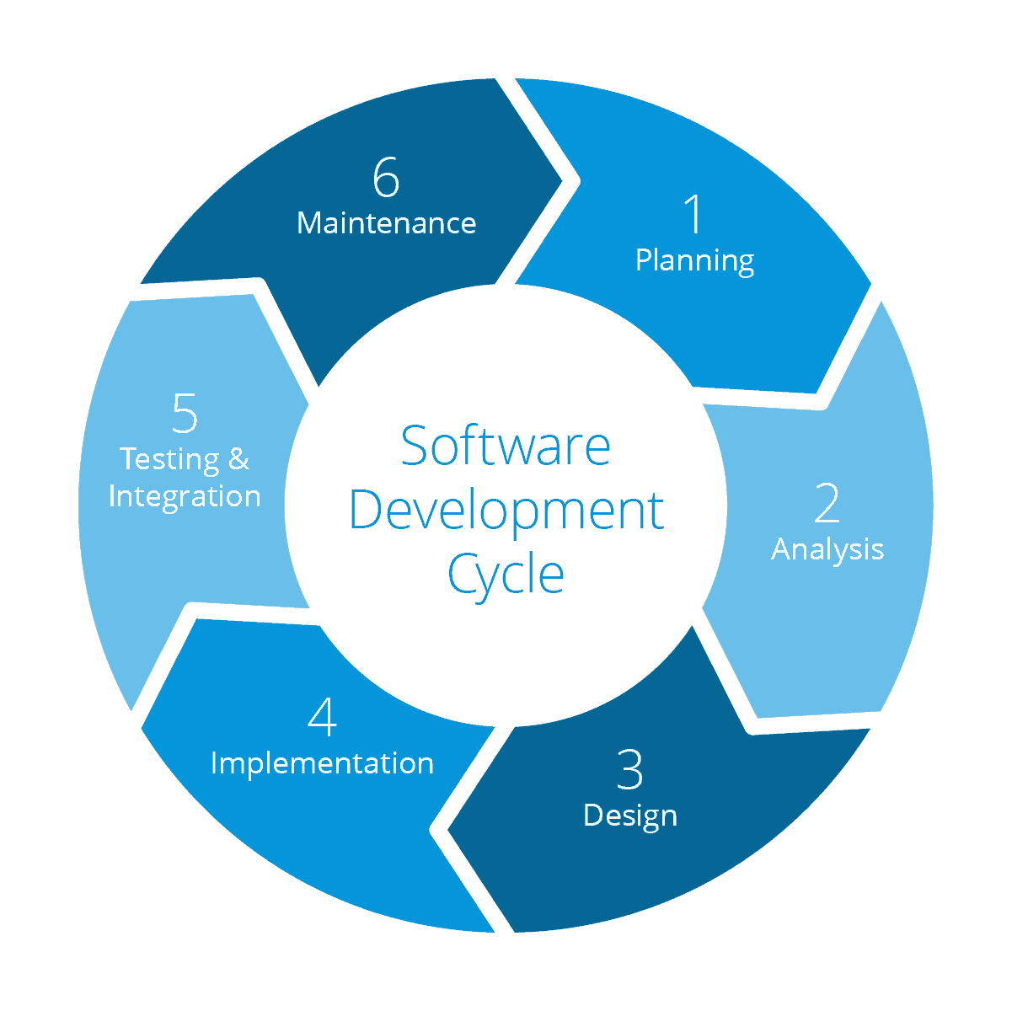
Requirement gathering
System Testing
Technology stack selection
Code implementation and development
UML artifacts design

Slide 18
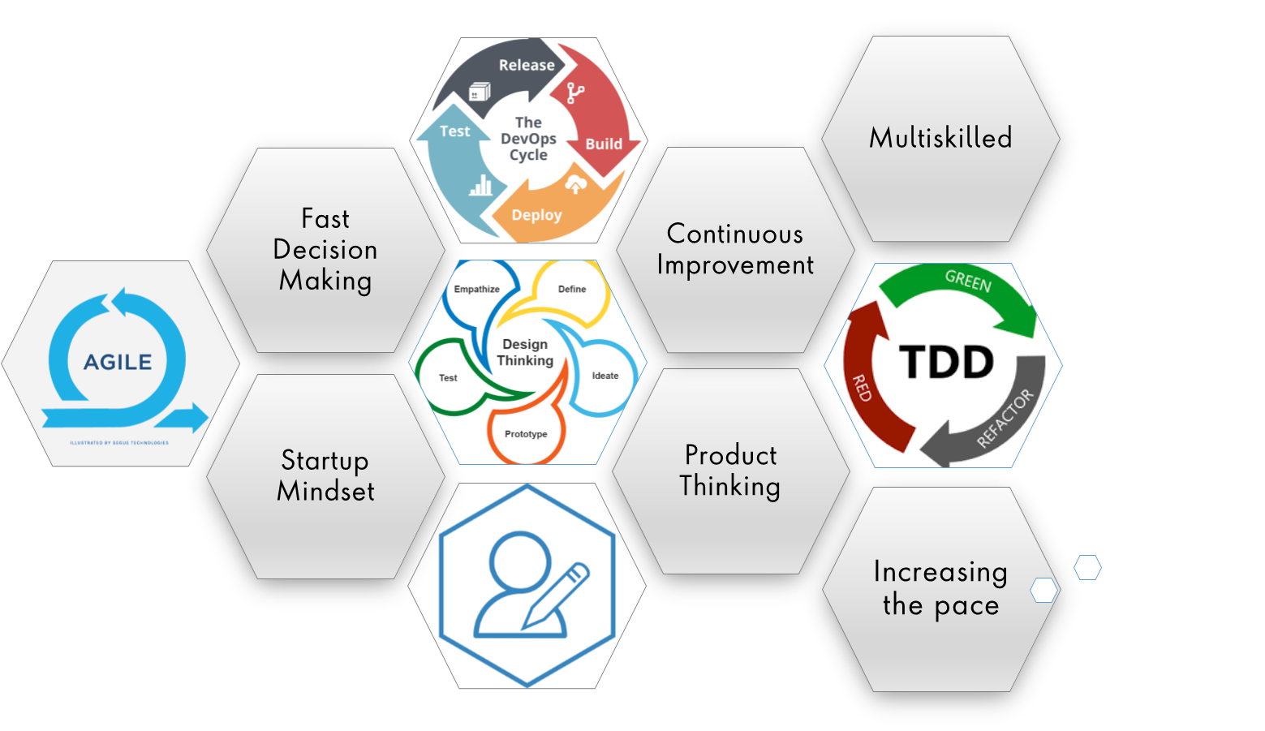
Notes:
Product Thinking (Design Thinking, Requirement Analysis, )
Multi Skilled (Frontend, Backend, DevOps)
Fast Decision Making (Agile)
Increasing the Pace (Automation CI/CD)
Startup Mindset (Agile)
Continuous Improvement (Retros)

Slide 19

Tech Stack
Notes:
Time – 2 mins

Slide 20









Backend
Tools
Core Language
NoSQL Database
Story Management
SQL Database
Documentation
Application Server
Framework
Infra
SCM
Notes:
Time – 1 min

Slide 21

Development
Notes:
Time – 1 min

Slide 22
Dividing into 5 groups and assigning 1 team lead and 4 members in each team.
Assigning the project
Requirement understanding
Research and analysis
Estimation
Sprint Planning
Spring Grooming
Delivery
Sprint Implementation
Development
Code Review
Commit
Integrate
Deploy
Test
Notes:
Time – 1 min

Slide 23

Challenges & Learnings
Notes:
Time – 2 mins
Challenges-
Installing the Tomcat server and running application on it.
Learnings-
Got to learn new technologies.
Learnt working together in teams.(collaboration)
Learnt how to write code which is accepted by the industry.
Learnt how to make UML diagrams for the given problem.

Slide 24
Challenges
Identifying the methods to be implemented at the initial stage of the project.
Understanding the flow of the project and real time implementation

Slide 25
Learning
Working as a team to complete the given task within the specified time.
Learnt to work with new technologies and their implementation.
Understood the project flow and to present the code in an organized way.

Slide 26

Demo
Notes:
Time –
POS- Student -5 min
REST - Professor - 3 min
DropWizard- 3 min

Slide 27

Questions
Notes:
Time - ?

Slide 28
Thank you
Notes:
Time – After this show the testimonial video. 1 min

