Slide 1

AI AGENT FOR AUTOMATED PENETRATION TESTING
C1PH3R C3LL
Product: Cipher-Lens
AI-Powered Unified VAPT Agent
Harimohan Mishra and Bhavyaa Shree
Notes:
Welcome judges. We are Harimohan Mishra and Bhavyaa Shree representing C1PH3R C3LL, and today we are presenting Cipher-Lens: an AI agent for automated, unified penetration testing.

Slide 2
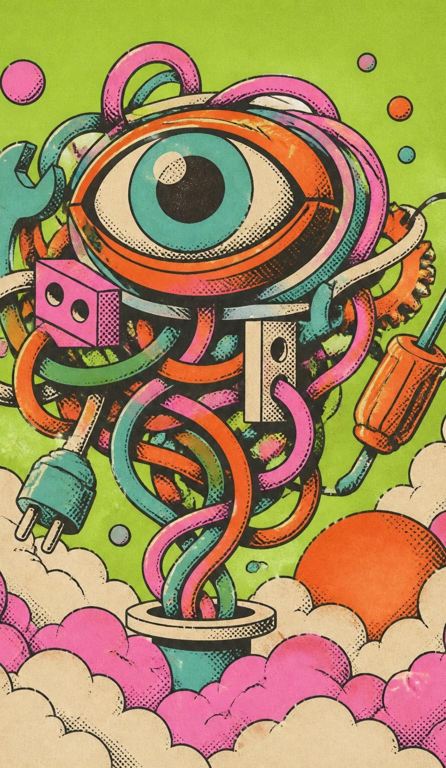
WHY PENETRATION TESTING NEEDS A RETHINK
Tool Sprawl: Analysts juggle many scanners that each speak a different language.
Alert Fatigue: The same issue is reported again and again, inflating reports.
Unsafe Automation: Autonomous AI can scan the wrong targets or run uncontrolled commands.
AI Hallucination: AI can invent vulnerabilities, scores or open ports.
No Proof Trail: Reports rarely separate what was observed from what was merely inferred.
Takeaway: Analysts spend more time stitching tool outputs together than analysing real risk.
Notes:
Penetration testers are drowning in operational friction. Tool sprawl, duplicate alerts, unsafe autonomous actions, hallucinations, and lack of verifiable evidence distract teams from understanding true business risk.

Slide 3

MEET CIPHER-LENS
A conversational AI security assistant guiding an authorised assessment from first request to client-ready report, with a human always in control.
THE 8-STEP END-TO-END PIPELINE
Analyst Request
Approved Scanning
Result Ingestion
Smart Planning
Risk Prioritisation
Unified VAPT Report
AI Correlation
Human Review
One conversation replaces many tools.
Every claim is backed by real scanner evidence.
Every consequential action needs human approval.
Notes:
Meet Cipher-Lens. It is an agentic copilot for security teams. Across eight structured steps, the analyst directs the scope, approves tactical scans, and reviews correlated findings before building a client-ready deliverable.

Slide 4

HOW CIPHER-LENS WORKS
Analyst Console: a guided 5-workspace web console.
AI Reasoning Layer: primary AI model, automatic backup and offline rule-based planner as a safety net.
Scope & Safety Gate: authorises every action before anything runs.
Scanner Adapters: Nmap, Nikto and OWASP ZAP run live; Nessus and OpenVAS/Greenbone results are imported.
Evidence & Audit Vault: raw outputs, findings and a tamper-evident activity log.
Report Engine: a professional PDF deliverable.
5 workspaces: Authorized Scope · Assessment Status · Audit Trail · Tool Integrations · VAPT Report
Notes:
Behind the scenes, Cipher-Lens couples an intuitive multi-page interface with a resilient dual-model AI reasoning engine, deterministic safety guardrails, heterogeneous scanner adapters, and a tamper-evident audit vault.

Slide 5

BUILT WITH
CORE & INTERFACE
AGENT REASONING
Python & Streamlit
Google Gemini API
Rapid reactive analyst console, clean state management, modular tooling.
Two-model automated failover plus deterministic offline rule planner.
SECURITY INSTRUMENTATION
DATA INTEGRITY & PDF
Live & Imported Scanners
SQLite, Pydantic & SHA-256
Nmap, Nikto, OWASP ZAP execution; Nessus, OpenVAS/Greenbone ingestion.
ReportLab (PDF) document generation, strict schemas, tamper-evident audit hashing.
Standards aligned: NIST SP 800-115 · OWASP Top 10 · CVE · CVSS · CWE · MITRE ATT&CK · NIST CSF 2.0
Notes:
Our stack is engineered entirely on battle-tested open-source tooling and reliable API primitives. We strictly conform to established industry taxonomies, including NIST SP 800-115, OWASP Top 10, CVSS, and MITRE ATT&CK.

Slide 6
WHAT ANALYSTS GET
Scope Shield: Define authorised targets and exclusions; anything outside is refused automatically.
Conversational Intake: Describe the assessment in plain English; Cipher-Lens turns it into a structured plan.
Adaptive Planning: The agent picks its next scan from what it has just discovered, and explains why.
Human Approval Gate: Intrusive or validation actions proceed only after explicit analyst sign-off.
Unified Findings Workbench: Results from all tools merged into one deduplicated view with confidence and status.
Evidence vs. Inference Separation: Observed scanner proof is always kept distinct from AI reasoning.
Smart Risk Prioritisation: Ranked by severity, exposure, exploitability and asset impact.
Tamper-Evident Audit Trail: Every decision and action is recorded and verifiable in one click.
Client-ready PDF report with executive summary, remediation roadmap and evidence index.
Notes:
Every feature is designed to reduce analyst burden while keeping accountability absolute. The agent handles tedious orchestration, correlation, and formatting, but the human retains complete operational authority.

Slide 7
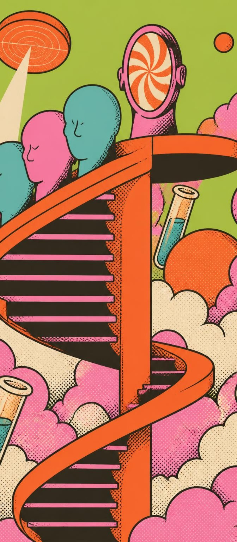
READY TO RUN, BUILT TO SCALE
Technical: A fully working prototype with live scanning, live AI planning, a human approval flow and PDF reporting, built on open-source tools and free-tier AI access.
Practical: Demonstrated end to end on OWASP Juice Shop, a deliberately vulnerable practice application chosen by the team as the demo lab; runs on a standard laptop with a simple local setup.
Reliable: Automatic AI failover and an offline planner keep the assessment running even if the AI service is unavailable.
Live Demo Flow: Register Scope → Ask → Approve → Scan → Review → Download Report
Notes:
This is not a slide mockup. Cipher-Lens is a working tool validated against the OWASP Juice Shop application, proving that local scanners and conversational AI can reliably coexist on commodity hardware.

Slide 8

HONEST ABOUT OUR BOUNDARIES
Operates only within authorised lab and sandbox targets, by design.
Nessus and OpenVAS/Greenbone are supported through result import rather than live execution.
AI planning depends on free-tier model quotas, with an offline planner as fallback.
Active validation always requires a human analyst, so the agent is deliberately not fully autonomous.
Transparency over overclaiming.
Notes:
We believe security tools must be transparent about their constraints. By deliberately constraining autonomy, isolating invasive commands, and gracefully handling API quotas, we protect the assessment environment.

Slide 9

WHAT'S NEXT
Live Enterprise Connectors: direct API integration with Nessus, OpenVAS/Greenbone, Burp Suite, and Metasploit (RPC automation already scaffolded).
Retest & Change Comparison: re-run assessments to verify fixes and highlight what changed.
Learning from Analyst Feedback: remember false-positive and triage decisions to sharpen future results.
Team Workspaces & Remediation Tracking: multi-analyst review with fix tracking and ticketing integration.
Branded Reports & Insight Dashboards: custom client-branded reports, multiple export formats and visual risk dashboards.
Cipher-Lens: Less tool juggling. More security reasoning. Human always in control.
Thank You — C1PH3R C3LL
Notes:
Our roadmap expands Cipher-Lens into an enterprise-grade collaborative platform with direct scanner APIs, differential re-testing, and feedback-driven triage. Thank you for your time, and we look forward to your questions.

