Slide 1
APPLIED MACHINE LEARNING ENGINEER
Reliable decision systems
for incomplete data
and uncertain models.
Harim Choi
Seoul · 2.harim.choi@gmail.com · harimxchoi.github.io
ML SYSTEMS PORTFOLIO
Notes:
[Sources]
- C:\Users\user\resume\resume\v2\harim_choi_resume.docx — current v2 positioning and contact
- C:\Users\user\resume\_sources\HarimxChoi.github.io\src\data\portfolio.ts — public-site positioning
[/Sources]

Slide 2
HARIM CHOI | APPLIED ML SYSTEMS
The model is one link in the decision path
I look for failure modes hidden behind headline metrics, then redesign evaluation and the system around them.
7+ years
+35%
5.4×
Top 1%
Applied ML across production and research
Internal relative bid-win KPI improvement
Inference path speedup · 136 s → 25 s
google-surf-mcp on MCP TOPLIST
02
Notes:
[Sources]
- C:\Users\user\resume\resume\v2\harim_choi_resume.docx — summary and selected outcomes
- C:\Users\user\resume\_sources\HarimxChoi.github.io\src\data\portfolio.ts — hero signals
[/Sources]

Slide 3
HARIM CHOI | APPLIED ML SYSTEMS
The operating pattern repeats across domains
01
02
03
04
Expose failure
Quantify trust
Connect action
Operate and learn
Leakage, domain gaps, collapse, identifiability limits
Calibration, conformal prediction, CRPS, ablation
Retrieval, simulation, policy gates, human approval
APIs, batch orchestration, checkpoints, provenance
The domain changes; the decision boundary stays explicit.
03
Notes:
[Sources]
- C:\Users\user\resume\resume\v2\harim_choi_resume.docx — summary and core skills
- C:\Users\user\resume\_sources\HarimxChoi.github.io\src\data\portfolio.ts — approach section
[/Sources]

Slide 4
HARIM CHOI | APPLIED ML SYSTEMS
Four roles, one expanding ownership boundary
2019.08–2020.10
2021.01–2024.11
2024.11–2026.02
2026.04–PRESENT
Nielsen Korea GTC
Sanha General Technology
Hanmac Group
Sejong Analysis Research Institute
Data Analyst
AI / Automation Engineer
ML Engineer / Researcher
Researcher
CV + RPA
Retail data automation
Document AI + CAD
Sole in-house developer
Korean NLP + RAG
Probabilistic ML
Probabilistic ML + MLOps
End-to-end ownership
04
Notes:
[Sources]
- C:\Users\user\resume\resume\v2\harim_choi_resume.docx — career section
- C:\Users\user\resume\_sources\HarimxChoi.github.io\src\data\portfolio.ts — four-role career data
[/Sources]

Slide 5
HARIM CHOI | APPLIED ML SYSTEMS
Sejong rebuilt the full procurement decision path
Inherited a 5-person, 6-month scope and rebuilt the end-to-end system independently within 3 months.
≈50 → 90%
Data collection
+ OCR
Feature
generation
Training +
model registry
199-quantile
interface
OCR accuracy under the internal protocol
+35%
Monte Carlo
simulation
3-way KPI
harness
Candidate
deployment
Internal relative bid-win KPI
136 → 25 s
MODEL FAMILIES
Quantile regression · conformal prediction · distributional regression · PFN / ICL
Vectorized inference · approximately 5.4×
05
Notes:
[Sources]
- C:\Users\user\resume\resume\v2\harim_choi_resume.docx — Sejong role, architecture, and metrics
- C:\Users\user\resume\_sources\HarimxChoi.github.io\src\data\portfolio.ts — English Sejong wording
[/Sources]

Slide 6
HARIM CHOI | APPLIED ML SYSTEMS
Hanmac paired production NLP with RAG drafting
NLP CLASSIFIER
Context-specific calibration
Weak supervision
RoBERTa-large
+ LoRA / PEFT
INT8 ONNX
≈330 MB
FastAPI batch
≈50 ms CPU
Redesigned R2CCP evaluation and inference with per-bin thresholds after observing multimodal interval collapse.
RAG DRAFTING AGENT
OCR + cost data
FAISS retrieval
LangChain +
LangGraph
Takeoff sheets +
official drafts
≈30%
Internal KPI improvement over the prior system
06
Notes:
[Sources]
- C:\Users\user\resume\resume\v2\harim_choi_resume.docx — Hanmac NLP, R2CCP, and RAG work
- C:\Users\user\resume\_sources\HarimxChoi.github.io\src\data\portfolio.ts — English Hanmac wording
[/Sources]

Slide 7
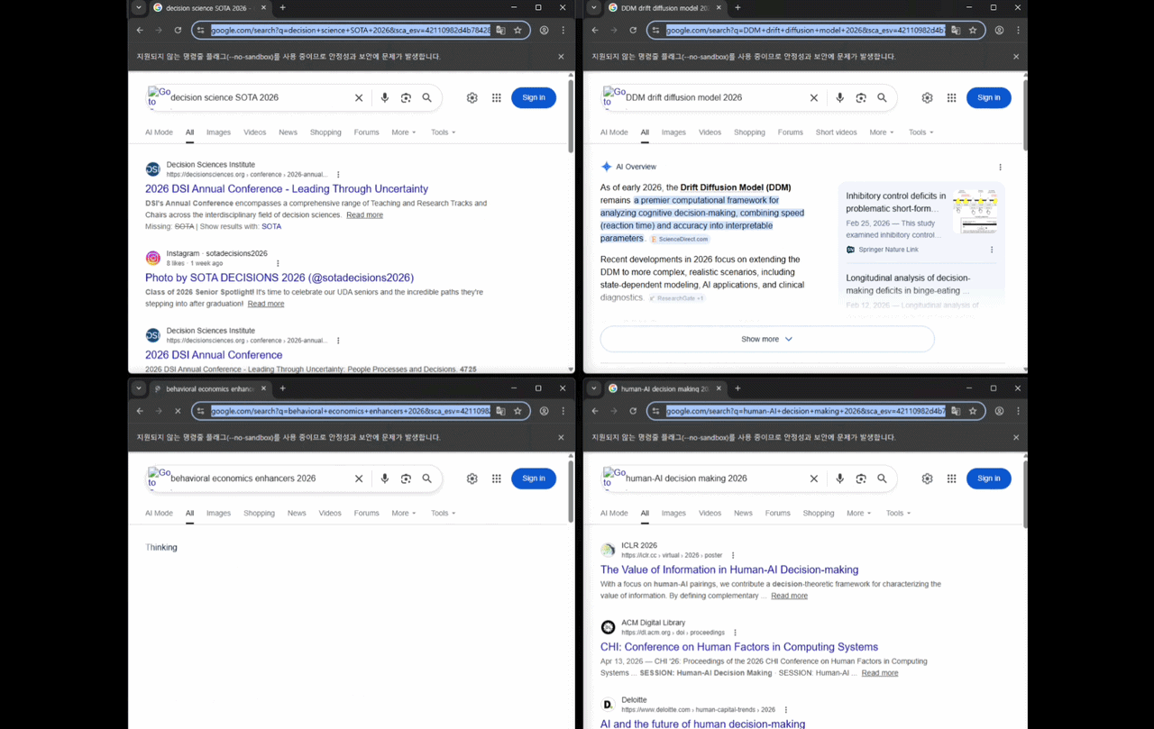
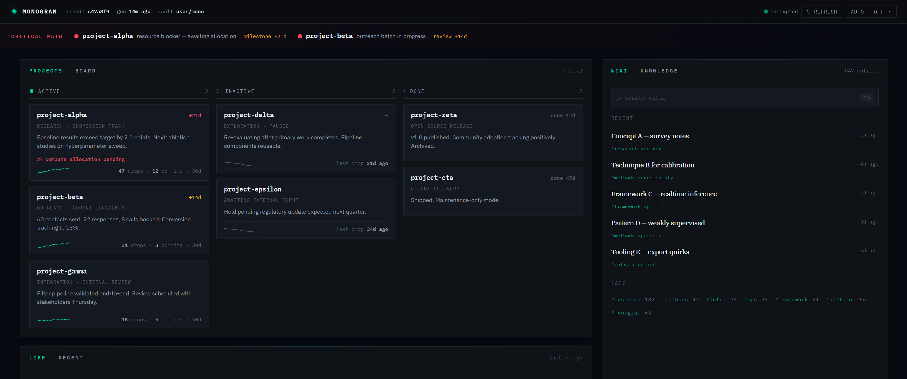
PROJECTS · AGENTIC AI · RETRIEVAL · PRODUCT SYSTEMS
A | Search and knowledge stay traceable
google-surf-mcp
Top 1% · 900 / 95,000 · 270+ stars
Monogram
5-stage pipeline
Five MCP tools unify Google Search, parallel search, HTML extraction, spatial PDF parsing, and health checks with SSRF defense and telemetry.
A Git-backed Markdown knowledge base combines ONNX INT8 embeddings, a sharded vector index, BM25, RRF, Personalized PageRank, and MMR.
07
Notes:
[Sources]
- C:\Users\user\resume\resume\v2\harim_choi_resume.docx — google-surf-mcp and Monogram claims
- C:\Users\user\resume\_sources\HarimxChoi.github.io\src\data\portfolio.ts — Group A project grouping
- C:\Users\user\resume\_work\portfolio_deck\gif_frames\frame-07.png — representative frame extracted from public demo.gif
- C:\Users\user\mono-patched\docs\images\dashboard.png — public Monogram dashboard
[/Sources]

Slide 8
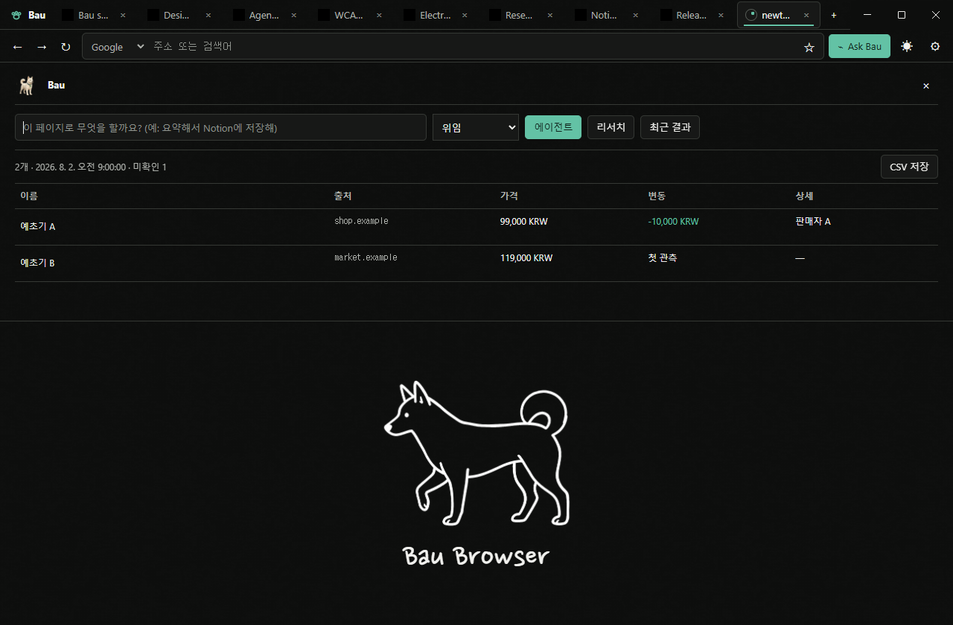
PROJECTS · AGENTIC AI · RETRIEVAL · PRODUCT SYSTEMS
A | Agents persist state and gate actions
LANGGRAPH TRAVEL AGENT
Budget · schedule
preferences
LangGraph
state
4 APIs
async
3-tier
options
FastAPI + Redis checkpoints
Native capture · synthetic fixture
Bau Browser
Electron 43 browser surface with origin- and verb-scoped propose → approve → execute controls, MCP, encrypted sync, and prompt-injection testing.
Human approval → CRM / SMS
Delivered to a U.S. travel agency · resumable execution · external messages only after approval
08
Notes:
[Sources]
- C:\Users\user\resume\resume\v2\harim_choi_resume.docx — Bau Browser and Travel Agent claims
- C:\Users\user\resume\_sources\HarimxChoi.github.io\src\data\portfolio.ts — Group A project grouping
- C:\Users\user\baubrowser\docs\ui-implementation\screenshots\desktop-research-table.png — Bau Browser screenshot; synthetic fixture caption required
[/Sources]

Slide 9
PROJECTS · AGENT EVALUATION · DECISION SYSTEMS
B | Evaluation and execution are different problems
Vargo
EMH Agent
POST-HOC ORACLE
POINT-IN-TIME DECISION PATH
PIT data
Trading
TQC
Policy
gate
Human
approval
Config A
Observed best
per task
Config B
+29 pp
Config C
Separate execution harness
up to, versus one fixed configuration
+84.26 pp
+0.838
Pre-execution task descriptions and difficulty did not identify the optimal configuration.
vs S&P 500 · 3 years
Sharpe ratio
09
Notes:
[Sources]
- C:\Users\user\resume\resume\v2\harim_choi_resume.docx — Vargo and EMH Agent claims
- C:\Users\user\resume\_sources\HarimxChoi.github.io\src\data\portfolio.ts — Group B project grouping
[/Sources]

Slide 10
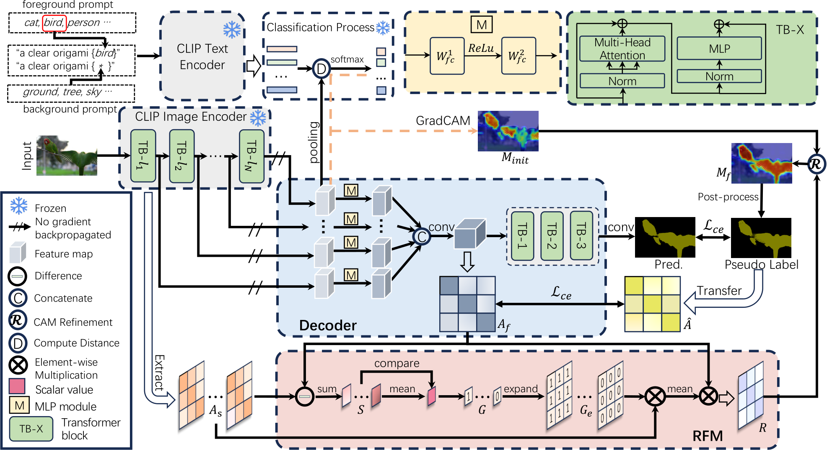
PROJECTS · COMPUTER VISION · CALIBRATION · RELIABILITY
C | WSSS improves only where disagreement is measurable
FULL COCO-VAL 2014
53.31%
mIoU across all
40,137 samples
+1.5 pp
over WeCLIP+
TPAMI ’25 · 51.8%
Reliability mapping replaces only pixels where prediction and pseudo-label disagree.
10
Notes:
[Sources]
- C:\Users\user\resume\resume\v2\harim_choi_resume.docx — WSSS method and full-denominator result
- C:\Users\user\resume\_sources\HarimxChoi.github.io\src\data\portfolio.ts — Group C project grouping
- C:\Users\user\resume\_sources\HarimxChoi.github.io\public\img\wsss-architecture.png — public WSSS architecture figure
[/Sources]

Slide 11
PROJECTS · COMPUTER VISION · CALIBRATION · RELIABILITY
C | Reliability spans edge pose and calibration
MyShot
EAT
ON-DEVICE 2D → 3D
TRAINING → CALIBRATION
Phone
video
YOLO-Pose
6 MB
MotionAGFormer-B
11.7M · INT8 ≈12 MB
3D swing
+ X-Factor
Entropy +
adversarial training
Checkpoint +
metric validation
Temperature
scaling
Calibrated
prediction
≈3.5 cm
3.1°
0.860
1.1%
joint-position error
X-Factor error
ISIC 2017 F1
best ECE
CR-SAM baseline: F1 0.85 · ECE 1.7%
No separate server required for the two-stage mobile path.
CIFAR-100: 81.23% accuracy · 3.37% ECE after temperature scaling
11
Notes:
[Sources]
- C:\Users\user\resume\resume\v2\harim_choi_resume.docx — MyShot and EAT methods and metrics
- C:\Users\user\resume\_sources\HarimxChoi.github.io\src\data\portfolio.ts — Group C project grouping
[/Sources]

Slide 12
HARIM CHOI | APPLIED ML SYSTEMS
The stack follows the decision path
01
Languages
Python · SQL · TypeScript · R · JavaScript / Node.js
02
Models
PyTorch · scikit-learn · Hugging Face · PFN / ICL · NLP · CV · RL
03
Agent + retrieval
MCP · LangGraph · LangChain · RAG · FAISS · custom vector index · HITL
04
Data + training
Weak / semi-supervised learning · pseudo-labeling · curation · leakage audit · domain shift
05
Evaluation
Calibration · conformal prediction · uncertainty quantification · CRPS · Monte Carlo · ablation
06
Production
Airflow · GPU orchestration · ONNX / quantization · FastAPI · Docker · Kubernetes · AWS / GCP
12
Notes:
[Sources]
- C:\Users\user\resume\resume\v2\harim_choi_resume.docx — core skills taxonomy
- C:\Users\user\resume\_sources\HarimxChoi.github.io\src\data\portfolio.ts — skills organized by decision path
[/Sources]

Slide 13
HARIM CHOI | APPLIED ML SYSTEMS
Best fit where models must survive real constraints
01
02
Production probabilistic ML
Agent + retrieval infrastructure
Distributional prediction, simulation, calibration, and KPI harnesses tied to operating decisions.
MCP, RAG, stateful workflows, scoped actions, approval gates, and recovery paths.
03
04
Reliable CV and calibration
End-to-end technical ownership
Weak supervision, pseudo-label refinement, 3D pose, ECE, domain-shift and leakage audits.
Data collection, OCR, training, evaluation, APIs, batch operations, deployment, and user support.
The useful question is not whether a model can score well, but whether its signal remains trustworthy when the system acts.
13
Notes:
[Sources]
- C:\Users\user\resume\resume\v2\harim_choi_resume.docx — summary, career, and skills
- C:\Users\user\resume\_sources\HarimxChoi.github.io\src\data\portfolio.ts — public positioning and approach
[/Sources]

Slide 14
CONTACT
Build reliable systems
under real constraints.
Open conversation: where could evaluation hide failure in your decision path?
EMAIL
GITHUB
PORTFOLIO
LINKEDIN
2.harim.choi@gmail.com
github.com/HarimxChoi
harimxchoi.github.io
linkedin.com/in/harimxchoi
Notes:
[Sources]
- C:\Users\user\resume\resume\v2\harim_choi_resume.docx — current v2 contact details
- C:\Users\user\resume\_sources\HarimxChoi.github.io\src\data\portfolio.ts — public contact links
[/Sources]

