Slide 1
Music Genre Classification
And Tagging
Team Name: Audiophitters
Team Members:
Darshan Navadiya (AU1841061)
Sanket B Shah (AU1841111)
Harin Khakhi (AU1841116)
Nilay Gandhi (AU1841118)

Slide 2
Introduction
Musical Genre is a category in which different musical pieces with same characteristics are placed into.
This task was performed by hand by experts which resulted in inconsistencies due to similarity and background of the musical pieces.
But, the demand for personalised song recommendations grew with time and hence demands for developing accurate and fast recommendation systems grew.
For recommending songs, the first step is to classify various songs into different categories called genres.
Due to increased demands of accurate classification, a need arose for accurate automated classification systems.
Hence, automated systems were created to avoid inconsistencies because music industry went under digital shift.

Slide 3
Problem Statement
Aim is to automate music genre classification.
Extract features from audio files.
Preprocessing of the data.
Searching and exploring different datasets and libraries which are compatible with each other, i.e, the features required by the dataset can be extracted by the library.
Finding useful features.
Finding best classifier.
Tagging the songs with moods related tags using lyrics of the song.
Applying NLP Techniques to find songs with similar tags.

Slide 4
EXISTING WORK
Spotify Recommendation Algorithm:
Spotify is a music streaming service and it makes playlists of songs of similar genres and moods
Youtube’s algorithm:
This algorithm focuses on not just music but other forms of content too.
Shazam Song Identification
This platform uses various technical features to identify a specific song.

Slide 5
Approach
Dataset: GTZAN Dataset
The Dataset consisted of 100 song samples of 10 different genres and were of 30 seconds and 3 seconds of length
We preprocessed the dataset in following steps:
The data was scaled, the string labels were encoded to numerical values
Using the library: Librosa, we extracted nearly 60 features out of the audio samples.
Features included various technical properties of the audio sample like: Zero Crossing Rate, Spectral Centroid, Spectral Rolloff, Mel Frequency Cepstral Coefficients(MFCCs), etc.
We further applied PCA and found that to retain 95% variance, 28 features out of 55 were enough
However, it affected the model performance negatively hence as of now, we decided to keep the original dataset.

Slide 6
Approach
Models Tried: We compared the performance of three different algorithms for this dataset
Logistic Regression
K-Nearest Neighbour
Support Vector Machine
These models were trained and then validated over different hyperparameters:
Logistic Regression: Type of Regularisation (L1 or L2)
K-Nearest Neighbour: Number of Neighbours
Support Vector Machine: Inverse Regularisation value and type of kernel

Slide 7
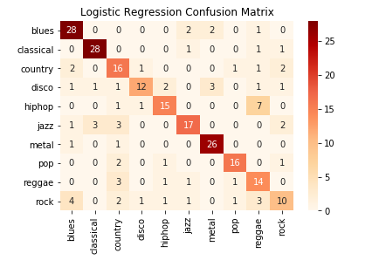
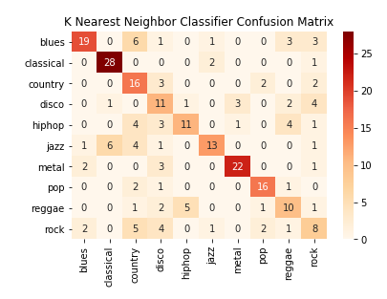
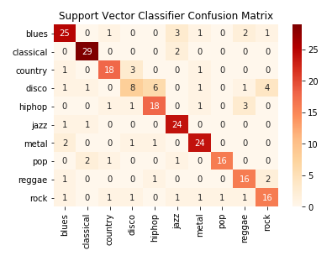
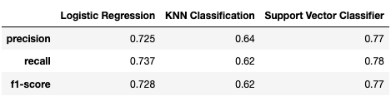
Initial Results
Notes:
No.1, No.2 and No.3 have been completed successfully
No.4 :- We modified ps command to help us in the Feedback Algo implementation
No.5 :- We used PS command for making the Feedback Algorithm

Slide 8
Individual Contribution
Darshan
Sanket
Extracting Features from new Sound
Exploring GTZAN’s Dataset
Data Visualization
Applying Logistic Regression Model
Exploring Spotify’s Dataset
Data Analytics
Applying Support Vector Classifier Model
Harin
Nilay
Learning Features
Data Analytics
Finding Best Hyperparameters for model
Performance Comparison among Models
Learning Features
Data Visualization
Data Processing
Applying KNN Classifier Model

Slide 9
Future Work
Mood Tagging:
Assign the song with different tags which will help in classifying the moods of the song
Lyrics of the song will be analysed to achieve this task.
Word Embeddings will be used to map the words with their meanings.
Algorithm to achieve this will be decided.
Random Forest Classifier:
This will be used to assign importances to the features.
Redundant features will be dropped.
3. Try to eliminate sklearn and hand program the algorithms

Slide 10
References
Dataset
T. Nkambule and R. Ajoodha, “Classification of music by genre using probabilistic models and deep learning models.”
“Pythonproject-musicgenreclassification,”Mar2021.[Online].Available:https://data-flair.training/blogs/python-project-music-genre-classification
A. Olteanu, “Gtzan dataset - music genre classification,” Mar2020.[Online].Available:https://www.kaggle.com/andradaolteanu/gtzan-dataset-music-genre-classification

