Slide 1
Music Genre Classification
And Tagging
Team Name: Audiophitters
Team Members:
Darshan Navadiya (AU1841061)
Sanket B Shah (AU1841111)
Harin Khakhi (AU1841116)
Nilay Gandhi (AU1841118)

Slide 2
Introduction
People like to hear to personalised music and hence recommendation systems are growing.
Hence, need for accurate and fast recommendation systems grew.
We created two recommendation systems :
Genre classification:
We classify a song into 10 predefined categories which are Blues, Classical, Country, Disco, Hiphop, Jazz, Metal, Pop, Reggae, Rock.
Mood Tagging:
We quantify the piece of music as to how much values of happiness and energeticness that musical piece has.

Slide 3
Problem Statement
Aim is to do:
Music genre classification via audio feature extraction
Music Mood tagging using Spotify’s descriptive features

Slide 4
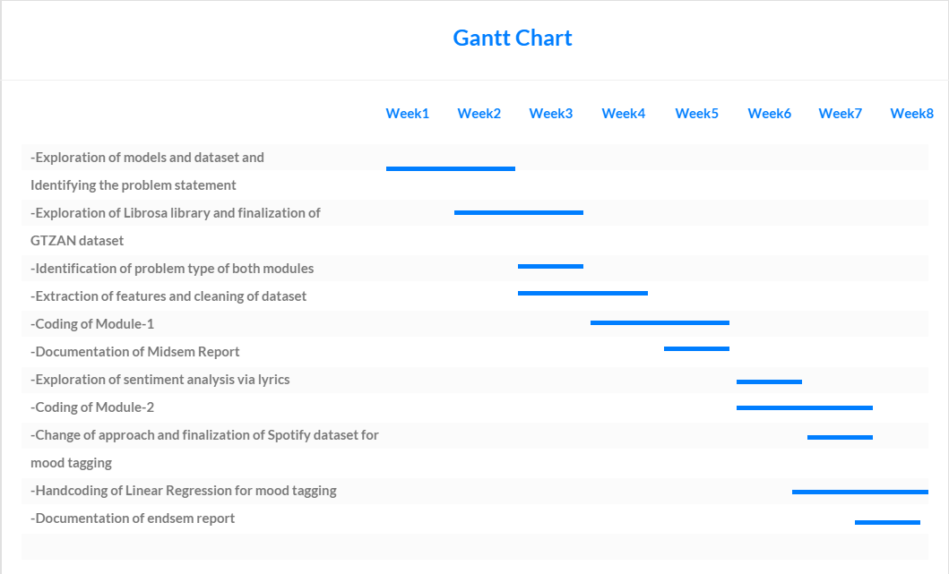
Project Progress

Slide 5
EXISTING WORK
Spotify Recommendation Algorithm:
Spotify is a music streaming service and it makes playlists of songs of similar genres and moods
Youtube’s algorithm:
This algorithm focuses on not just music but other forms of content too.
Shazam Song Identification
This platform uses various technical features to identify a specific song.

Slide 6
Approach for Genre Classification
Dataset: GTZAN Dataset
The Dataset consisted of 100 song samples of 10 different genres and were of 30 seconds and 3 seconds of length
We preprocessed the dataset in following steps:
The data was scaled, the string labels were encoded to numerical values
Using the library: Librosa, we extracted 55 features out of the audio samples.
Features included various technical properties of the audio sample like: Zero Crossing Rate, Spectral Centroid, Spectral Rolloff, Mel Frequency Cepstral Coefficients(MFCCs), etc.
We further applied PCA and found that to retain 95% variance, 28 features out of 55 were enough
However, it affected the model performance negatively hence as of now, we decided to keep the original dataset.

Slide 7
Approach for Mood Tagging
Dataset: Spotify’s Dataset
Dataset contained 17 features including descriptive features like danceabillity, happiness, energeticness, etc. and irrelevant information like release date, etc.
We preprocessed the dataset in following steps:
Dropped the irrelevant information and kept descriptive features.
Target dataset consisted of 2 columns: energeticness and happiness.
If happiness is +1 then the song is happy and if it’s value is -1, then the song is sad.
If energeticness is +1 then the song is energetic and if it’s value is -1, then the song is calm.

Slide 8
Approach for Genre Classification and Mood Tagging
Models Tried for Genre Classification: We compared the performance of three different algorithms for this dataset
Logistic Regression
K-Nearest Neighbour
Support Vector Machine
Support Vector Machine gives best performance. So we selected SVC.
Models tried for Mood Tagging: Since there were two target values, two models were trained for estimating happiness and energeticness. They were trained keeping Mean Square Error as the cost function.

Slide 9
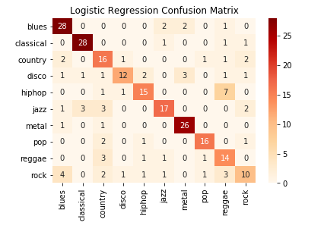
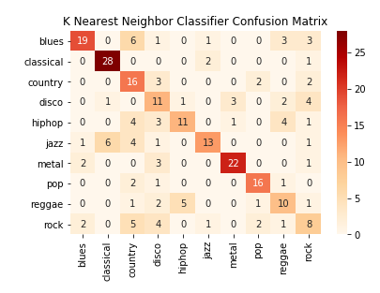
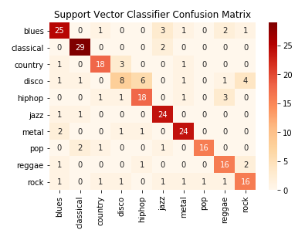
Final Results of Genre Classification
Confusion matrices of Logistic Regression, K Nearest neighbor and Support Vector Classifier respectively.

Slide 10
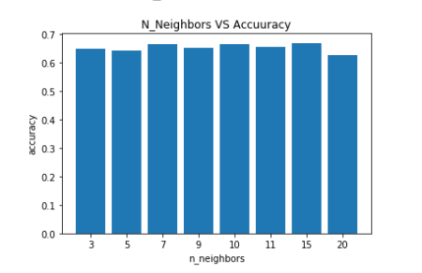
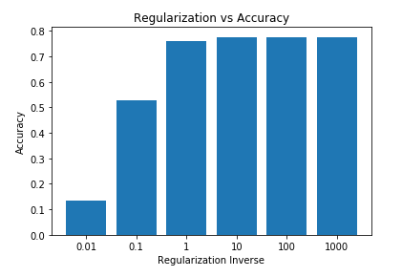
Final Results of Genre Classification
Checking for various values of N
(K Nearest Neighbors)
Checking for various values of N
(Support Vector Machine)

Slide 11
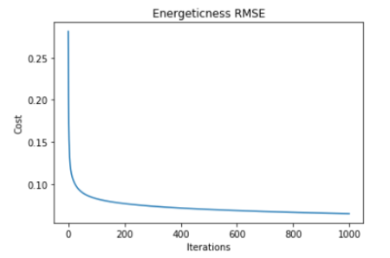
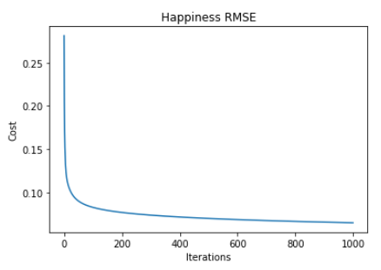
Final Results of Mood Tagging
Reduction of cost w.r.t iterations for Energetics feature
Reduction of cost w.r.t iterations for Happiness feature

Slide 12
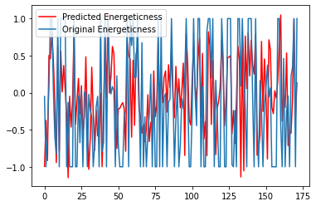
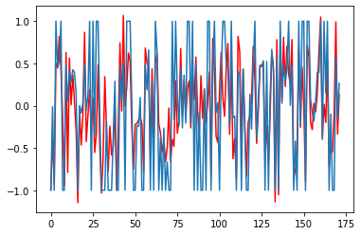
Final Result of Mood Tagging
Comparison in predicted and original values of Happiness on Test Dataset
Comparison in predicted and original values of Energeticness on Test Dataset

Slide 13
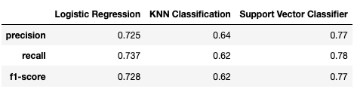
Conclusion
Comparison of Precision, Recall and F1 Scores for the three algorithms of genre classification.
As it can be seen, SVM performs the best.
For Mood Tagging, Linear Regression was chosen because Polynomial regression overfitted the data.

Slide 14
Individual Contribution
Darshan
Sanket
Exploring GTZAN’s Dataset
Data Visualization
Comparison of Linear and Poly Regression
Exploring Spotify’s Dataset
Applying Support Vector Classifier Model
Attempting to Hand-code Multi-class SVM model
Harin
Nilay
Exploring Features
Performance Comparison among Models
Handcoding Linear Regression
Data Processing
Applying KNN Classifier Model
Obtaining results for handcoded models

Slide 15
References
Dataset
T. Nkambule and R. Ajoodha, “Classification of music by genre using probabilistic models and deep learning models.”
“Pythonproject-musicgenreclassification,”Mar2021.[Online].Available:https://data-flair.training/blogs/python-project-music-genre-classification
Muhammadghazimuharam, “Music mood classification”, Dec 2020. [Online]. Available:https://www.kaggle.com/muhammadghazimuharam/music-mood-classification
A. Olteanu, “Gtzan dataset - music genre classification,” Mar2020.[Online].Available:https://www.kaggle.com/andradaolteanu/gtzan-dataset-music-genre-classification
Musicblogger, “Spotify music data to identify the moods”, DEC 2020. [Online]. Available:https://www.kaggle.com/musicblogger/spotify-music-data-to-identify-the-moods

