Slide 1
Keyloggers and security
CAPSTONE PROJECT
Presented By:
1. M.Hari Nandhini- Madha Engineering College- BE(CSE)

Slide 2
OUTLINE
Problem Statement
Proposed System/Solution
System Development Approach
Algorithm & Deployment
Result
Conclusion
Future Scope
References

Slide 3
Problem Statement
In Today's Digital Landscape, Ensuring Security Measures To Protect Sensitive Information Is Paramount. However, There Exists A Necessity To Understand And Mitigate Potential Threats, Such As Keylogging, Which Can Compromise Data Integrity And Confidentiality. Thus, It's Imperative To Explore Keylogger Implementation And Associated Security Concerns.

Slide 4
Proposed Solution
We Suggest Building A Keylogger Using The Pynput Package For Keyboard Input Capture And Python's Tkinter Framework For The GUI. The Keylogger Will Record Keystrokes And Store Them In Text And JSON Formats For Later Analysis.

Slide 5
System Approach
Technology Used:
Python: To Program The Keylogger's Features.
Tkinter: For Building The Graphical User Interface, Or Gui.
Python Input: For Keystroke Recording.
Json: An Organized Format For Storing Data About Keystrokes

Slide 6
Algorithm & Deployment
INITIALIZATION : Configure The Variables And Flags That Are Required.
ORGANIZING EVENTS:
On_press(key): Indicates Which Keys Are Pressed And Held.
On_Release(key): Records Released Keys And Keeps Track Of Flag Status.
CAPTURING:
Use Create Text.Log(key): To Store Keystrokes In A Text File.
Using The Generate.Json File: Keystrokes Are Recorded As A JSON File (Keys Utilized).
HANDLING KEYLOGGER CONTROL:
Start_keylogger(): Initiates The Keylogging Process.
Stop_Keylogger(): Closes The Keylogging.

Slide 7
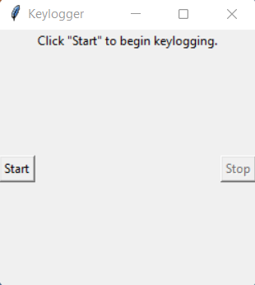
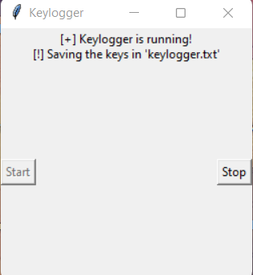
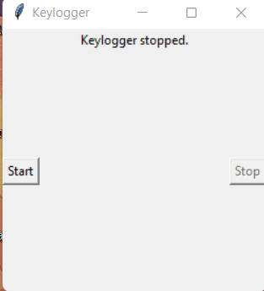
Result
The graphical user interface (GUI) includes "Start" and "Stop" buttons to control the keylogging process. When the keylogger is started, it captures keystrokes and saves them in designated files. Stopping the keylogger halts the logging process.

Slide 8
Conclusion
The Ease With Which Keyboard Inputs Can Be Recorded With A Key Logger Highlights The Necessity Of Strong Security Measures In Preventing Unauthorized Access To Sensitive Information. To Strengthen System Security Against Potential Attacks, One Must Be Aware Of Keylogging Techniques.

Slide 9
Future scope
To Strengthen Security Measures, It Is Recommended To Safeguard The Logged Data Using Encryption Techniques.
User Authentication: Unauthorized Access Can Be Prevented By Utilizing User Authentication Methods.
Advanced Logging Features Like Timestamping And Window Tracking Should Also Be Incorporated For More Comprehensive Logging Capabilities..

Slide 10
References
A Survey on Keylogger and its Detection Techniques by Vishal Bharti, Aditya Kumar Gupta, and Shailendra Mishra https://www.ijcaonline.org/archives/volume75/number5/12835-1514
Analysis of Keylogger Attacks and Countermeasures by Hongliang Liu, Ruiying Du, and Quansheng Zhuang https://www.semanticscholar.org/paper/Analysis-of-Keylogger-Attacks-and-Countermeasures-Liu-Du/54c7255bace229c82e4a5fd812ba8dd8829180c1
Detection of Keyloggers: A Review by Shukor Abd Razak, Ku Ruhana Ku-Mahamud, and Ramlan Mahmod https://www.researchgate.net/publication/220955239_Detection_of_Keyloggers_A_Review
A Comprehensive Study on Keylogger Attack and Defense by Shuo Chen, Rui Wang, XiaoFeng Wang, and Kehuan Zhang https://www.usenix.org/legacy/events/sec11/tech/full_papers/Chen.pdf

Slide 11
THANK YOU

