Slide 1



2303811714821008 - V HARINARAYANAN

Slide 2
PROBLEM IDENTIFICATION
OBJECTIVE
BLOCK DIAGRAM OF PROPOSED SYSTEM
DATA STRCTURE USED
ADVANTAGES OF PROPOSED SYSTEM

Slide 3
Project Goals Definition: Clearly defining the project's goals and objectives provides a framework for evaluating its performance and identifying discrepancies.
Information Gathering: Collecting data from diverse sources such as stakeholders, end-users, project documentation, and system metrics offers valuable insights into potential areas of concern.
Data Analysis: Analyzing the gathered data helps identify patterns, trends, or anomalies that may indicate underlying issues affecting the project's performance.
Feedback Collection: Seeking feedback from stakeholders and end-users provides firsthand insights into the project's strengths and weaknesses, helping to pinpoint areas for improvement.

Slide 4
Enhancing Efficiency: This subtopic involves improving the effectiveness of task execution and resource utilization within the system. By implementing a queue-based task scheduler, tasks can be managed and executed more efficiently, reducing delays and improving overall workflow.
Scalability: Scalability refers to the system's ability to handle increasing workloads or user demands without sacrificing performance. A scalable system can efficiently accommodate growth by distributing tasks across multiple resources or nodes.
Reability: Reliability in a system refers to its consistent and dependable operation, ensuring minimal downtime or disruptions, thus building user confidence and trust in its performance.

Slide 5
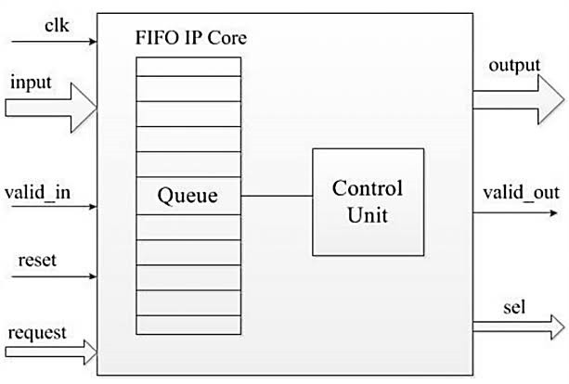
BLOCK DIAGRAM OF PROPOSED SYSTEM

Slide 6
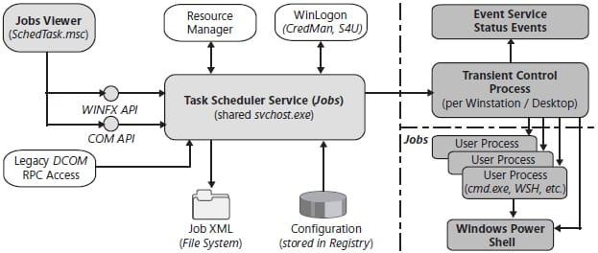
ARCHITECTURE DIAGRAM

Slide 7
Array : * tasks array within TaskScheduler stores tasks.
*Used as a queue to manage task execution order.
Array Implementation : Utilizing arrays to manage queue elements efficiently, enabling basic enqueue and dequeue operations.
Linked List Implementation : Implementing queues using linked lists for dynamic sizing, allowing for flexible memory allocation and efficient insertion and deletion of elements.
4 .Priority Queue :
Priority queues are a specialized form of queues where elements are dequeued based on their priority level.
This subtopic focuses on how priority queues are implemented using advanced data structures such as heaps or balanced trees.

Slide 8
The proposed system,offers several advantages
Modularity: The system is modularized with clear separation of concerns. Each function (e.g.,
adding tasks, executing tasks) is encapsulated within its own module, enhancing code readability and maintainability.
Flexibility: The system allows tasks to be added dynamically, enabling flexibility in task management. Tasks can be added or removed from the scheduler without affecting the overall functionality of the system.
Eﬃcient Task Management: By using a queue-based data structure, the system ensures that tasks are executed in the order they were added (FIFO). This helps in managing tasks
efficiently, especially in scenarios where tasks need to be processed sequentially.

Slide 9


Slide 10


K.RAMAKRISHNAN COLLEGE OF TECHNOLOGY (AUTONOMOUS), TRICHY
CIA II Project Review
QUEUE BASED TASK SCHEDULER
PRESENTED BY
2303811714821008-V.HARINARAYANAN

Slide 11
PRESENTATION OVERVIEW
Module Description
Module implementation
Source Code
Screenshot
Conclusion and Future Enhancement

Slide 12
Module Description
Task and Scheduler Structure: Define structures for tasks(function pointer and data) and a task
scheduler (task array and front/rear pointers).
Initialization and state checks : Includes functions to initialize the scheduler and check if it is empty or full.
Sample Task and Execution: Contains a sample task function for demonstration and a main function
to initialize, schedule, execute tasks, and free the scheduler.

Slide 13
Module Implementation
Structure definition: Defines task and scheduler structures with necessary pointers and data.
Initialization and Checks: Implements functions to initialize the scheduler and check its empty or full status.
Task Scheduling and Execution: Adds tasks to the scheduler ,manages queue positions,and executes
tasks in FIFO order.
Sample and main functions: Provides a sample task function and a main function to demonstrate
scheduler usage, including initialization, task scheduling,execution, and cleanup.

Slide 14
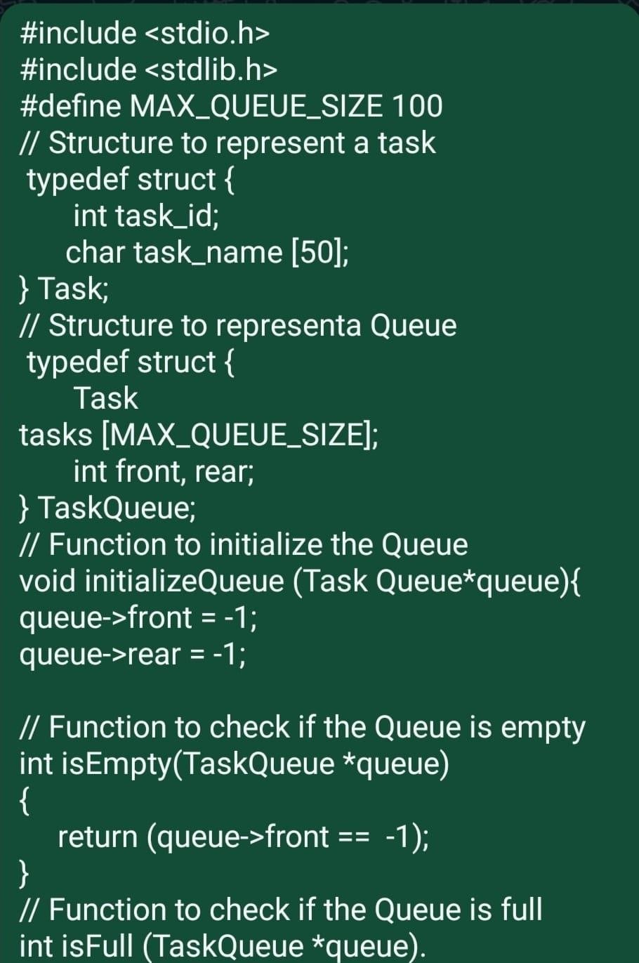
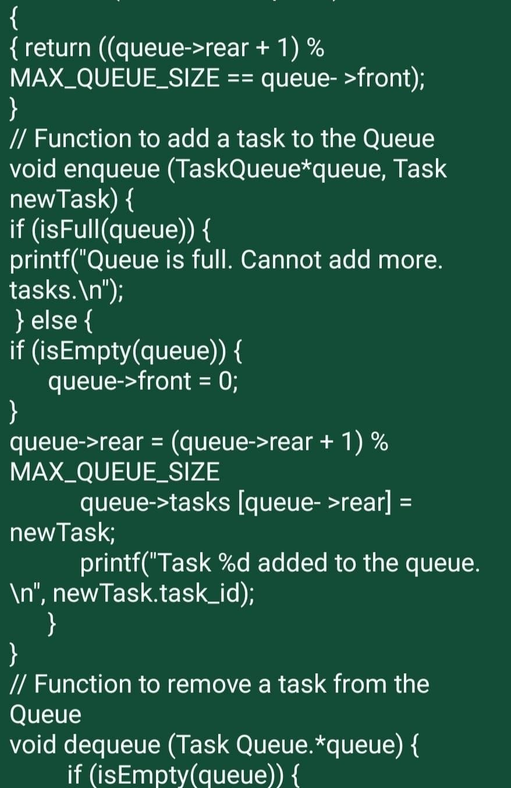
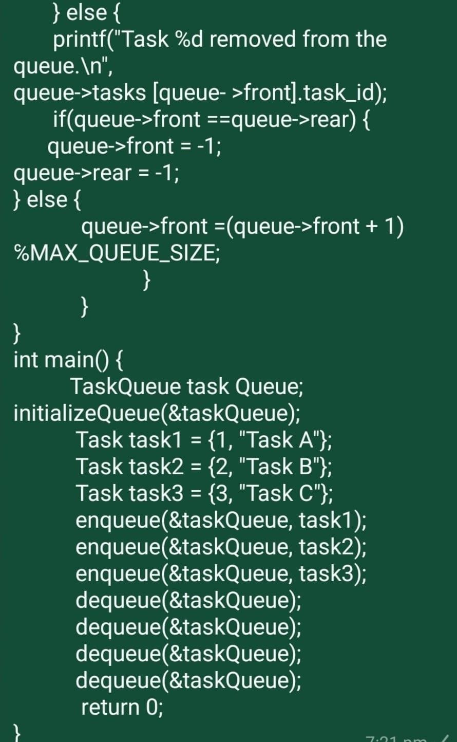
Source Code

Slide 15
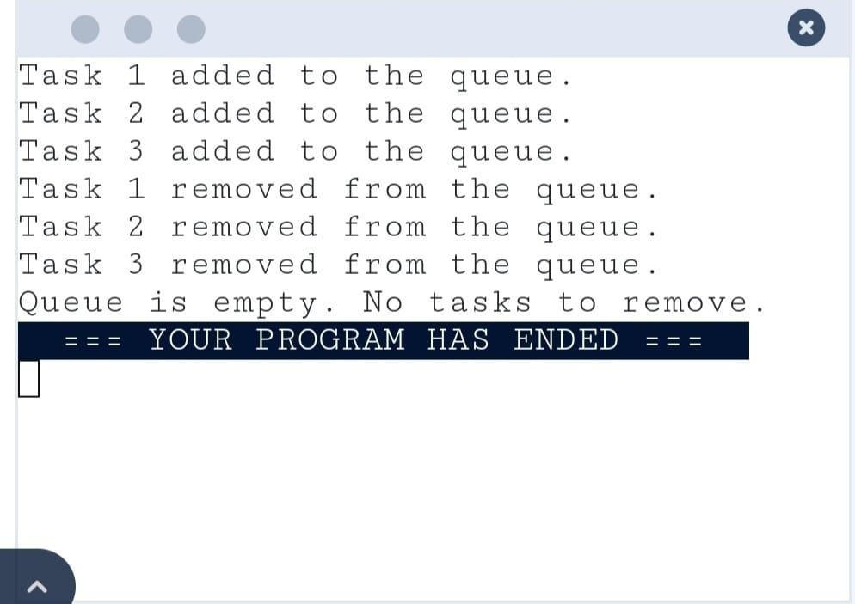
Screenshot
▪
▪
▪

Slide 16
Conclusion
The implementation of a queue-based task scheduler within this project represents a significant advancement in both functionality and efficiency. This strategic enhancement provides several key benefits that collectively elevate the system's performance, reliability, and scalability.
SOCIAL MEDIA PLATFORM: incorporate a queue-based task scheduler such as Celery with RabbitMQ for efficient management of tasks like content moderation and real-time updates, ensuring platform responsiveness.
GAMING: utilize a queue-based task scheduler for tasks like matchmaking and leaderboard updates,
ensuring smooth gameplay and efficient event management.

Slide 17
FUTURE ENHANCEMENT
The best way to work with queues is to prioritize tasks, handle errors gracefully, and ensure scalability by distributing the workload across multiple workers, leveraging robust queue management systems like RabbitMQ or Kafka, and implementing efficient task processing algorithms.
The future advantages of queue-based task scheduling lie in its potential for handling
increasingly complex and diverse workloads, ensuring scalability, fault tolerance, and efficient resource utilization in rapidly evolving technological landscapes.
In the future, queue-based task scheduling will be pivotal for real-time applications spanning IoT, edge computing, autonomous systems, and augmented reality, ensuring efficient data processing and resource management.

Slide 18
THANK YOU

