Slide 1
CS 325 Analysis of Algorithms
Instructor: Ali Ebnenasir and Maher Elshakankiri
E-mail: ebnenasa@oregonstate.edu and Maher.Elshakankiri@oregonstate.edu
Subject: CS325
Email should be a secondary contact for course questions with the primary contact being the course discussion board and message in Canvas.
Textbook: Introduction to Algorithms by Cormen, Leiserson, Rivest, Stein, 3rd edition.

Slide 2
Grade Evaluation
Homework ------------------------------- 50%
Quizzes ------------------------------- 15%
Midterm Exam ------------------------------- 15%
Final Exam -------------------------------- 20%
TOTAL -------------------------------- 100%
HW Discussions -------------------------------- 5% (extra)

Slide 3
Homework
There are eight homework assignments with both written problems and same programming problems.
Due by 11:59pm (generally Sunday)
Written portion submitted in Canvas and programming portion submitted to TEACH
A subset of the homework problems will be graded. Assignments that are not neatly written up using a word processor/text editor will not be graded.

Slide 4
Exams
There are 2 exams for this course,
The Midterm Exam
Covers week 0 to week 5 material.
The Final Exam
Covers week 6 to week 10 material.
You will be allowed one 8.5”x11”, double-sided, typed-or-handwritten note sheet at each of your

Slide 5
Grading Policies:
Any requests for extensions/special accommodations must be made in advance, in writing and sent to the instructor via Canvas messaging.
Homework will be accepted up to 1 day late for a 10% penalty.
Any disagreement in scoring must be addressed within one week of the work being graded. All questions about grading must be placed in the “Assignment Comments” section of the Canvas submission for that assignment.
Grading Scale: Note: Numerical scores will be rounded to the nearest integer
Grade | Average
A | 93 or greater
A- | 90 - 92
B+ | 87 - 89
B | 83 - 86
B- | 80 - 82
C+ | 77 - 79
C | 73 - 76
C- | 70 - 72
D+ | 67 - 69
D | 63 - 66
D- | 60 - 62
F | less than 60

Slide 6
Design and Analysis of Algorithms
Analysis: predict the cost of an algorithm in terms of resources and performance. Theory
Design: design algorithms which minimize the cost
Basic goals for an algorithm:
always correct
always terminates
Performance - often draws the line between
what is possible and what is impossible.

Slide 7
CS 325 - Topics
Asymptotic Analysis and Complexity Classes.
Analysis on experimental run time data.
Linear, polynomial, exponential regression
Recursion, recurrences
Performance determines what is feasible and what is impossible.
When to use a Heuristic or an Approximation Algorithm
Travelling Salesman Problem
Knapsack Problem
Scheduling
.

Slide 8
Algorithm Design Paradigms
There is no one “best” method to solve all problems
Brute Force
Divide and Conquer
Greedy
Dynamic Programming
Graph Algorithms
Linear Programming
Approximation

Slide 9
Problems vs Algorithms
Many algorithms exist to solve the sorting problem.
Running time is associated with an algorithms.
Bounds on running times may also be associated with the problem.
Example
Problem: Sorting a list of integers
Algorithms: Insertion Sort, Merge Sort, Naive Sort

Slide 10
How do we compare Algorithms?
We need to define a number of objective measures.
Compare execution times?
Not good: times are specific to a particular computer and programming language!!
Count the number of statements executed?
Not good: number of statements vary with the programming language as well as the style of the individual programmer.

Slide 11
Our Machine Model
Generic Random Access Machine (RAM)
Executes operations sequentially
Set of primitive operations:
Arithmetic. Logical, Comparisons, Function calls
Simplifying assumption: all ops cost 1 unit
Eliminates dependence on the speed of our computer, otherwise impossible to verify and to compare

Slide 12
Types of Analysis
Worst case
Provides an upper bound on running time
An absolute guarantee that the algorithm would not run longer, no matter what the inputs are
Best case
Provides a lower bound on running time
Input is the one for which the algorithm runs the fastest
Average case = Expected Value
Provides a prediction about the running time
Assumes that the input is random

Slide 13
Input Size
Express running time as a function of the input size n (i.e., f(n)).
size of an array
# of elements in a matrix
# of bits in the binary representation of the input
vertices and edges in a graph

Slide 14
Asymptotic Analysis
To compare two algorithms with running times f(n) and g(n), we need a rough measure that characterizes how fast each function grows.
Running time of an algorithm as a function of input size n for large n.
Compare functions in the limit, that is, asymptotically! (i.e., for large values of n)
Worst Case Analysis

Slide 15
Problems vs Algorithms
For any given problem there are potentially many different types of algorithms to solve it.
Problem: Sorting a list of integers
Algorithms: Insertion Sort, Merge Sort, Naive Sort

Slide 16
Participation Question
If n is the size the list to be sorted, the running time of Merge Sort is
a) O(n²) – Clap
O(nlogn) – Stand
Both a) and b) - Stomp

Slide 17
Participation Question
If n is the size the list to be sorted, the running time of Merge Sort is
a) Θ(n²) – Clap
Θ(nlogn) – Stand
Both a) and b) - Stomp
Note: Θ is a “tight” bound

Slide 18
Participation Question
If n is the size the list to be sorted, the running time of Insertion Sort is
a) O(n²) – Clap
O(nlogn) – Stand
Both a) and b) - Stomp

Slide 19
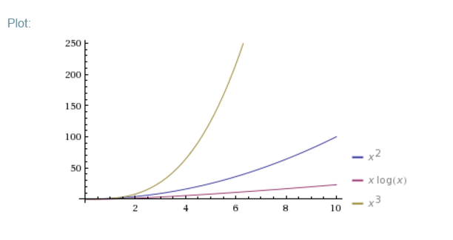
Problems vs Algorithms
For any given problem there are potentially many different types of algorithms to solve it.
Problem: Sorting a list of integers
Algorithms: Insertion Sort, Merge Sort, Naive Sort
Running time
Insertion Sort is O(n²)
Merge Sort is O(nlgn)
Naive Sort is O(n³)

Slide 20
Formally DefineThe Problem of Sorting
Input: sequence ⟨a₁, a₂, …, a_{n}⟩ of numbers.
Output: permutation ⟨a'₁, a'₂, …, a'_{n}⟩ such
that a'₁ ≤ a'₂ ≤ … ≤ a'_{n} .
Example:
Input: 8 2 4 9 3 6
Output: 2 3 4 6 8 9

Slide 21
Importance of Sorting
Maintain a directory of names, phone book, sort by grades of students, …
Find the median
Binary Search assumes array is sorted.
Greedy Algorithms
Problem vs Algorithm
Many algorithms exist to solve the sorting problem.
Running time is associated with an algorithms.
Bounds on running times may also be associated with the problem.

Slide 22
Algorithm 1: Insertion sort
INSERTION-SORT (A, n) ⊳ A[1 . . n]
for j ← 2 to n
do key ← A[ j]
i ← j – 1
while i > 0 and A[i] > key
do A[i+1] ← A[i]
i ← i – 1
A[i+1] = key
“pseudocode”
1
i
j
n
A:
key
sorted

Slide 23
Example of insertion sort
8
2
4
9
3
6

Slide 24
Example of insertion sort
8
2
4
9
3
6

Slide 25
Example of insertion sort
8
2
4
9
3
6
2
8
4
9
3
6

Slide 26
Example of insertion sort
8
2
4
9
3
6
2
8
4
9
3
6

Slide 27
Example of insertion sort
8
2
4
9
3
6
2
8
4
9
3
6
2
4
8
9
3
6

Slide 28
Example of insertion sort
8
2
4
9
3
6
2
8
4
9
3
6
2
4
8
9
3
6

Slide 29
Example of insertion sort
8
2
4
9
3
6
2
8
4
9
3
6
2
4
8
9
3
6
2
4
8
9
3
6

Slide 30
Example of insertion sort
8
2
4
9
3
6
2
8
4
9
3
6
2
4
8
9
3
6
2
4
8
9
3
6

Slide 31
Example of insertion sort
8
2
4
9
3
6
2
8
4
9
3
6
2
4
8
9
3
6
2
4
8
9
3
6
2
3
4
8
9
6

Slide 32
Example of insertion sort
8
2
4
9
3
6
2
8
4
9
3
6
2
4
8
9
3
6
2
4
8
9
3
6
2
3
4
8
9
6

Slide 33
Example of insertion sort
8
2
4
9
3
6
2
8
4
9
3
6
2
4
8
9
3
6
2
4
8
9
3
6
2
3
4
8
9
6
2
3
4
6
8
9
done

Slide 34
Running time
The running time depends on the input: an already sorted sequence is easier to sort.
Major Simplifying Convention: Parameterize the running time by the size of the input, since short sequences are easier to sort than long ones.
T_{A}(n) = time of A on length n inputs
Generally, we seek upper bounds on the running time, to have a guarantee of performance.

Slide 35
Kinds of Analyses
Worst-case: (usually)
T(n) = maximum time of algorithm on any input of size n.
Average-case: (sometimes)
T(n) = expected time of algorithm over all inputs of size n.
Need assumption of statistical distribution of inputs.
Best-case: (NEVER)
Cheat with a slow algorithm that works fast on some input.

Slide 36
Insertion sort analysis
Worst case: Input reverse sorted.
[arithmetic series]
Is insertion sort a fast sorting algorithm?
Moderately so, for small n.
Not at all, for large n.

Slide 37
Insertion sort analysis
Average case: All permutations equally likely.
Is insertion sort a fast sorting algorithm?
Moderately so, for small n.
Not at all, for large n.

Slide 38
Insertion sort analysis
Best Case: Already sorted. Nearly Sorted??
O(n)

Slide 39
Can we sort better?
Insertion upper bound O(n²)
Are there other ways to sort??

Slide 40
Merge Sort
Sorting Problem: Sort a sequence of n elements into non-decreasing order.
Divide: Divide the n-element sequence to be sorted into two subsequences of n/2 elements each
Conquer: Sort the two subsequences recursively using merge sort.
Combine: Merge the two sorted subsequences to produce the sorted answer.

Slide 41
Merge sort – Pseudo code
MERGE-SORT A[1 . . n]
If n = 1, done.
Recursively sort A[ 1 . . ⎡n/2⎤ ] and A[ ⎡n/2⎤+1 . . n ] .
“Merge” the 2 sorted lists.
Key subroutine: MERGE

Slide 42
Merging two sorted arrays
20
13
7
2
12
11
9
1

Slide 43
Merging two sorted arrays
20
13
7
2
12
11
9
1
1

Slide 44
Merging two sorted arrays
20
13
7
2
12
11
9
1
20
13
7
2
12
11
9
1

Slide 45
Merging two sorted arrays
20
13
7
2
12
11
9
1
20
13
7
2
12
11
9
1
2

Slide 46
Merging two sorted arrays
20
13
7
2
12
11
9
1
20
13
7
2
12
11
9
20
13
7
12
11
9
1
2

Slide 47
Merging two sorted arrays
20
13
7
2
12
11
9
1
20
13
7
2
12
11
9
20
13
7
12
11
9
1
2
7

Slide 48
Merging two sorted arrays
20
13
7
2
12
11
9
1
20
13
7
2
12
11
9
20
13
7
12
11
9
20
13
12
11
9
1
2
7

Slide 49
Merging two sorted arrays
20
13
7
2
12
11
9
1
20
13
7
2
12
11
9
20
13
7
12
11
9
20
13
12
11
9
1
2
7
9

Slide 50
Merging two sorted arrays
20
13
7
2
12
11
9
1
20
13
7
2
12
11
9
20
13
7
12
11
9
20
13
12
11
9
20
13
12
11
1
2
7
9

Slide 51
Merging two sorted arrays
20
13
7
2
12
11
9
1
20
13
7
2
12
11
9
20
13
7
12
11
9
20
13
12
11
9
20
13
12
11
1
2
7
9
11

Slide 52
Merging two sorted arrays
20
13
7
2
12
11
9
1
20
13
7
2
12
11
9
20
13
7
12
11
9
20
13
12
11
9
20
13
12
11
20
13
12
1
2
7
9
11

Slide 53
Merging two sorted arrays
20
13
7
2
12
11
9
1
20
13
7
2
12
11
9
20
13
7
12
11
9
20
13
12
11
9
20
13
12
11
20
13
12
1
2
7
9
11
12

Slide 54
Merging two sorted arrays
20
13
7
2
12
11
9
1
20
13
7
2
12
11
9
20
13
7
12
11
9
20
13
12
11
9
20
13
12
11
20
13
12
1
2
7
9
11
13
20
Time = Ο(n) to merge a total of n elements (linear time).

Slide 55
Merge Sort – Example
Original Sequence
Sorted Sequence
18
26
32
6
43
15
9
1
18
26
32
6
43
15
9
1
1
6
9
15
18
26
32
43
18
26
32
6
43
15
9
1
18
26
32
6
43
15
9
1
6
26
32
6
18
26
32
18
1
9
15
43
1
9
15
43
18
26
43
15
9
1
18
26
32
6
43
15
9
1
32
6
18
26
6
32
15
43
18
26
6
32
15
43
1
9
1
9
18
26
32
15
1
15
18
26
32
6
43
15
9
1
18
26
6
43
9
26
32
6
43
15
9
9
1
18
32
6
43
1
18
26
32
6
43
15
9
1
18
26
32
6
43
15
9
1

Slide 56
Analyzing merge sort
T(n)
Θ(1)
2T(n/2)
Ο(n)
MERGE-SORT A[1 . . n]
If n = 1, done.
Recursively sort A[ 1 . . ⎡n/2⎤ ] and A[ ⎡n/2⎤+1 . . n ] .
“Merge” the 2 sorted lists
Sloppiness: Should be T( ⎡n/2⎤ ) + T( ⎣n/2⎦ ) , but it turns out not to matter asymptotically.

Slide 57
Recurrence for merge sort
Θ(1) if n = 1;
T(n) =
2T(n/2) + Ο(n) if n > 1.
We shall usually omit stating the base case when T(n) = Θ(1) for sufficiently small n, but only when it has no effect on the asymptotic solution to the recurrence.
Week 2 provides several ways to find a good upper bound on T(n).

Slide 58
Recursion tree
Solve T(n) = 2T(n/2) + cn, where c > 0 is constant.

Slide 59
Recursion tree
Solve T(n) = 2T(n/2) + cn, where c > 0 is constant.
T(n)

Slide 60
Recursion tree
Solve T(n) = 2T(n/2) + cn, where c > 0 is constant.
cn
T(n/2)
T(n/2)

Slide 61
Recursion tree
Solve T(n) = 2T(n/2) + cn, where c > 0 is constant.
cn
cn/2
cn/2
T(n/4)
T(n/4)
T(n/4)
T(n/4)

Slide 62
Recursion tree
Solve T(n) = 2T(n/2) + cn, where c > 0 is constant.
cn
cn/2
cn/2
cn/4
cn/4
cn/4
cn/4
…
Θ(1)

Slide 63
Recursion tree
Solve T(n) = 2T(n/2) + cn, where c > 0 is constant.
cn
cn/2
cn/2
h = lg n
cn/4
cn/4
cn/4
cn/4
…
Θ(1)

Slide 64
Recursion tree
Solve T(n) = 2T(n/2) + cn, where c > 0 is constant.
cn
cn
cn/2
cn/2
h = lg n
cn/4
cn/4
cn/4
cn/4
…
Θ(1)

Slide 65
Recursion tree
Solve T(n) = 2T(n/2) + cn, where c > 0 is constant.
cn
cn
cn/2
cn/2
cn
h = lg n
cn/4
cn/4
cn/4
cn/4
…
Θ(1)

Slide 66
Recursion tree
Solve T(n) = 2T(n/2) + cn, where c > 0 is constant.
cn
cn
cn/2
cn/2
cn
h = lg n
cn/4
cn/4
cn/4
cn/4
cn
…
…
Θ(1)

Slide 67
Recursion tree
Solve T(n) = 2T(n/2) + cn, where c > 0 is constant.
cn
cn
cn/2
cn/2
cn
h = lg n
cn/4
cn/4
cn/4
cn/4
cn
…
…
Θ(1)
#leaves = n
Θ(n)

Slide 68
Recursion tree
Solve T(n) = 2T(n/2) + cn, where c > 0 is constant.
cn
cn
cn/2
cn/2
cn
h = lg n
cn/4
cn/4
cn/4
cn/4
cn
…
…
Θ(1)
#leaves = n
Ο(n)
Total = Ο(n lg n)

Slide 69
Conclusions
Ο(n lg n) grows more slowly than Ο(n²).
Therefore, merge sort asymptotically beats insertion sort in the worst case.
Nearly Sorted??

Slide 70
A tighter bound
Θ(n lg n) grows more slowly than Θ(n²).
More about Theta Θ in the next lecture.

Slide 71
Sorting
Merge Sort
Insertion Sort
Worst Case : Θ(nlgn)
Average Case: Θ(nlgn)
Best Case : Θ(nlgn)
Worst Case : Θ(n²)
Average Case: Θ(n²)
Best Case : Θ(n)

Slide 72
A bad sorting algorithm
Bogosort is a highly ineffective sorting function based on the generate and test paradigm. The function successively generates permutations of its input until it finds one that is sorted. It is not useful for sorting, but may be used for educational purposes, to contrast it with more efficient algorithms.
Two versions of the function exist: a deterministic version that enumerates all permutations until it hits a sorted one and a randomized version that randomly permutes its input.
PseudoCode: Randomized
while not Sorted(list) do
shuffle(list)
done

Slide 73
Time Complexity
Worst Case :
O((n+1)!) or O( (n+1)!) for deterministic version
Randomized this algorithm has no upper bound)
Average Case: O(n*n!) or O( (n+1)!) assume a uniform distribution so that the probably of obtaining the sorted value is 1/n! and it takes time n to sort.
Best Case : O(n) (when array given is already sorted)

Slide 74
Bubble Sort
Bubble Sort is the simplest sorting algorithm that works by repeatedly swapping the adjacent elements if they are in wrong order.
Bubblesort( array A)
for i from 1 to n
for j from 0 to n - 1
if A[j] > A[j + 1]
swap( A[j], A[j + 1] )
Worst Case : Θ(n²)
Average Case: Θ(n²)
Best Case : Θ(n²)

Slide 75
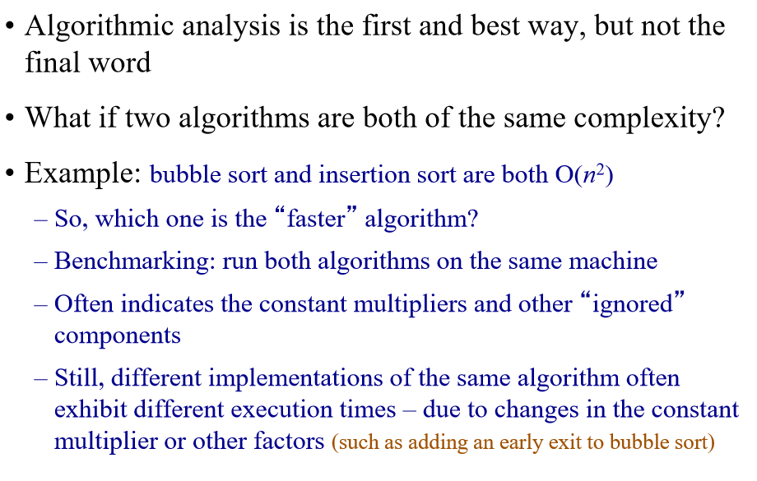
Benchmarking

Slide 76
Experimental Analysis
Implement the algorithm & Collect running time data

Slide 77

Problem:
Sorting
Must be correct
Merge Sort
Insertion Sort
Design Algorithms:
Asymptotic analysis
Theoretical Running Time
O(nlogn)
O(n²)
Implement, run, collect data
Experimental Running Time
T(n) = 0.3nlogn + 0.01
T(n) = 0.06n2 + 0.002n + 0.1
Problem Complexity Class:
Polynomial P

Slide 78
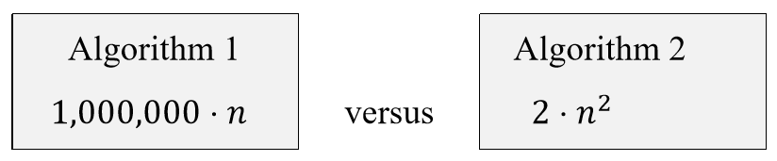
Constant factors and domination
Suppose we have two algorithms with exact running times of:
Is it reasonable to say that runtime of Algorithm 2 is slower than Algorithm1?
For small values of n
Algorithm 2 is better
For large values of n
Algorithm 1 is better

Slide 79
Asymptotic performance
When n gets large enough, an n² algorithm always “beats” a n³ algorithm.
T(n)
n
n₀

Slide 80
Asymptotic Notation
Big-Oh - O notation: asymptotic “less than”:
f(n)=O(g(n)) implies: f(n) “≤” g(n)
Omega - Ω notation: asymptotic “greater than”:
f(n)= Ω (g(n)) implies: f(n) “≥” g(n)
Theta - Θ notation: asymptotic “equality”:
f(n)= Θ (g(n)) implies: f(n) “=” g(n)

Slide 81
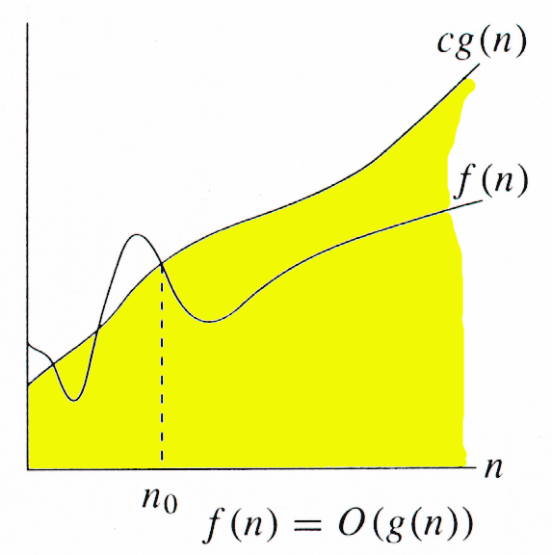
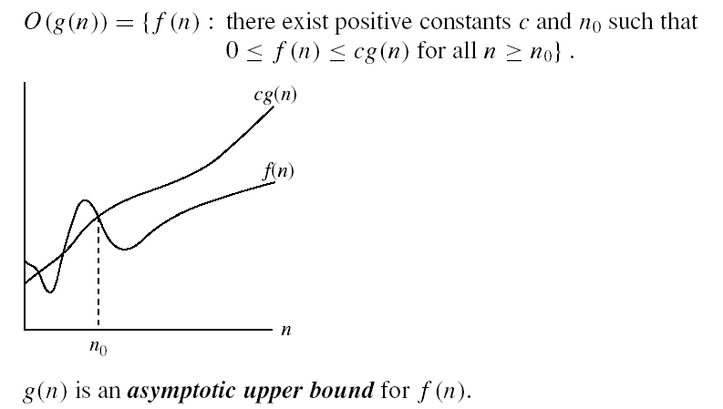
O-notation

Slide 82
Big-O example, graphically
Note 30n+8 isn’t less than n anywhere (n>0).
It isn’t even less than 31n everywhere.
But it is less than 31n everywhere to the right of n=8.
30n+8 is O(n)
cn = 31n
30n+8
Value of function →
n
n>n₀=8 →
Increasing n →

Slide 83
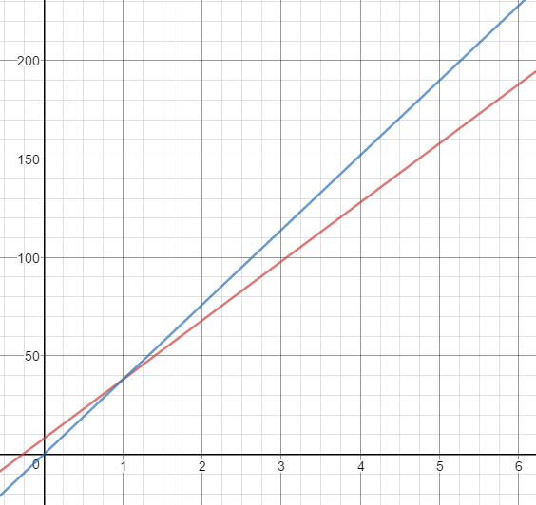
Not Unique - Example
Show that 30n+8 is O(n).
Show ∃c,n₀: 30n+8 ≤ cn, ∀n ≥ n₀ .
Let c=38, n₀=1. Assume n ≥ n₀=1.
Then cn = 38n = 30n + 8n ≥ 30n + 8, so
30n+8 ≤ 38n. when n ≥ 1
n ≥ 1
38n
30n+8

Slide 84
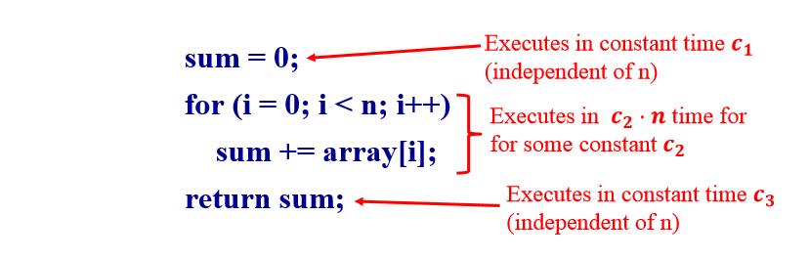
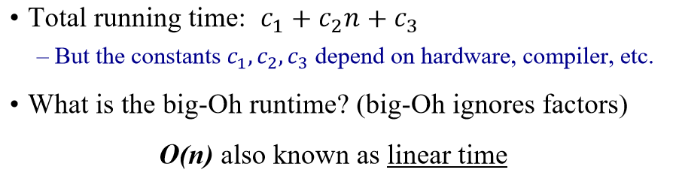
A Simple Code Example

Slide 85
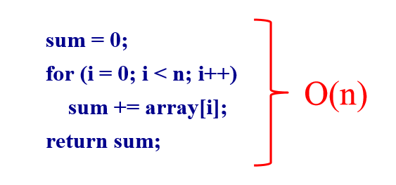
A Simple Example

Slide 86
Non-Linear Times
Consider the Insertion Sort Algorithm
Let n be the size of the input list to be sorted
Runtime is O(n²), also known as quadratic time.
Suppose size doubles, what happens to execution time?
It goes up by a factor of 4. Why?

Slide 87
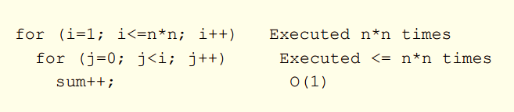
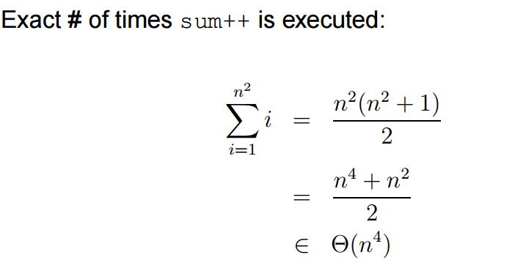
Iterative Algorithm Analysis

Slide 88
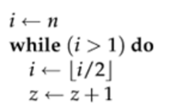
Iterative Algorithm Analysis
Θ(lgn)

Slide 89
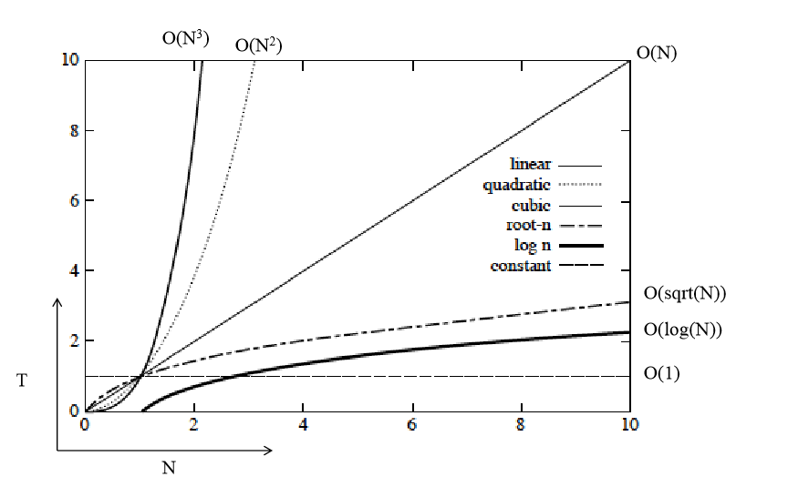
Orders of Growth

Slide 90
Big Oh Classes
Constant O(1)
Logarithmic O(log (n))
Linear O(n)
Quadratic O(n²)
Cubic O(n³)
Polynominal O(n^{k}) for any k>0
Exponential O(k^{n}), where k>1
Factorial O(n!)

Slide 91
Rank the following functions in increasing order of growth
10n, lg(2^{n}), 1000, sqrt(n), 3n², n!, logn, 3^{n}

Slide 92
A polynomial of degree k is O(n^{k})
Recall: f(n) is O(g(n)) if there exist positive constants c and n₀ such that f(n) ≤ c ⋅ g(n) for all n ≥ n₀
Proof:
Suppose f(n) = b_{k}n^{k} + b_{k-1}n^{k-1} + … + b₁n + b₀
Let a_{i} = | b_{i} |
f(n) ≤ a_{k}n^{k} + a_{k-1}n^{k-1} + … + a₁n + a₀
Therefore all polynomial functions f(n) of degree k are O(n^{k}).

Slide 93
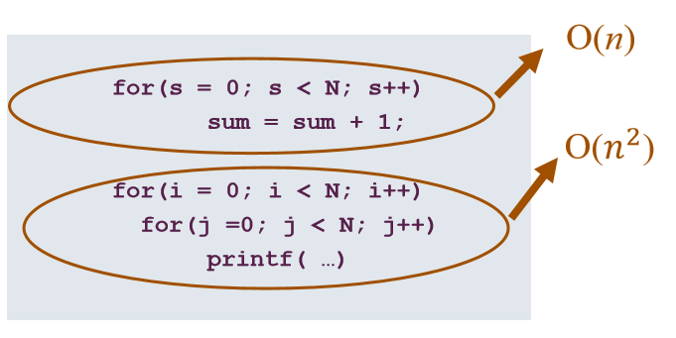
What does this mean in practice?
Total = O(n) + O(n²) = O(n + n²) = O(n²)

Slide 94
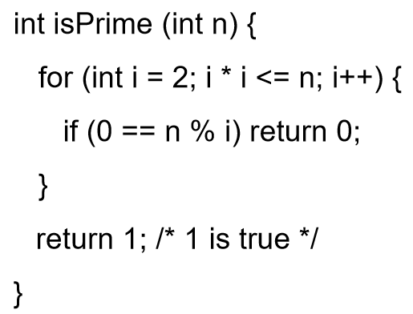
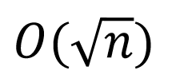
Code Example
What is the “Big-Oh” running time in terms of n?

Slide 95
Trouble with Big-Oh
Just an upper bound. Factually true but practically meaningless.
3n is O(n²)
3n is O(n⁴)
3n is O(n)
Many times only Big-Oh is reported but it is assumed a “tight” upper bound.

Slide 96
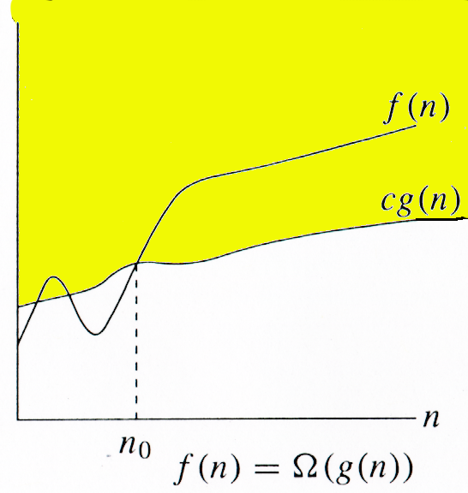
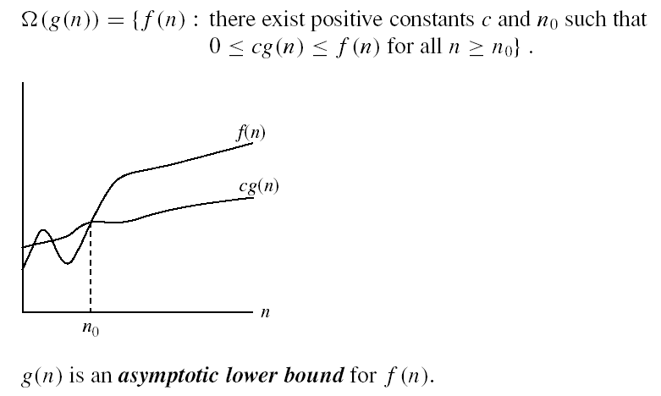
Omega Ω -notation
Ω(g(n)) is the set of functions with larger or same order of growth as g(n)

Slide 97
Omega Graphically
Note 30n+8 isn’t less than n anywhere (n>0).
30n+8 is Ω(n)
30n+8
Value of function →
n
n>0
Increasing n →

Slide 98
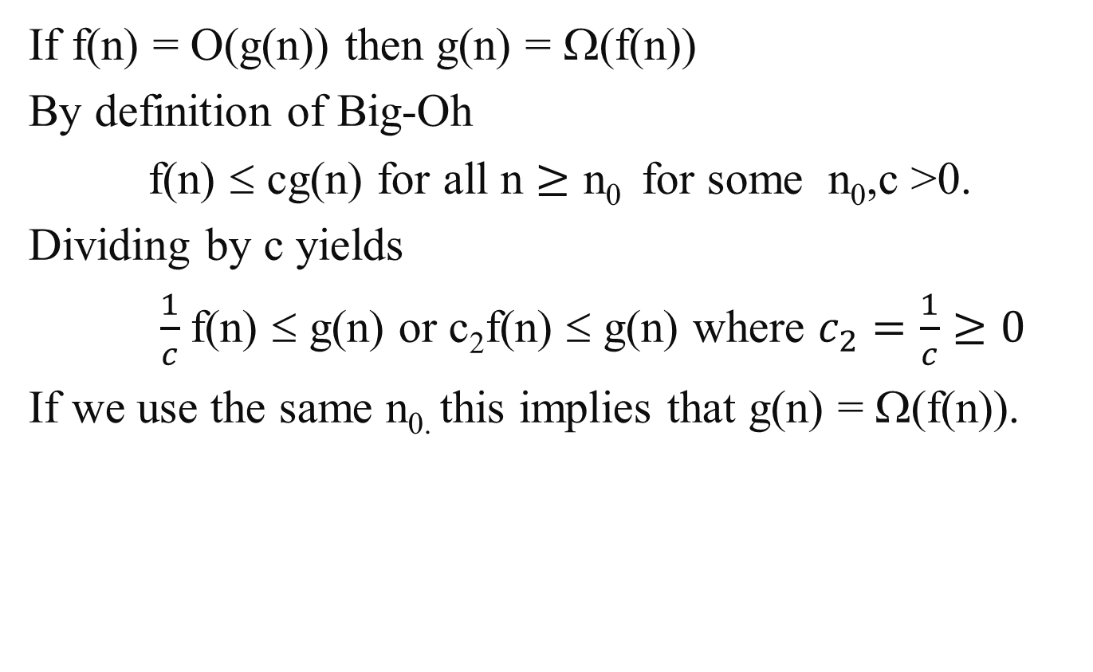
Property of Big-Oh and Omega
If f(n) = O(g(n)) then g(n) = Ω(f(n))
By definition of Big-Oh
f(n) ≤ cg(n) for all n $≥\text{n}\text{0 }$ for some n₀,c >0.
Dividing by c yields
$\frac{1}{c}$f(n) ≤ g(n) or c₂f(n) ≤ g(n) where $c_{2}=\frac{1}{c}≥0$
If we use the same n_{0.} this implies that g(n) = Ω(f(n)).

Slide 99
A non-negative polynomial of degree k is Ω(n^{k})
Proof:
Suppose f(n) = b_{k}n^{k} + b_{k-1}n^{k-1} + … + b₁n + b₀
For large n’s the fractions go to zero, so if we set n₀ large enough we can ignore all terms except b_{k} . Thus a value for n₀ must exist.
Therefore all polynomial functions f(n) of degree k are Ω(n^{k}).

Slide 100
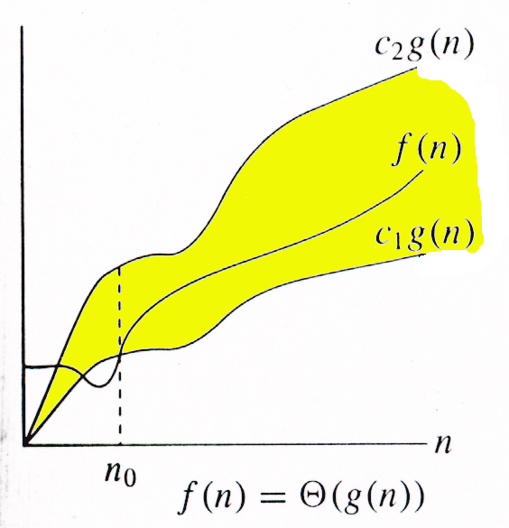

Θ-notation
Θ(g(n)) is the set of functions with the same order of growth as g(n)
g(n) is an asymptotically tight bound for f(n).

Slide 101
Big-Theta example, graphically
Note 30n+8 isn’t less than n anywhere (n>0).
It isn’t even less than 31n everywhere.
But it is less than 31n everywhere to the right of n=8.
30n+8 ∈ Θ(n)
cn = 31n
30n+8
Value of function →
n
n>n₀=8 →
Increasing n →

Slide 102
A non-negative polynomial of degree k is Θ(n^{k})
Proof: From previous Big-Oh and Omega
f(n) = b_{k}n^{k} + b_{k-1}n^{k-1} + … + b₁n + b₀ is Θ(n^{k} )
Short-cut:
Drop low-order terms; ignore leading constants.
Example: 3n³ + 90n² – 5n + 6046 = Θ(n³)

Slide 103



Relations Between Θ, O, Ω

Slide 104
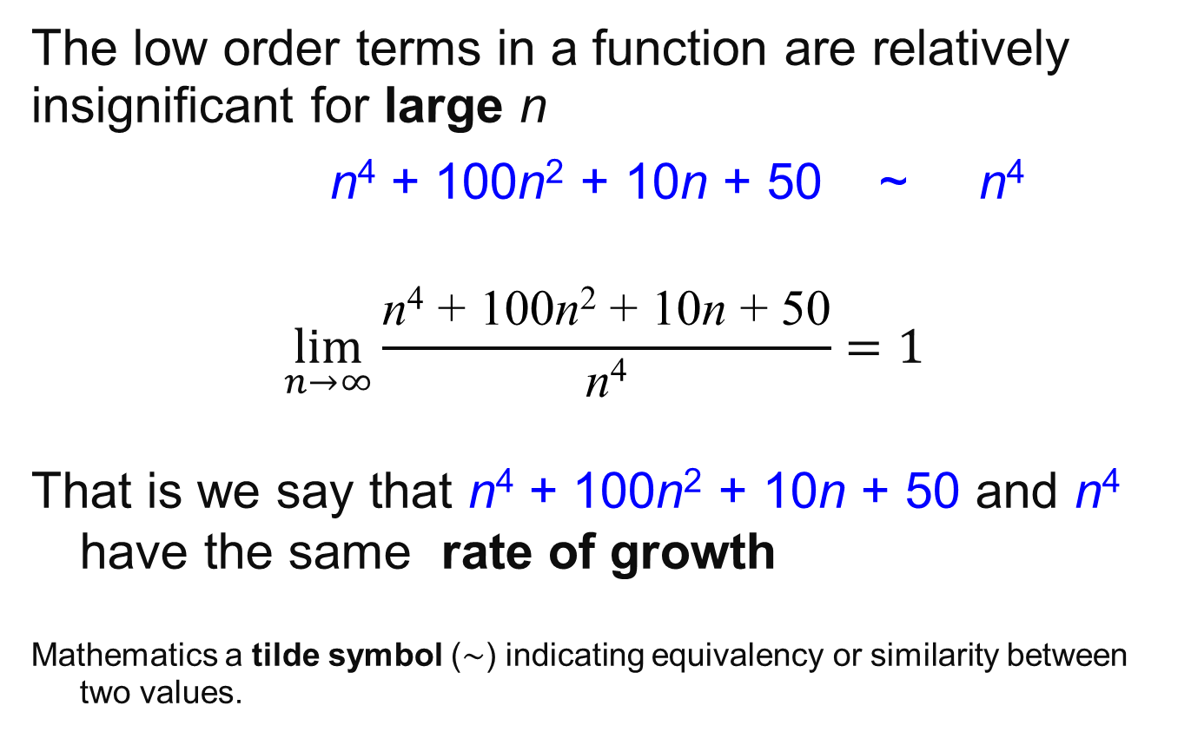
Rate of Growth
The low order terms in a function are relatively insignificant for large n
n⁴ + 100n² + 10n + 50 ~ n⁴
$$\lim_{n→∞}{\frac{\text{n}\text{4}\text{ + 100}\text{n}\text{2}\text{ + 10}\text{n}\text{ + 50}}{\text{n}\text{4}}=1}$$
That is we say that n⁴ + 100n² + 10n + 50 and n⁴ have the same rate of growth
Mathematics a tilde symbol (∼) indicating equivalency or similarity between two values.

Slide 105
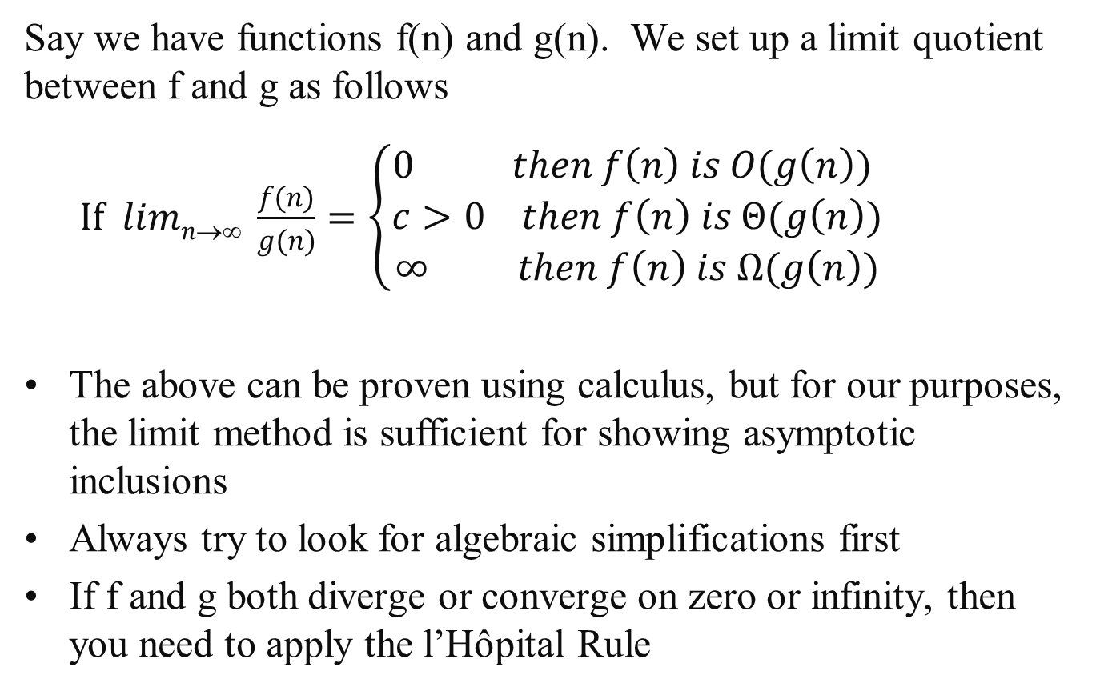
Limit Method: The Process
Say we have functions f(n) and g(n). We set up a limit quotient between f and g as follows
$If limn→∞ \frac{f(n)}{g(n)}=\left\{\begin{aligned}0 then f\left(n\right) is O(g\left(n\right)) \\ c>0 then f\left(n\right) is Θ(g\left(n\right)) \\ ∞ then f\left(n\right) is Ω(g\left(n\right))\end{aligned}\right.$
The above can be proven using calculus, but for our purposes, the limit method is sufficient for showing asymptotic inclusions
Always try to look for algebraic simplifications first
If f and g both diverge or converge on zero or infinity, then you need to apply the l’Hôpital Rule

Slide 106
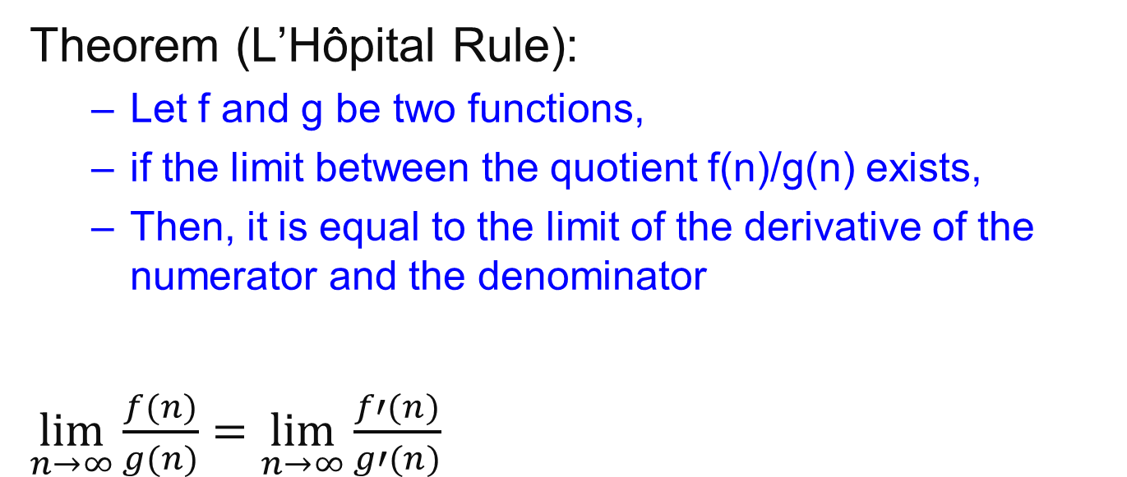
L’Hôpital Rule
Theorem (L’Hôpital Rule):
Let f and g be two functions,
if the limit between the quotient f(n)/g(n) exists,
Then, it is equal to the limit of the derivative of the numerator and the denominator
$\lim_{n→∞}{\frac{f(n)}{g(n)}=}$ $\lim_{n→∞}{\frac{f′(n)}{g′(n)}}$

Slide 107
Limit Method: Example 1
Example: Let f(n) =2^{n}, g(n)=3^{n}. Determine a tight inclusion of the form f(n) ∈ Δ (g(n))
What is your intuition in this case? Which function grows quicker?

Slide 108
Limit Method: Example1
Using algebra
lim_{n→∞} 2^{n}/3^{n} = lim_{n→∞} (2/3)^{n}
Now we use the following Theorem
 | 0 | if α < 1
lim_{n→∞} α^{n} = | 1 | if α = 1
 | ∞ | if α > 1
lim_{n→∞} 2^{n}/3^{n} = lim_{n→∞} (2/3)^{n}
= 0
Therefore we conclude that 2^{n} is O(3^{n})

Slide 109
Using Wolfram Alpha
https://www.wolframalpha.com/
lim(x->inf)(2^x/3^x)

Slide 110
Limit Method: Example 2
Example: Let f(n) =log₂n, g(n)=log₃n². Determine a tight inclusion of the form
f(n) ∈ Δ(g(n))
What is your intuition in this case?

Slide 111
Limit Method: Example 2
We set up our limit
lim_{n→∞} f(n)/g(n) = lim_{n→∞} log₂n/log₃n²
= lim_{n→∞} log₂n/(2log₃n)
Here we use the change of base formula for logarithms:
log₃n = log₂n / log₂3
lim_{n→∞} log₂n/(2log₃n) = lim_{n→∞} (log₂n log₂3) /(2log₂n)
= lim_{n→∞} (log₂3)/2
= (log₂3) /2
≈ 0.7924, a positive constant
So we conclude that f(n)∈Θ(g(n)) that is
log₂n ∈Θ(log₃n²) which implies that log₃n² ∈Θ(log₂n)

Slide 112
Important Result
All logs have the same asymptotic growth rate no what the base is.
In many CS algorithms the base is 2.
But we get sloppy since lg(n) is Θ(logn)

Slide 113
Properties
Theorem:
f(n) = Θ(g(n)) ⇔ f = O(g(n)) and f = Ω(g(n))
Transitivity:
f(n) = Θ(g(n)) and g(n) = Θ(h(n)) ⇒ f(n) = Θ(h(n))
Same for O and Ω
Reflexivity:
f(n) = Θ(f(n))
Same for O and Ω
Symmetry:
f(n) = Θ(g(n)) if and only if g(n) = Θ(f(n))
Transpose symmetry:
f(n) = O(g(n)) if and only if g(n) = Ω(f(n))

Slide 114
Let f, g and h be asymptotically positive functions. Prove or disprove each of the following conjectures.
Transitivity f(n) = Θ(g(n)) and g(n) = Θ(h(n)) ⇒ f(n) = Θ(h(n))
By definition f(n) = Θ(g(n)) implies there exist positive constants c₁, c₂, and n₀ such that 0 ≤ c₁ g(n) ≤ f (n) ≤ c₂ g(n) for all n ≥ n₀
2. By definition g(n) = Θ(h(n)) implies there exist positive constants c₃, c₄, and n₁ such that 0 ≤ c₃ h(n) ≤ g(n) ≤ c₄ h(n) for all n ≥ n₁
3. Show f(n) = Θ(h(n)) that is there exist positive constants c₅, c₆, and n₂ such that 0 ≤ c₅ h(n) ≤ f (n) ≤ c₆ h(n) for all n ≥ n₂
By combining 1 and 2: c₁c₃ h(n) ≤ c₁ g(n) ≤ f (n) let c₅ = c₁c₃ so c₅ h(n) ≤ f (n)
Again from 1 and 2: f (n) ≤ c₂ g(n) ≤ c₂ c₄ h(n) let c₆ = c₂c₄ so c₆ h(n) ≤ f (n)
And let n₂ = max {n₀ , n₁}

Slide 115
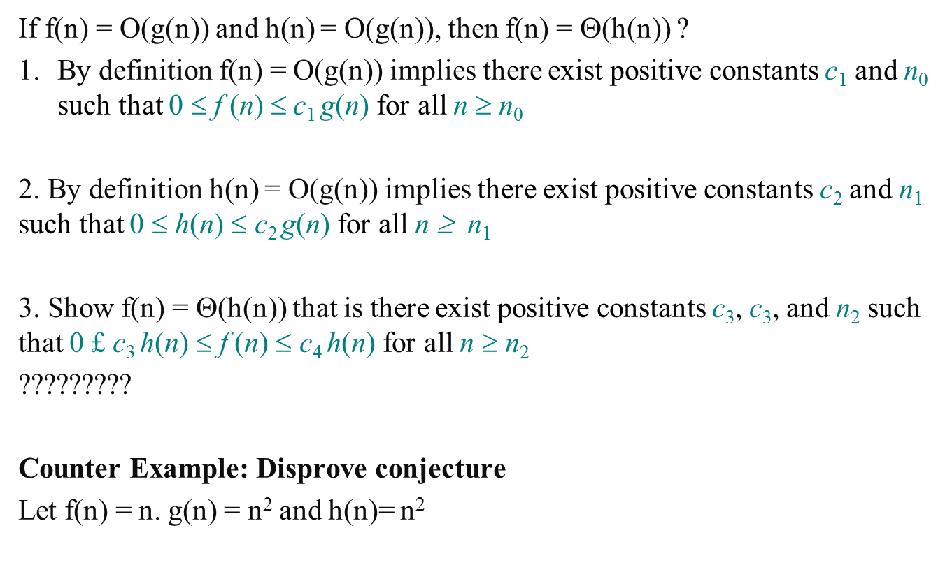
Let f, g and h be asymptotically positive functions. Prove or disprove each of the following conjectures.
If f(n) = O(g(n)) and h(n) = O(g(n)), then f(n) = Θ(h(n)) ?
By definition f(n) = O(g(n)) implies there exist positive constants c₁ and n₀ such that 0 $$ f (n) $$c₁ g(n) for all n ≥ n₀
2. By definition h(n) = O(g(n)) implies there exist positive constants c₂ and n₁ such that 0 $$ h(n) $$ c₂ g(n) for all n ≥ n₁
3. Show f(n) = Θ(h(n)) that is there exist positive constants c₃, c₃, and n₂ such that 0 £ c₃ h(n) $$ f (n) $$ c₄ h(n) for all n ≥ n₂
?????????
Counter Example: Disprove conjecture
Let f(n) = n. g(n) = n² and h(n)= n²

Slide 116
Let f and g be asymptotically positive functions. Prove or disprove each of the following conjectures.
If f₁(n) = O( g₁(n)) and f₂(n) = O( g₂(n)) then
f₁(n)+f₂(n) = O( max{g₁(n), g₂(n)} ) .

