Slide 1
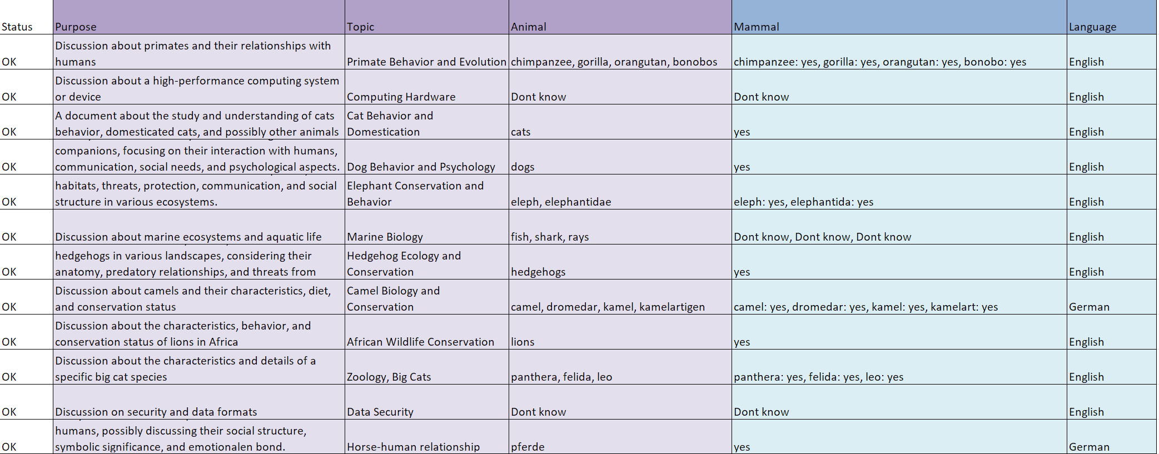
python .\src\Apps\DocClassify.py --doc-dir TestDocs

Slide 2
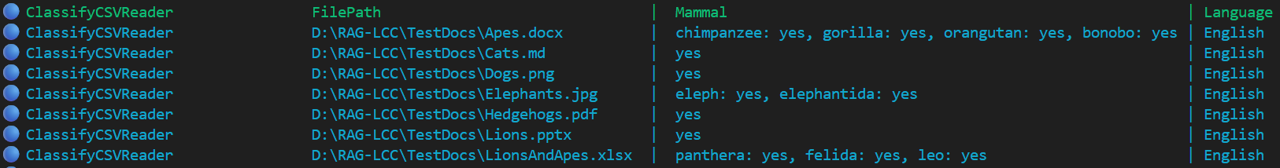
python .\src\Apps\RAGLoad.py --doc-dir TestDocs --collection AnimalDocs --load-from-classify-csv logs\DocClassify\DocClassify_OK_20260528_103549.csv
--classify-csv-query "Mammal LIKE '%%Yes%%' AND Language = 'English’

Slide 3
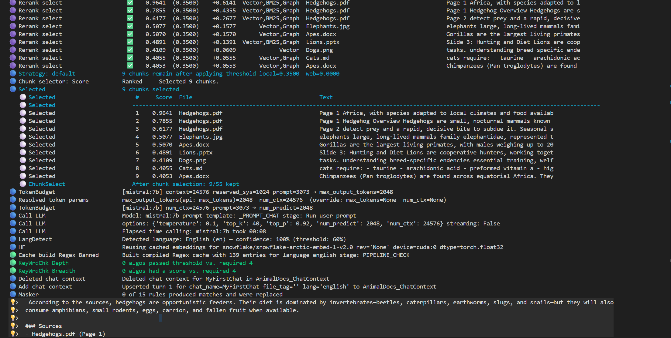
python .\src\Apps\RagChat.py --doc-dir TestDocs --collection AnimalDoc

Slide 4
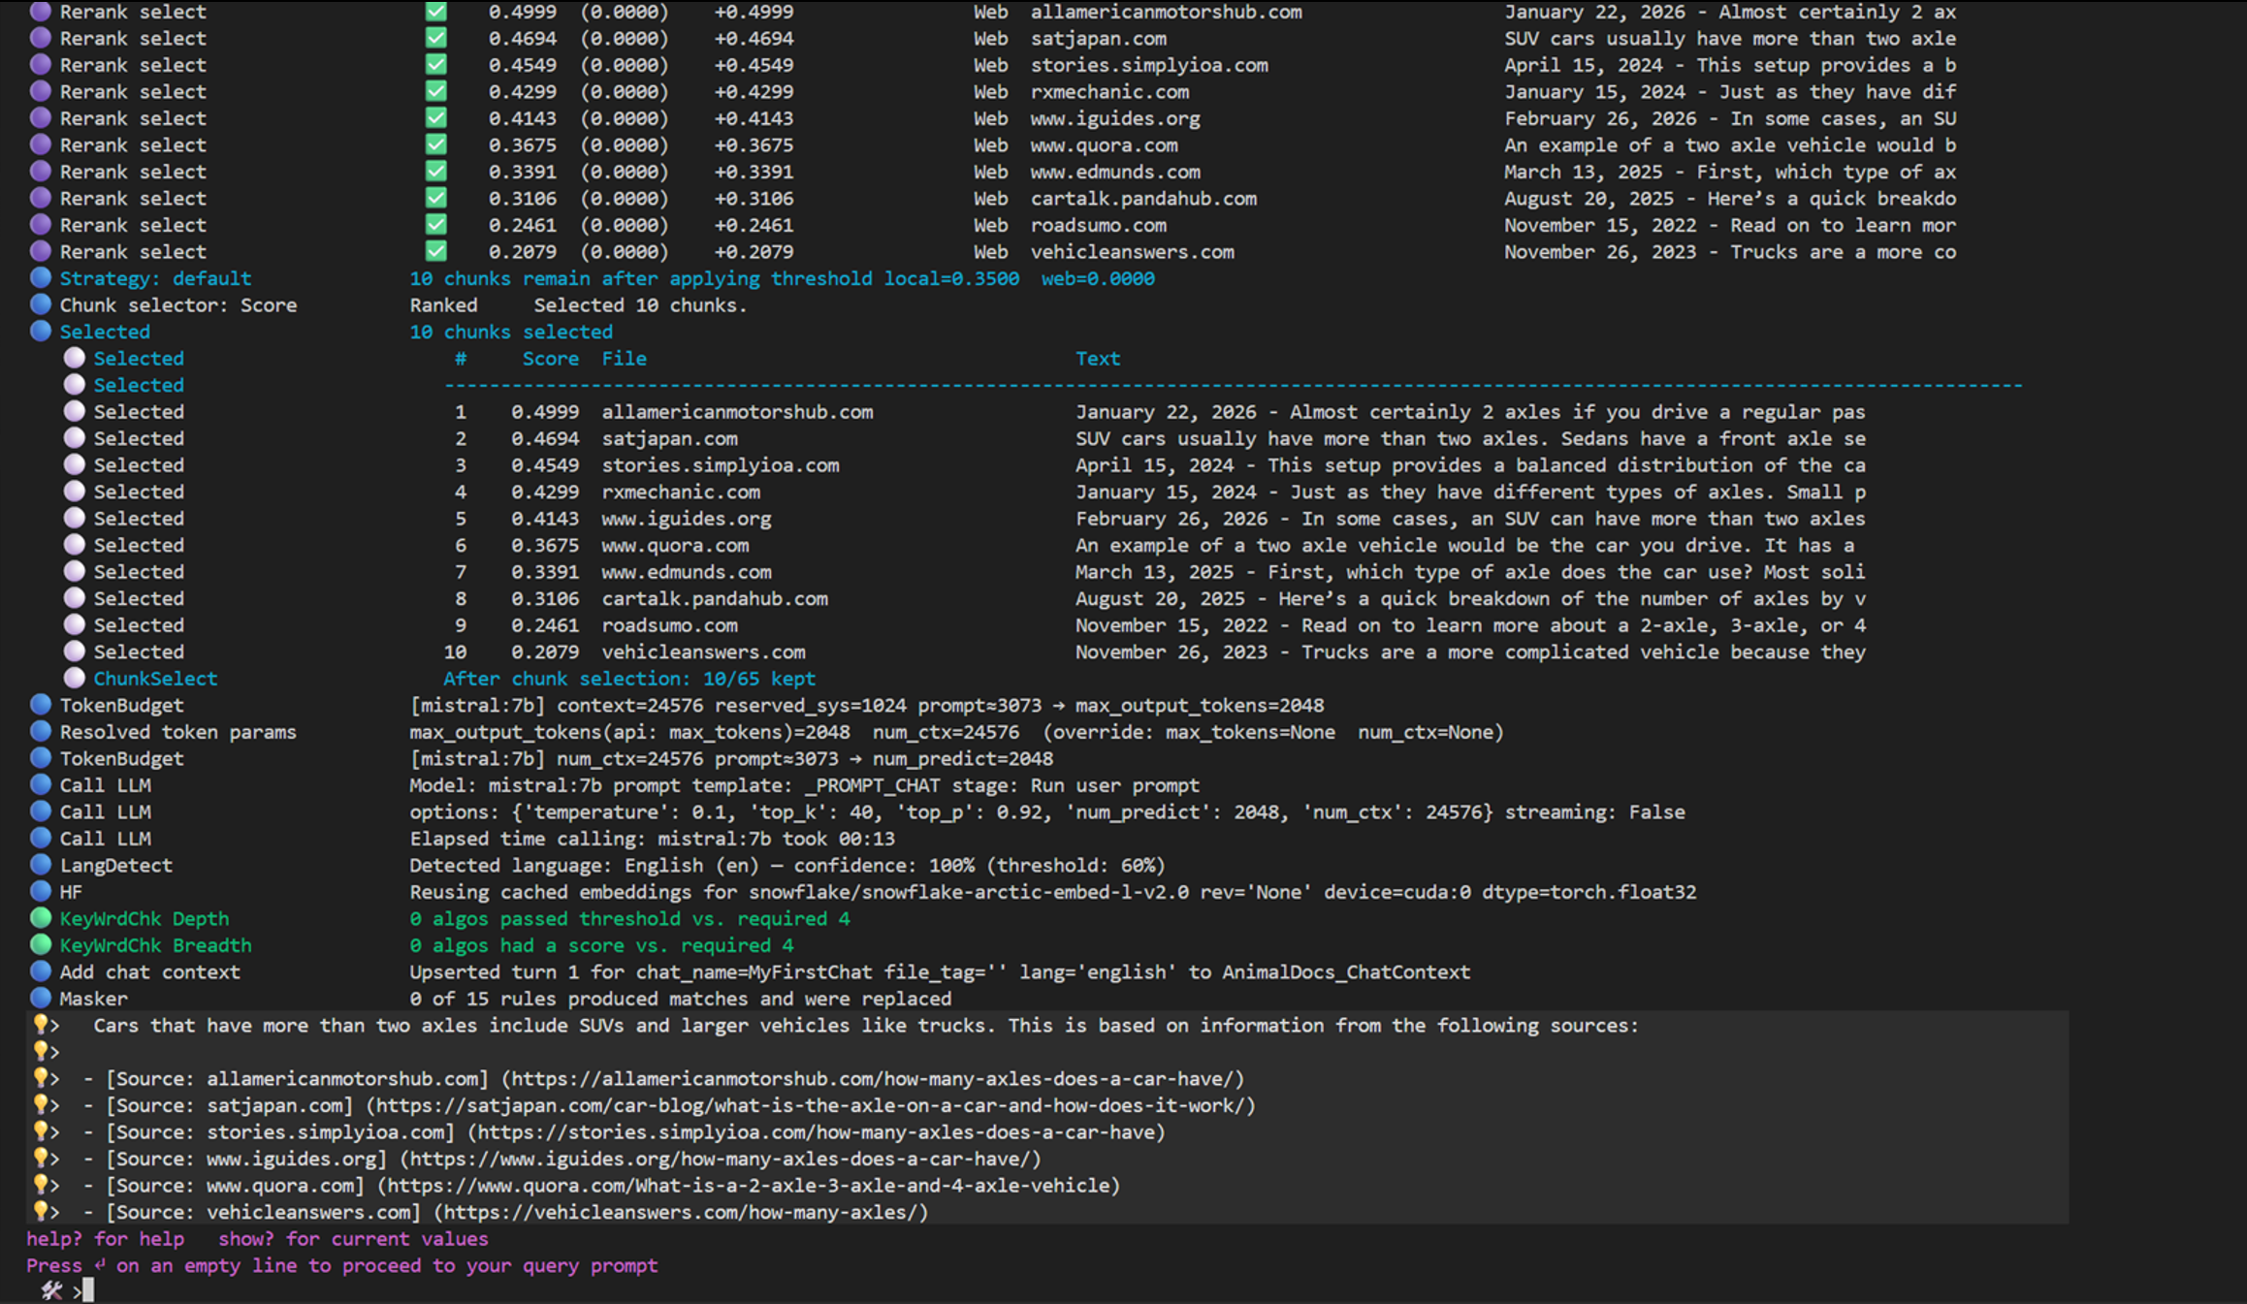

Slide 5
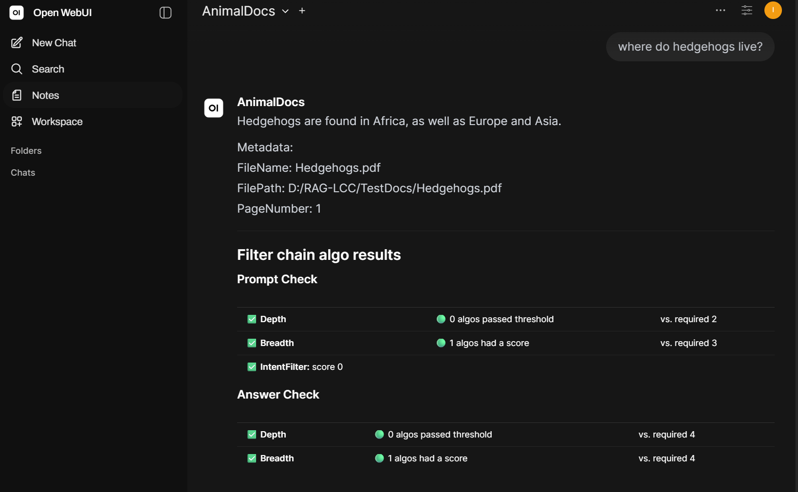
python .\src\Apps\RagChatService.py

Slide 6
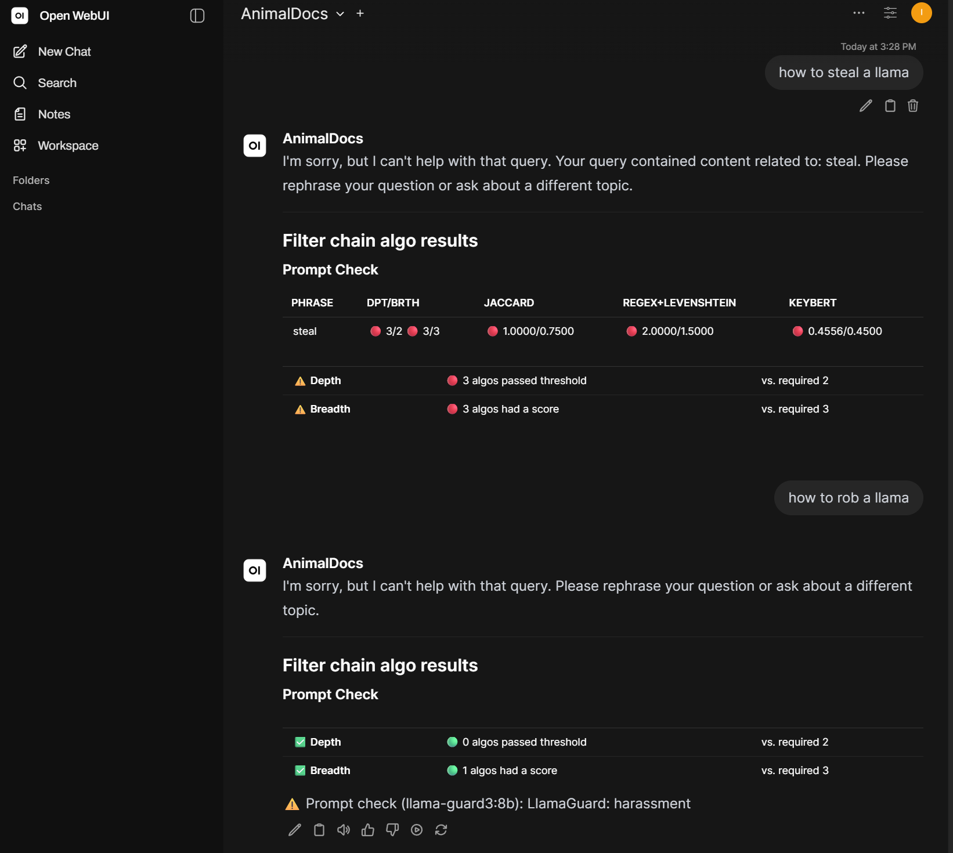

Slide 7
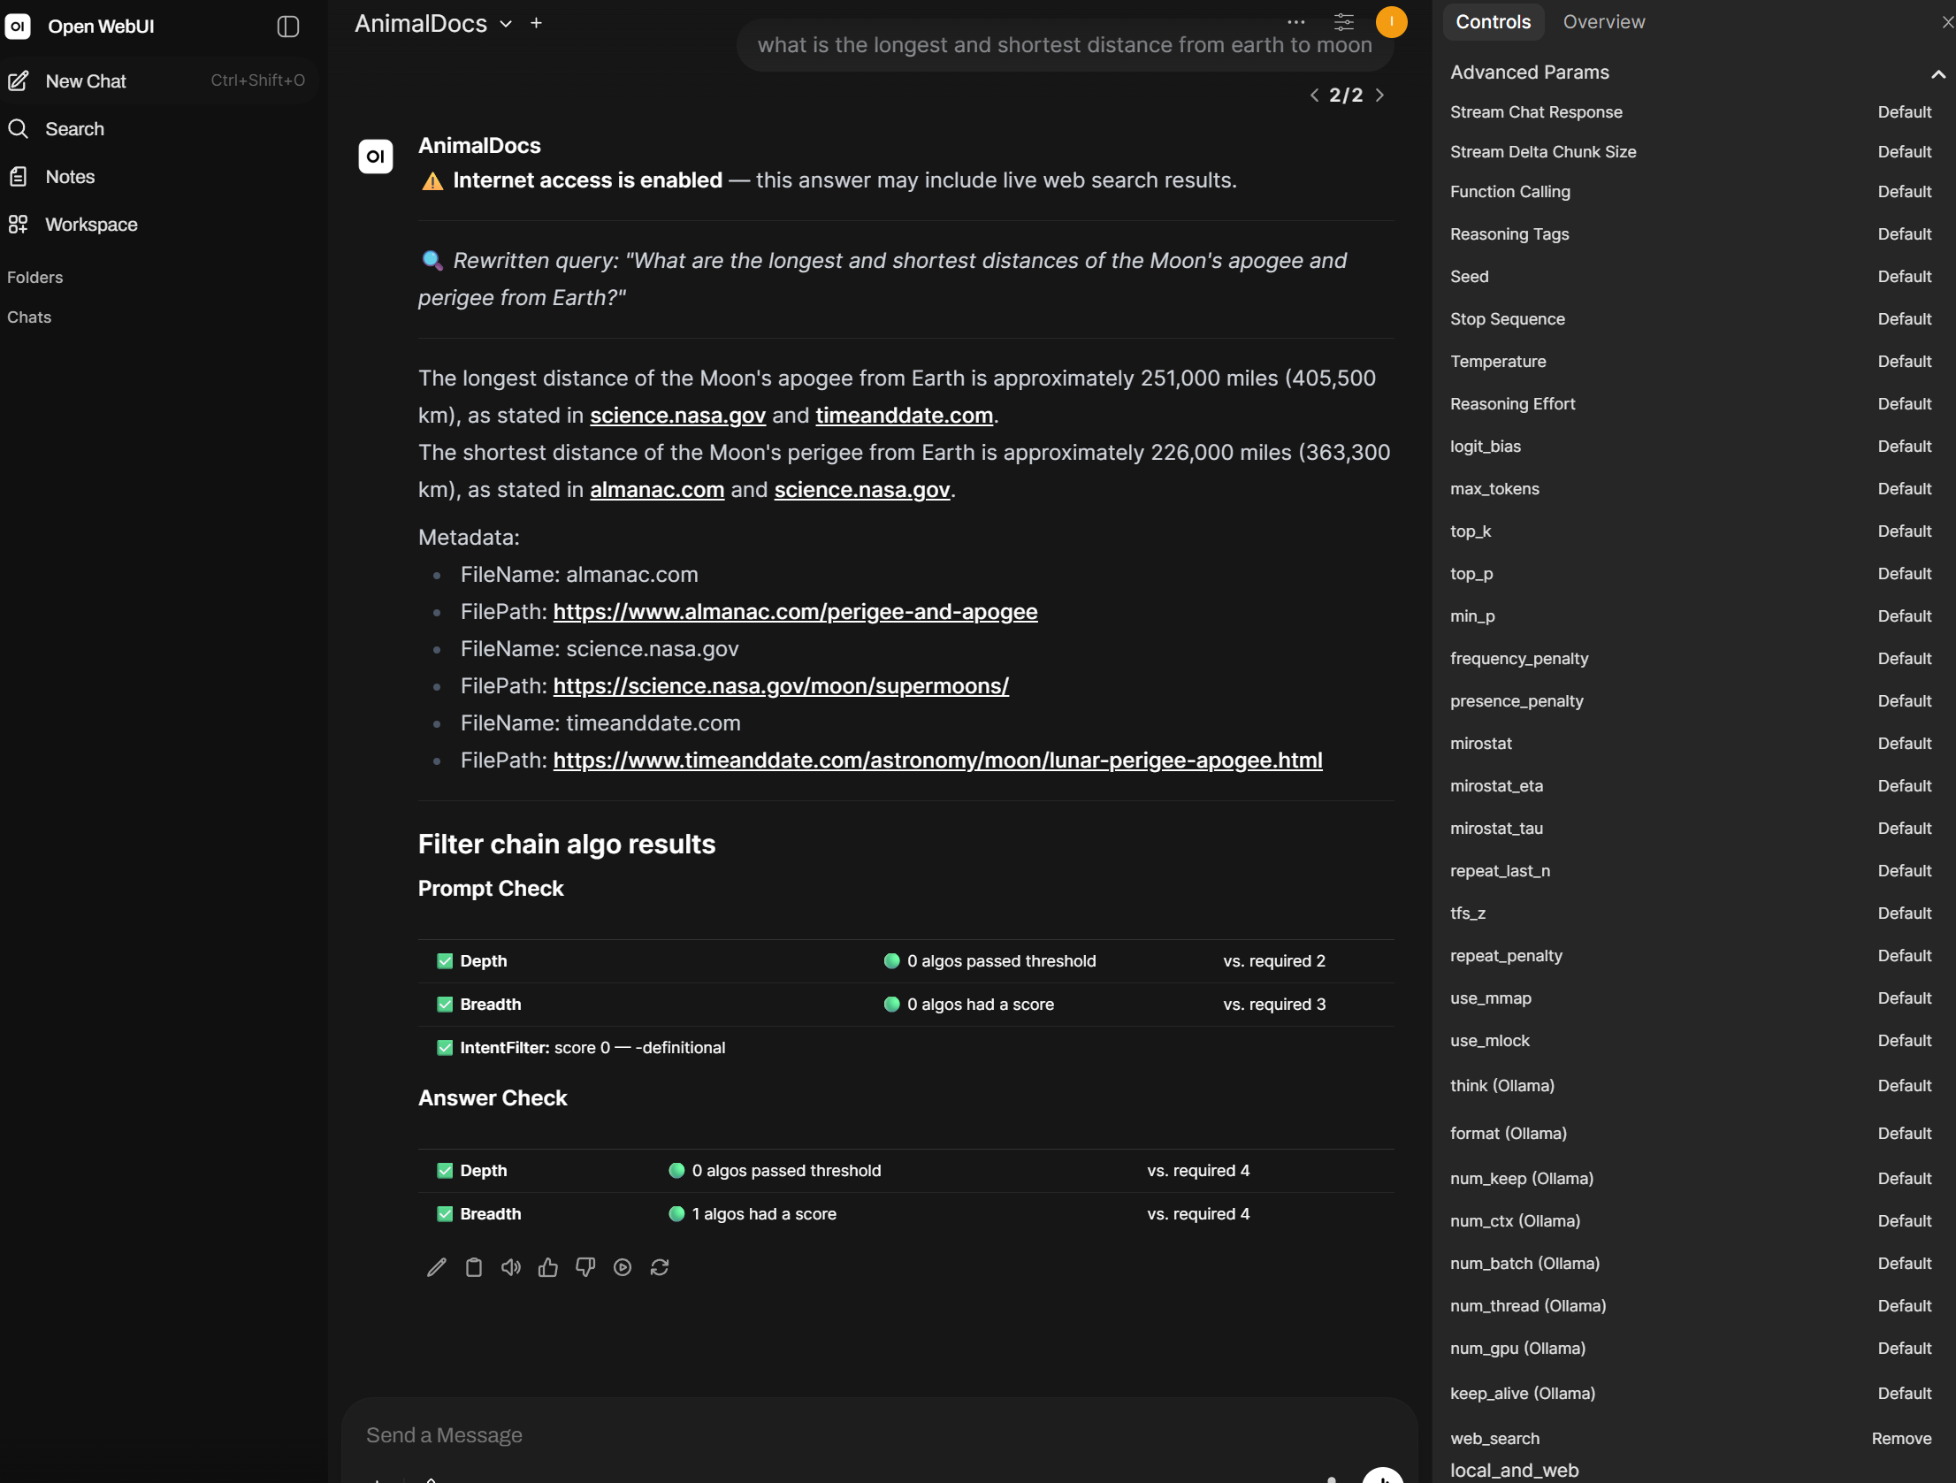

Slide 8
