Slide 1
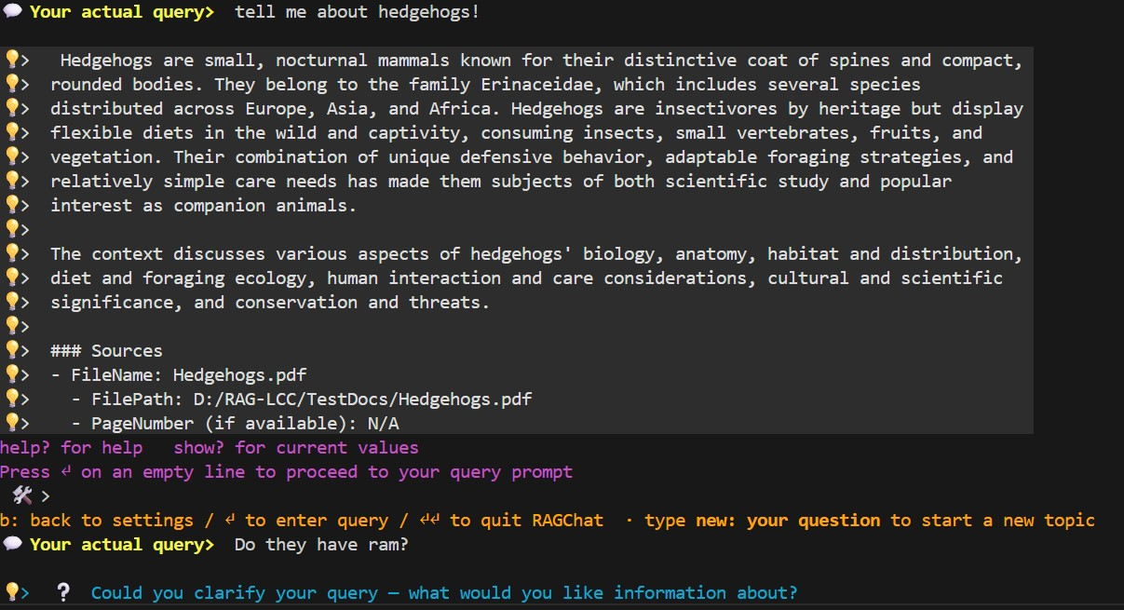
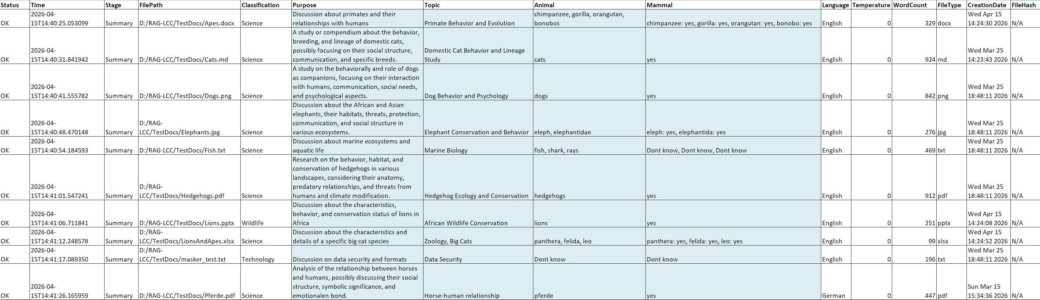
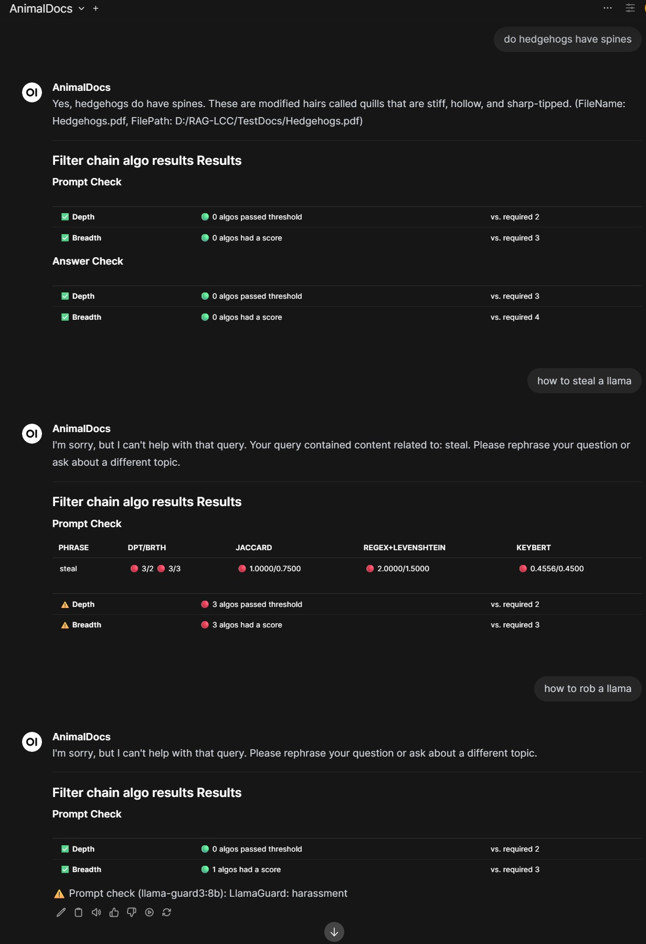
RAG-LCC
RAGChat
Optional SQLite filter query on classification
Experimental RAG Under Constraints
Classification · Hybrid Retrieval · Context-Safe Chunking · Constrained Hardware
DocClassify
RAGLoad
RAGChat terminal
RAGChatService
Acts as backend for Open WebUI
DocClassify CSV output
Experimental – Research use only · Not for production · See LEGAL.md
Research · Lab · Open Source (MIT) · Models carry their own licenses — see LEGAL.md
Open WebUI via RAGChatService

Slide 2
The RAG-LCC Core Idea
Not more context — more structured, more inspectable context
Standard RAG
RAG-LCC
Optimise for SCALE Embed → top-k → LLM
VS
Designed to prioritise correctness over scale Classify → Filter → Retrieve → Reason
Classify First
Filter Chains
Hybrid Retrieval
Transparent Pipeline
Documents are analysed and compressed before any retrieval step
Multi-algorithm detection helps filter problematic content before indexing
Vector + BM25 + Graph fused via RRF helps mitigate document-dominance bias
Intermediate decisions are designed to be inspectable — built for reasoning about RAG, not just outputs

Slide 3
Four Applications — One Pipeline
Modular, configuration-driven, offline-first
DocClassify
RAGLoad
RAGChat
RAGChatService
Batch Document Classification
Document Ingestion Pipeline
Interactive Retrieval + Chat
OpenAI-style REST API
▸ Keyword extraction (KeyBERT + NLTK stems)
▸ 6 chunking strategies with per-file routing
▸ 7 retrieval modes (Vector, BM25, Graph, fused)
▸ Same pipeline as RAGChat
▸ Optional LLM-assisted label generation
▸ Banned-phrase filter chains (6 algorithms)
▸ Cross-encoder reranking · RetrievalGate
▸ Ready-to-use integration path for Open WebUI
▸ Outputs structured CSV for downstream use
▸ Builds ChromaDB · BM25 · entity-graph index
▸ Query rewrite for multi-turn coreference
▸ Thread-pool worker model
▸ Three extraction variants: STRICT · BALANCED · RECALL
▸ Classify-then-Load with SQL WHERE filtering
▸ Terminal GUI with live parameter tuning
▸ Configurable API key & HTTP listener

Slide 4
End-to-End Pipeline
Raw documents → classified → loaded → retrieved → answered
Stage 1
DocClassify
Stage 2
RAGLoad
Stage 3
RAGChat / Service
◉ Keyword extraction
◉ Classify-then-Load filter
◉ Query rewrite + RetrievalGate
◉ LLM label generation
◉ Chunking strategies
◉ Hybrid retrieval (7 modes)
◉ Semantic compression
▶
◉ ChromaDB · BM25 · Graph
▶
◉ RRF fusion + cross-encoder
◉ CSV output
◉ Banned-phrase chains
◉ LLM reasoning
Optional: SQL WHERE filter
Each stage is independently testable · Fully configuration-driven · Steps are designed to be inspectable

Slide 5
DocClassify — Semantic Compression
Classify documents before they enter the retrieval stack
How it works
Extraction Variants
1.
Extract keywords with KeyBERT (two-pass, n-gram aware)
STRICT
temp=0.0 · top_k=1 · near-greedy · minimum noise
2.
Apply NLTK Snowball stemmer for normalisation
BALANCED
temp=0.0 · top_k=10 · small candidate pool
RECALL
temp=0.1 · top_k=40 · wider sampling · max coverage
3.
ReverseStemmer restores original words in output
4.
Optional LLM assigns semantic labels per document
Key Capabilities
▸ KeyBERT selector: STRICT · BALANCED · RECALL (independent of LLM variant)
5.
Write structured CSV with per-document metadata
▸ Two-pass extraction: broad first pass, refined second pass
6.
RAGLoad reads CSV + optional SQL WHERE clause
▸ CSV output filterable via SQLite WHERE clause in RAGLoad
▸ Can reduce token usage before any retrieval or chat step

Slide 6
Classify-then-Load Workflow
Filter what enters the vector store using classification results + SQL
DocClassify
CSV Output
SQL Filter
RAGLoad
Classify all docs in directory
▶
Per-document label & keyword metadata
▶
WHERE Animal LIKE '%cat%'
▶
Ingest only the matching documents
CLASSIFY_CSV_QUERY = "Animal LIKE '%cat%'"
→ Only documents where the 'Animal' classification column matches 'cat' are loaded into ChromaDB
Token Efficiency
Operator Control
Conflict Avoidance
Fewer irrelevant docs enter the vector store — can help reduce noisy context from the start
SQL semantics: arbitrary WHERE conditions on any classification column
Helps keep semantically unrelated documents out of the same retrieval scope

Slide 7
RAGLoad — Document Ingestion
Chunk · filter · index into ChromaDB + BM25 + entity graph
ChromaDB
BM25 Index
Entity Graph
Dense vector store (HNSW, Snowflake Arctic embeds)
Keyword-based lexical retrieval index
spaCy NER + noun-phrase co-occurrence graph
Multi-Algorithm Filter Chain (runs before any chunk enters the index)
Regex + Levenshtein
Jaccard Similarity
BM25 Scorer
KeyBERT Keywords
Cosine / SBERT
Consensus Rules
6 Chunking Strategies · per-file-type routing · DETAILED and FAST profiles
◦ Chunks passing filter thresholds are selected for upsert into ChromaDB
◦ Banned-phrase detection uses depth (# algos above threshold) AND breadth (# algos with any score) consensus
◦ Unicode normalisation + leet-speak mapping applied before detection
◦ Masking regex runs at extraction time; masked form is stored in ChromaDB
◦ HNSW parameters (NEIGHBORS_RETRIEVE) are immutable after collection creation

Slide 8
Six Chunking Strategies
Chunking is a semantic boundary problem — not a token counting problem
Semantic
Fixed-Size
Heading
Splits on topic boundaries using embedding cosine distance
Equal-length token or character chunks
Splits on document headings; section path stored in HeadingPath metadata. Breadcrumb mode: prefix · suffix (default) · off
Use for: mixed-content long documents
Use for: uniform, dense text with low structure
Use for: structured reports, technical docs, wikis
Slide
Sliding Window
Sentence Window
Presentation slide boundaries detected and respected
Overlapping fixed-size windows preserve cross-boundary context
Sentence-level chunks with surrounding sentence context
Use for: PowerPoint / presentation files
Use for: dense reference material needing overlap
Use for: precision Q&A over factual prose
Per-file-type routing: .pdf · .docx · .xlsx · .pptx · .md · .txt each routed independently via DETAILED / FAST profile

Slide 9
Hybrid Retrieval — 7 Modes
Combine vector, lexical, and graph signals with Reciprocal Rank Fusion · optional live web leg (DuckDuckGo, web_search=on) fuses as a 4th RRF leg
Mode
Description
Why it matters
VECTOR
ChromaDB dense embeddings only
Vector
Generalises meaning beyond exact wording
BM25
Keyword lexical index only
GRAPH
Entity co-occurrence graph only
BM25
Preserves discourse anchors & exact terms
VECTOR_BM25
ChromaDB + BM25 → RRF fusion
VECTOR_GRAPH
ChromaDB + Graph → RRF fusion
Graph
Pulls co-occurrence clusters — avoids document dominance
BM25_GRAPH
BM25 + Graph → RRF fusion
ALL
ChromaDB + BM25 + Graph → weighted RRF fusion
RRF
Merges ranked lists without score normalisation
Modes
Switchable per strategy or overridden at query time
Graph retrieval uses spaCy en_core_web_sm (MIT) for NER + noun-phrase extraction — can perform well on general/encyclopedic text without domain-specific NER, depending on corpus characteristics

Slide 10
Context Management
RetrievalGate · Query Rewrite · Chunk Selection Strategies
RetrievalGate
Query Rewrite (Coreference Resolution)
▸ Detects underspecified queries before LLM call
▸ Rewrites pronouns across multi-turn chat turns
▸ "what are the specifications?" → returns ❔ clarification
▸ Turn 1: "What do hedgehogs eat?"
▸ Uses spaCy Person=3 morphology — no hand-maintained word lists
▸ Turn 2: "Do they hibernate?" → rewritten to "Do hedgehogs hibernate?"
▸ Blocks: vague pronoun · missing entity anchor · bare attribute question
▸ File-context-aware: rewrite LLM sees active document scope
▸ Aims to reduce hallucination risk by detecting underspecified queries
▸ Dedicated rewrite LLM (configurable, Mistral default)
Chunk Selection Strategies (post-rerank filtering)
NARROW
BALANCED_FILE_CAP
WIDE
ULTRA_WIDE
DEFAULT
Tight score threshold, few chunks, lower expected hallucination risk
Per-file chunk cap prevents large docs from dominating context
Higher recall, more context, broader answers
Maximum context window usage — for long-form synthesis
Balanced threshold + per-file cap (recommended starting point)

Slide 11
Multi-Algorithm Filter Chain
Six detectors · consensus scoring · human-review logs
Regex
Jaccard
BM25
Word-boundary match Fuzzy fallback via Levenshtein Fast, memory-efficient
Token-based similarity Containment scoring Char n-gram similarity
Probabilistic relevance Percentile normalisation Language-aware cache
KeyBERT
Levenshtein
Cosine
SBERT embedding keywords Two-pass n-gram extraction Frozen phrase matrix
Edit distance Typo & obfuscation detection Character-level variation
Semantic similarity SBERT embeddings (supplementary, optional)
Consensus Scoring
DEPTH → ≥ N algorithms each exceed their individual threshold (strong agreement)
BREADTH → ≥ M algorithms each produce any non-zero score (weak but broad signal)
Flag if (depth ≥ REQUIRED_ALGOS_ABOVE_THRESHOLD) OR (breadth ≥ REQUIRED_DIFFERENT_ALGOS_HAVE_A_SCORE)
Human-review CSV/XLSX written for every flagged chunk · LLM guard as final supplementary check

Slide 12
RAGChatService — OpenAI-style /chat/completions API
Expose the full RAG pipeline as a network endpoint · Open WebUI integration path included
OpenWebUI / Other Clients
RAGChatService HTTP Listener
RAG Pipeline
Ollama LLM
→
→
→
Clients supporting /chat/completions schema
Accepts POST /chat/completions Thread-pool workers
Same as RAGChat: Retrieve → Rerank → LLM
Local model endpoint Mistral / LLaMA
Key Features
API Endpoint
Implements /chat/completions schema — designed for clients that support this endpoint
Thread Pool
Configurable worker pool handles concurrent requests without per-request startup
Safety Checks
Prompt + response validation runs inside every worker thread — same as RAGChat
Algo Results Toggle
Per-request option to include retrieval scores in the response payload
API Key
Simple shared secret authentication via Config_RAGChatService.py

Slide 13
Configuration System
Selector → Profile → Parameters · everything is a Python config file
Pattern: _ACTIVE_X = "SLOT" → _DICT["SLOT"] → individual parameters
One value change switches an entire pre-validated parameter set
Configuration File
Controls
Config_Global.py
Paths · device · HNSW profile · chunker profile
Config_Models.py
LLM · embedding · cross-encoder · Ollama model selector
Config_RAGLoad.py
Chunking params · batch sizes · ingestion settings
Config_RAGChat.py
Retrieval thresholds · re-ranking · chunk-select strategy
Config_RAGChatService.py
HTTP listener · API key · thread pool · algo results flag
Config_DocClassify.py
Extraction variant · KeyBERT variant · classification keys
Config_Banned.py
Keyword lists · detection thresholds · consensus rules
Config_Internet_Env.py
Optional network tracing · outbound connection observability
Resolution order: Defaults → Config_*.py → Environment Variables → CLI Flags
(Config_Models.py and Config_Banned.py are not exposed as CLI flags)

Slide 14
Multilingual Support
Two-pass query translation · language-aware retrieval · coherent multi-turn chat
User Query (any language)
Language Detect (langdetect)
Pass 1: Translate Query → Corpus
Pass 2: Post-Rewrite
Re-translate Query
e.g. 'Wo leben Igel?' (German)
→
Identifies source language with confidence threshold
→
Query translated to corpus language for retrieval
→
Rewritten query re-checked
for foreign entities injected
from chat history
Key Design Points
Corpus Language
Retrieval always happens in the corpus language — reduces cross-language embedding mismatch
Backend
facebook/m2m100_418M (MIT, ~1.7 GB, default) · Argos Translate (local, MIT) · configurable via _ACTIVE_TRANSLATION in Config_Models.py
Multi-turn
Language context preserved across turns; topic-switch ('new:') resets translation scope
Content Check
Banned-phrase detection runs in corpus language regardless of query language
Config
_ACTIVE_TRANSLATION selector in Config_Models.py chooses the active translation backend

Slide 15
Hardware & Design Principles
Offline-first · modest GPU · transparent · research-grade
Design Principles
Hardware Targets
Configuration-Driven
All behaviour parameterised via Python configs + CLI
▸ Tested on at least one NVIDIA RTX-class GPU (see docs for tested configurations)
▸ CPU-only fallback for all components
Offline-First
May run locally; can be configured for offline-first operation.
▸ INT8 quantisation support for embedding models
User Responsibility
Framework enables experiments; operators verify results
▸ Configurable token-budget caps can help reduce OOM risk in typical use
Explicit Over Hidden
Designed to make state explicit and intermediate results inspectable.
Model Stack
Singleton Patterns
Stateful components maintain consistency across calls
Embedding
Snowflake Arctic-embed-l-v2.0 (HuggingFace)
Cross-Encoder
ms-marco-MiniLM (mmarco, HuggingFace)
Modular Detection
Multiple algorithms with configurable consensus scoring
LLM
Mistral 7B (Apache 2.0) · LLaMA 3 (Meta Llama 3 Community License)
Safety Check
LLaMA Guard 3:8b (Meta Llama 3 Community License) · Mistral 7B (Apache 2.0)
Human Review
Flagged content written to CSV/XLSX for operator sign-off
Rewrite LLM
Mistral 7B (separate Ollama call)
Translation
Argos (local) · Helsinki · MADLAD-400

Slide 16
Get Started
Clone · install · review configs · run the test suite · explore
git clone <this-repo> && cd RAG-LCC
Documentation
python -m venv .venv
INSTALL.md
Prerequisites · dependencies · first run
.venv\Scripts\Activate.ps1 # Windows
CONFIGURATION.md
Every Config_*.py reference
pip install -r requirements.txt
ARCHITECTURE.md
Pipeline internals · diagrams
# Review and copy example configs (see INSTALL.md)
EXAMPLES.md
Terminal sessions · screenshots
# Review and accept each model licence before first use
# LLaMA 3 / LLaMA Guard: Meta Llama 3 Community License (see LEGAL.md)
HANDS_ON_TOUR.md
Curated experiments
LEGAL.md
Compliance definitions · governance
python ./src/Apps/RAGLoad.py --doc-dir TestDocs
python ./src/Apps/RAGChat.py --doc-dir TestDocs
SECURITY.md
Security policy · limitations
# Optional: classify first, then load
Articles & Write-ups
python ./src/Apps/DocClassify.py --doc-dir TestDocs
▸ dev.to · Experimenting with RAG-LCC on Constrained Hardware
python ./src/Apps/RAGLoad.py --doc-dir TestDocs \
▸ reddit/r/Rag · When the Pronoun 'They' Breaks Your RAG
--classify-csv <csv_path>
▸ reddit/r/Rag · When Your RAG System Confidently Asks About Hedgehog RAM
▸ dev.to · Speaking the Corpus's Language: Multilingual RAG Across Turns
▸ reddit/r/Rag · Filtering the Noise: A Practical Multi-Layer Banlist Pipeline for RAG Systems

Slide 17
RAG-LCC
Retrieval-Augmented Generation — research tool for exploring constraints and correctness
Experimental · Provided as-is, no warranty · Not for production use · All model licenses apply separately — see LEGAL.md
Classify first
Hybrid retrieval
Context-safe chunking
Multi-layer filtering
Transparent & local
Compress meaning before retrieval, not after
7 modes · RRF fusion · cross-encoder reranking
6 strategies, per-file routing, coherence-first
6 algorithms · consensus scoring · human review
Offline-first · inspectable · research-grade
Research · Lab · Open Source · github.com

