Slide 1

Project Title: Nutrition Insight Dashboard
Subtitle: Data Visualization & Analysis Project
By: Harini D.
Tools Used: Excel · Power Query · Pivot Tables

Slide 2
Project Overview
Objective:
Analyze food nutrition data and uncover meaningful insights that support healthier food choices.
Dataset Source: Kaggle – Food Nutrition Dataset
Key Focus Areas:
Identify foods that are low in calories and high in protein
Highlight nutrient-dense food options
Compare nutritional values between recommended and non-recommended foods

Slide 3
🧹 Data Cleaning Process – Issues & Fixes
✅ 1. Data Issues Identified
🟤 Missing values (e.g., calories missing for frozen peas)
🟤 Negative values (e.g., French fries with -1 protein)
🟤 Nulls in sat. fat and fiber
🟤 Inconsistent units (cup, gram, piece)
🛠 2. Cleaning Actions Taken
🟤 Replaced missing calorie values with verified sources
🟤 Corrected invalid entries (e.g., -1 protein → accurate estimate)
🟤 Left some values as null (e.g., saturated fat) to avoid assumptions
🟤 Standardized data types (decimal for fat, fiber)

Slide 4
Data Transformation & Tools Used
📊 Custom Columns Created:
Calorie Range (High/Low)
Protein Range (High/Low)
Nutrient Density Score
Recommendation
🛠 Tools Used:
Power Query: for data type handling, IF logic, and column creation
Excel: for pivot tables, filters, charts, and validation

Slide 5
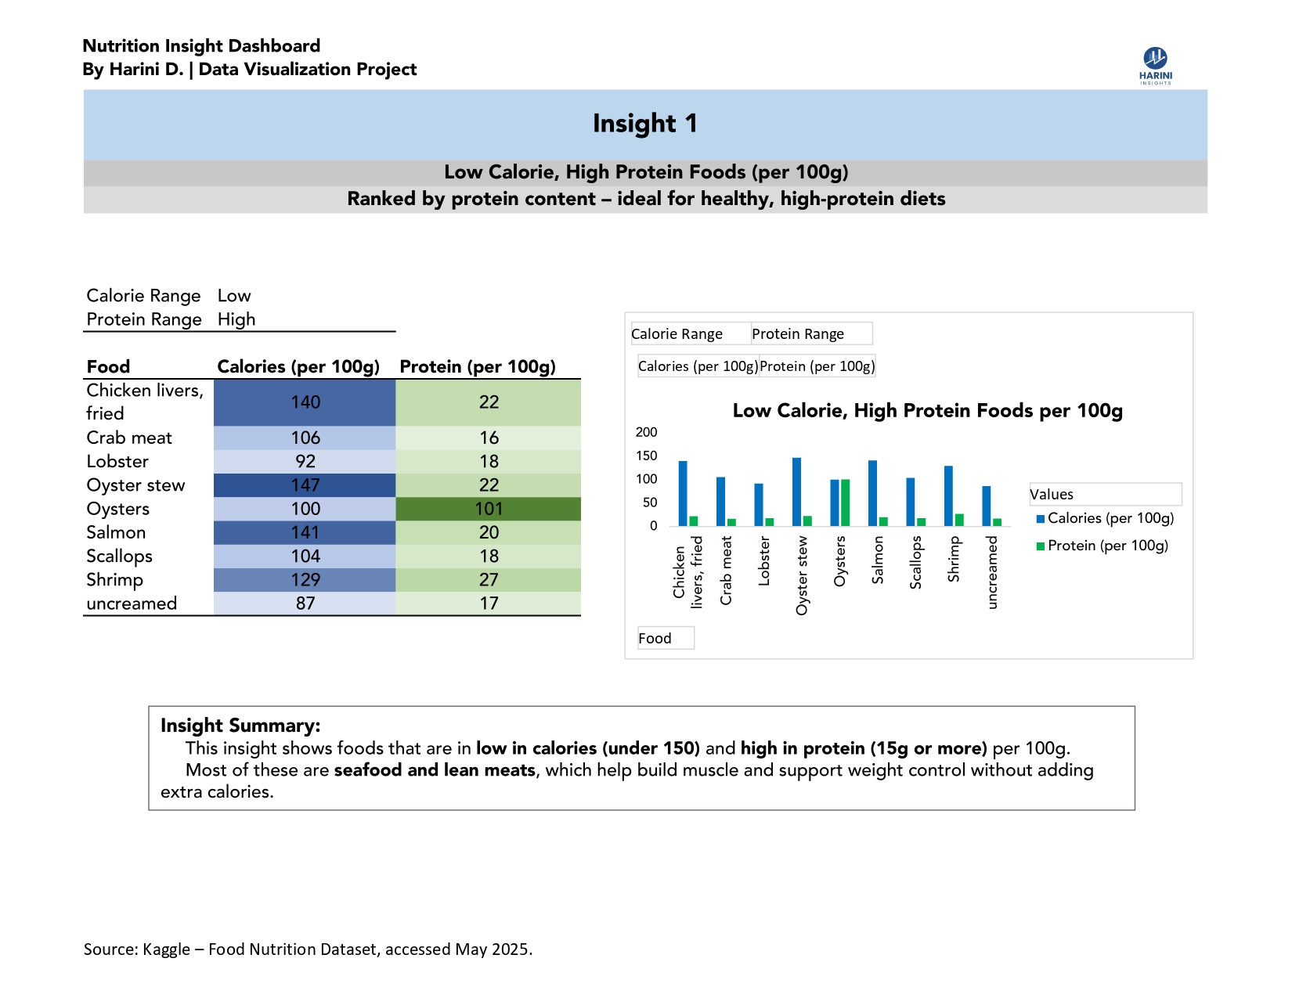

Slide 6
🥦Insight 1 – Top Low-Calorie, High-Protein Foods (per 100g)
✅ Takeaway:
Foods like shrimp, crab meat, and chicken liver offer high protein while staying under 150 kcal per 100g.
These foods are ideal for muscle gain and weight management.
📊 Chart:
Clustered bar chart of top 10 foods ranked by protein content
💡 Insight Summary:
Low-calorie, high-protein foods are great for healthy eating. Most items found were seafood and lean meats.

Slide 7
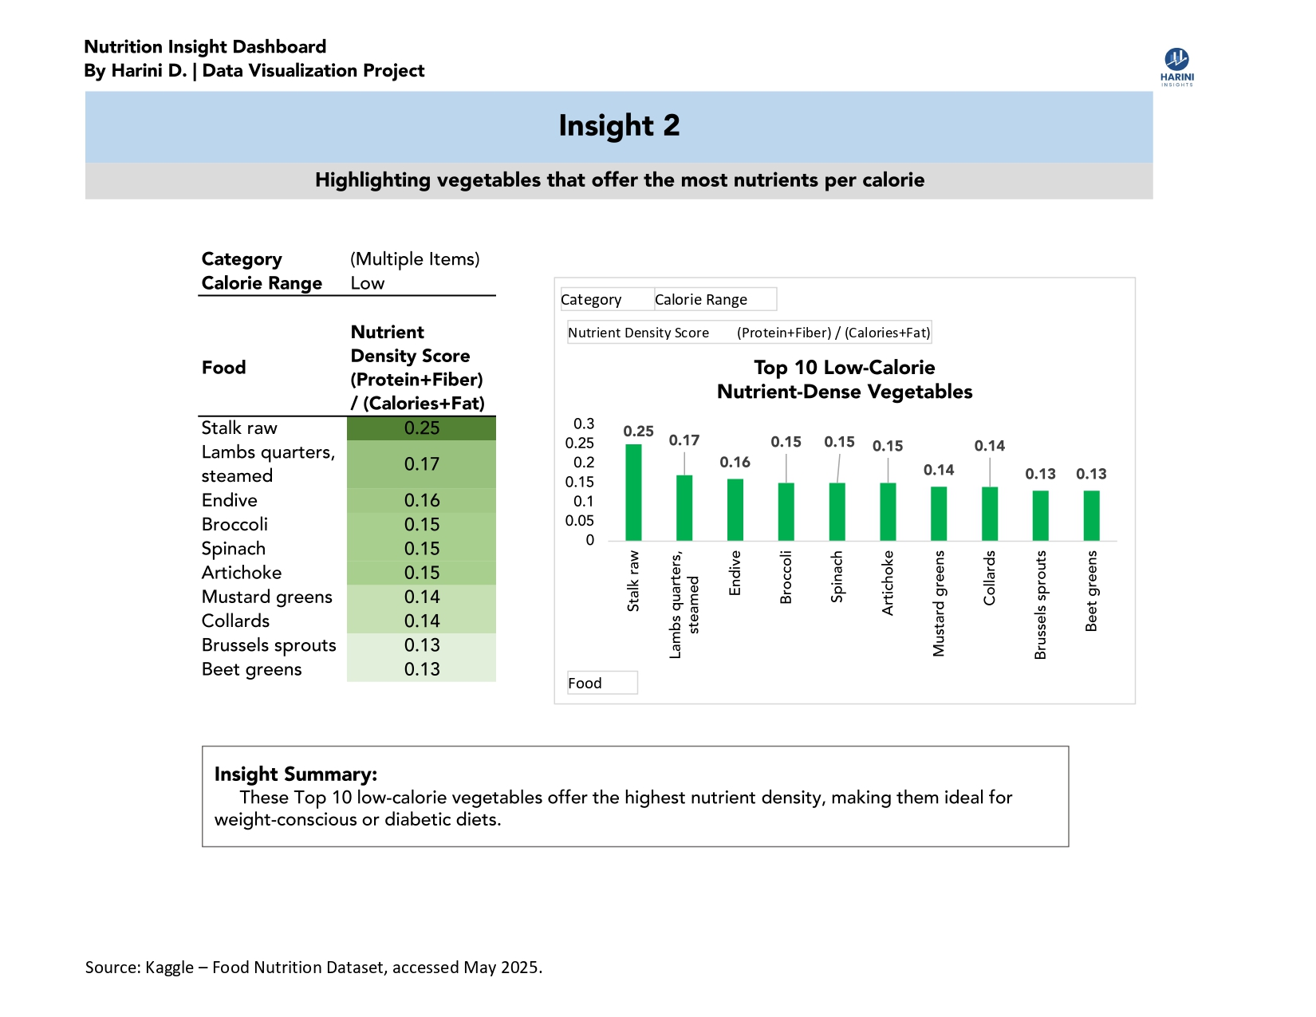

Slide 8
🥦Insight 2 – Nutrient-Dense Vegetables
✅ Takeaway:
Vegetables like beet greens and Brussels sprouts offer high nutrients per calorie.
📊 Chart:
Top 10 vegetables by Nutrient Density Score (Protein + Fiber / Calorie + Fat)
💡 Insight Summary:
Vegetables with high fiber and moderate protein score well in nutrient density. These are ideal for balanced diets.

Slide 9
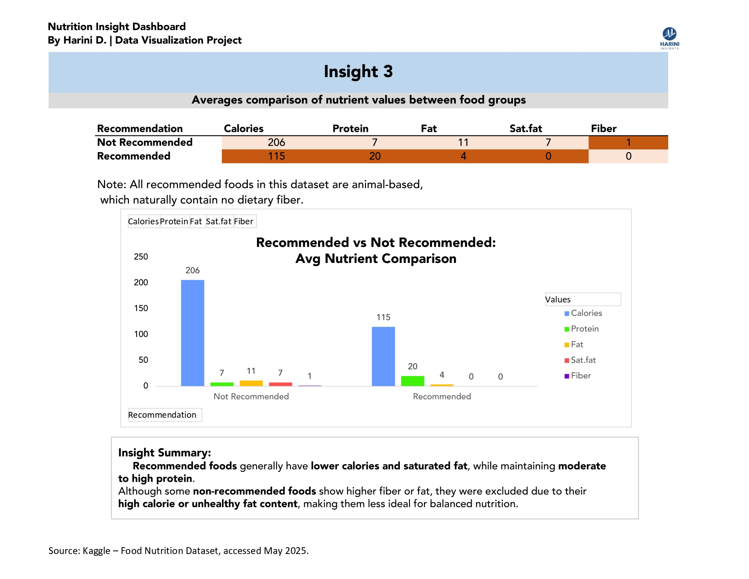

Slide 10
🥦Insight 3 – Recommended vs Not Recommended Foods
✅ Takeaway:
Recommended foods have lower calories and saturated fat, while still providing good protein. Non-recommended foods showed higher Fiber due to inclusion of high-fat or processed plant-based items.
📋 Table: Comparison of average values for Calories, Protein, Fat, Sat. Fat, and Fiber
📊Chart: Clustered bar chart comparing both groups
💡Insight Summary:
Recommended foods are mostly lean and low-fat, but lack fiber due to being animal-based. Not recommended foods sometimes contain more fiber but come with higher fat and calories.

Slide 11
Conclusion
What I Learned:
How to clean and transform real-world data using Power Query
Created calculated columns to support analysis
Built clear visual reports using Excel Pivot Tables and Charts
Learned to interpret food data from a nutrition perspective
Next Step: Continue building data projects with other datasets (e.g., health, sales, finance)
Contact: bharini2608@gmail.com | LinkedIn: linkedin.com/in/harini-baskar-1525a7367
Source: Kaggle – Food Nutrition Dataset, accessed May 2025

