Slide 1
MINISTRY CATEGORY: HRD. TEAM LEADER NAME : E. HARINI PAVITHRA. PROBLEM CODE :#MHRD8 COLLEGE CODE: 4125. PROBLEM STATEMENT: Mind Education System: Increasingly, a number of countries including developed countries are giving a lot of importance to the Mind Education in the Education system of the country. With the increase in the suicide rates, attacks for minor issues, intolerance, the issue of Mind Education system becomes very important. How to incorporate a Good Mind Education in our Education system is a big challenge. Education should while making a person more knowledgeable also should make him/her a better human being. How to do that?
IDEA/SOLUTION: The solution is to develop an application for students who wish to improve their personality and to know how to control themselves. Based on the type of issue faced the student,the appropriate guidance is provided by the means of mind related games,videos and articles . Diary writing is provided to make the students evaluate themselves. Jokes and quotes are added for stress reduction. The talent of student is recognized by uploading a video or a photo of their talent which can be encouraged with predefined comments and likes by other app users . Finally the student is allowed to take selfie with a smile to close the app,since forced smile can reduce stress.

Slide 2
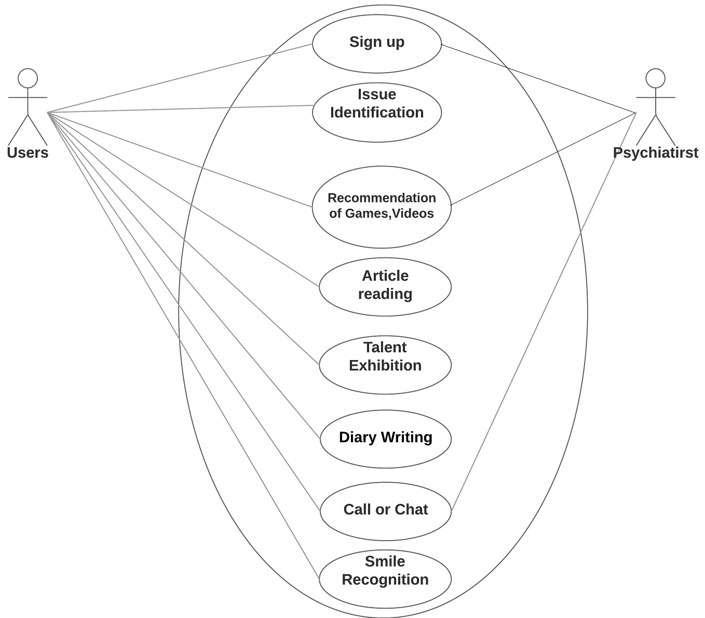
USE CASE:
DEPENDENCY:
Parse cloud framework is used for storage. Internet is required.

