Slide 1
IBM University Engagement Project Submission
“Exploring the Power of Agentic AI with IBM Granite and IBM Bob”

Slide 2

Project Title – AI Job Mentor for Informal Workers
Domain of Project – Employment / Career Guidance / Artificial Intelligence
Student Name | Recent Passport Photo | Email ID | Mobile number [WhatsApp]
SRI HARINI T R |  | sriharini.sh16@gmail.com | 8015386819

Slide 3
Problem Statement
Problem Statement : AI Job Mentor for Informal Workers
The Challenge:
Millions of informal workers such as daily wage labourers, artisans, gig workers, and self-employed individuals struggle to find suitable job opportunities, skill-development programs, and financial resources. Many are unaware of nearby jobs, government schemes, and training opportunities. Limited digital access and lack of personalized guidance further widen the opportunity gap.

Slide 4
Problem Statement
The Objective:
Build an AI-powered Job Mentor that provides personalized career guidance and opportunity recommendations for informal workers. The solution should:
Personalized Job Recommendations – Suggest suitable jobs based on skills, experience, location, and preferences.
Job Matching & Match Score – Match workers with relevant opportunities and explain why they are suitable.
Skill-Gap Analysis – Identify missing skills required for target jobs and suggest ways to improve them.
Training Recommendations – Recommend relevant skill-development and training opportunities.
Government Scheme Guidance – Help workers discover suitable government schemes and benefits.
AI Mentor Chat – Provide conversational, personalized guidance for jobs, skills, training, and schemes.
Multi-Agent Intelligence – Use specialized AI agents for job matching, skill analysis, training, and scheme guidance.
Accessible Interface – Provide simple, user-friendly interaction suitable for workers with limited digital literacy.

Slide 5
Proposed Solution
Proposed Solution: AI-Powered Job Mentor
The proposed solution is a multi-agent AI Job Mentor built using IBM Bob, IBM watsonx.ai, and Granite Models to provide personalized career guidance for informal workers.
The system uses AI to recommend suitable jobs based on skills, experience, location, and preferences, while Granite provides intelligent reasoning and conversational guidance.
The system consists of four key agents:
Job Recommendation Agent – Suggests suitable job opportunities.
Skill Gap Agent – Identifies missing skills and improvement areas.
Training Agent – Recommends relevant training programs.
Government Scheme Agent – Guides workers towards suitable schemes and benefits.
A user-friendly Streamlit dashboard provides access to worker profiles, job matches, skill analysis, training, schemes, and the AI Mentor Chat.
IBM Bob orchestrates the agents, while watsonx.ai and Granite power the AI capabilities.
Overall, the solution connects informal workers with jobs, skills, training, and government opportunities through an accessible AI mentor.

Slide 6
Technology Used
IBM Bob – For building and orchestrating multi-agent workflows.
IBM Granite – For AI reasoning, natural language understanding, and personalized guidance.
IBM Cloud – For secure and scalable deployment of the AI solution.
IBM watsonx.ai – For Granite model access and AI capabilities.
RAG – For retrieving relevant information and generating reliable responses.
Streamlit – For building the user-friendly AI Job Mentor dashboard.

Slide 7
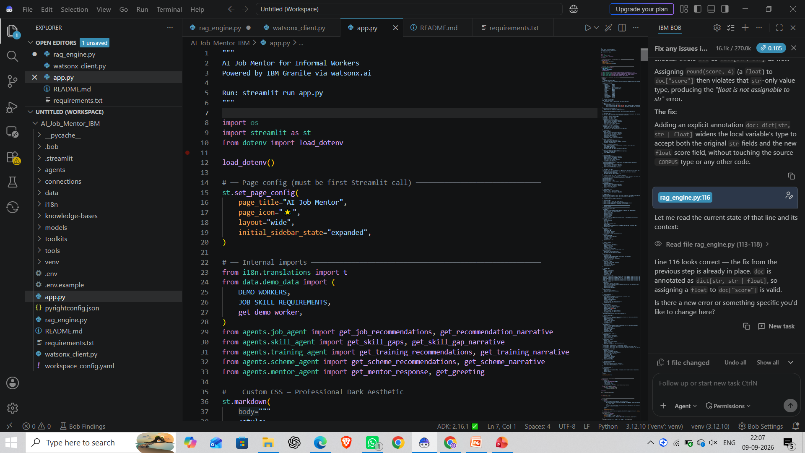
Required Files created using IBM bob -
app.py – Main Streamlit application
rag_engine.py – RAG-based information retrieval
watsonx_client.py – IBM watsonx.ai / Granite integration
requirements.txt – Project dependencies
README.md – Project setup and usage instructions
.env.example – IBM Cloud configuration template

Slide 8
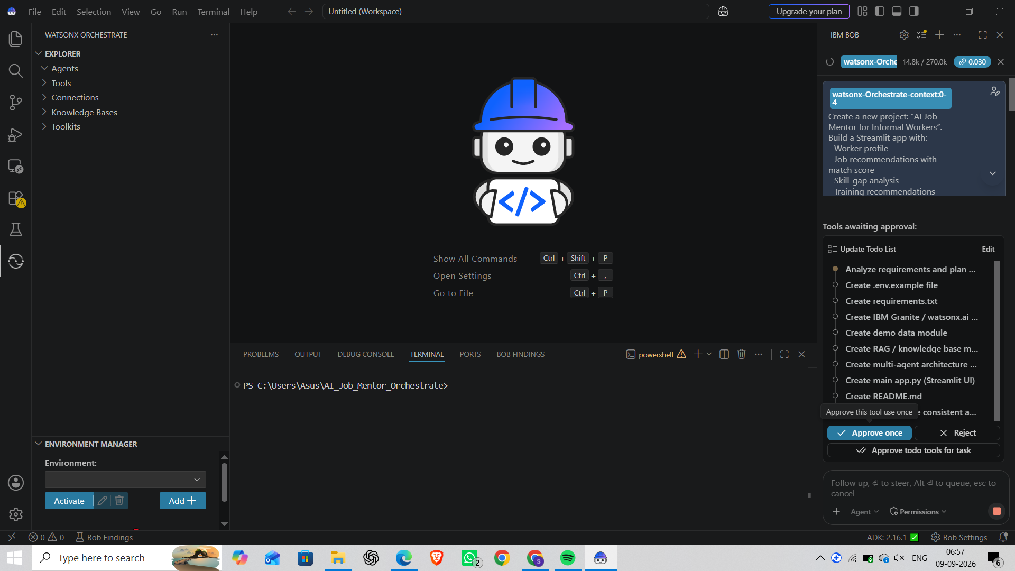
IBM Bob Screenshots:

Slide 9
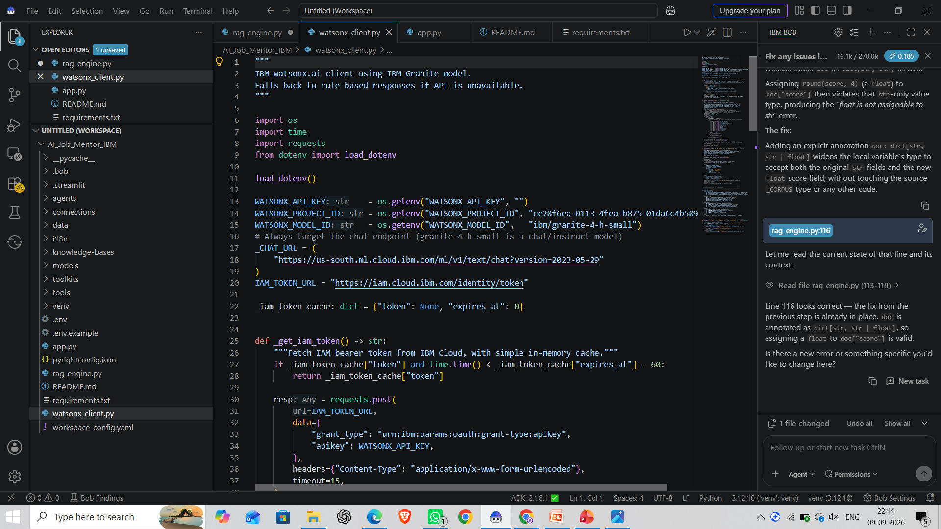

Slide 10
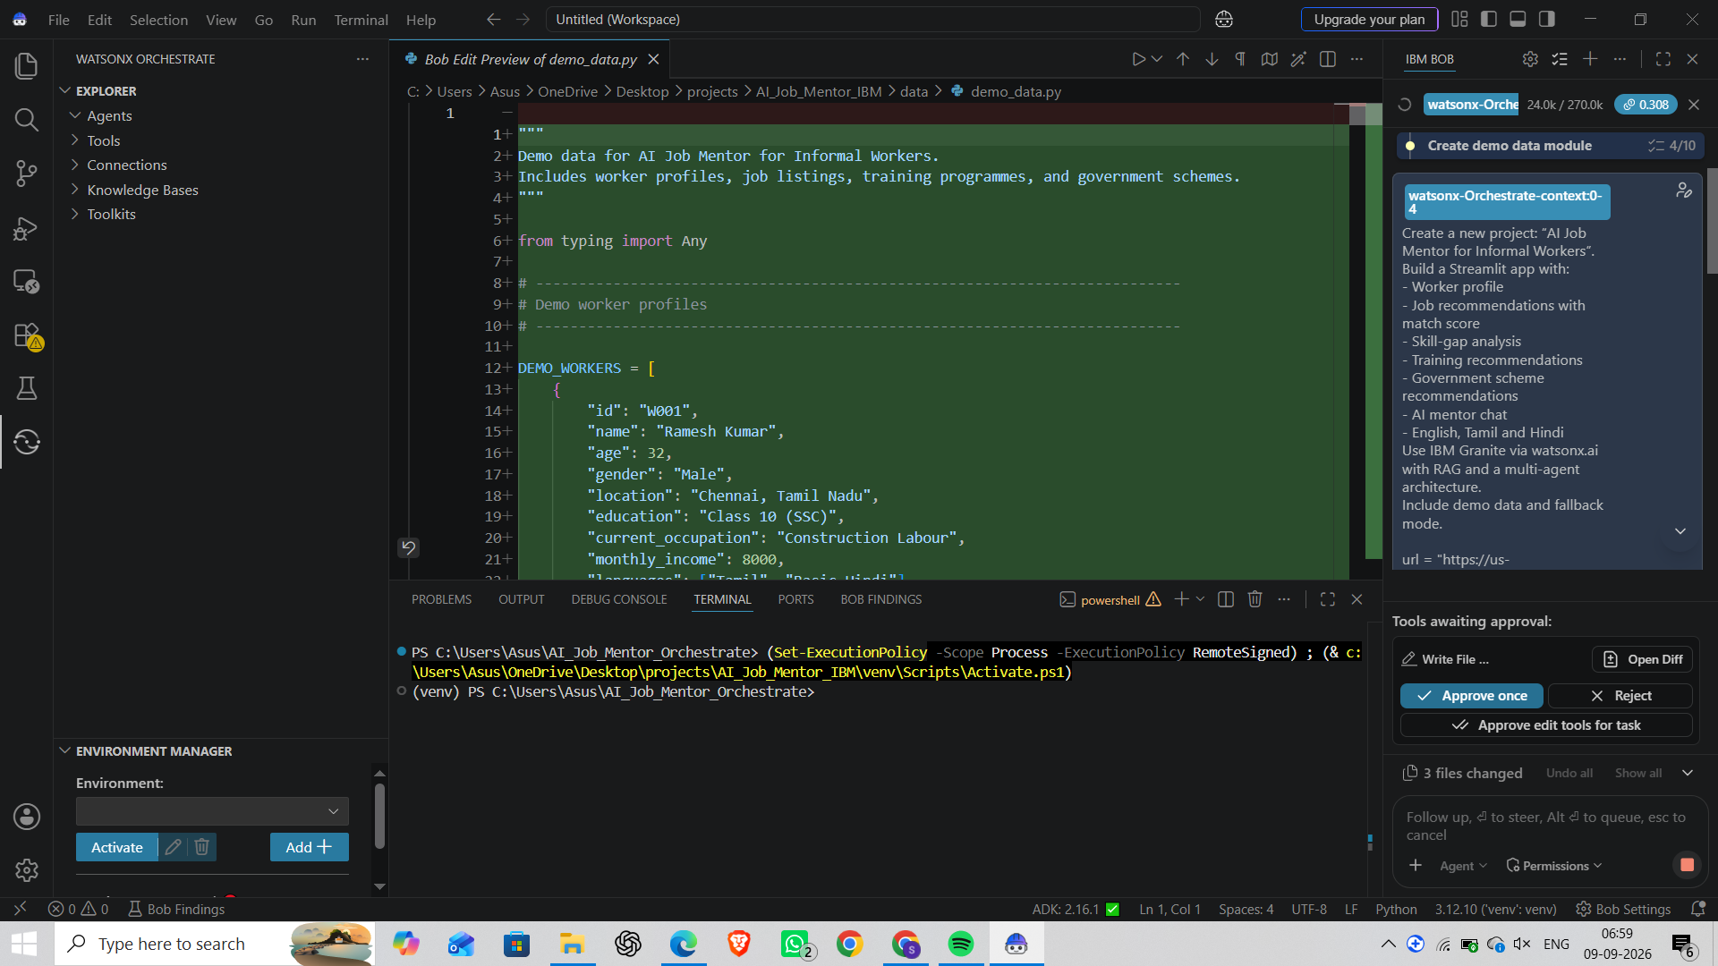

Slide 11
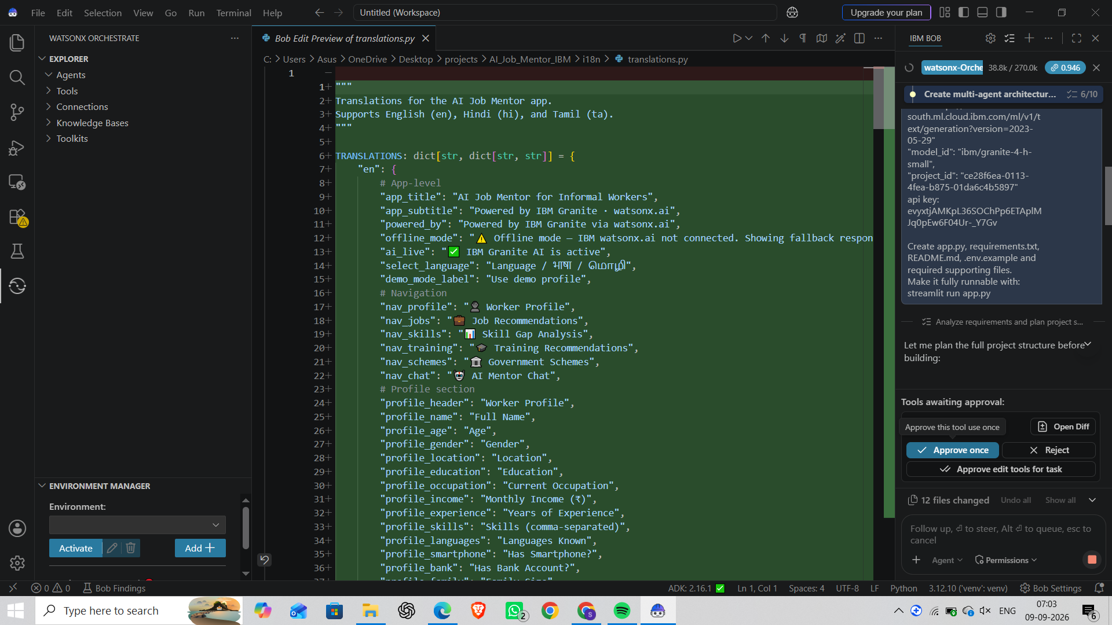

Slide 12
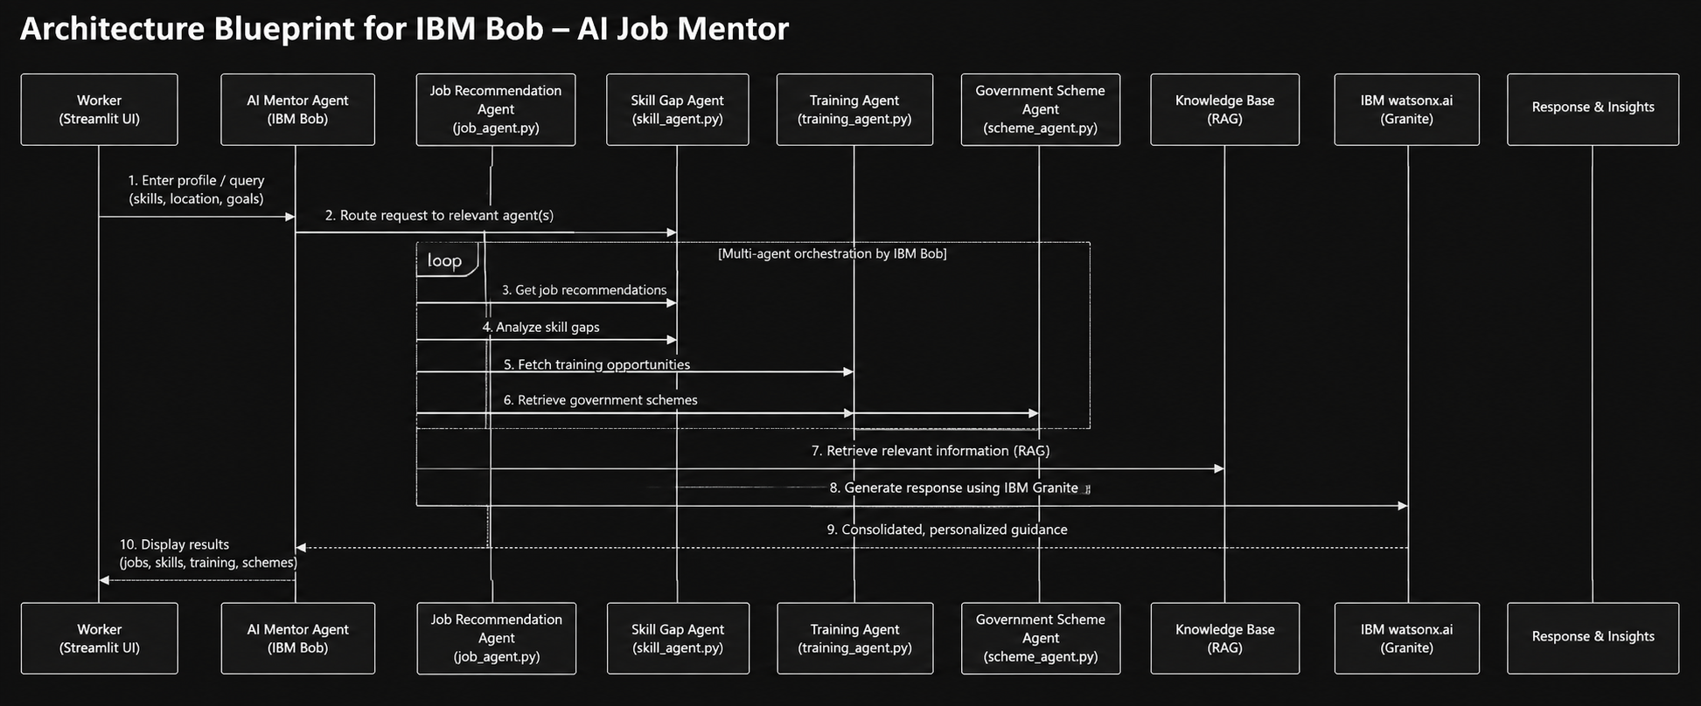
Architecture blueprint for IBM bob:

Slide 13

Role of Agentic AI in the solution
Role of Agentic AI in AI Job Mentor
Agentic AI enables the AI Job Mentor to act as an intelligent career guidance system rather than a simple chatbot. Using IBM watsonx.ai and IBM Granite, it coordinates specialized tasks to provide personalized support for informal workers.
Job Recommendation Agent – Matches workers with suitable job opportunities based on their skills and experience.
Skill Gap Agent – Identifies missing skills and suggests areas for improvement.
Training Agent – Recommends relevant skill-development and training opportunities.
Government Scheme Agent – Helps workers discover suitable government schemes and benefits.
AI Mentor Agent – Provides conversational, personalized career guidance.
The agents work together with context awareness, using the worker's profile, skills, location and goals to provide relevant recommendations.
Overall, Agentic AI makes the platform personalized, goal-driven and accessible, helping informal workers make better career decisions.

Slide 14
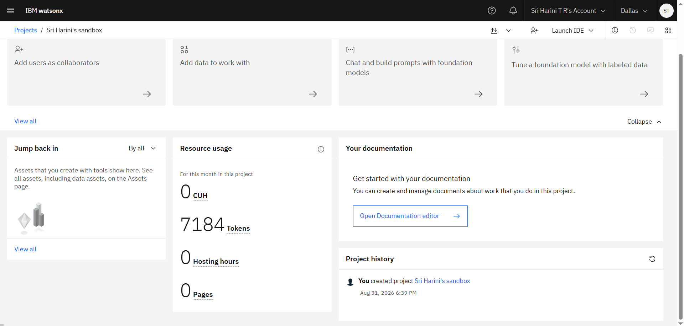
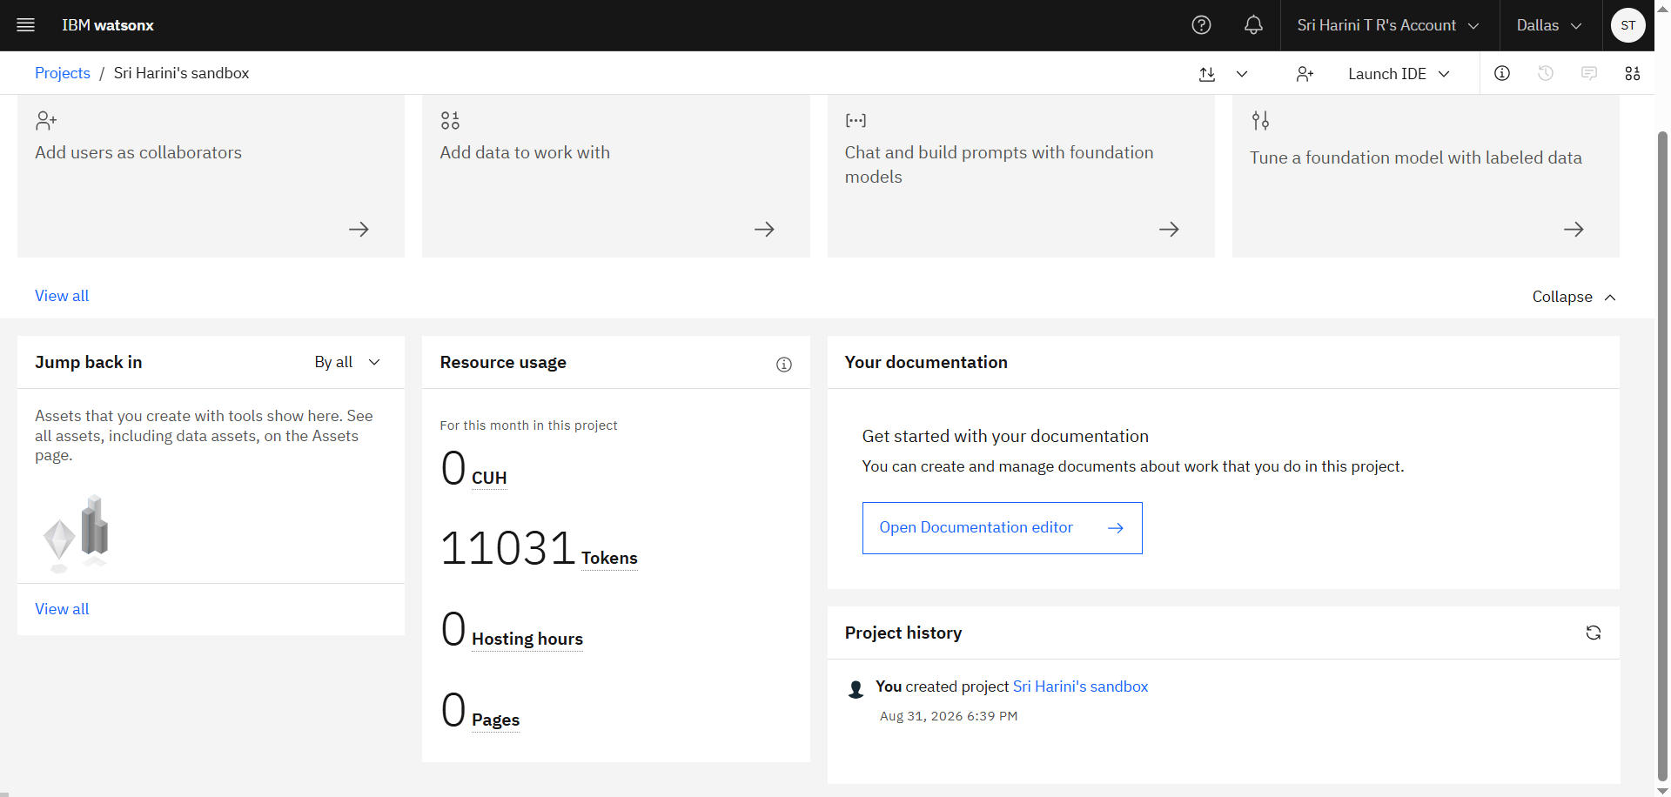
Token Usage
3,847 tokens token are used
Before Prompt
After Prompt
·
·
·

Slide 15
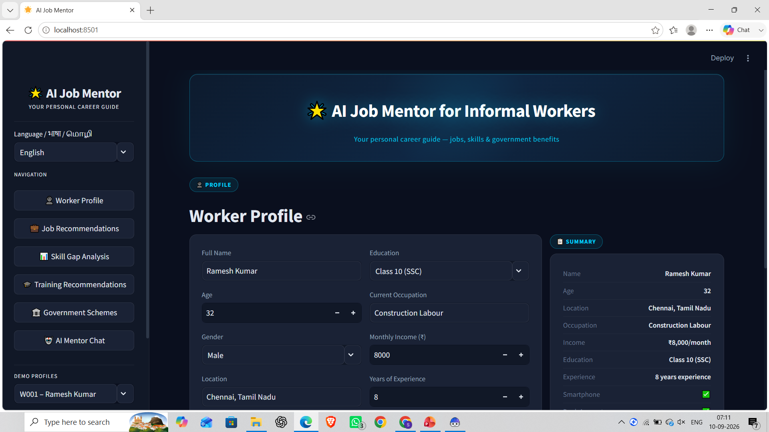
Project Output Screenshot
·
·
·

Slide 16
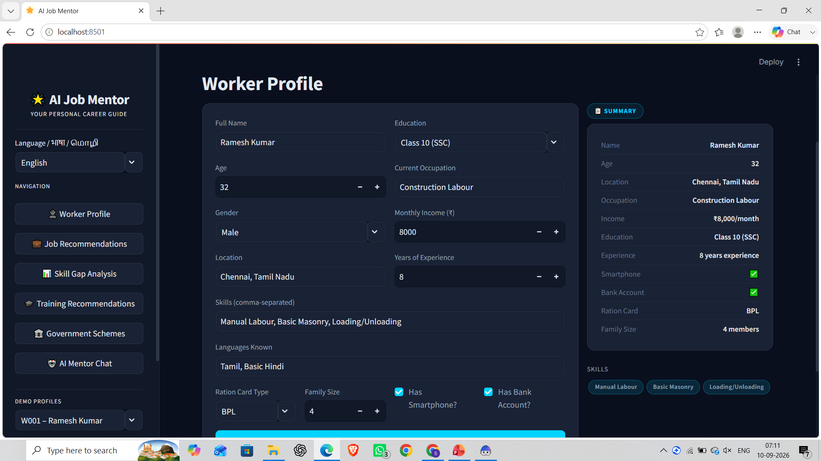
Project Output Screenshot
Please put IBM Bob output screenshots with 2-3 prompts.
You can take 2-3 more slides for each screenshot
·
·
·

Slide 17
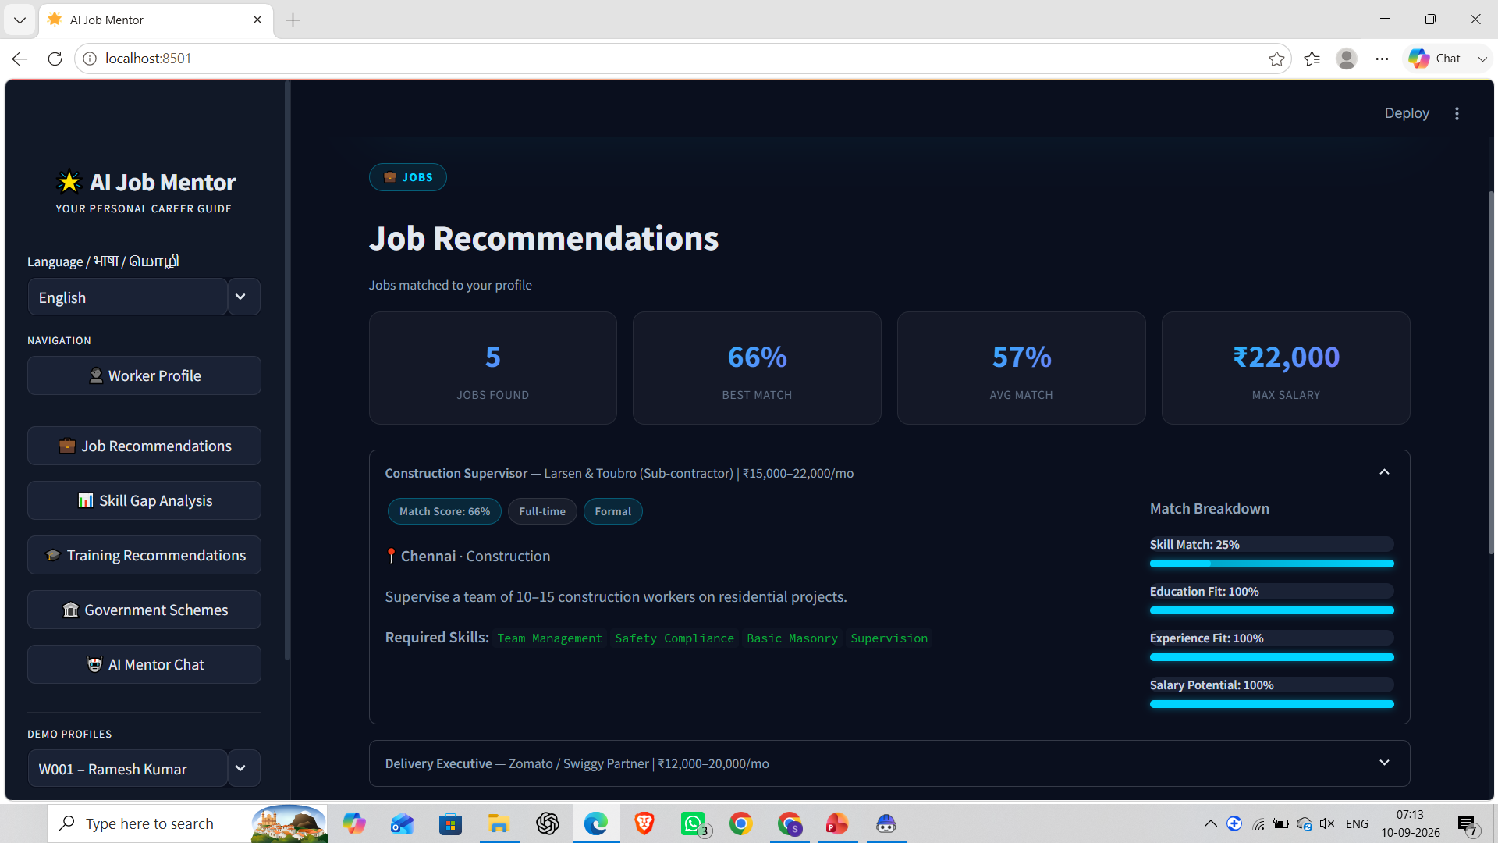
Project Output Screenshot
Please put IBM Bob output screenshots with 2-3 prompts.
You can take 2-3 more slides for each screenshot
·
·
·

Slide 18
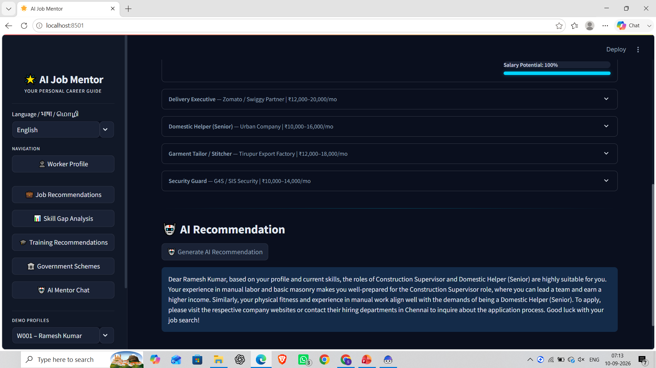
Project Output Screenshot
Please put IBM Bob output screenshots with 2-3 prompts.
You can take 2-3 more slides for each screenshot
·
·
·

Slide 19
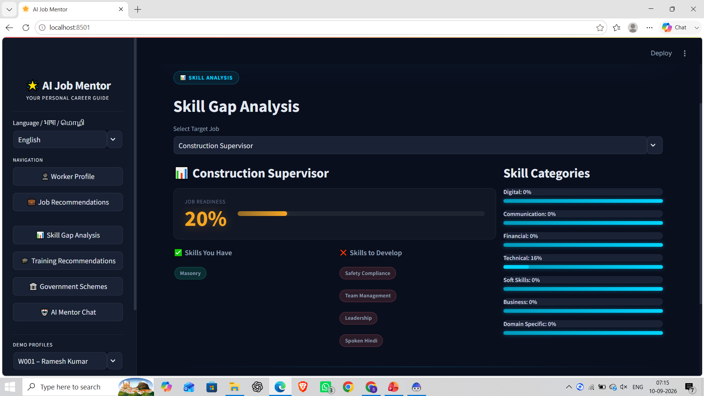
Project Output Screenshot
Please put IBM Bob output screenshots with 2-3 prompts.
You can take 2-3 more slides for each screenshot
·
·
·

Slide 20
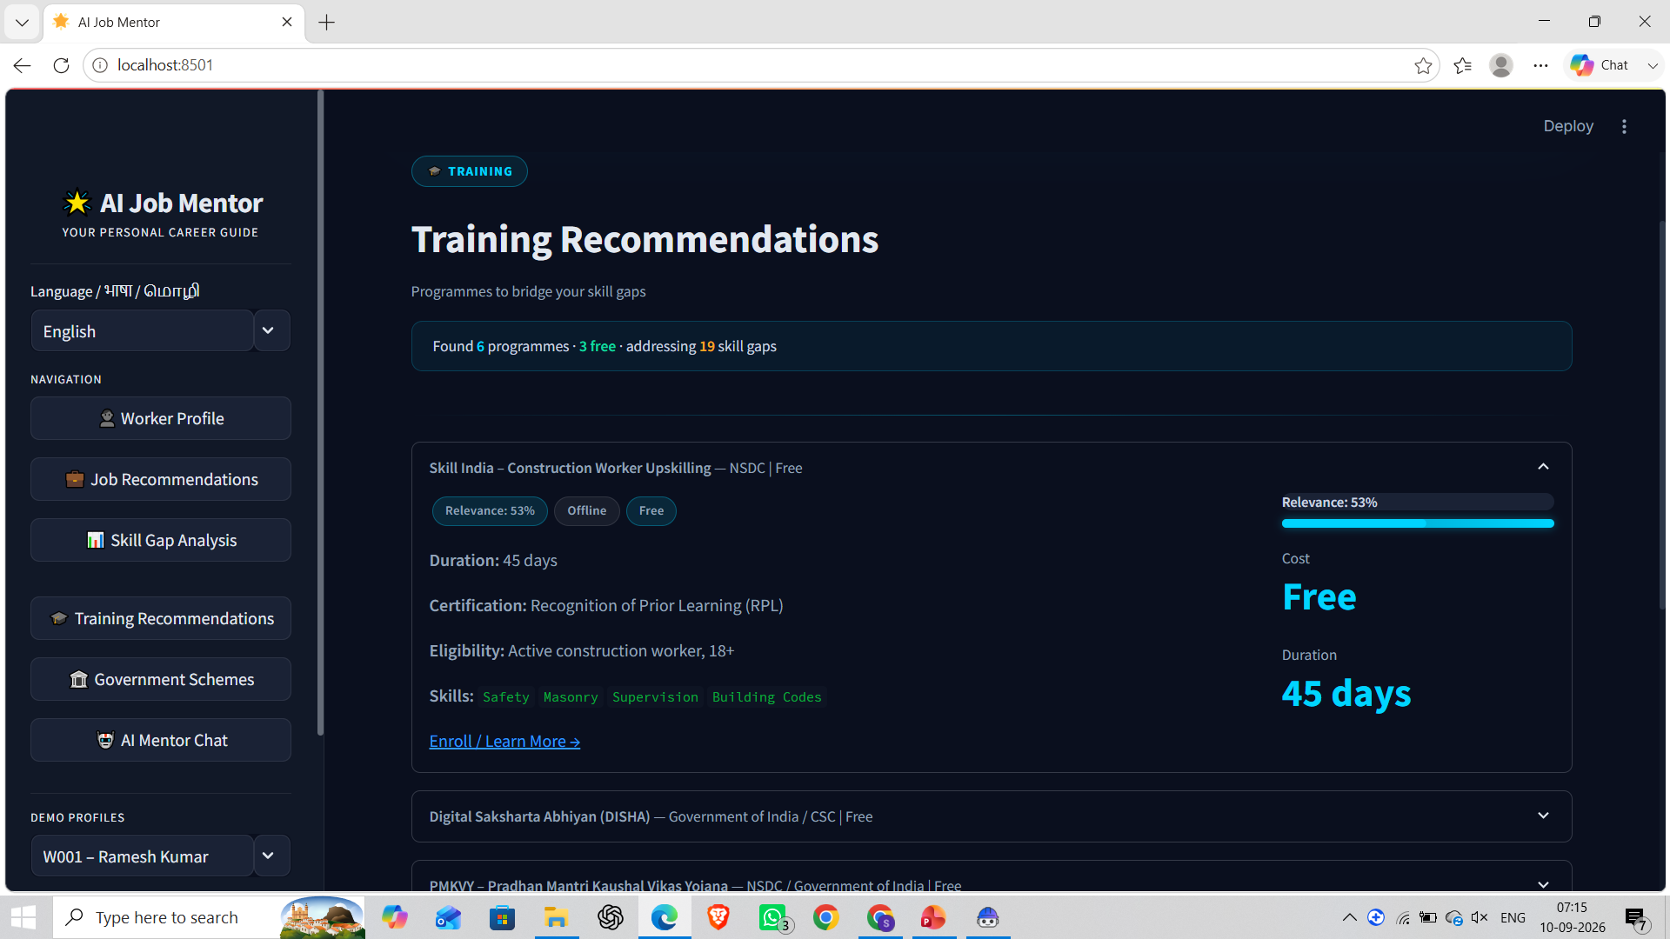
Project Output Screenshot
Please put IBM Bob output screenshots with 2-3 prompts.
You can take 2-3 more slides for each screenshot
·
·
·

Slide 21
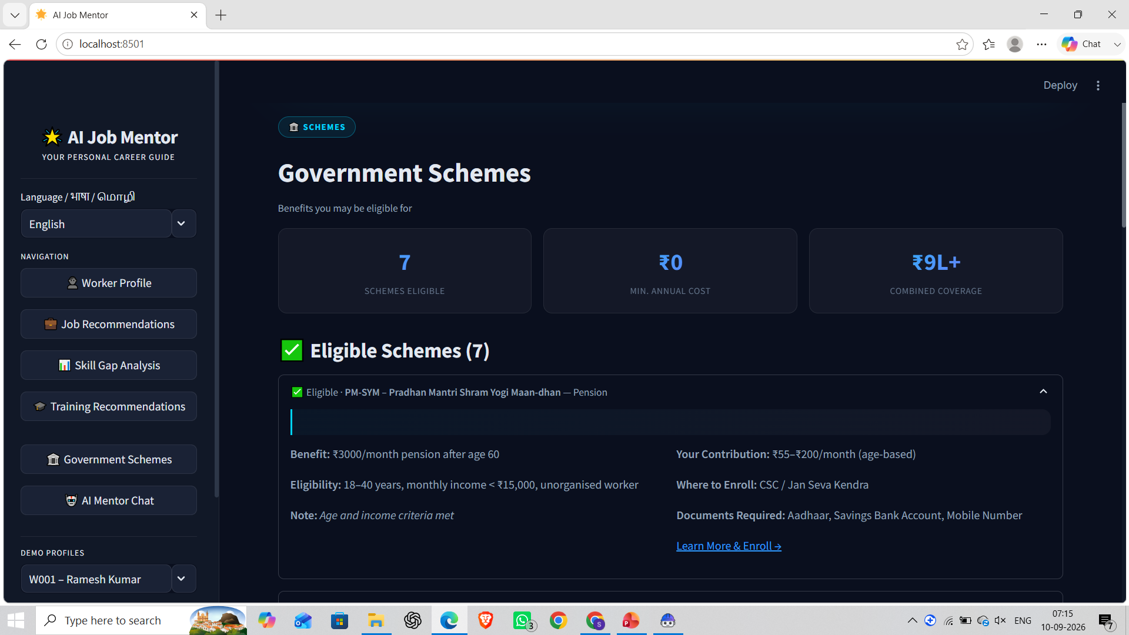
Project Output Screenshot
Please put IBM Bob output screenshots with 2-3 prompts.
You can take 2-3 more slides for each screenshot
·
·
·

Slide 22
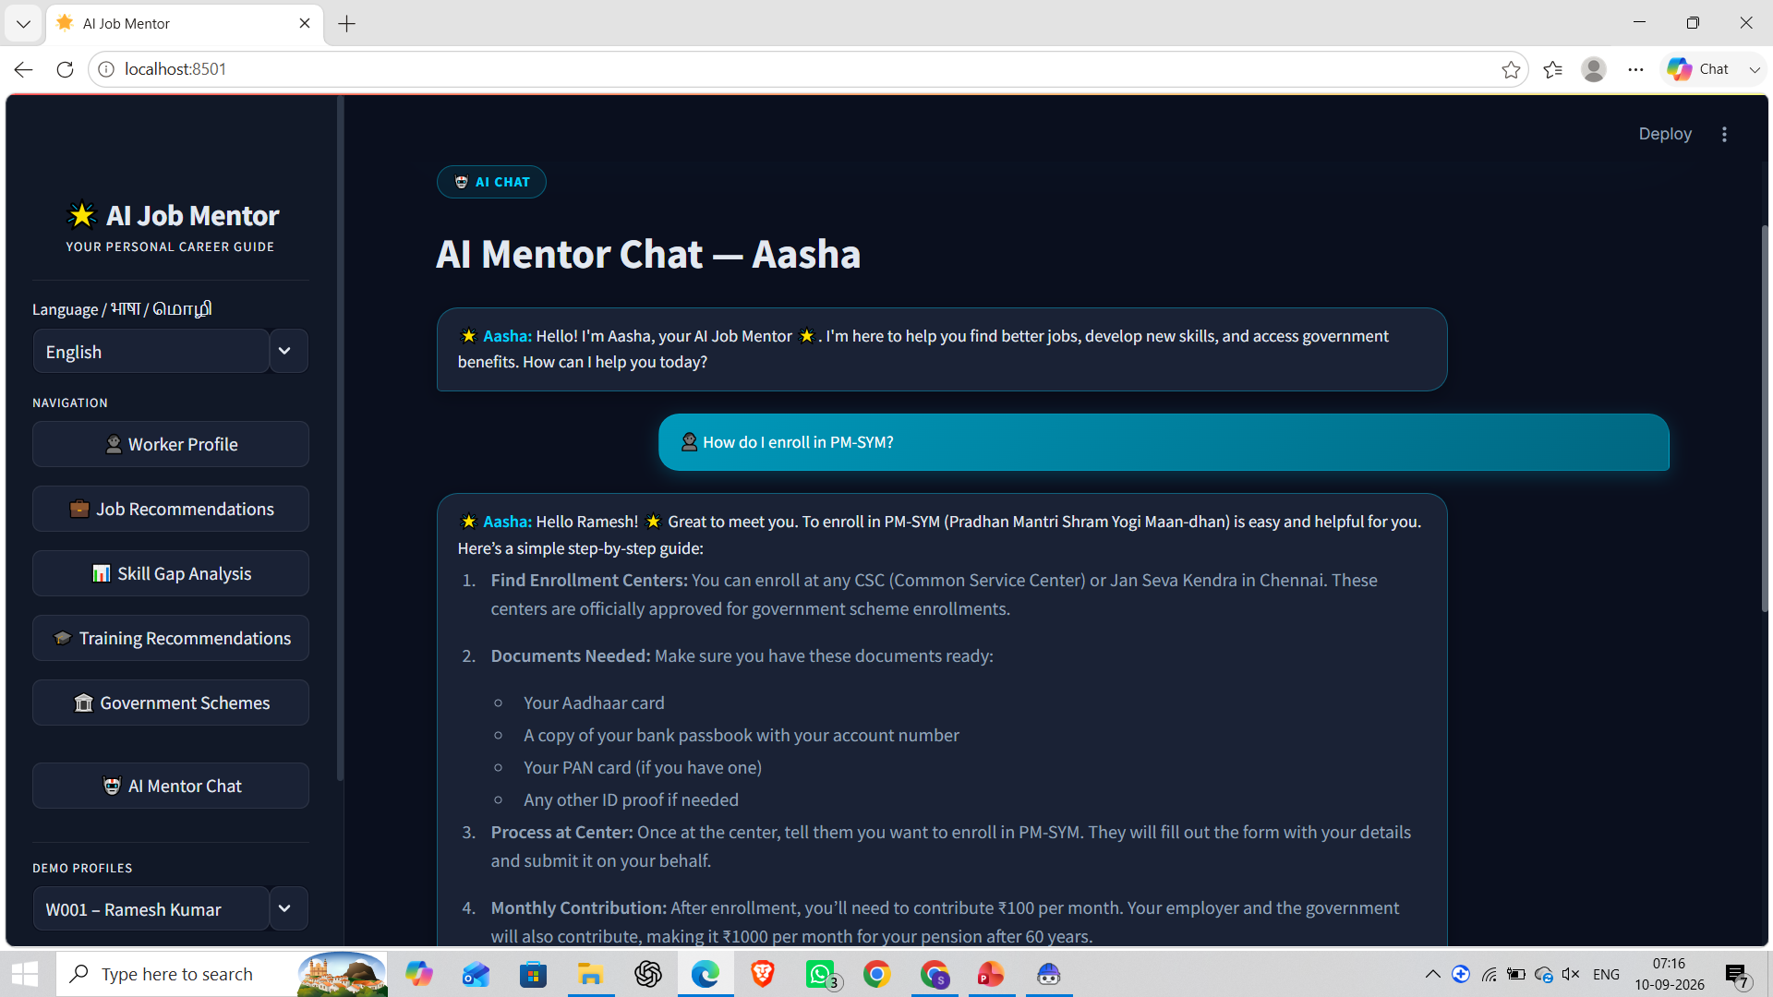
Project Output Screenshot
Please put IBM Bob output screenshots with 2-3 prompts.
You can take 2-3 more slides for each screenshot
·
·
·

Slide 23
Novelty and Uniqueness
The proposed AI Job Mentor stands out by combining Agentic AI, RAG, and personalization into a single intelligent career-guidance system.
Multi-Agent Intelligence – Specialized agents collaborate to provide job, skill, training, and government-scheme guidance.
Personalized Job Matching – Recommends suitable jobs based on the worker’s skills, experience, location, and career goals.
Skill-Gap Intelligence – Identifies missing skills and shows what the worker needs to develop for target jobs.
RAG-Based Guidance – Retrieves relevant information to provide more reliable and context-aware recommendations.
Training & Upskilling – Suggests relevant training opportunities based on identified skill gaps.
Government Scheme Discovery – Helps workers identify relevant government schemes and employment benefits.
Multilingual Accessibility – Supports English, Tamil, and Hindi to make AI guidance easier to access.
Scalable AI Architecture – Built using IBM Bob, IBM watsonx.ai, and IBM Granite for intelligent and adaptable career assistance.
This makes the solution a smart, personalized, and accessible AI career mentor, rather than a simple job-search platform.

Slide 24
Git Hub Link
GitHub Repository:
https://github.com/Harini-Sri-19/AI_Job_Mentor_IBM
Repository includes:
Source code & Streamlit application
IBM Bob / Agent files
RAG & IBM Granite integration
Requirements & README
Problem Statement PDF
Project Presentation
·
·
·

Slide 25
Future Scope
Voice-Based AI Mentor & Multilingual Expansion – The system can be enhanced with voice interaction and additional regional languages, helping workers with limited digital literacy access job guidance more naturally.
Real-Time Job & Training Integration – Integration with live job portals, training platforms, and local employment databases can provide updated opportunities based on the worker’s skills, location, and preferences.
Government Scheme & Benefits Integration – The platform can be expanded to provide real-time scheme updates, eligibility checking, and application guidance for relevant government programs.
Advanced Skill & Career Planning – Future versions can provide long-term career pathways, skill progression tracking, and personalized upskilling plans based on changing job-market requirements.
·
·
·

Slide 26
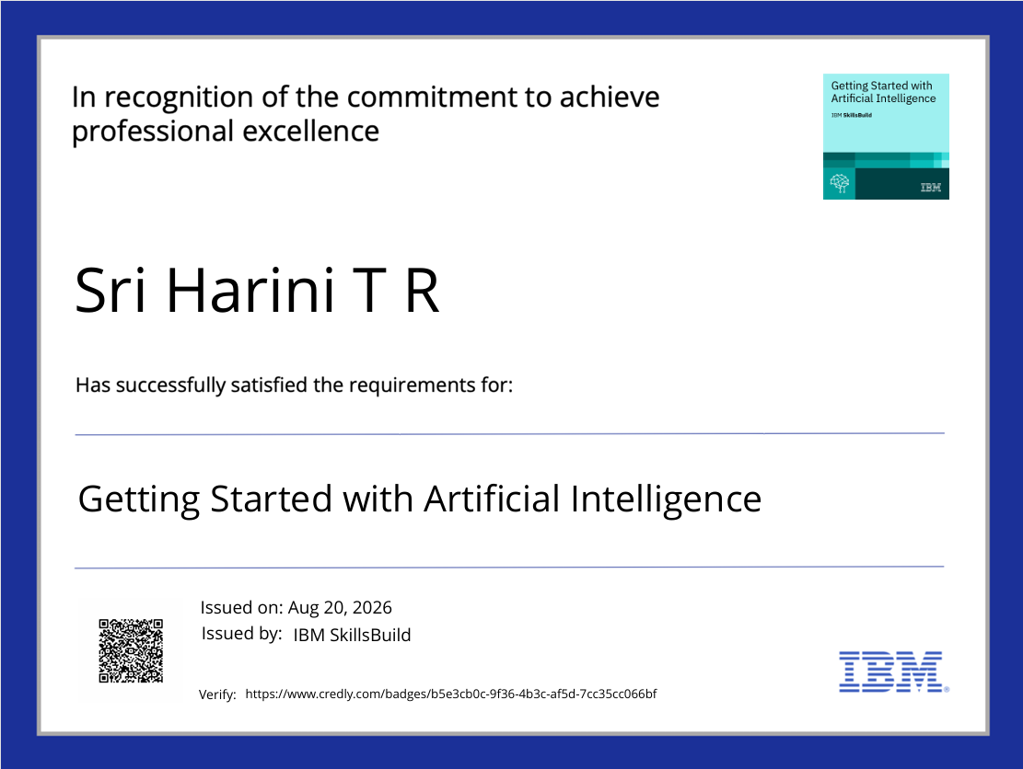
Certificates Earned:

Slide 27
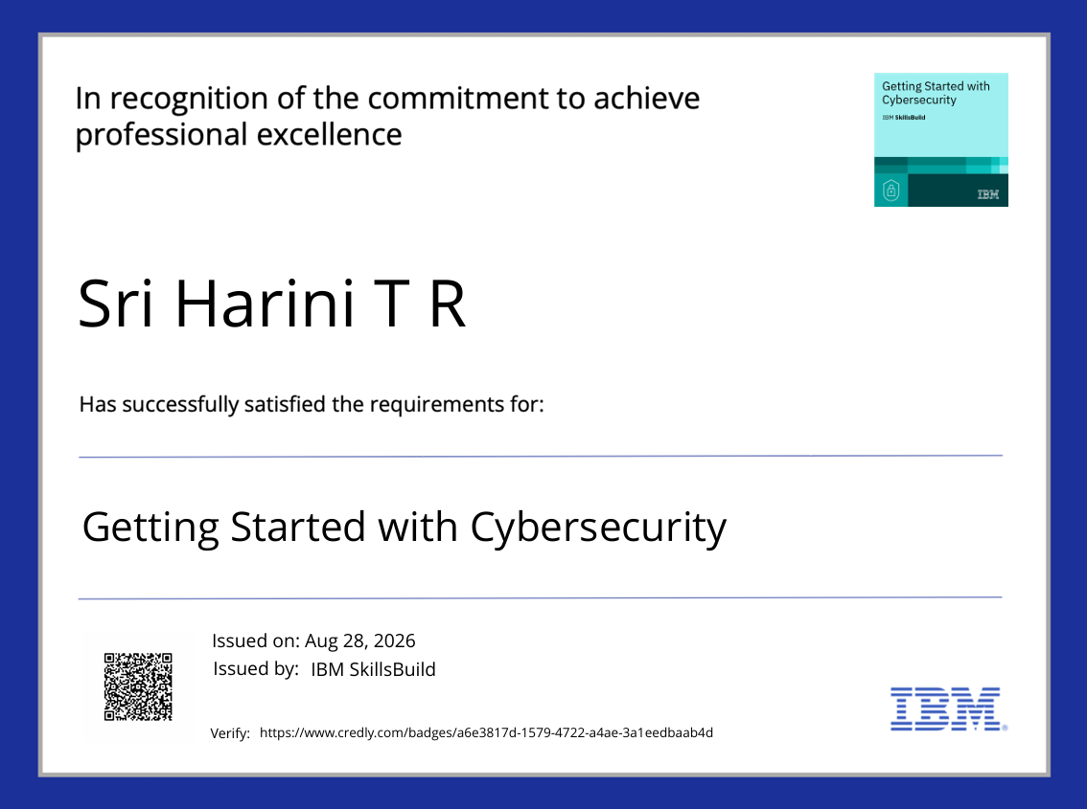
Certificates Earned:

Slide 28

Certificates Earned:

Slide 29
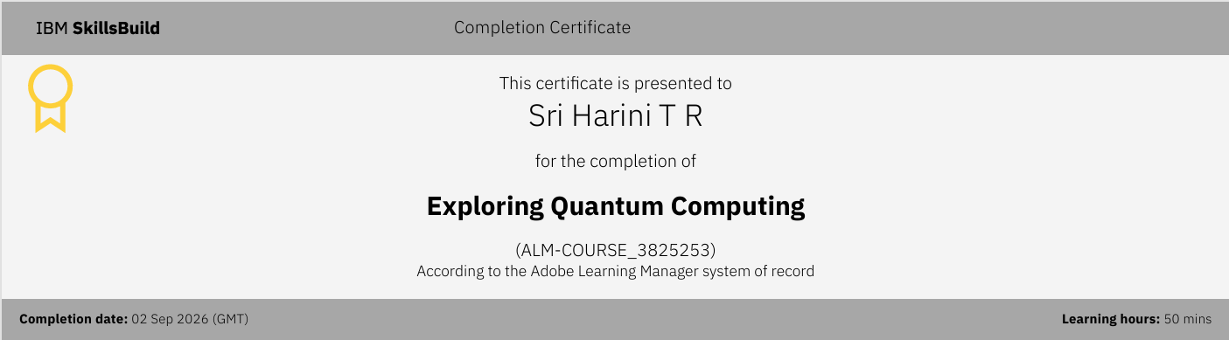
Certificates Earned:

Slide 30
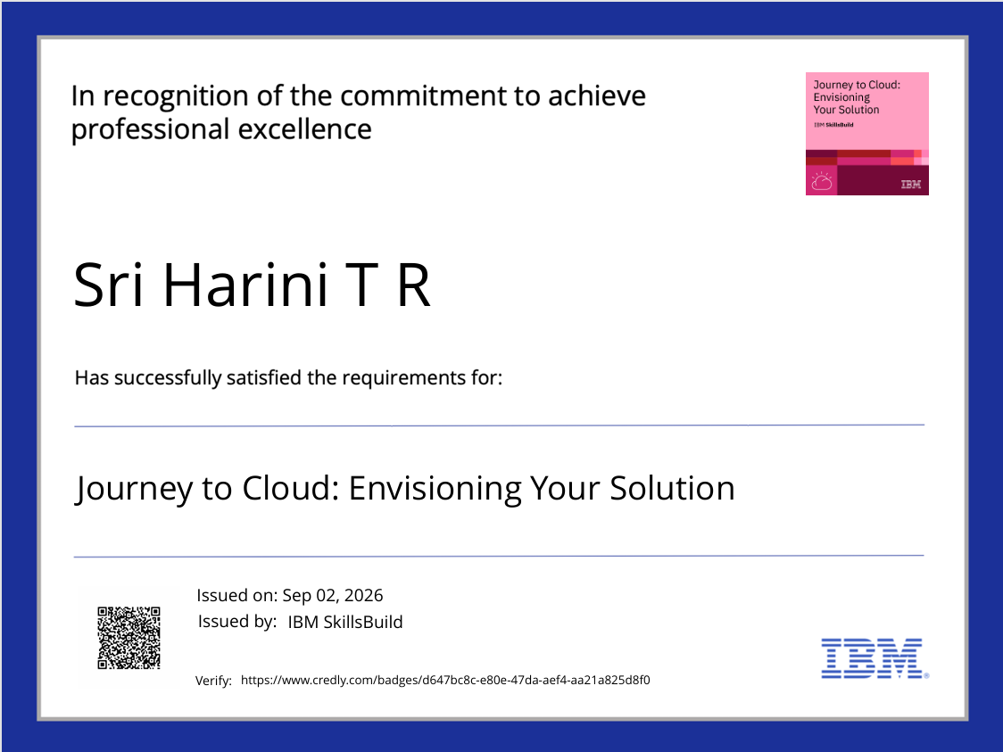
Certificates Earned:

Slide 31
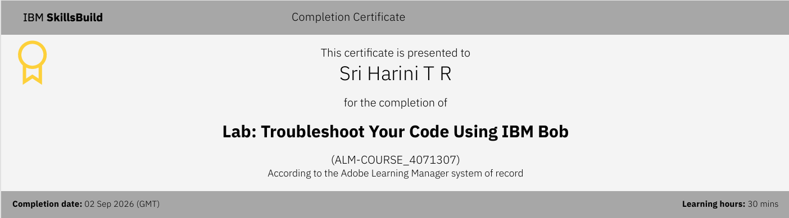
Certificates Earned:​
IBM BOB Certificate

Slide 32


